Slide 1
Pre-work/flipped learning
Read Hodder textbook p415 on Urban drainage and Urban hydrology and make notes/a mind map on:
Urban precipitation
Water movement through urban catchments

Slide 2
Contemporary urban environments
• Urban precipitation, surfaces and catchment characteristics; impacts on drainage basin storage areas; urban water cycle, water movement through urban catchments as measured by hydrographs.
• Issues associated with catchment management in urban areas. The development of sustainable urban drainage systems (SUDS)
• River restoration and conservation in damaged urban catchments with reference to a specific project. Reasons for and aims of the project; attitudes and contributions of parties involved; project activities and evaluation of project outcomes.
Learning Objectives:
Describe and explain the effect of urban surfaces on the water cycle.
Analyse a hydrograph for an urban area.
Define the term sustainable urban drainage systems (SUDS) and describe different SUDS strategies.
Describe and evaluate a specific urban river restoration project, outlining the reasons for its restoration and the attitudes and contributions of the stakeholders involved.
Key terms:
Sustainable urban drainage systems (SuDS)

Slide 3
Key Term
Sustainable urban drainage systems (SuDS) -
drainage solutions that provide an alternative to the direct channelling of surface water through networks of pipes and sewers to nearby watercourses.

Slide 4
Urban precipitation and water movement through urban catchments
TASK: Using your knowledge from the pre-work fill in the missing blanks:
Urban precipitation falls in ___________ amounts and with greater intensity in towns and cities.
_______________ urban surfaces like roads, car parks and rooftops prevent precipitation from infiltrating.
Urban areas are designed to shed water ____________ and move it into storm sewer systems.
Water gathers ___________ and erosional power as it travels underground.
When the water leaves storm drains and empties into streams they fill _________.
_____________ infiltration leads to less groundwater and soil water levels reducing base flow.
The resultant storm hydrograph for an _________ river has a flashy discharge but low base flow.
Impermeable speed rapidly urban
Reduced quickly greater power

Slide 5
Urban precipitation and water movement through urban catchments
Urban precipitation falls in greater amounts and with greater intensity in towns and cities.
Impermeable urban surfaces like roads, car parks and rooftops prevent precipitation from infiltrating.
Urban areas are designed to shed water quickly and move it into storm sewer systems.
Water gathers speed and erosional power as it travels underground.
When the water leaves storm drains and empties into streams they fill rapidly.
Reduced infiltration leads to less groundwater and soil water levels reducing base flow.
The resultant storm hydrograph for an urban river has a flashy discharge but low base flow.

Slide 6
The effect of urban surfaces on the water cycle

Slide 7
Why has urbanisation increase the risk of flooding?

Slide 8
Why has urbanisation increase the risk of flooding?
Flashy discharge means urban areas are more likely to have flooded rivers after heavy rainfall.
Increasing population and urban growth
Predicted increase in severe weather due to climate change means more people are at risk from flooding

Slide 9
Urban precipitation, surfaces and catchment characteristics
TASK: With reference to the images describe and give reasons for the catchment characteristics of rural, suburban and central urban land uses.
Images from p154 Oxford text book.

Slide 10
Urban hydrology is characterised by:
The effect of the urban environment on river discharge.

Slide 11
Changes in a storm hydrograph for a stream following urban development of its catchment.
Note the difference in pre urban and post urban development.

Slide 12
The urban water cycle: flood hydrograph
TASK: Complete activities 1a and b (taken from p155 Oxford text book).

Slide 13
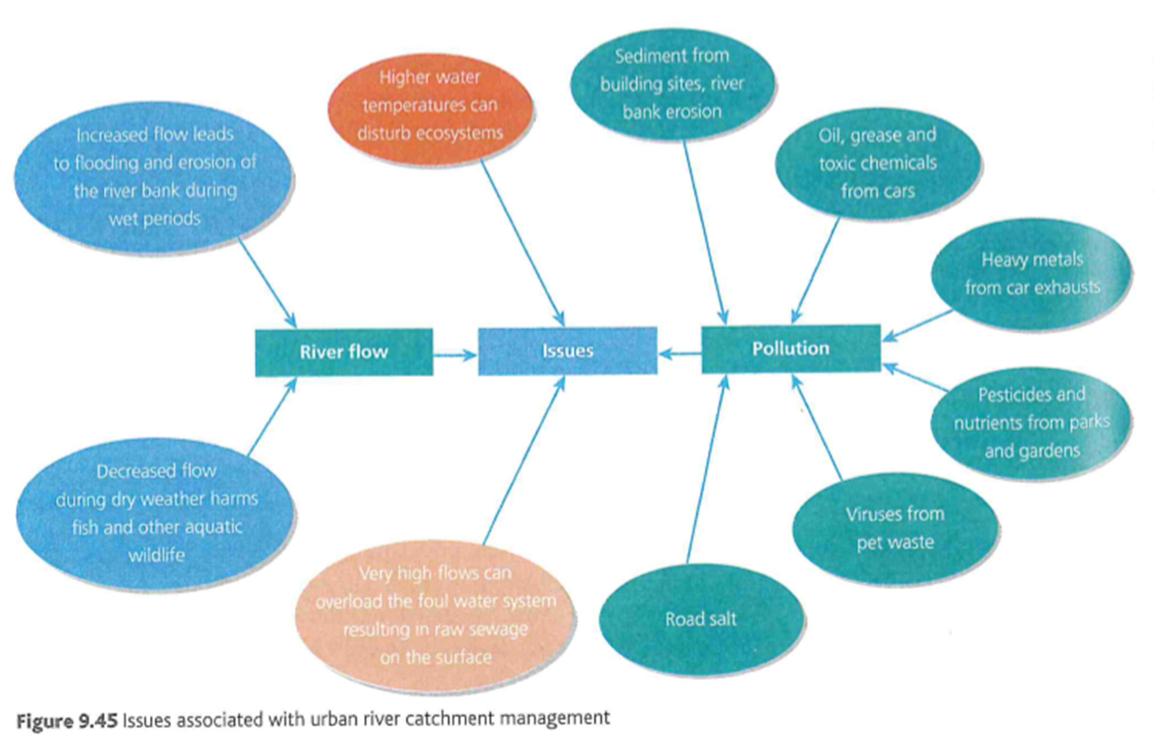
Issues associated with urban river catchment management
Scan p 416 hodder

Slide 14
Issues associated with urban river catchment management
Pollutants can
  harm fish and wildlife populations
  kill native vegetation
  Foul drinking water supplies
  Make recreational areas unsafe and unpleasant
Sediment from erosion can
  Fill spaces between rocks on the stream bottom reducing living space or habitat for the biological communities.

Slide 15
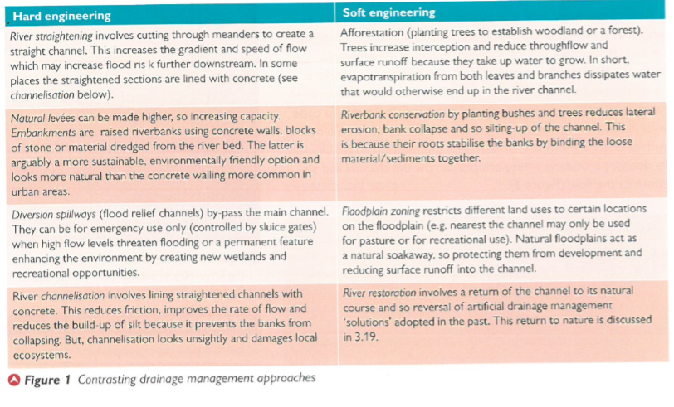
TASK: Study Figure 1 ‘Contrasting drainage management approaches’. Critically assess hard and soft engineering solutions to urban drainage management.

Slide 16
Sustainable urban drainage systems (SuDS)
SUDS is a relatively new approach to managing rainfall by using natural processes in the landscape to:
  Reduce flooding
  Control flooding
  Provide amenity to the community
  TASK: Watch the video clip on SuDs and make notes on the measures that can be put in place to manage rainfall.
https://www.youtube.com/watch?v=LMq6FYiF1mo

Slide 17
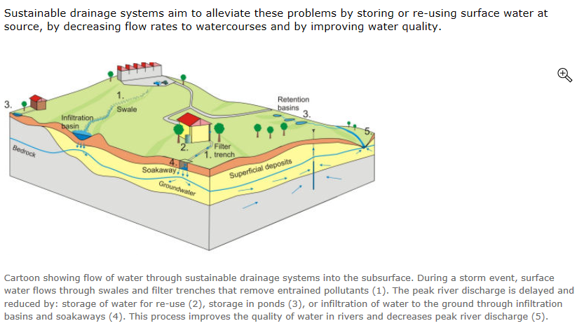
Catchment management in urban areas – Sustainable urban drainage systems (SuDS)
Key term
‘swale’ -
a grass channel

Slide 18
Tasks: Use Oxford text book p157-159 complete the following on Sustainable urban drainage systems (SuDS)
Summarise the techniques used and benefits of SuDs. (p157)
What was the original aim of the Lamb Drove SuDs scheme? (p158)
Annotate the diagram to explain the role of the measures implemented using information from p159.
Using the Lamb Drove case study and figures 5 and 6 (p158-159) complete the following:
  Summarise the impacts of the Lamb Drove development.
  Summarise evidence that the Lamb Drove project is a success and now cited as ‘best practise’ for all planner’s nationally.

Slide 19
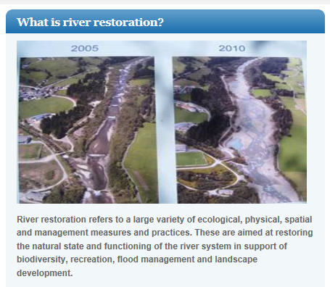
Catchment management in urban areas – River Restoration and Conservation

Slide 20
River restoration and conservation in damaged urban catchments
River restoration has two main aims:
To improve the quality and function of rivers.
To restore the river so it can support healthy and thriving ecosystems.
Restoration can occur at different scales:
Large scale restoration projects could include an entire flood plain. Buildings might be removed and water channels brought back to a more natural course.
Small scale projects could restore a section of river by removing hard engineering and replacing it with more natural features.
Restoration can be seen to work with SuDs and other projects in the urban environment.

Slide 21
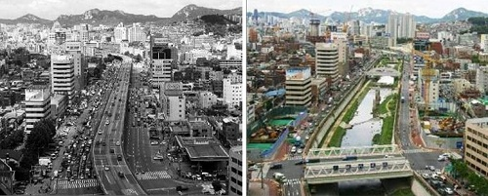
The Cheonggyecheon River project, Seoul, South Korea:
An example of river restoration and conservation in a damaged urban catchment
Images before and after restoration.

Slide 22
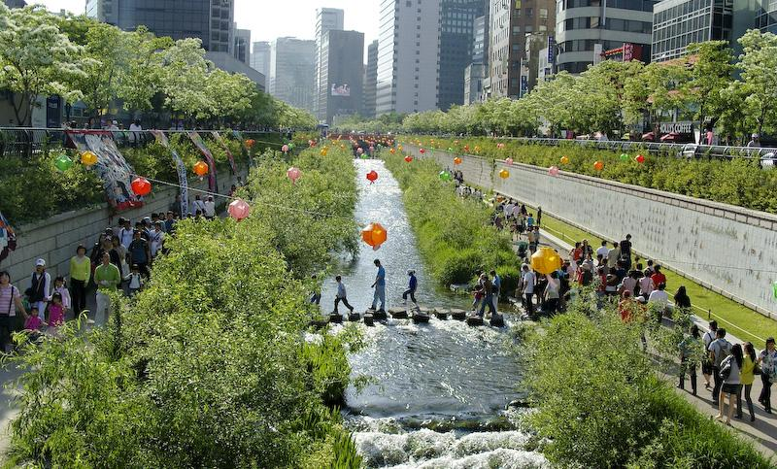
The Cheonggyecheon River project, South Korea:
An example of river restoration and conservation in a damaged urban catchment
TASK: Watch the clip on the project and answer the questions in your booklet. https://vimeo.com/255489488

Slide 23
TASK: Watch the clip on the project and answer the following questions.
Following the implementation of the restoration how has wildlife and average temperatures been affected?
What flood control policy had historically been put in place?
What was the river originally used for?
What happened to the quality of the river over time?
When was the river covered?
When was the expressway built?
In 2003 what was usage of the area like?
What had happened to the structure covering the river by the 1990’s?
When was the restoration project started?
Give details of the restoration project: time taken, cost and length of river restored.
What issues were raised over the restoration and how were these resolved?
How did Seoul’s citizens participate in the restoration project?
How does the restoration project benefit Seoul?

Slide 24
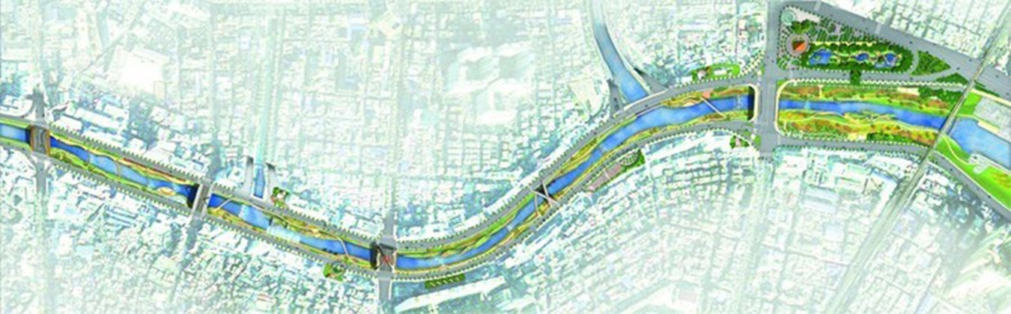
Stakeholder participation
River restoration involves a wide range of stakeholders from the public and private sector including policy makers, practitioners, scientists and non-government organisations, as well as all citizens groups potentially impacted.
By actively drawing these various stakeholders into the process, visions can be shared and tuned towards each other.
This makes for different interests to be met and increases support for restoration efforts.
TASK: Who were the stakeholders in the Cheonggyecheon River project?

Slide 25
TASK: River Restoration and Conservation Project Case Study
Produce a mind map/revision document case study for the Cheonggyecheon River project, Seoul, South Korea.
Include the following:
  The reasons for the project, including its overall aims and dates of the project.
  Description of the restoration and conservation work carried out.
  Contributions from the various parties involved, including their attitudes to the project.
  How the project has had an impact on water movement through the urban catchment.
  An evaluation of the success or otherwise of the project including economic sustainability, traffic, environment and inclusive design.
  Include annotated maps and images to support your work.
Resources:
Hodder text book p 418 - 419
Online - images/maps

Slide 26
Extension Task
A lot has been written about the fact that increasing numbers of people are replacing lawns and gardens with impermeable surfaces –
What impact is this having?
How could people be persuaded to reverse this trend?
The RHS are running a campaign to encourage people to green up urban areas.
For more information, go to: RHS: Why greening grey Britain is important. (Urban greening) https://www.rhs.org.uk/science/gardening-in-a-changing-world/greening-grey-britain/urban-planting

Slide 27
Extension Task
Look at the proposals (by a former Geography teacher) to make London the first National Park City.
http://www.nationalparkcity.london/
What would be the costs and benefits for London and the rest of the UK?
(Link here with issues such as the urban heat island, air and water pollution and sustainability)

Slide 29
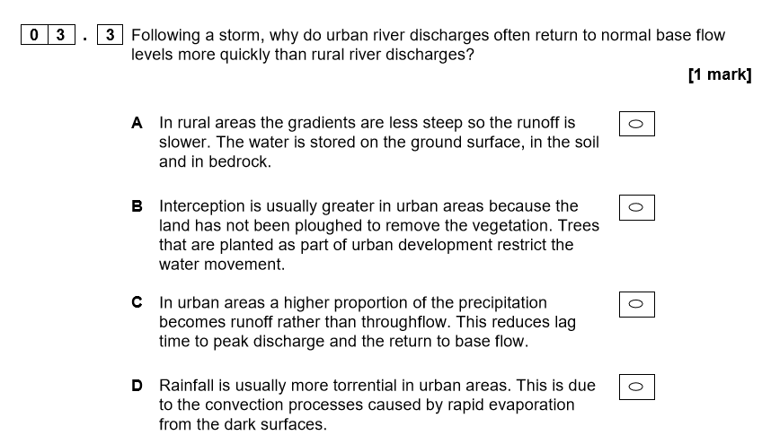

Slide 30
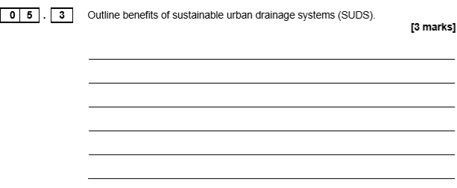

Slide 31
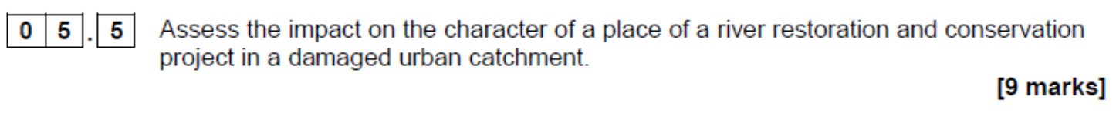

Slide 32
Pre-work/Flipped Learning
Read Hodder text book p 420-422 and make notes/mind map on ‘urban waste and its disposal’ under the following headings:
  Waste generation,
  Sources of waste in urban areas,
  Impacts of increasing waste generation
Using p422-424 Hodder and p164-166 Oxford text book make notes on the different methods of waste management and disposal below. Include positives and negatives – this could be completed as a table.
  Recycling and recovery
  Trade
  Reduction(incineration)
  Burial (landfill)
What is submergence of waste? See Hodder textbook p424

