Slide 1
Unit 3: Applying the Principles of Personal Training

Slide 2
Bones of the human skeleton

Slide 3
Functions of the Skeleton
Support
Protection
Source of blood cell production
Storage of minerals
Attachment
Notes:
Gives distinctive shape; allows attachment of muscles & soft tissue.
Bones act as levers and form joints to allow movements
Bones support and protect vital organs
Some bones contain bone marrow to produce white & red cells & platelets
Bones are made of minerals within cartilage; they act as a mineral store for calcium, magnesium & phosphorus
Provide surfaces for attachment of soft tissue – this is why they are irregular

Slide 4
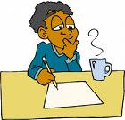
What is a joint?
My elbow, hip & knee are joints, but what is the definition of a joint?
A joint is a place where two or more bones meet

Slide 5
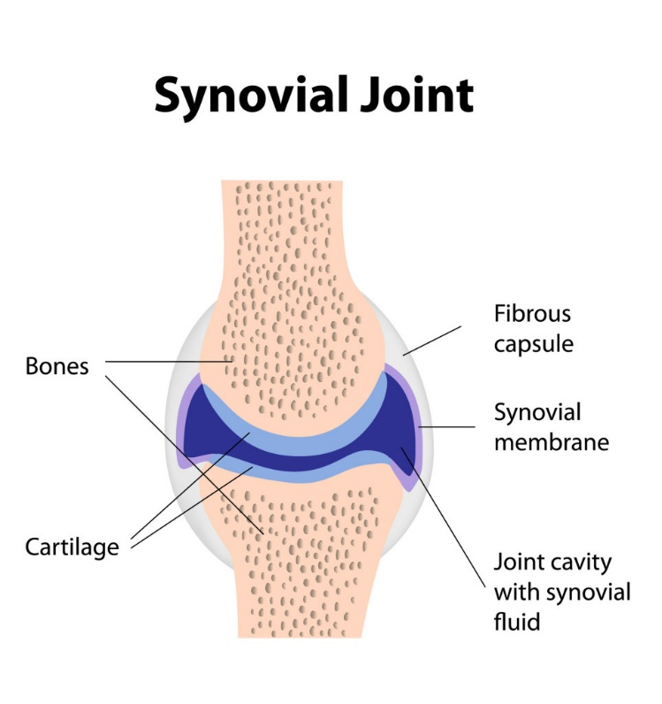
Synovial Joints
What is a
synovial joint?
Synovial joint – freely moveable
Why? – Has cartilage to absorb impact, ligaments to provide stability and synovial fluid to prevent friction

Slide 6
What do parts of a synovial joint do?
Part | Description
Fibrous Capsule | - Allows movement of the joint. - Strength from collagen fibres keeps a joint in place and resists dislocation.
Cartilage | - Shock absorption (to absorb impact)
Synovial Membrane | - Secretes synovial fluid
Synovial Fluid | Lubricates joints Supplies nutrients to the joint Removes metabolic waste

Slide 7
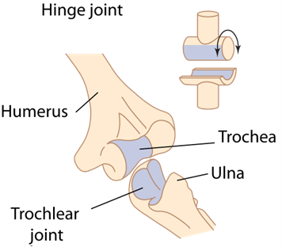
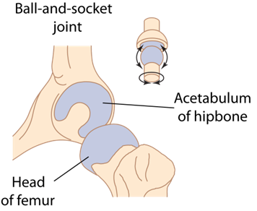
Types and movement of Synovial Joint
Type | Description and location
Hinge | At the elbow, knee and ankle Allow movement in one direction. Movement allowed at the elbow and knee are FLEXION and EXTENSION Allows you to bend and straighten the knee (flexion when bending to jump and extension when jumping; bending and straightening elbow when bouncing a ball)
Ball and Socket | At the shoulder and hip Flexion/extension, rotation, abduction, adduction, circumduction A round end of one bone fits into a cup-like shape of the joining bone. Allows you to swing through the full range of movement (when kicking or throwing a ball)
Notes:
Hinge - Cylindrical protrusion of one bone articulates with trough-shaped depression of another
Ball & Socket - Ball shaped head of one bone articulates with a cup like socket of another bone
Condyloid - Similar to ball and socket, but much flatter and shallower.

Slide 8
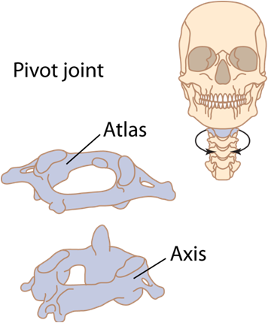
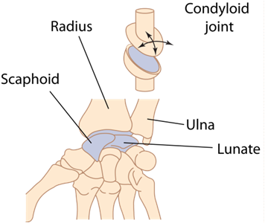
Types of Synovial Joint
Type | Description
Pivot | Between the top two vertebrae in the neck Allows for rotation Turning head to follow the ball
Condyloid (Ellipsoid) | In the wrist Flexion/extension, abduction, adduction, circumduction Good range of movement to hit the tennis ball with the racquet
Notes:
Gliding
Articulating surfaces are almost flat and of similar size
Pivot
Rounded structure of one bone articulates with ring-shaped structure of another
Saddle
Similar to ellipsoid, but surfaces are concave and convex

Slide 9
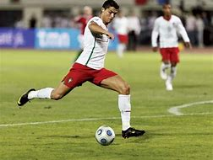
Synovial Joints in action
1. Describe what is happening at the hip
2. Describe what is happening at the knee

Slide 10
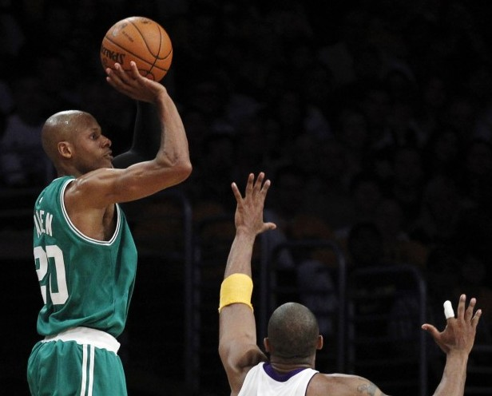
Synovial Joints in action
1. Describe what is happening at the shoulder
2. Describe what is happening at the elbow

Slide 11
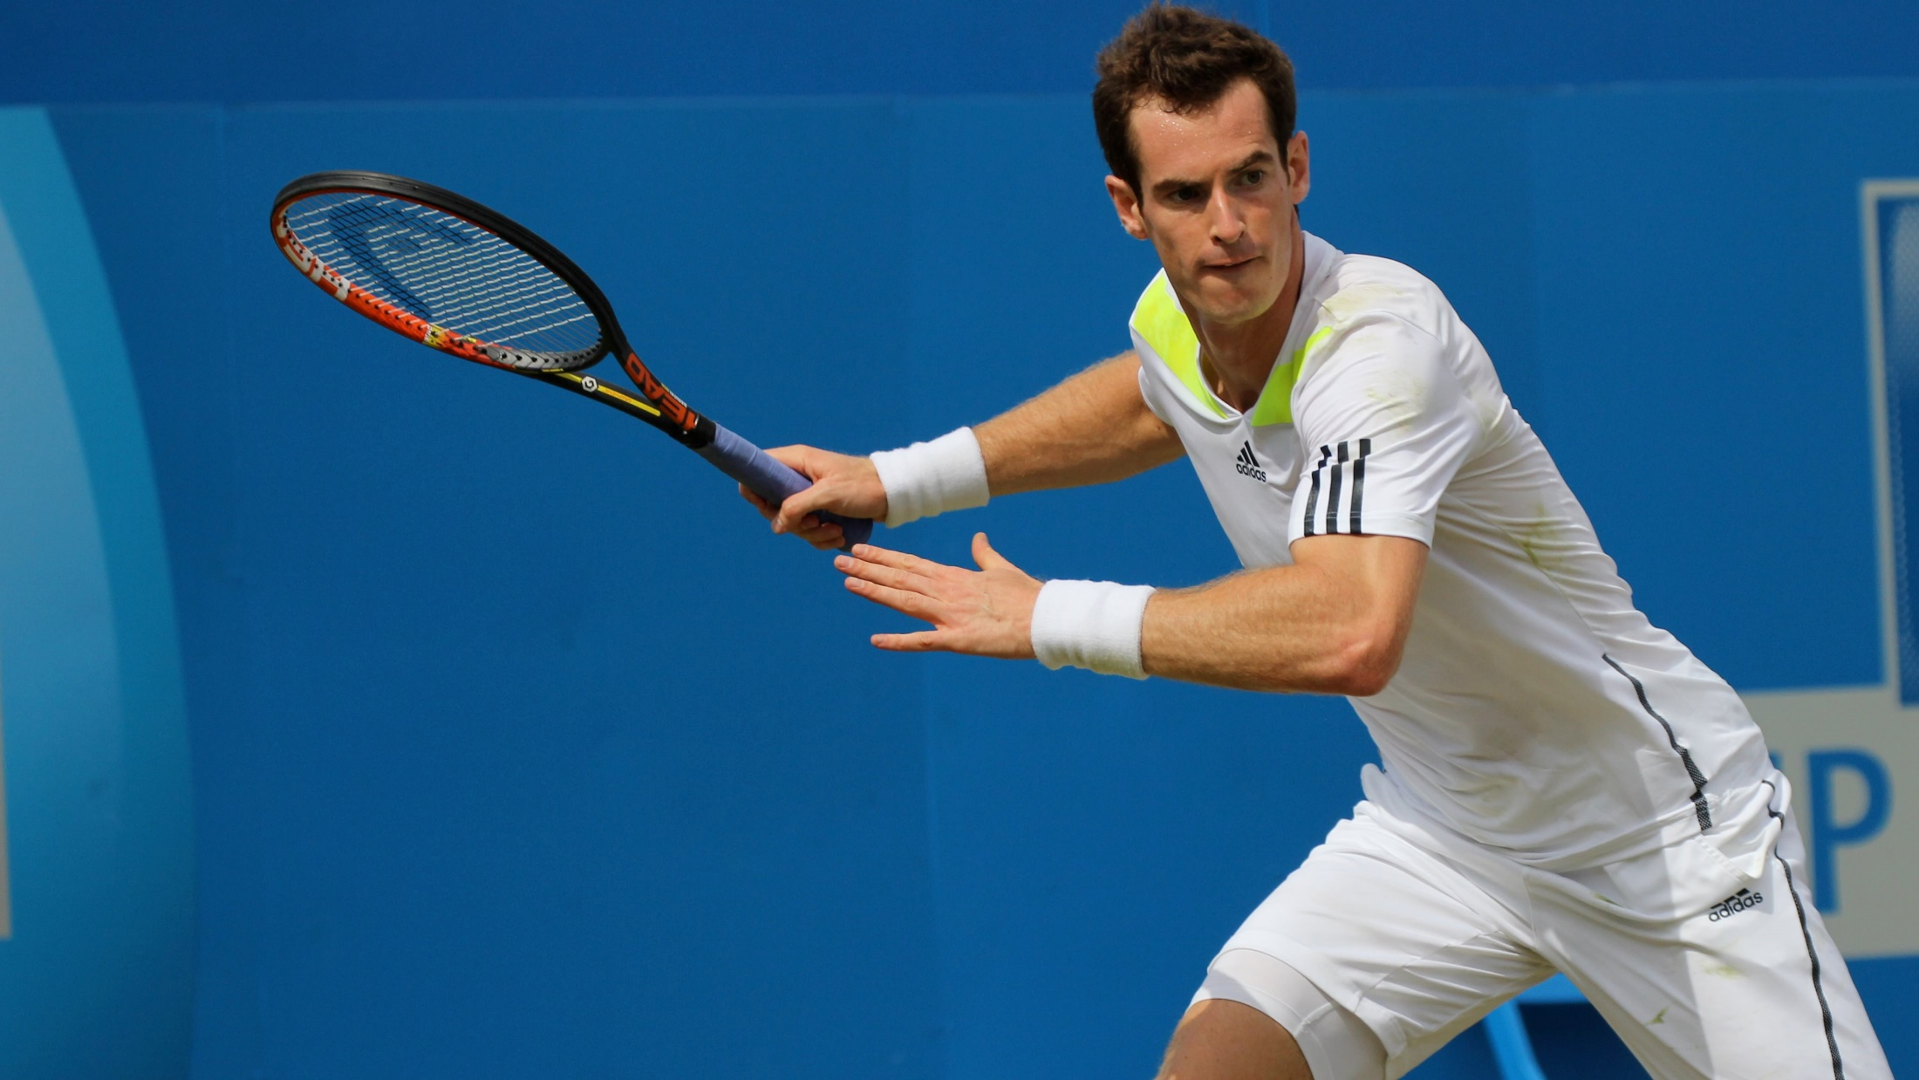
Synovial Joints in action
1. Describe what is happening at the shoulder (racquet arm)
2. Describe what is happening at the elbow (racquet arm)

Slide 12
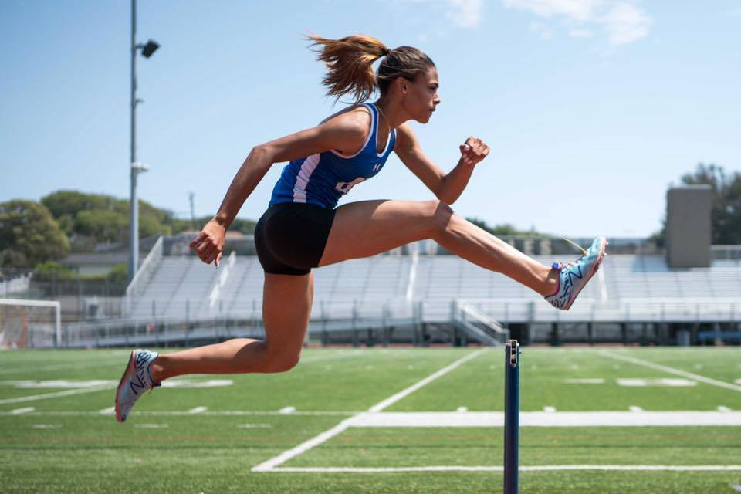
Synovial Joints in action
1. Describe what is happening at the shoulder
2. Describe what is happening at the elbow
3. Describe what is happening at the hip of the lead leg
4. Describe what is happening at the knee of the lead leg

Slide 13
Major Skeletal Muscles
Anterior View Posterior View

Slide 14
Effect of exercise on the musculoskeletal system
Why??
Warm Up
What?
Pulse Raiser
Increase body/muscle temperature
Stretches
- Increase range of movement

Slide 15
Effect of exercise on the musculoskeletal system
Why??
Main Session
What?
Muscle temperature increases
Overload through resistance training = muscle fibre microtears- this will happen in slow twitch fibres when training muscular endurance or fast twitch when training strength- why should this be progressive??

Slide 16
Effect of exercise on the musculoskeletal system
Why??
Cool Down
What?
Lower Pulse Raiser
Remove waste products (lactic acid etc.)
Stretches
- Increase range of movement (long term)

Slide 17
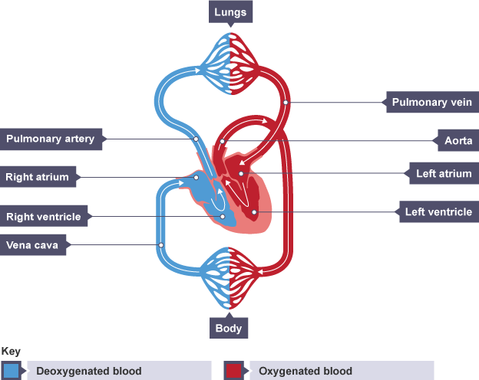
Cardiovascular System

Slide 18
Cardiovascular System
Part | Function
Atria | Receives blood into the heart. The right atrium receives deoxygenated blood from body. The left atrium receives oxygenated blood from the lungs. Blood moves from the atria into the ventricles through a valve.
Ventricles | Sends blood away from the heart. The right ventricle sends deoxygenated blood to the lungs for oxygen. The left ventricle sends oxygenated blood to the body for energy.
Aorta | Carries oxygenated blood from the left ventricle to the rest of the body. Has a strong, muscular wall as has to force blood to travel a long distance. A small lumen and high blood pressure.
Vena Cava | Carries deoxygenated blood from the body to the heart. Blood vessel wall is not muscular. A wide lumen and lower blood pressure.
Pulmonary Artery | Sends deoxygenated blood from the right ventricle to the lungs to pick up oxygen. The only artery to carry deoxygenated blood!
Pulmonary Vein | Carries oxygenated blood to the left atrium from the lungs. The only vein to carry oxygenated blood!

Slide 19
Respiratory System

Slide 20
Respiratory System
Part | Function
Lungs | Large organs that hang in the thoracic cavity. There is a left and right lung, which aid transport of oxygen and waste products. All gaseous exchange takes place here. Protected by the rib cage.
Trachea | Known as windpipe. Air flows in from the mouth and down trachea towards lungs. Contains rings of cartilage to stop it collapsing. It branches into right and left bronchus.
Bronchus | There is a left and right bronchus, one in each lung. Their main role is to conduct air into the lungs.
Bronchioles | First airway branches that do not contain cartilage. Join the bronchus to the alveoli so that gases can be exchanged.
Alveoli | Air sacs at the end of the bronchioles that allow gaseous exchange. They deliver carbon dioxide back to the lungs and pick up oxygen to send to the body. Large surface area and only 1 cell thick = fast gas exchange.
Diaphragm | Separates the chest from the abdomen and is the most important breathing muscle. Contracts to allow the thoracic cavity to get bigger so that air can flow in. Relaxes to reduce thoracic cavity and force air out.

Slide 21
Effect of exercise on the cardiorespiratory system
Why??
Warm Up
What?
Pulse Raiser
Increase heart rate
Increase breathing rate

Slide 22
Effect of exercise on the cardiorespiratory system
Why??
Main Session
What?
Heart rate increases
Breathing rate increases
Build up of lactic acid as intensity of session increases and you start to work more ANAEROBICALLY (without oxygen) as heart/lungs cannot meet energy demand- muscles start to ache!

Slide 23
Effect of exercise on the cardiorespiratory system
Why??
Cool Down
What?
Heart rate decreases
Breathing rate decreases

