Slide 1
Unit 3 Applying the principles of personal training
The effect my fitness training has on the musculoskeletal and cardiorespiratory systems

Slide 2
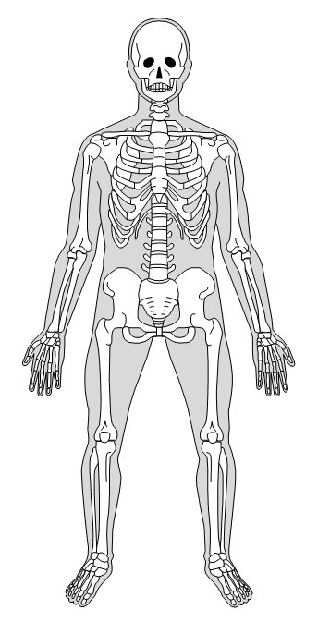
The human skeleton
Right click each box and Edit Text to write in the boxes

Slide 3
The human skeleton
FUNCTIONS OF THE SKELETON

Slide 4
jOINTS
Define what a joint is
What is a synovial joint?

Slide 5
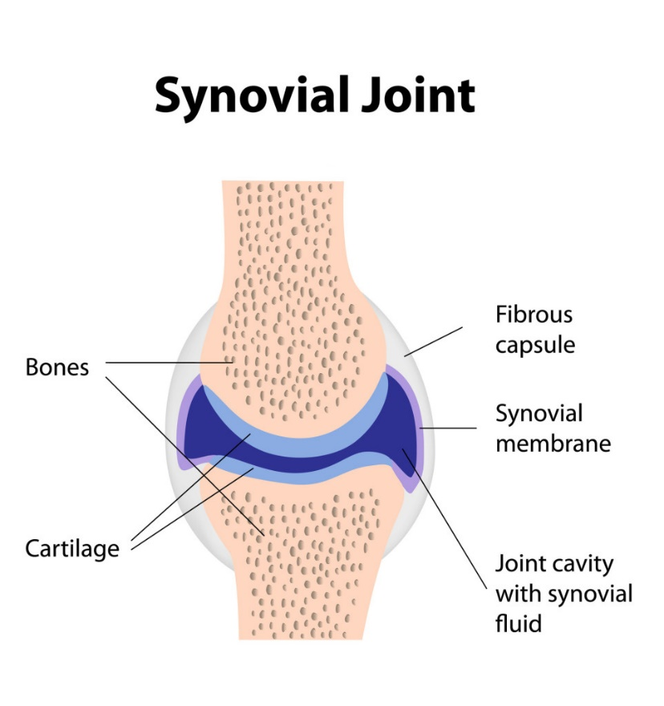
Synovial joints
Please label the joint below and describe what each part does
Right click each box and Edit Text to write in the boxes

Slide 6
Types of synovial joint
Describe each type of joint and where it is found in the body
Hinge joint
Ball and socket joint
Pivot joint
Condyloid joint

Slide 7
Synovial Joints in action
Introduce this section by saying that synovial joints play a big part in performing sporting movements successfully.
Include one of the examples from your work booklet here- include picture (should not be your own sport)

Slide 8
Synovial Joints in action
Include another example from your work booklet here- include picture (should not be your own sport)

Slide 9
Synovial Joints in action
Include examples of what synovial joints you use in your own sport and how they move/work during key movements- include a picture of the sport

Slide 10
The musculoskeletal system
Right click each box and Edit Text to write in the boxes

Slide 11
The musculoskeletal system: the warm up
Using your work booklet, describe what happens to the musculoskeletal system during your warm up.
Write in the first person (“during my pulse raiser” etc.)
Then explain why this happens/why this is important for preparing your body for your fitness training session

Slide 12
The musculoskeletal system: My session
Using your work booklet, describe what happens to the musculoskeletal system during your main sessions. Make sure that you talk about each type of session separately.
Write in the first person (“during my aerobic session on the treadmill” etc.)
For each point, explain why this happens/why this is important for your progression through your fitness training programme

Slide 13
The musculoskeletal system: The cool down
Using your work booklet, describe what happens to the musculoskeletal system during your cool down.
Write in the first person (“when lowering my pulse” etc.)
Then explain why this happens/why this is important following a training session

Slide 14
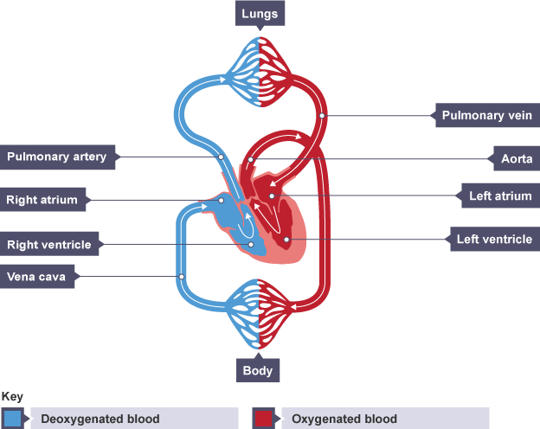
The cardiovascular system
Right click each box and Edit Text to write in the boxes

Slide 15
The cardiovascular system
Part of the Heart | Structure and Function
Atria
Ventricles
Aorta
Vena Cava
Pulmonary Artery
Pulmonary Vein

Slide 16
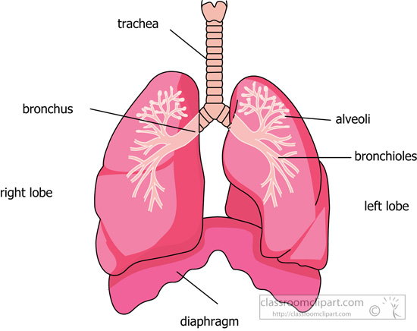
The respiratory system
Right click each box and Edit Text to write in the boxes

Slide 17
The cardiorespiratory system: the warm up
Using your work booklet, describe what happens to the cardiorespiratory system during your warm up.
Write in the first person (“during my pulse raiser” etc.)
Then explain why this happens/why this is important for preparing your body for your fitness training session

Slide 18
The cardiorespiratory system: my session
Using your work booklet, describe what happens to the cardiorespiratory during your main sessions. Make sure that you talk about each type of session separately.
Write in the first person (“during my aerobic session on the treadmill” etc.)
For each point, explain why this happens/why this is important for your progression through your fitness training programme

Slide 19
The cardiorespiratory system: the cool down
Using your work booklet, describe what happens to the cardiorespiratory system during your cool down.
Write in the first person (“when lowering my pulse” etc.)
Then explain why this happens/why this is important following a training session

