Slide 1
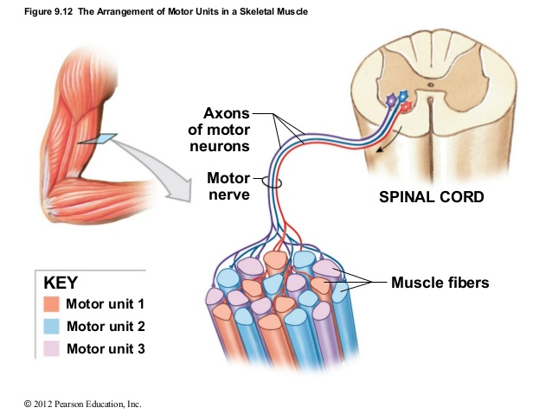

Slide 3
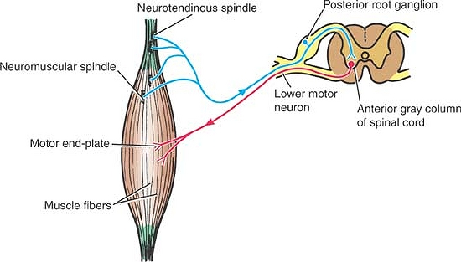
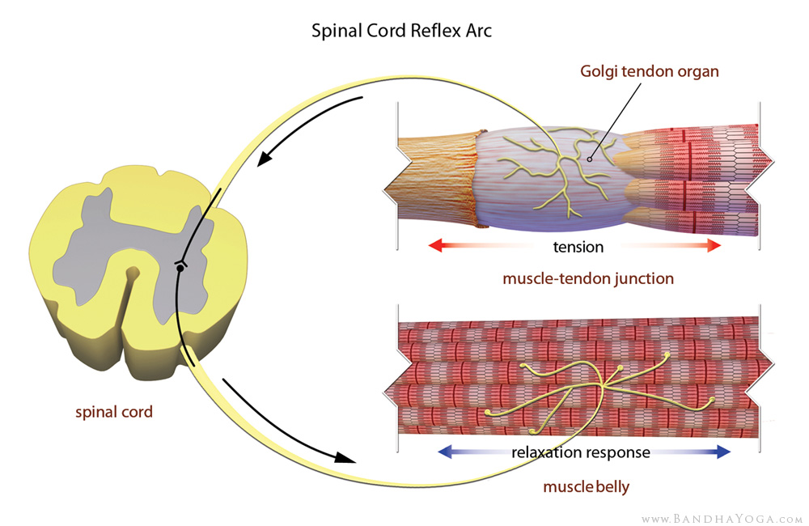
Muscle Spindle detects stretch and creates contraction
Golgi Tendon Organ senses the contraction and inhibits the muscle spindle signal

