Slide 1

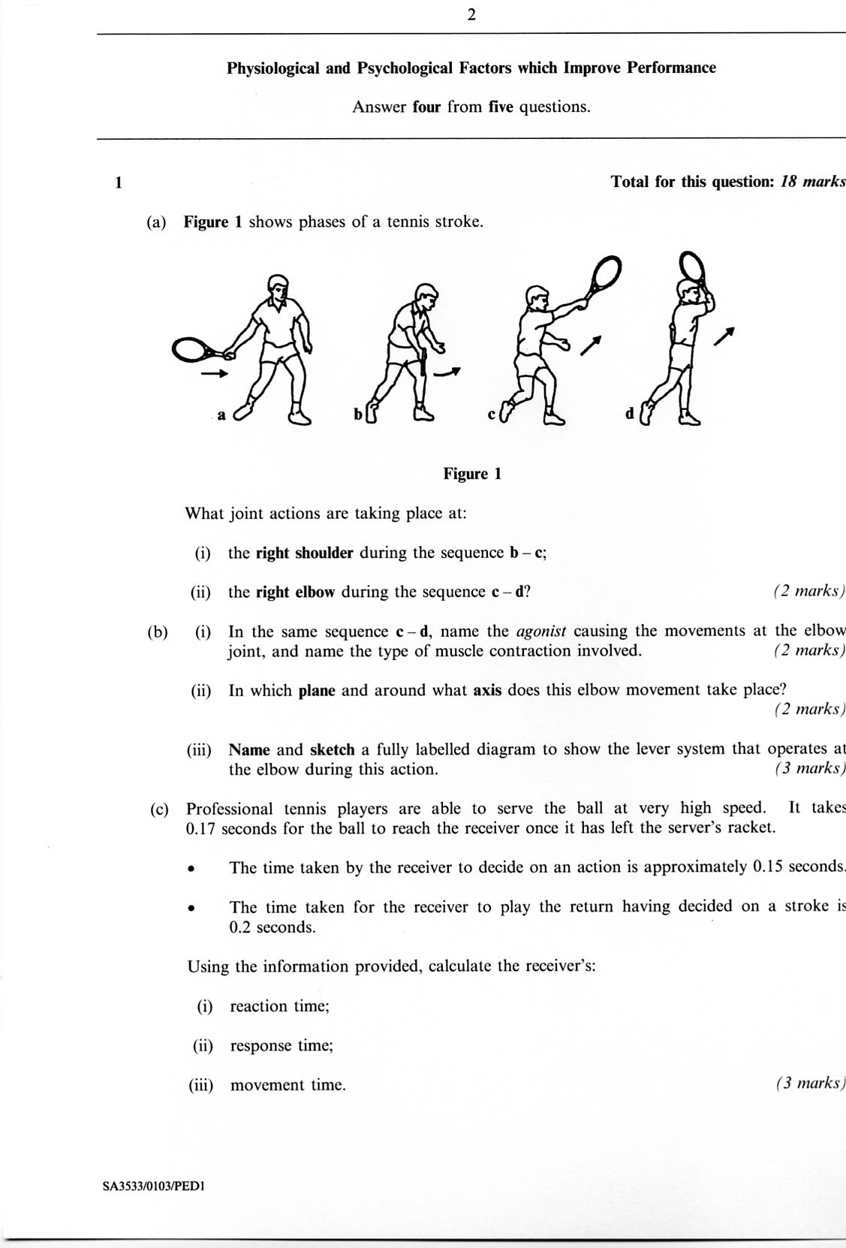
Forehand Racquet Strokes
Shoulder action
Joint Action a-d | Agonist | Plane | Axis | Type of contraction | Lever System
Elbow action
Joint Action c to d | Agonist | Plane | Axis | Type of contraction | Lever System

Slide 2
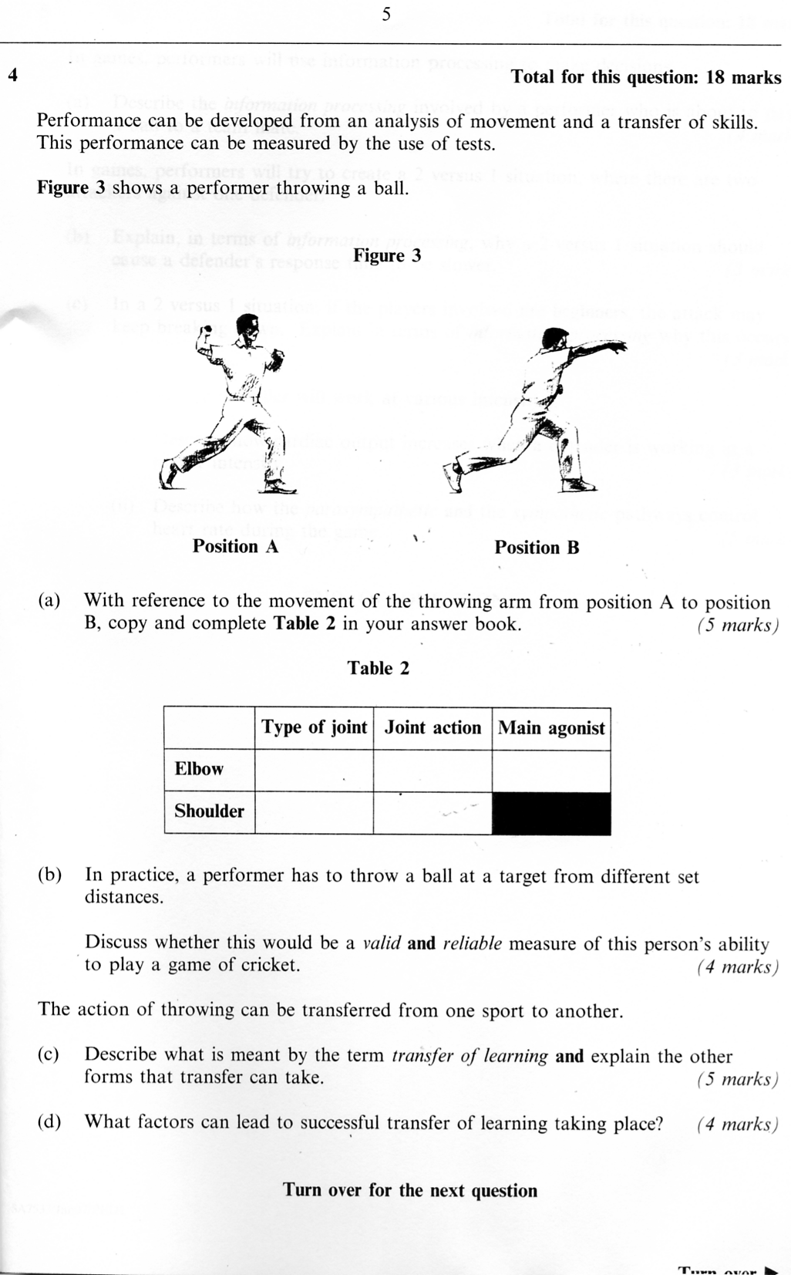
Over-arm Throwing
Joint Action a-d | Agonist | Plane | Axis | Type of contraction | Lever System
Shoulder action
Elbow action

Slide 3
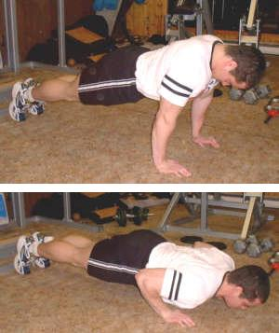
Press Up
Elbow action
Joint Action | Agonist | Plane | Axis | Type of contraction | Lever system
Upward
Downward

Slide 4
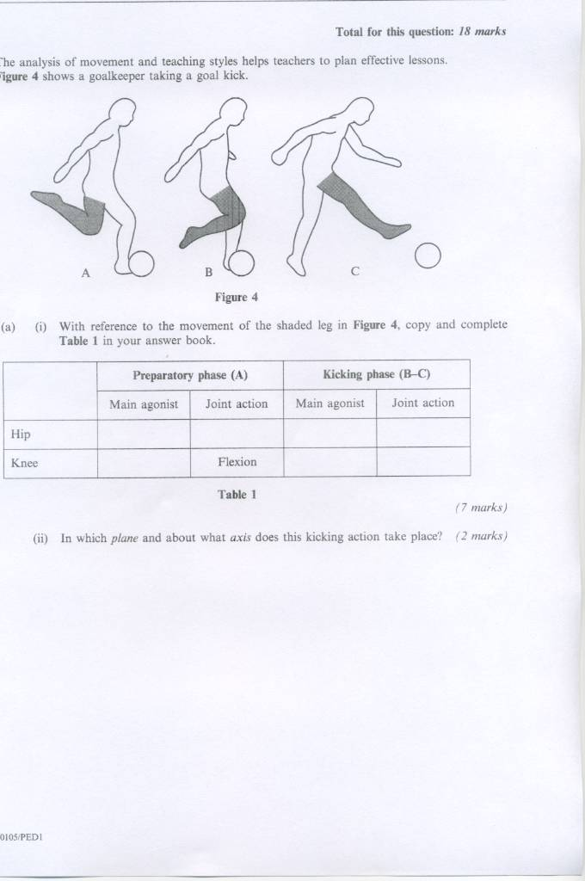
Kicking
Joint Action a-c | Agonist | Plane | Axis | Type of contraction | Lever system
Hip action
Knee action
Ankle action

Slide 5

Jumping
Joint Action Upward phase | Agonist | Plane | Axis | Type of contraction | Lever system
Hip action
Knee action
Ankle action

Slide 6
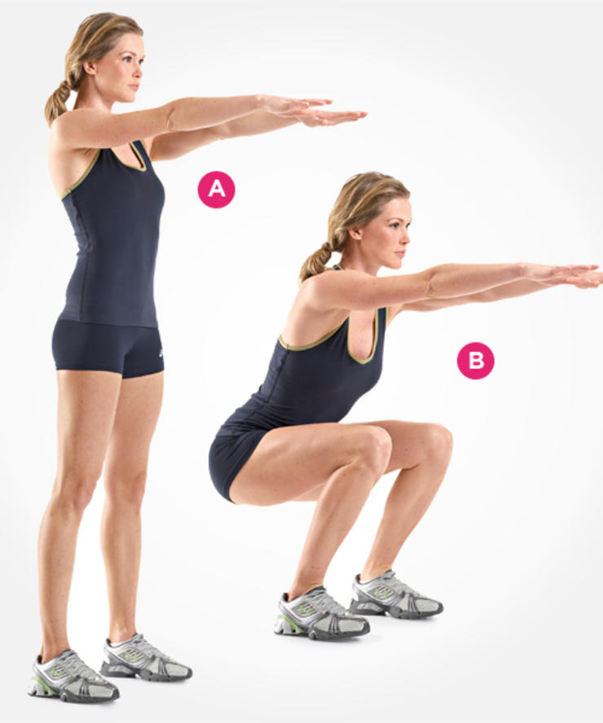
Squats
Joint Action Downward phase | Agonist | Plane | Axis | Type of contraction | Lever system
Hip action
Knee action
Ankle action

Slide 7

Running
Recovery
Drive –always the leg in contact with the ground
Hip | Recovery |  |  |  |  | Drive
Joint Action | Agonist | Plane | Axis | Type of contraction | Lever system | Joint Action | Agonist | Plane | Axis | Type of contraction
Knee | Recovery |  |  |  |  | Drive
Joint Action | Agonist | Plane | Axis | Type of contraction | Lever system | Joint Action | Agonist | Plane | Axis | Type of contraction
Ankle | Recovery |  |  |  |  | Drive
Joint Action | Agonist | Plane | Axis | Type of contraction | Lever system | Joint Action | Agonist | Plane | Axis | Type of contraction

Slide 8
Make up your own movement analysis example.

