Slide 1
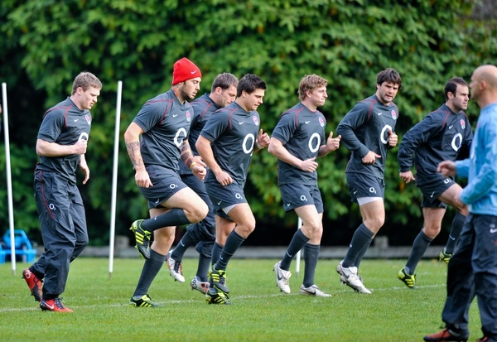
Benefits of warm-up
Limits DOMS
(Delayed Onset of Muscle Soreness)
Decreased muscle viscosity
Increased elasticity
Greater speed and force of contraction
Reduces risk of injury
BLOOD
MUSCLES
Decreased viscosity of blood
Increased blood flow
NERVES
Increased speed of
nerve conduction
Increased synovial fluid
leads to more
movement
Vascular shunt initiated
Vasodilation of arterioles to working muscles
JOINTS
BLOOD
VESSELS
HORMONAL
ENZYMES
BRAIN
Increased enzyme activity
ensures readily available
energy
Release of adrenaline
increases heart rate so more O2
is delivered to muscles
Improves alertness,
readiness and reaction time

Slide 2
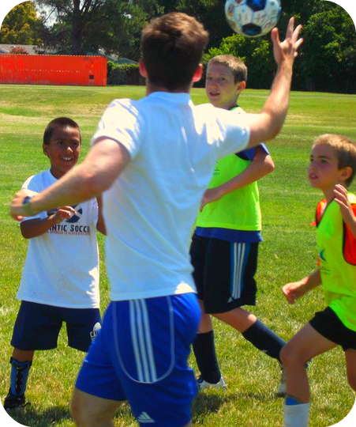
Benefits of cool-down
Keeps arterioles dilated so that oxygen can be flushed through the muscle tissue
CAPILLARIES
MUSCLES
Lactic acid removed and oxidised
Reduction of DOMS
VEINS
Prevents blood pooling in the veins

Slide 3
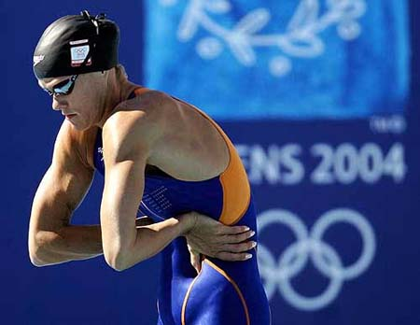
Safety implications for warm-up stretches
Warm-up prior to stretching
Make stretch sports specific
(Begin) slowly
Hold stretch for no more than 30 seconds
Never hold a painful stretch – injury
No bouncing on static stretches
Balance/equalise stretches/agonists and antagonists

