Slide 1
Exercise Physiology
Energy

Slide 2
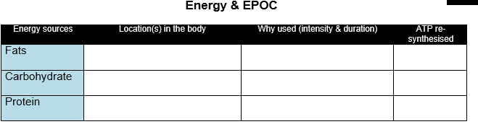
Stored as triglycerides
– converted to Free fatty acids
Long duration (45 mins +), Low intensity
FFAs can only be broken down aerobically
> 38 ATP
Stored as glycogen in muscle/liver
Short duration (to 45 mins), High intensity
Also used in mix with fats to fuel first
20 – 45 mins of aerobic work
36 - 38 ATP
Amino acids in muscle cell
Only used when both Glycogen and Fat stores are depleted.
< 38 ATP

Slide 3
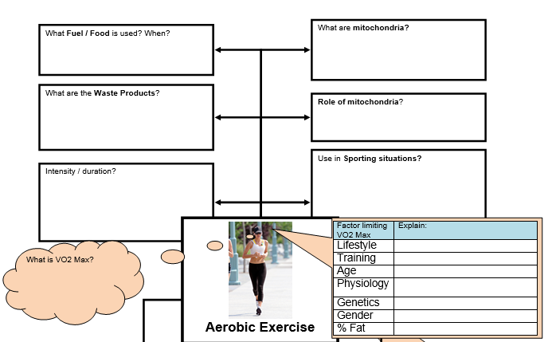
Glycogen/glucose & fats
Parts of a muscle cell where aerobic ATP re-synthesis occurs
CO2
H20
Houses the Krebs Cycle &
Electron Transport Chain
Marathon running
Recovery jogging in team sports
Low intensity – long duration
e.g. smoking
Lack of interval/continuous/fartlek
Maximum amount of oxygen that can be utilised by the muscles per min (ml/kg/min)
Lower VO2 Max as you get older
e.g. smaller SV = lower VO2 Max
e.g. fewer ST fibres
Lower VO2 Max in females
Higher % body fat = lower VO2 Max

Slide 4
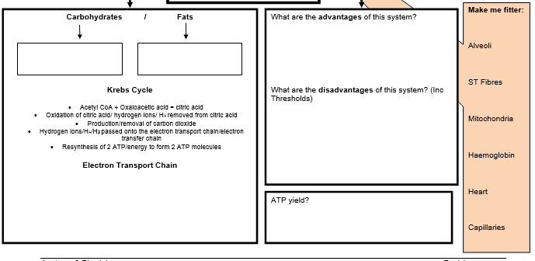
Large quantities of ATP produced
No harmful waste products
Long duration
Glycolysis
Beta Oxidation
Surface area
recruitment
Can not fuel high intensity work
Requires large amounts of oxygen
ATP not readily available/ slow release
Size / number
  Hydrogen (atoms) transported to the cristae of the mitochondria
  Electrons removed from hydrogen are passed along by electron carriers.
  Oxygen combines with hydrogen to form water
  Re-synthesis of 34 ATP (much higher from fats)
No. of RBCs
34 – 36 ATP
SV
Density/ number

Slide 5
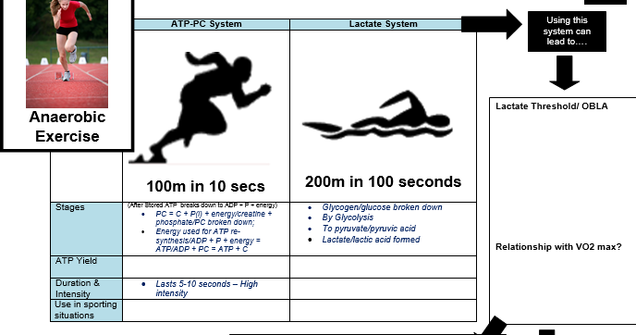
The point where blood lactate dramatically increases to 4mmol/L
1 ATP per 1 PC
2 ATP per 1 glucose
OBLA occurs at 50-60% of VO2 Max in untrained, 85% of VO2 max in elite athletes
10s – 2 mins – high intensity
Sprinting down wing
400m sprint

Slide 6
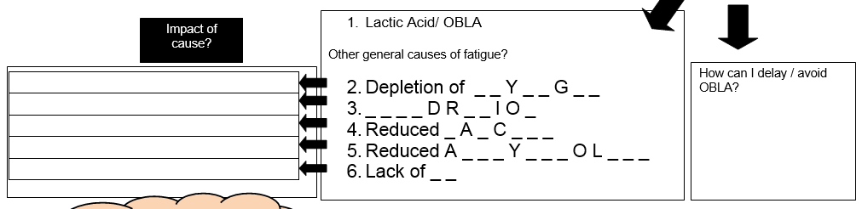
forced to use fats at low intensity
G L C O E N
Lactate threshold training
Monitor work intensity
Warm-up/ active recovery
‘Buffering’
leads to over-heating
D E H Y A T N
Inhibits muscle contractions
C L I U M
Inhibits muscle contractions
C E T L C H I N E
Needed for quick/ explosive burst
P C

Slide 7
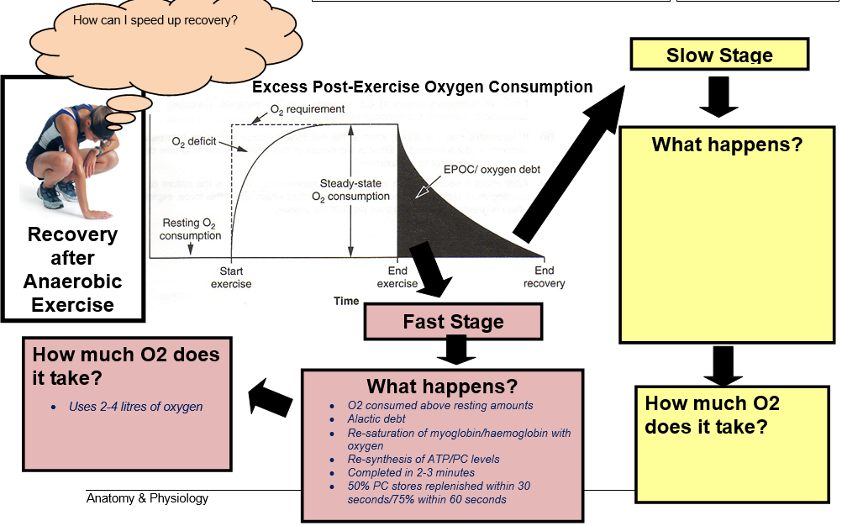
Warm-up, Cool-down, consumption
of glucose/glycogen, active
recovery, rotate subs
O2 consumed above resting amounts
Lactic acid Debt
Completed in 1 hour
Lactic acid converted to glucose, H20 and CO2, Sweat/ urine,
protein
Uses 5 – 8 litres of oxygen

Slide 8
Point where lactate accumulates in the blood
Occurs at 4mmol/l or above
Onset blood lactate accumulation (OBLA)
Depends on aerobic fitness of performer
Highly trained individual at approx 85% of VO2(max)
Untrained individual at approx 50-60% of VO2(max)
Buffering is a process which aids the removal of lactic acid and maintains acidity levels in the blood and muscle. A trained performer can cope with higher levels of blood lactate and can speed up its removal

Slide 9
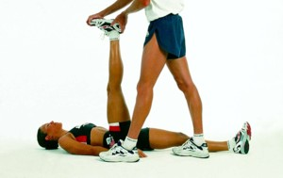
Step 1
13
Ex Phys
Here, the individual performs a passive stretch with the help of a partner and extends the leg until tension is felt.
This stretch is detected by the muscle spindles. If the muscle is being stretched too far then a stretch reflex should occur.

Slide 10
Step 2
13
Ex Phys
The individual then isometrically contracts the muscle for at least 10 seconds (by pushing their leg against their partner).
Golgi tendon organs are also sensitive to tension developed in a muscle and during an isometric contraction send an inhibitory signal which overrides the excitory signal from the muscle spindle and inhibits the stretch reflex.

Slide 11
Step 3
13
Ex Phys
Passive stretch is performed again resulting in more range of motion
There is further relaxation of the target muscle as a result and it can be stretched further.

Slide 12
Physiological Adaptations to Flexibility Training
13
Ex Phys
Changes to skeletal muscle
Increased resting length of the muscles
Changes to connective tissue.
Increased resting length of the tendons and ligaments.
These changes result in:
Increased joint range of movement and,
Decreased resistance to joint movement.
Reduced chance of injury

Slide 13
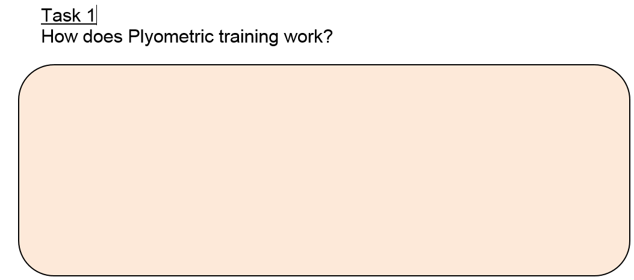
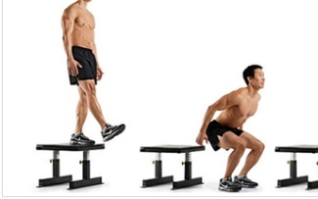
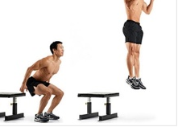
Eccentric contraction/ lengthening of muscle
Detected by Muscle spindle apparatus
(sensitive to rate of change of length in muscle)
Sends messages/
signals to the CNS
Stretch reflex initiated – to prevent overstretch of muscle
Results in more powerful concentric contraction of muscle

Slide 14
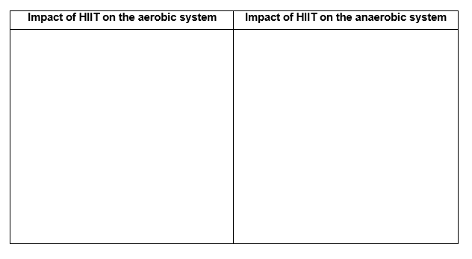
High Intensity Interval Training (HIIT)
Recovery intervals:
Improves Fat burning potential
Utilises ST fibres
Improves removal of lactic acid
Improves aerobic endurance
Work intervals:
Improves glucose metabolism
Improves anaerobic endurance
Hypertrophy and increased recruitment of Fast Oxidative fibres
https://www.youtube.com/watch?v=iEc7QFc5vIQ

Slide 15
Advantages of weight training | Disadvantages of weight training
Develops strength/ power/muscular endurance (depending on %1RM/sets/reps used) | Weight gain – could reduce mobility/speed of games players
Specific muscles can be targeted | Injury – risk of muscle tears if using heavy weights or performing quick lifts
Weight bearing makes the muscular skeletal system resistant to injuries eg – improved bone density reduces risk of osteoporosis | DOMS means rest days needed– could interfere with other training

Slide 16
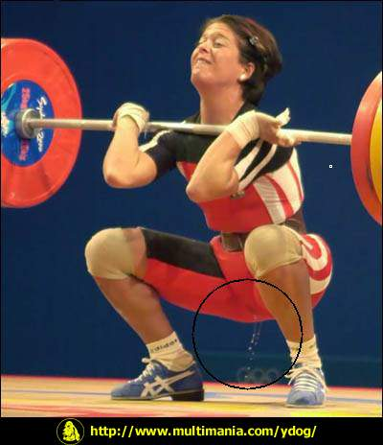
12
Ex Phys
Adaptations to Strength Training
Physiological Changes
Muscle Hypertrophy
Hyperplasia (increase in muscle fibre number)
Increase in number/size of contractile protein (width of actin /myosin filaments)
Increase in actin/myosin cross-bridges
Neural Adaptations
Improved recruitment of motor units & fast twitch muscle fibres
Increased co-ordination of motor units
Reduction in proprioceptor/antagonist muscle inhibition allowing the antagonist to stretch further and the agonist to contract with more force
Metabolic Adaptations
Increase in ATP, PC and glycogen stores
Increasing buffering capacity/ tolerance of fast twitch fibres to work with high levels of lactic acid
Increased efficiency to remove lactic acid / Delay OBLA
Increased glycolytic enzyme actions e.g. PFK

Slide 17
Re-cap quiz
Give an example of the type of athlete who might benefit from plyometrics [1]
Explain the role of the muscle spindle apparatus during
plyometric training. [4]
Outline the short-term (immediate) and long-term implications of altitude training. [6]
Define the term ‘indirect calorimetry’. [1]
Any power athlete/sprinter/jumper
Detects rate of change in length of muscle (during eccentric
work)
Prevents over-stretch injury
Sends nervous information to CNS
Causes stretch reflex
Results in more powerful concentric contraction
Elastic potential
Short-term:
- Reduced O2 diffusion gradient/lower pp of O2 in atmosphere
So reduced saturation of haemoglobin/myoglobin
Resulting in fatigue/inability to train at high intensity/detraining
Altitude sickness
Long-term:
Red blood cell production/count increases
Haemoglobin content increases
Increased O2 transport
Aerobic endurance enhanced/ delayed OBLA/ work at higher intensity for longer/Increased VO2 max
Calculation of energy expenditure from measurement of O2 consumption/CO2 released

Slide 18
Altitude training
14
Ex Phys
Advantages:
• Increase in the number of red blood cells
• Increased concentration of haemoglobin
• Enhanced oxygen transport
Disadvantages:
• Expensive
• Altitude sickness
• Difficult to train well due to the lack of oxygen
• Detraining due to the fact that training intensity has to reduce
when the performer first trains at altitude due to the decreased availability
of oxygen.
• Benefits can be quickly lost on return to sea level

Slide 19
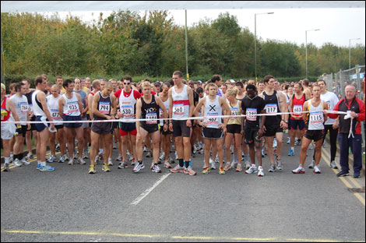
Description
19
Ex Phys
Carbo-loading is a kind of dietary manipulation
not just a pre-match bowl of pasta!
Deplete stores of glycogen through training/
7 days prior to event have high protein/fat diet
Lower training load & High carbohydrates diet 3 days prior to the event
Super
compensation!
Increased glycogen synthase
Days until event
7
6
5
4
3
2
1

Slide 20
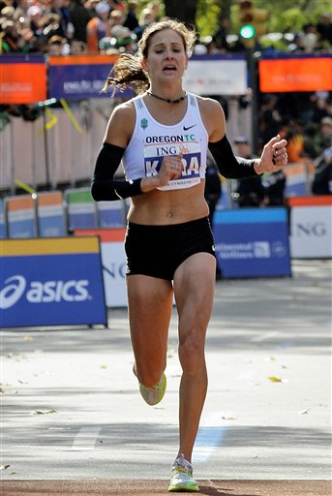
Positives
Who benefits?
19
Ex Phys
Endurance athletes
(and team sports players)
Possible Negatives
Training without sufficient glycogen stores
is very difficult and quality may be lost
Danger of having depleted glycogen stores if
not done correctly
Muscle glycogen stores
Risk of weight gain due to water retention
Liver glycogen stores
Fatigue resistance
(they can work for longer)

Slide 21
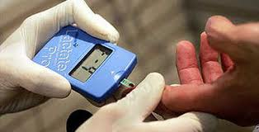
Lactate Sampling
http://www.youtube.com/watch?v=1QcIHRUELuY
What is it?
Measuring blood lactate levels - it is accurate!
Advantages?
Allows training intensity to be correct/ monitored over time
Lactate threshold can be established and training intensity can be set at a level just below this point (threshold training).
Can measure OBLA/ exhaustion point
Provides a comparisons with previous performance
Limitations?
Expensive
High degree of sport science support required – e.g. laboratory technicians, physiologists etc
Dangers of mis-interpretation/ unreliable results could lead to inefficient training intensities set
How is it done?
“Ramp test” increasing running speeds would be used, each lasting four minutes in duration.
Plot the lactate data against running speed, on a graph.
At first the increase in lactate with running speed is quite small, but beyond a certain point, this increase will become rapid. It is this point that is commonly referred to as the lactate threshold.
The higher the pace at which the lactate threshold occurs, the fitter the athlete is considered to be.
Which athletes?
Are used amongst elite performers in sports such as running, swimming and rowing
How does it measure energy expenditure?
The higher the blood lactate the more carbohydrate is being metabolised
The lower the blood lactate, the more fat is being burned
http://www.youtube.com/watch?v=8d4NPZNQLNo

Slide 22
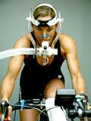
Respiratory Exchange Ratio (RER)
What is it?
The ratio of carbon dioxide produced to oxygen consumed
Also referred to as the Respiratory Quotient (RQ).
How is it done?
Athlete works whilst breathing into a respiratory gas analyser or Douglas Bag
The Respiratory Exchange Ratio (RER) is calculated.
A RER value (close to) 0.7 = a mix of carbohydrate and fat is being oxidised (aerobic respiration)
A RER value of (close to) 1.0 = only carbohydrate is being oxidised (anaerobic respiration)
Which athletes?
Any
Advantages?
Indicates the type of energy (carbohydrate, fats, protein) that your body is primarily oxidising
Tells you if you’re working aerobically/anaerobically (useful when monitoring training intensity)
Indicates energy requirement/dietary needs in your activity
Dis-advantages?
Expensive/equipment/ expertise required
Laboratory conditions – sport-specific? (validity?)
How does it measure energy expenditure?
Calculated from Ratio of Co2 versus O2 consumed
Lower value indicates fat burn/ aerobic energy expenditure
Higher value (close to 1.0) indicates more efficient anaerobic expenditure/ use of carbohydrates to re-synthesise ATP
http://www.youtube.com/watch?v=Be2VeQ2UHqY

Slide 23
Continuous
Fartlek
Continuous training with short elements of harder work
Hard work could involve sprint, change of terrain of a hill.
E.g. 30 mins run on treadmill but sprint or incline last 5 seconds of every minute
Good for team players or for preventing boredom
Steady-state exercise (approx. 70% of Max HR)
For at least 30 mins
E.g. 30 mins run on treadmill

Slide 24
Indirect Calorimetry
What is it?
Estimation of energy metabolism from measurements of carbon dioxide production and oxygen consumption.
Can be done during rest or steady-state exercise.
How is it done?
Resting or exercising athlete breathes into a respiratory gas analyser or Douglas Bag
Metabolic Cart calorimeter collects and quantifies the volume and concentration of O₂ inspired and CO₂ expired by the subject.
Resting Energy Expenditure is calculated by the Weir Formula:
Metabolic rate (kcal per day) = 1.44 (3.94 VO₂ + 1.11 VCO₂)
Results are displayed in software attached to the system
Which athletes?
Any
Advantages?
Non-invasive
Accurate
This method allows estimating REE and Basal Metabolic Rate
Allows for identification of energy substrates that are being predominantly metabolized by the body at a specific moment.
Therefore informs about overall energy and nutritional requirements of performers
Indicates energy requirement/dietary needs in your activity
Dis-advantages?
Expensive/equipment/ expertise required
Laboratory conditions – sport-specific? (validity?)
Software failure/loss of data storage
How does it measure energy expenditure?
Indirectly – from concentration of O2/Co2 in expired air
https://www.youtube.com/watch?v=cw9BWFMyO6s

Slide 25
VO2 Max Testing
What is it?
Calculation of the maximal amount of oxygen that can be utilised by the muscles in one minute.
Often tested indirectly/ estimated.
How is it done?
Athlete works on ergometer or treadmill
Intensity of work increases to exhaustion
Respiratory gas analyser or Douglas Bag used to collect expired air
Computer software calculates the volume and concentration of oxygen expired
Other tests use standardised values to predict or estimate VO2 max from test scores
Maximal tests include Multi-stage Fitness test, Cooper Run, Harvard Step test
Sub-maximal tests include Queens College Step Test
Which athletes?
Particularly useful to aerobic, endurance or team sports
Advantages?
VO2 max is a good predictor of actual performance in aerobic events (e.g. useful for team selection)
VO2 max can predict OBLA
Gas analysis is valid and reliable
Dis-advantages?
Other than gas analysis, tests are only predictive and therefore less valid and reliable than gas analysis
Maximal tests require subjects to work to exhaustion so these can cause fatigue/ interfere with training/give unreliable scores if participants do not give maximum effort
Gas analysis is expensive, requires expertise and can be prone to software error – need to be repeated
Difficult to replicate specific sport conditions in laboratory
How does it measure energy expenditure?
VO2 indicates how much ATP is being re-synthesised aerobically
Use of fats versus glycogen can be indicated from percentage of VO2 max
https://www.youtube.com/watch?v=fn3Yr-LS_l0

Slide 26
Exam practice:
A Rugby fitness coach is testing the VO2 max of his/her players.
Evaluate the use of different methods of testing VO2 max. [8]
Sample of student work:
VO2 Max can be defined as the maximum volume of oxygen that can be taken in and utilised by the body per minute. One way to measure VO2 max is by direct gas analysis in a laboratory. Using this method we would usually make a player run on a treadmill at increasing intensity until exhaustion and the air expired is analysed by computer software, such as Metabolic Cart. The volume and concentration of expired oxygen is calculated and compared against atmospheric air in order to establish how much oxygen has been used for the task. This method is a very accurate measure of VO2 max but the testing procedure may lack validity for Rugby performance because straight line running on a treadmill is very different to the way that energy is re-synthesised during a Rugby match. For example, in a Rugby match energy will also be expended in short sprints followed by short recover or by the upper body muscles and this is not measured in the laboratory conditions described.

Slide 27
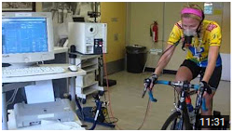
Metabolic cart – on YouTube
https://www.youtube.com/watch?v=cw9BWFMyO6s

Slide 28
Impact of SAQ Training on the anaerobic energy systems
Improved spatial summation (synchronisation)
Leading to Improved hypertrophy & recruitment of Fast twitch fibres (FTX)
These fibres have increased stores of PC & glycogen
PC system and Lactic acid systems can work at high intensity for longer before threshold is reached

Slide 29
