Slide 1
Sports Injuries

Slide 2
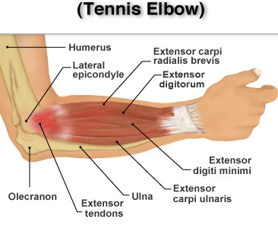
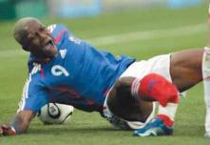
Types of injury
Acute
(fractures, dislocations, strains, sprains)
Chronic
(achilles tendonitis, stress fracture,‘tennis elbow’)

Slide 3
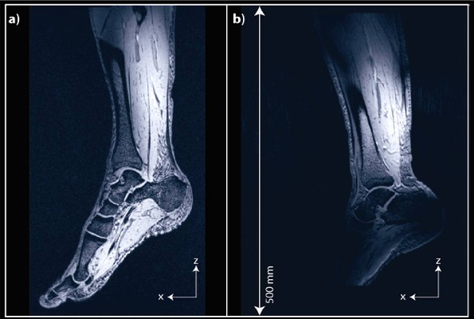
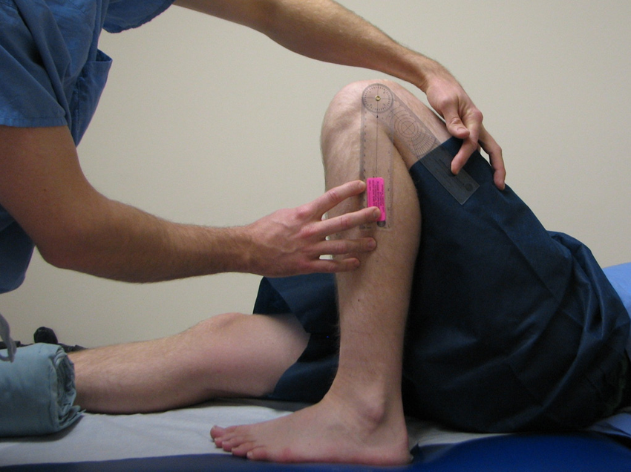
Screening
Imaging tests (X-rays, MRI scan) to rule out a bone fracture.
Tests for joint range of motion, postural alignment, muscle imbalances to indicate training needed to correct the problem and reduce the risk of injury.

Slide 4
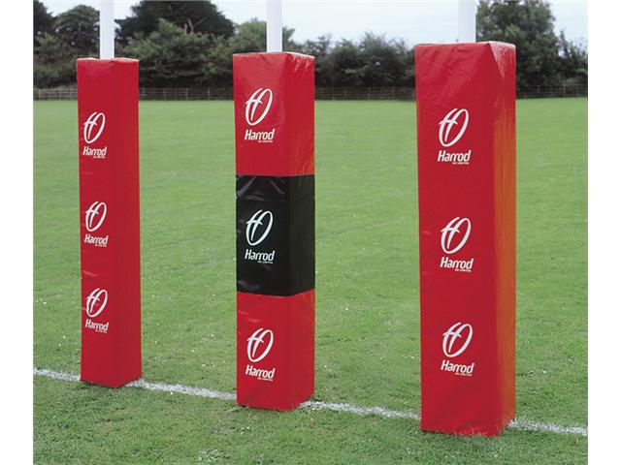
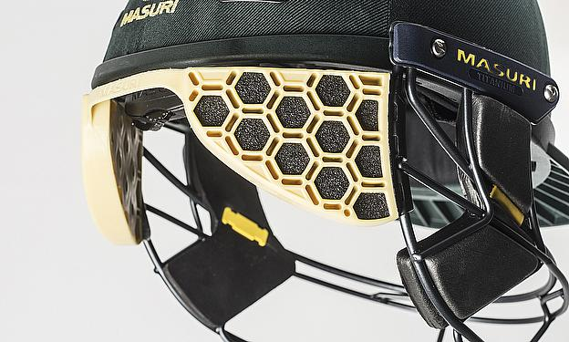
Protective equipment
E.g. Rugby post protectors reduce the risk of fractures from impact injury against the posts.
Protective clothing such as stem guard helmets in Cricket is often classed as protective equipment also.

Slide 5
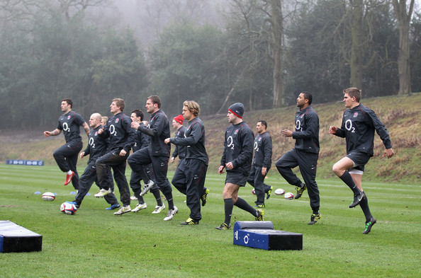
Warm-up
Increases the elasticity of muscles, tendons and ligaments helping to prevent sprains and strains due to an increased range of motion.
More synovial fluid released in the joints reduces wear and tear associated with chronic joint problems (e.g. Achilles tendonitis).
Also improves psychological readiness, alertness and reaction time

Slide 6
Flexibility training
Use of active, passive, static and ballistic stretching
Results in increased resting length of muscles and connective tissues
Increases joint range of motion and reduces resistance to movement.
Less likely to suffer strains.

Slide 7
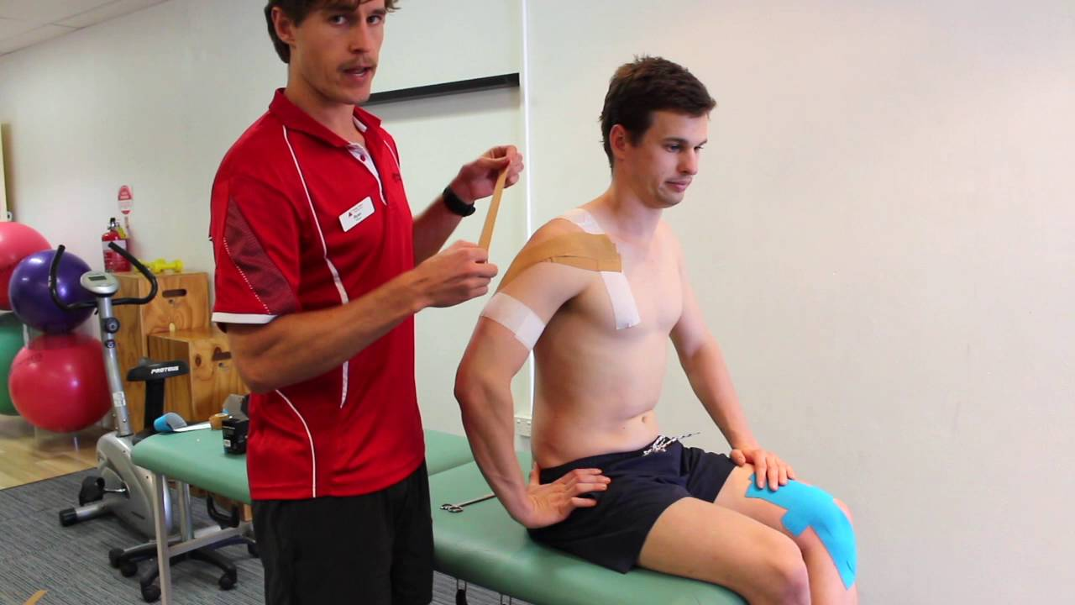
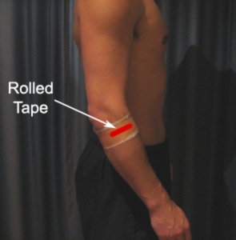
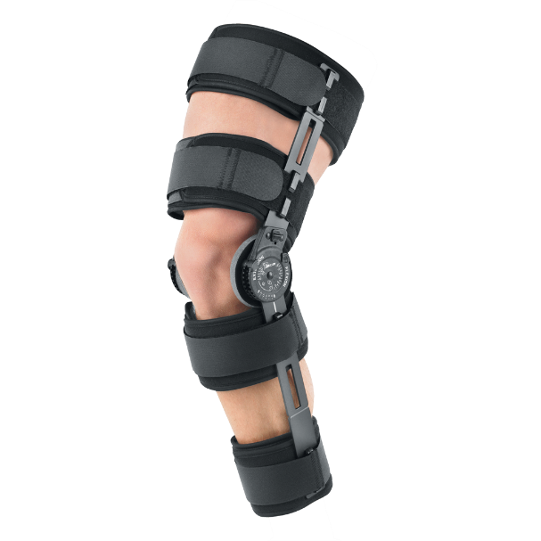
Taping and bracing
Taping can help with support and stability at shoulder joint to prevent dislocation and can also be used to prevent worsening of ‘tennis elbow’.
Bracing is more substantial and prevents
further injury after an operation.

Slide 8
Physiological Adaptations to Flexibility Training
Prevention of injuries
Adaptations result in:
Increased joint range of movement (ROM) prevents over-stretch injuries e.g. hamstring tears
Decreased resistance to joint movement.
Changes to skeletal muscle
Increased resting length of the muscles
Changes to connective tissue.
Increased resting length of the tendons and ligaments.

Slide 9
Step 1
13
Ex Phys
Here, the individual performs a passive stretch with the help of a partner and extends the leg until tension is felt.
This stretch is detected by the muscle spindles. If the muscle is being stretched too far then a stretch reflex should occur.

Slide 10
Step 2
13
Ex Phys
The individual then isometrically contracts the muscle for at least 10 seconds (by pushing their leg against their partner).
Golgi tendon organs are also sensitive to tension developed in a muscle and during an isometric contraction send an inhibitory signal which overrides the excitory signal from the muscle spindle and inhibits the stretch reflex.

Slide 11
Step 3
13
Ex Phys
There is further relaxation of the target muscle as a result and it can be stretched further (increased ROM).

Slide 12
Explain the use of PNF stretching to improve performance and prevent injuries. [8]
AO1 – Knowledge of PNF [2]
Involves passive/static stretch
Followed by isometric contraction or hold phase
Followed by further stretch
AO2 – Application of PNF to prevention of injury and performance improvement [3]
Eg PNF leads to increased resting length of muscle/ connective tissue
A gymnast will have greater ROM at hip and can perform a splits
Eg Reduction in antagonist inhibition

Slide 13
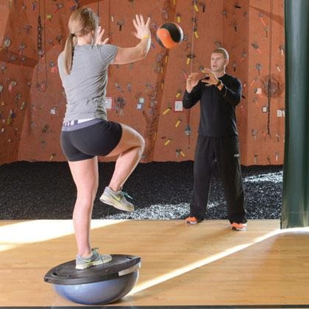
How/why do we train it? = using balance exercises to restore lost proprioception after a joint injury e.g. ankle sprain
What is Proprioception? subconscious process using a system of receptor nerves (proprioceptors) located in the muscle, tendons and joints to provide information about the body’s position.

Slide 14
Strength training for rehabilitation
https://www.youtube.com/watch?v=OsRKIEWLjr8

Slide 15
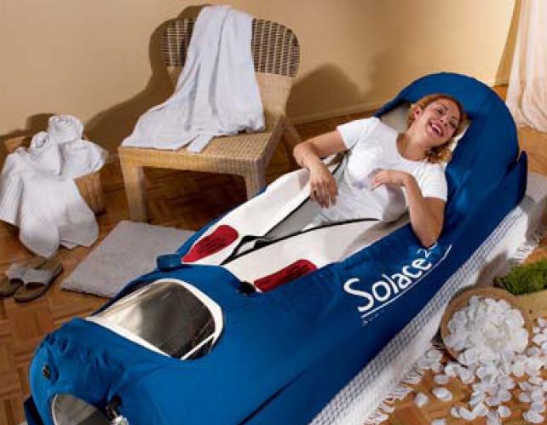
Hyperbaric chambers
How does it work?
The chamber is pressurised
This increases the amount of O2 that can be breathed in
Haemoglobin is fully saturated with O2
More oxygen can be diffused to injured area
Effects?
Reduces swelling
Formation of new blood cells
Increases white cell activity at injured site
http://www.youtube.com/watch?v=j5TpSj3_Ggg

Slide 16
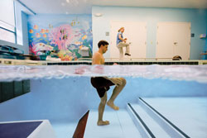
Hydrotherapy
How does it work?
Takes place in warm water to aid circulation
Squats, lunges, walking and running in water
Buoyancy of water supports body weight
Reduces load and impact on joints
Effects?
Exercising against the resistance allows for gradual strengthening of the injured area.
Allows more movement than is permitted on land
Improves blood circulation, relieves pain and relaxes muscles.

Slide 17
Ice baths
How does it work?
After high intensity/ impact work
Done for 5 – 10 minutes -usually broken up into ‘hot and cold’ sessions (2 mins ‘hot’ followed by 1 min in cold bath)
Cold water causes the blood vessels to constrict and this drains the blood out of the legs
On leaving the bath, muscles fill up with new oxygenated blood helping the cells function better
Effects?
Aids in removal (‘flushing out’) of lactic acid from muscles
Reducing soreness (DOMS)
Can be unpleasant at the time
http://www.youtube.com/watch?v=-VIi0deVWGo

Slide 18
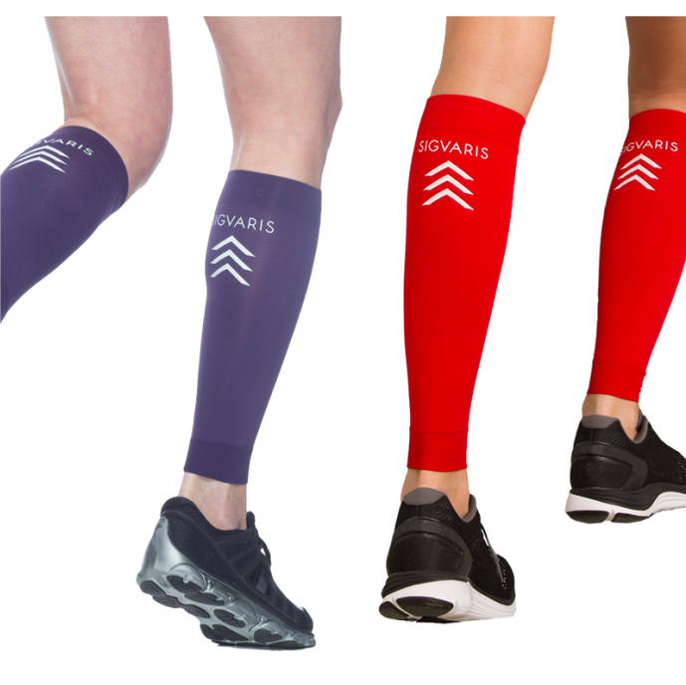
Compression garments
How does it work?
Medical grade compression garments worn
Apply external pressure to squeeze muscles and blood vessels during exercise
Effects?
Improve blood circulation – assist venous blood flow
Assists blood lactate removal
Reduce DOMS

Slide 19
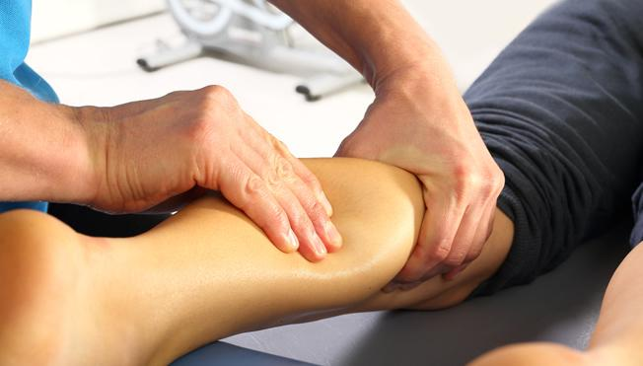
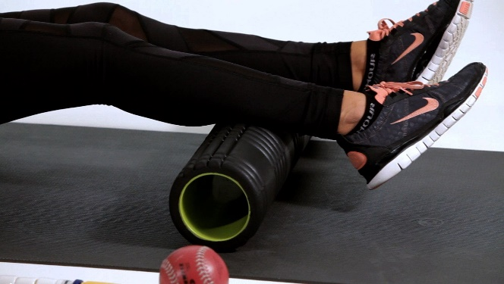
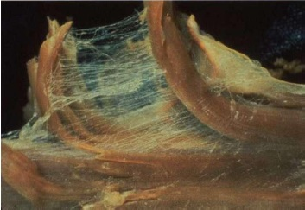
Massage & Foam Rolling
Release tension & tightness in the muscle (myofascial release) so improves joint mobility
Speed up removal of waste products like lactic acid
Breaks down scar tissue caused by tissue damage
Increased blood flow speeds up delivery of nutrients for repair of tissues
Fascia connecting individual muscle fibres.

Slide 20
DOMS (Delayed Onset of Muscle Soreness)
Occurs due to the structural damage to muscle fibres and connective tissue surrounding the fibres.
Occurs 24-48 hours following excessive eccentric contraction when muscle fibres are put under a lot of strain.
This type of muscular contraction is performed mostly during weight training and plyometrics.
A thorough warm-up and cool-down can help to avoid / reduce DOMS.
DOMS can also be reduced by minimising eccentric muscle contractions early in the session and ensure training intensity is increased gradually.
Ice baths and massage / foam rolling can also be used.

Slide 21
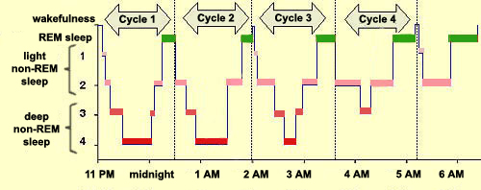
Importance of Sleep for Recovery
During sleep, rebuilding of damage to muscles occurs
Most of the re-building occurs in during deep sleep
The deepest part of sleep is the third stage of non-REM sleep
where brain waves are at their slowest and blood flows from the brain to the muscles to restore.
If sleep is too short then time for muscle repair is limited.

Slide 22
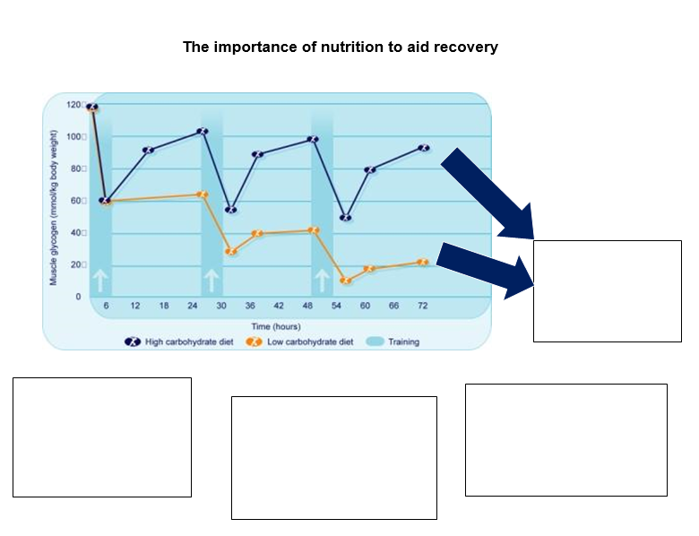
Muscle glycogen stores are depleted during training and need to be replenished after
Eating glycogen in the first 20-minutes after exercise enhances performance the next day
Liquid can be absorbed much more quickly that solids and also helps to rehydrate.
Consume 4:1 ratio of carbohydrate to protein (e.g. Sardines on toast or chocolate milk) as protein helps with re-synthesis of glycogen

Slide 23
Re-cap quiz
Hyperbaric chambers increase the pressure of O2 at the injury site. Why does this benefit the rehabilitation of the injured area? [2]
Reduces swelling at site
Raises activity of white blood cells
Define and give an example of a chronic sports injury [2]
long-term/over-training/over-use/repetitive strain injury
E.g. tennis elbow/ stress fracture/or equiv
How are ice baths beneficial to a Rugby player’s recovery from playing? [3]
Constriction of veins/blood vessels/muscle pump
Recover faster/faster removal of waste products e.g. lactic acid
Reduction of DOMS/reduces inflammation/swelling/pain
Allows them to train more frequently
How can a performer be rehabilitated from a soft tissue injury such as a muscle strain? [4]
A. R – rest, I – Ice, C – Compression / comfort, E – Elevation
B. Massage
C. Strength training/ conditioning
D. Flexibility training/ stretching/ PNF
E. Cryotherapy
F. Proprioceptive training

Slide 24
Re-cap quiz
Outline the causes of DOMS? (3)
Explain the positive impacts of foam-rolling (2)
What is the difference between an acute injury and a chronic injury? (1)
Sketch vector diagrams for a shot and a shuttle in flight (4)

Slide 25
Essay practice
Evaluate the use of different cryotherapy methods in injury rehabilitation and recovery from exercise for Rugby players. [8]
AO1
Cryotherapy = the use of cooling/ cold temperatures to treat injury
Ice packs
Ice baths
Whole body cryotherapy chambers
AO2
Eg Rugby players apply ice pack to swollen ankle as part of RICE treatment of acute injuries/strains or sprains
Eg After exercise, Rugby players wear protective swimming costume, socks, gloves etc
Immersed in liquid nitrogen to below – 100 degrees
For up to 3 mins.
Blood from arms and legs flows to the core to vital organs
AO3
+ Reduces swelling
+ limits pain and inflammation
Possibility of ice burns
Danger of more pain if pack is compressed to much or if bone is broken
+ On leaving the chamber, blood returns to arms and legs full of oxygen which helps heal injured cells.
+ Faster recovery means players are able to train/play again sooner
- Expensive
AO1 (sub-max 1 mark)
• Involves sitting in ice cold water for between 5–20 minutes / physiological explanation regarding vasoconstriction to extremities / limbs / vasodilation occurs after leaving the ice bath / flush of oxygen rich blood (1).
AO3 (sub-max 3 marks)
• Long arduous training for a marathon can result in a build-up of lactic acid which can be removed as a result of ice bath use (1).
• Strong belief in the physiological benefits for such athletes / the general theory behind this cold therapy is that the exposure to cold helps to combat the microtrauma (small tears) in muscle fibres and resultant soreness caused by intense or repetitive exercise / reduce swelling (1).
• Fairly easy to incorporate into training routine – simply needs some preparation of large water container and ice, eg wheelie bin (1).
• Not completely proven to aid recovery / some evidence suggests that cold water is effective rather than ice cold (1).
• Other recovery methods may be better / easier / less extreme, eg cool down and massage / cool down and foam rolling, etc (1).

