Slide 1
Pub Quiz
The Elbow joint is used when performing a Dumbbell curl. State the joint type and articulating bones at the elbow.
What is the type of contraction used to lower the dumbbell down slowly. [3]
2. What type of joint is the ankle and what movements can it perform? [3]
3. The knee and hip are both used when striking a football. For each joint, name an agonist muscle used when executing the ball strike and state the movement created. [4]
4. When performing ‘jumping jacks’ the shoulder moves though abduction (up) and adduction (down). Name any two other movements that can be performed by the shoulder joint in sport. [2]

Slide 2
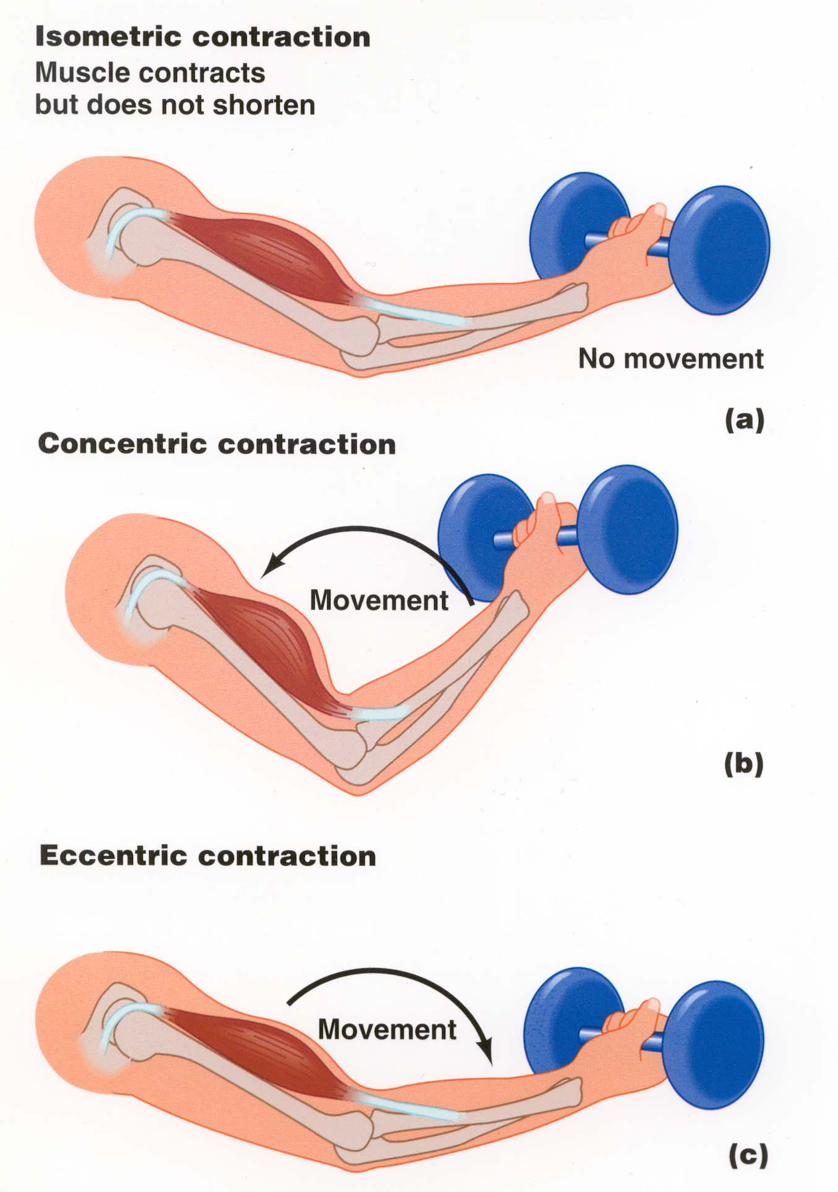
Types of Contraction
ISOMETRIC CONTRACTION =
No change in muscle length
CONCENTRIC CONTRACTION =
Muscle shortens
In the down phase, what muscle is the agonist/ prime mover?
ECCENTRIC CONTRACTION =
Muscle lengthens

Slide 3
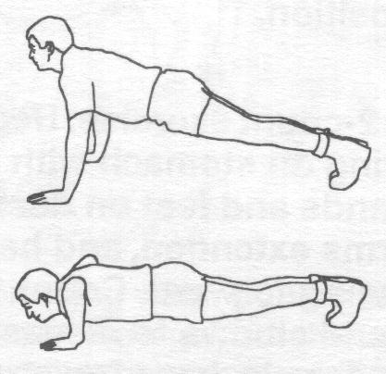
1
2
3
Down Phase
Up Phase
Holding in the down phase
-
 | Movement at elbow | Muscle contracting | Type of contraction
1
2
3
Flexion
Triceps Brachii
Eccentric
Extension
Triceps Brachii
Concentric
None –
Fixed in Flexion
Triceps Brachii
Isometric

Slide 4


Slide 5
Re-cap quiz
Name the three planes of motion [3]
Describe the three types of muscular contraction [3]
State the plane and axis of movement that occurs at the knee during running. [2]
Fill in the information for the upward phase of a dumbbell curl: [3]
Agonist muscle =
Antagonist muscle =
Contraction type =

Slide 6
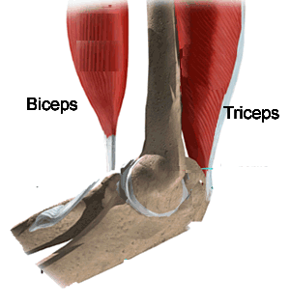
Levers
1st Class Levers – the fulcrum is between the effort and the load/resistance.
Triceps
Brachii
F
Biceps
Brachii
Effort Load/ resistance
Fulcrum
E
L
This type of lever can increase the effects of the effort and the speed of a body. An example of this type can be seen in the action of extending the elbow in a push-up or over-arm throw.

Slide 7
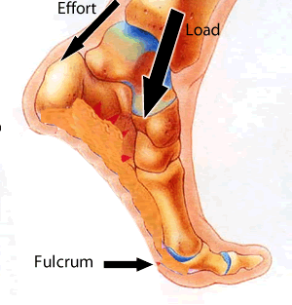
Levers
2nd Class Levers – the load (resistance) is between Fulcrum and the Effort
Effort
Load
Effort
Load
Fulcrum
This type of lever is generally thought to increase only the effect of the effort force (i.e. it can be used to overcome heavy loads). Plantarflexion of the ankle involves the use of a second order lever.
Fulcrum

Slide 8
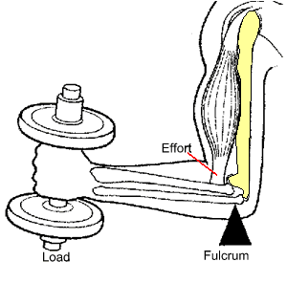
Levers
3rd Class Levers –the Effort is between the Fulcrum and the Load
They are responsible for the majority of movements in the human body. They can increase the body’s ability to move quickly but in terms of applying force they are very inefficient.
Effort
Load
Fulcrum
Effort
Can be seen in the elbow during flexion in the upward phase of a bicep curl.
Fulcrum
Load

Slide 9
Mechanical Advantage
2nd class levers are at a mechanical advantage because the effort arm is longer than the load arm.
This means that heavy loads can be moved with less effort/force.
Consider pushing a door open…..

Slide 10
Mechanical Disadvantage
1st and 3rd Class levers are at a mechanical disadvantage because the load arm is longer than the effort arm.
Most levers in the body are 3rd class levers.
The longer the resistance arm of the lever, the greater the speed at the end of it.
This is why a ball will accelerate more if we throw it with a fully extended arm or use a racquet/bat to extend the resistance arm.

Slide 11
1, 2 or 3?
For 1, 2 or 3 think ‘F,L,E!’

