Slide 1


Slide 2
Characteristic | Function | So what?
High Mitochondrial density High Myoglobin content High capillary density | Large site for aerobic metabolism / respiration. Transport large amounts of oxygen from cell membrane to mitochondria. Transport large amounts of oxygen to muscle cell for aerobic respiration. | Performer can work for longer or at higher intensities without producing too much lactic acid and suffering from muscle fatigue. Eg… Very low fatigability

Slide 3
Characteristic | Function | So what?
Large motor neurone and fast conduction capacity Large Phosphocreatine stores Large glycogen stores Very high myosin ATPase activity | Fast speed of nerve impulse Large immediate stores of energy within the muscle fibre Very fast reactions to release energy | Very fast speed of contraction, well suited to explosive activities such as chest pass, bowling a cricket ball etc. If pass is explosive, it gives less time for defender to intercept the ball.

Slide 4
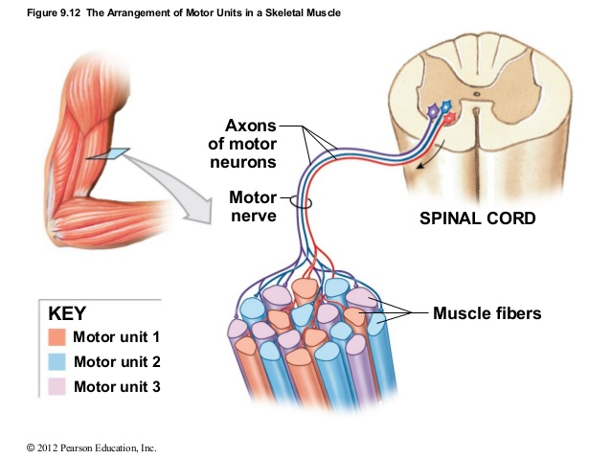

Slide 6
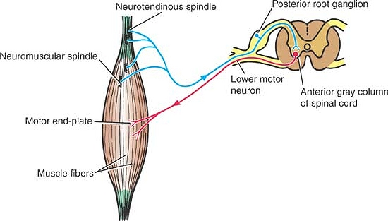
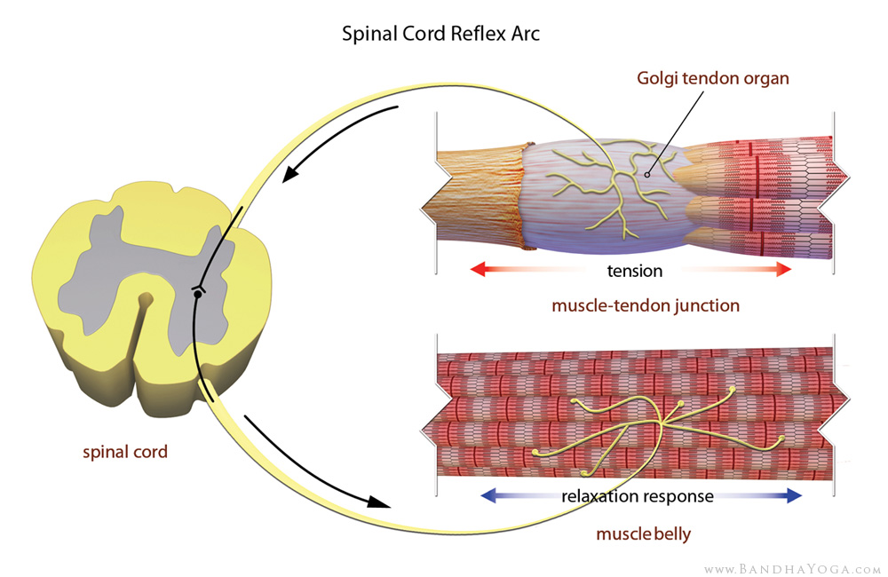
Muscle Spindle detects stretch and creates contraction
Golgi Tendon Organ senses the contraction and inhibits the muscle spindle signal

