Slide 1

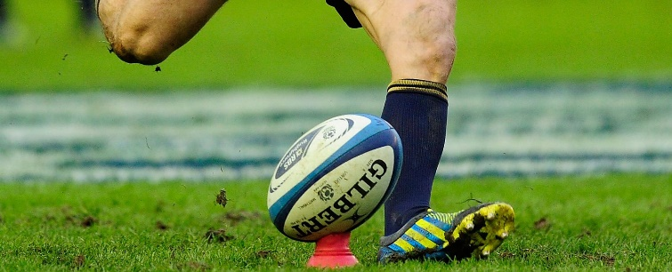
Force
A push or a pull that alters, or tends to alter, the state of motion of a body.
A force can:
Cause a body at rest to move. For example……..
Cause a moving body to change direction, accelerate or decelerate. For example………
Change an object’s shape. For example……..

Slide 2
Newton’s First Law of Motion
The law of Inertia states:
“A body will continue in a state of rest or of uniform velocity unless acted upon by an external force”
Sports Example?

Slide 3
Newton’s Second Law of Motion
The law of acceleration states:
“When a force acts on an object, the rate of change of momentum experienced by the object is proportional to the size of the force and takes place in the direction in which the force acts.”
Sports Example?

Slide 4
Newton’s Third Law of Motion
This states that :
“For every action there is an equal and opposite reaction.”
Sports Example?

Slide 5

Start Timer
10 Minutes
10
8
6
4
2
0

