Slide 1

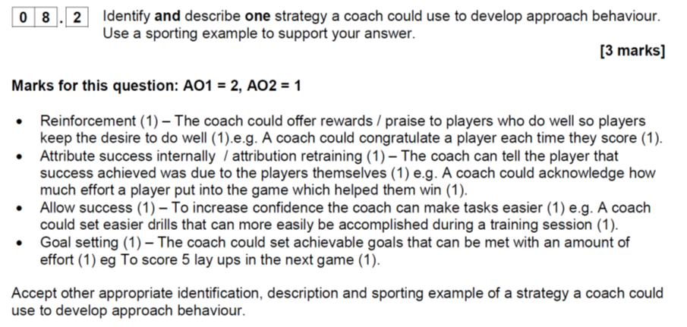

Slide 2
Attribution Theory
‘Perceived causes of events and behaviours’ (Gill 1986)
‘The reasons we give for success or failure’ (Bonney 2006)
The reasons we give for our own behaviour and that of others.
Task
Get your phones / google out and, in pairs, play a game of your choice. After one go each, write down why you won or lost.

Slide 3
What does this mean for sports performer?
Weiner believes that the difference between high and low achievers is the way in which they attribute success and failure.

Slide 4
Lets play Family Fortunes to find the correct attributions. A hundred sports people were asked, “What was the reason for you winning or losing? The survey said:
X
4 answers
1
Ability
X
2
Effort
3
Task Difficulty
X
4
Luck
You bunch of losers!
According to Weiner (1974) these are the four main categories of attributions for winning or losing.

Slide 5
Weiner continued his theory by saying these attributions can be divided into two dimensions
Locus of Causality
where the performer believes the reason to lie – can be internal (ability & effort) or external (luck & task difficulty)
Stability
is the attribute likely to change next time – can be stable (ability & task difficulty) or unstable (effort & luck)

Slide 6
Locus of Causality
Internal External
Ability
“We were too good for the opposition”
Task Difficulty
“They were from a league below us.”
Stability
Unstable Stable
Effort
“All the team worked hard and pulled together”.
Luck
“The umpire made a questionable decision to give us that penalty flick”

Slide 7
If you win: attribute success to internal, stable attributes such as ability – feel confident, proud
If you lose: attribute failure to external, unstable attributes such as luck – prevents shame and lack of confidence.
However!!

Slide 8
It would be wise to look at a third dimension of Control. Performers do not have control of luck, opposition and so on but they do control the effort box.

Slide 9
Learned Helplessness – Dweck (1975, 1980)
Learned helplessness is a feeling that failure is:
  Inevitable
  Out of your control
It can be:
  Specific Learned Helplessness eg I am rubbish at penalty flicks.
  Global / Universal Learned Helplessness eg I am rubbish at Hockey / all sports.
It is caused by attributing failure to internal, stable factors such as ability.

