Slide 1
Projectile Motion
3.4.1 Mechanics

Slide 2
Aims
Scalars and Vectors
2-D motion
Projectile Motion

Slide 3
Scalars
Scalars are quantities which only have a numerical value
Examples are:
25 s, 3.4 miles and 1 x10¹⁰ stars approx. in a galaxy
The size of a scalar is called the magnitude

Slide 4
Vectors
As we have seen, vectors have magnitude and direction
Such as: displacement, velocity and acceleration

Slide 5
Question
5 m
30 ms⁻¹ East
5 mi North
20 degrees Celsius
256 Bytes
4000 Calories

Slide 6
Question
5 m | Scalar
30 ms⁻¹ East | Vector
5 mi North | Vector
20 degrees Celsius | Scalar
256 Bytes | Scalar
4000 Calories | Scalar

Slide 7
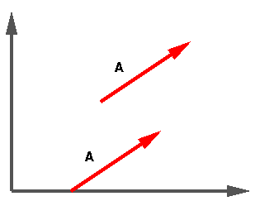
Vectors
We use vector diagrams to visualise what is going on in a physical system
Even though we can work out most problems algebraically, a picture can help point out subtleties of a problem

Slide 8
Vectors
We are concerned with 2 concepts in this picture:
Tip and Tail vectors – basically arrows help us understand their direction
Vectors which have the same direction and magnitude can be easily manipulated

Slide 9
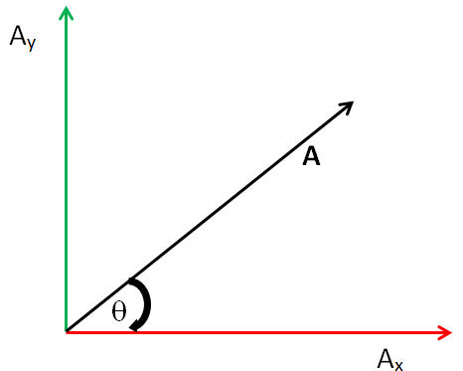

Vector Components
$\left|A\right|=\sqrt{A_{x}^{2}+A_{y}^{2}}$
$A_{x}=\left|A\right|\cos{θ }$
$A_{y}=\left|A\right|\sin{θ }$
$θ=\tan^{−1}{\frac{A_{y}}{A_{x}}}$

Slide 10
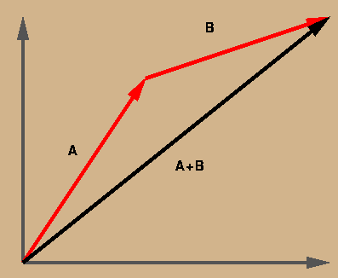
Vector Addition
The following diagram illustrates a vector sum. Notice that we may move the tail of the second vector to the tip of the first vector to get the resultant vector
It does not matter which vector is moved, as long as the are tip-to-tail with each other

Slide 11
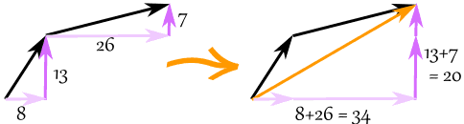
Vector Addition
We add vectors by adding the x parts then adding the y parts
a = (8,13) and b = (26,7)
c = a + b
c = (8,13) + (26,7) = (8+26,13+7) = (34,20)

Slide 12
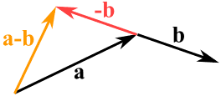
Subtracting Vectors
Remember: to subtract, first reverse the vector we want to subtract, then add
k = (4,5) from v = (12,2)
a = v + −k
a = (12,2) + −(4,5) = (12,2) + (−4,−5) = (12−4,2−5) = (8,−3)

Slide 13
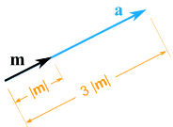
Multiplying Vectors with Scalars
multiply the vector m = (7,3) by the scalar 3
a = 3m = (3×7,3×3) = (21,9)

Slide 14
Question
A telephone pole support cable is in the way of some construction workers. In order for the work to proceed, the cable must be moved 2 metres closer to the pole. If the pole is 10 metres tall and the cable is currently fastened to the ground 8 meters from the pole, how much will the workers need to cut off from the cable when they move it?

Slide 15
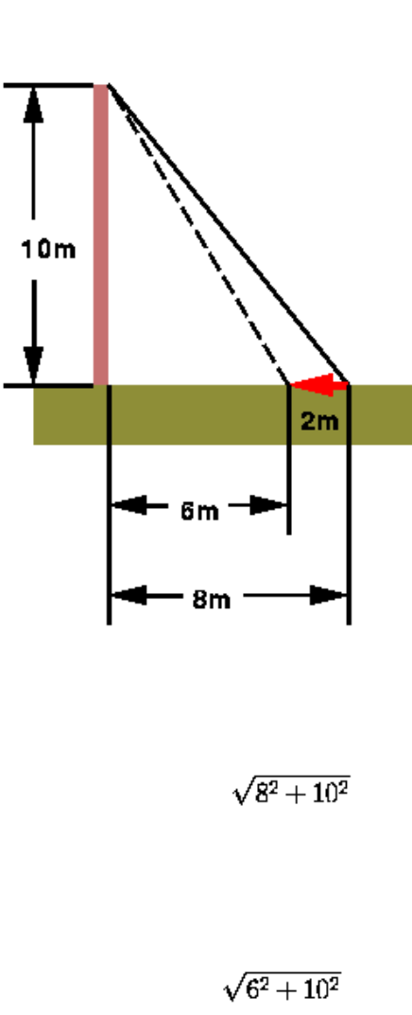
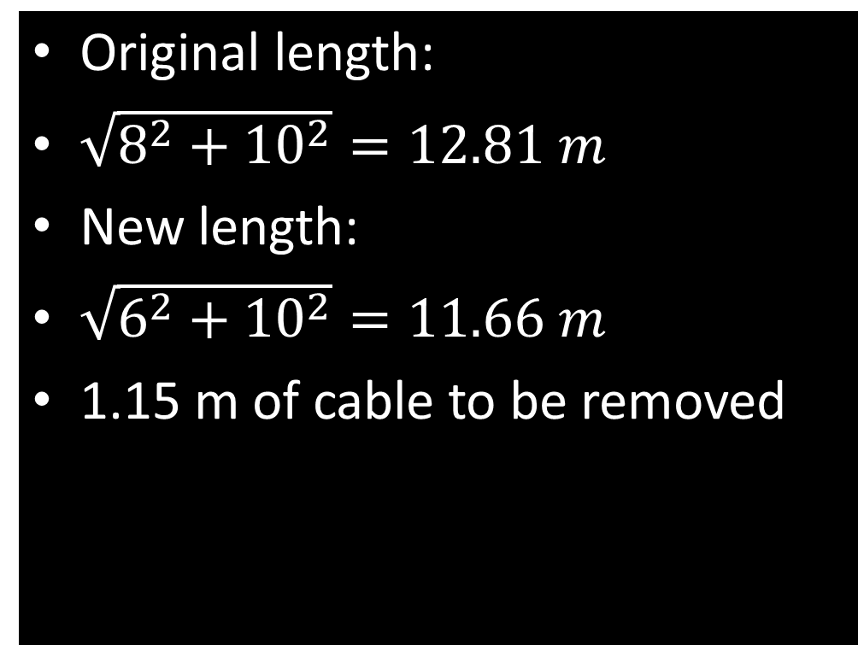
Answer
Original length:
$\sqrt{8^{2}+{10}^{2}}=12.81 m$
New length:
$\sqrt{6^{2}+{10}^{2}}=11.66 m$
1.15 m of cable to be removed

Slide 16
Question
A cross-country skier skis 1.00 km north and then 2.00 km east on a horizontal snowfield.
How far and in what direction is she from the starting point?

Slide 17

Answer
$\sqrt{{1.00}^{2}+{2.00}^{2}}=2.24 km$
$\tan^{−1}\left(\frac{1.00}{2.00}\right)=26.6^{o}$

Slide 18
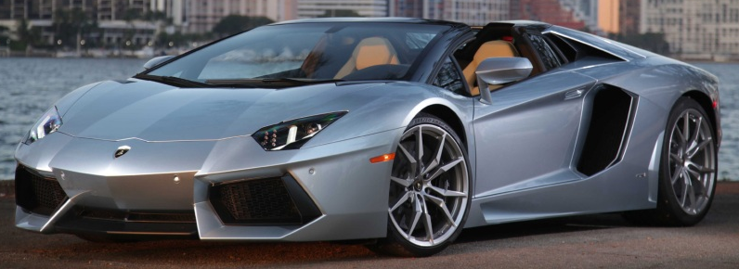
Hard Question
Three players on a reality TV show are brought to the centre of a large, flat playing field. Each is given a metre stick, a compass, a calculator, a shovel and (in a different order for each contestant) the following instructions:
A: 72.4 m, 32.0º east of north
B: 57.3 m, 36.0º south of west
C: 17.8 m due south
At the specified location, a Lamborghini Aventador is buried! Two contestants go crazy and dig up everything, but the winner calculates where to go, what does she calculate?

Slide 19
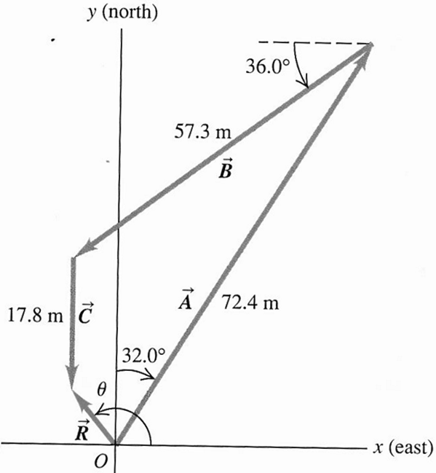
Answers

Slide 20
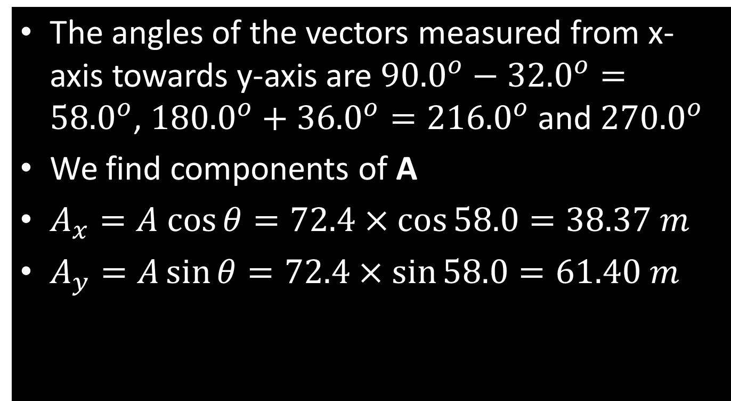
Answer
The angles of the vectors measured from x-axis towards y-axis are ${90.0}^{o}−{32.0}^{o}={58.0}^{o}$, ${180.0}^{o}+{36.0}^{o}={216.0}^{o}$ and ${270.0}^{o}$
We find components of A
$A_{x}=A cos{θ}=72.4×\cos{58.0}=38.37 m$
$A_{y}=A\sin{θ}=72.4×\sin{58.0}=61.40 m$

Slide 21
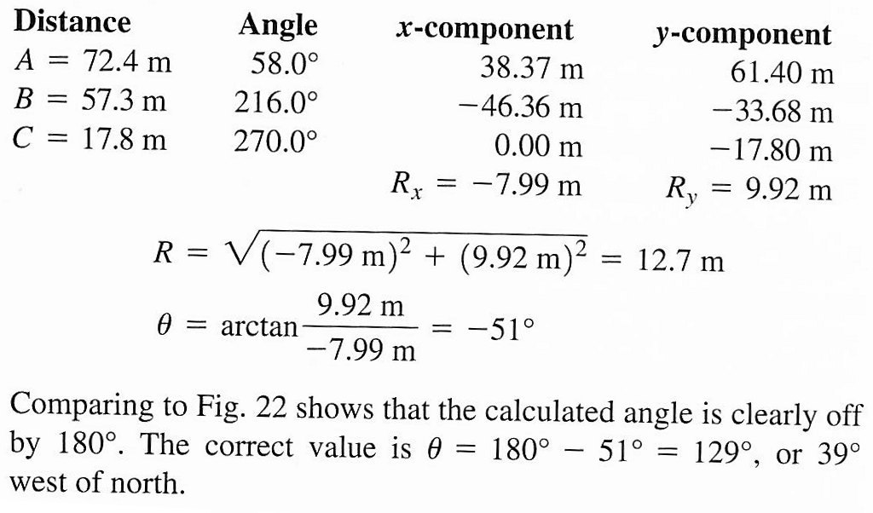
Answer
All displacements are:

Slide 22
Projectiles
Any object which is only acted upon by gravity is a projectile

Slide 23
Key Assumptions
1. The acceleration of the object is always equal to g and is always downwards
2. The horizontal velocity of the object is constant because the acceleration of the object does not have a horizontal component
3. The motions in the horizontal and vertical directions are independent of each other

Slide 24
2-D Motion
Remember that projectile motion is essentially motion in 2 directions: x and y
Both components are independent of each other

Slide 25
Velocity in 2-D Motion
We have seen velocity in 1-D
Remember velocity is a vector – so has direction
In 1-D we only considered v along the x-axis normally, but in 2-D we also move in the y-axis

Slide 26
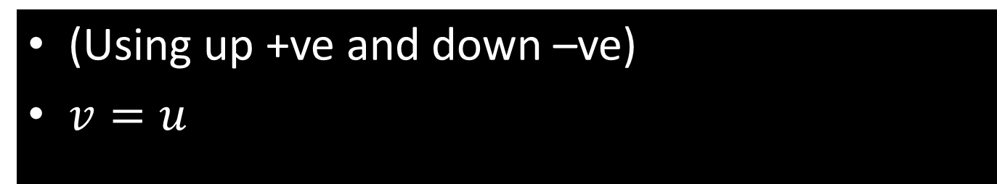
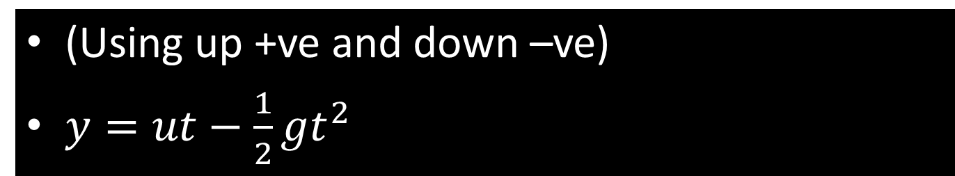
Vertical Aspects
(Using up +ve and down –ve)
$y=ut−\frac{1}{2}{gt}^{2}$
Horizontal Aspects
(Using up +ve and down –ve)
$v=u$

Slide 27
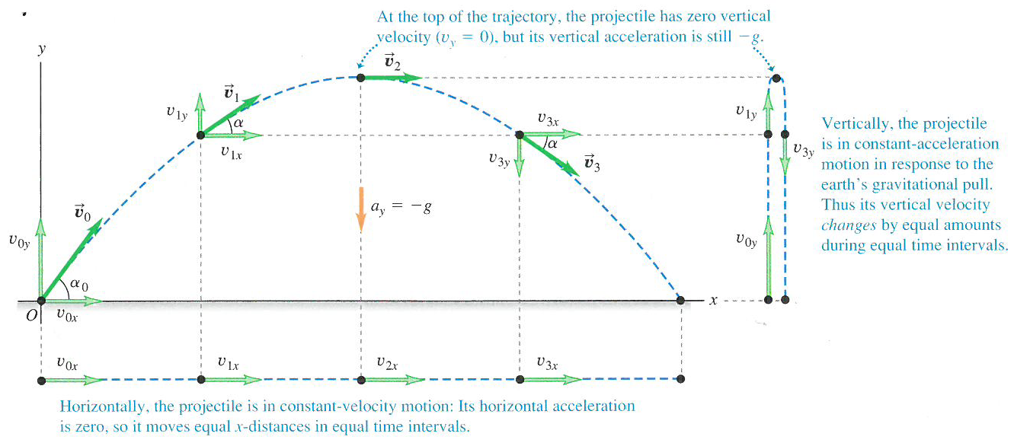
Horizontal and Vertical Together

Slide 28
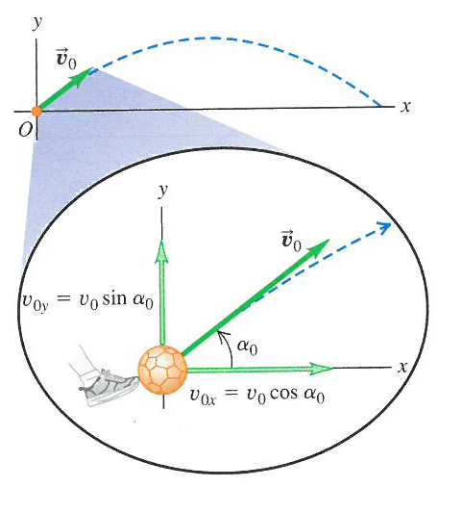
Horizontal and Vertical Together

Slide 29
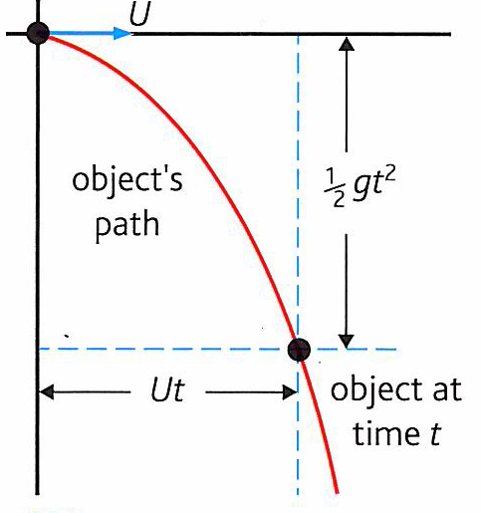
Projectile Motion without Up!
In some cases, projectile motion is a result of horizontal and downwards motion but not up

Slide 30
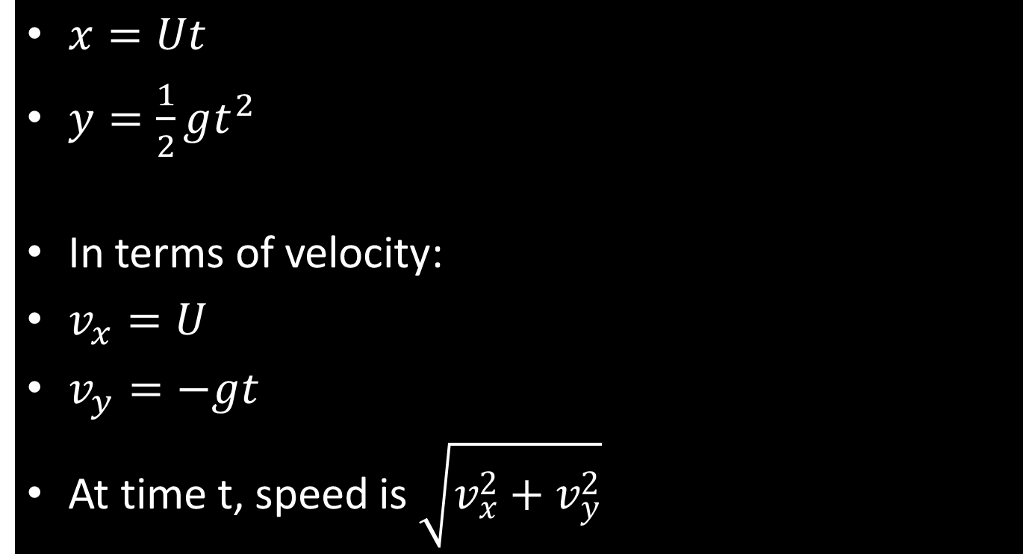
Projectile Motion without Up!
$x=Ut$
$y=\frac{1}{2}gt^{2}$
In terms of velocity:
$v_{x}=U$
$v_{y}=−gt$
At time t, speed is $\sqrt{v_{x}^{2}+v_{y}^{2}}$

Slide 31
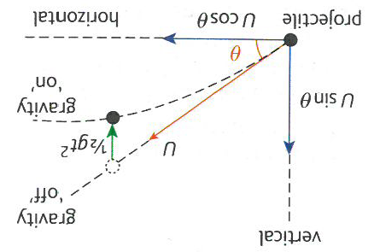
Gravity

Slide 32
Question
An object is projected horizontally at a speed of 15ms⁻¹ from the top of a tall tower of height 35.0m
a) how long does it take to fall to the ground?
b) How far does it travel horizontally?
c) What is its speed just before impacting the ground?

Slide 33
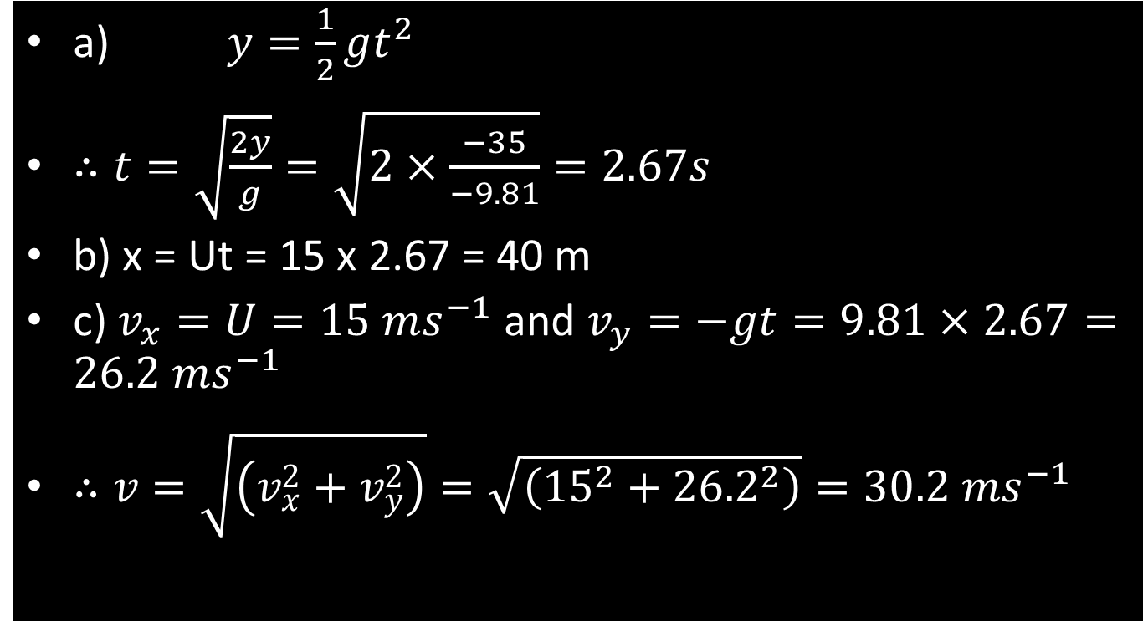
Answer
a) $y=\frac{1}{2}gt^{2}$
$∴t=\sqrt{\frac{2y}{g}}=\sqrt{2×\frac{−35}{−9.81}}=2.67s$
b) x = Ut = 15 x 2.67 = 40 m
c) $v_{x}=U=15 ms^{−1}$ and $v_{y}=−gt=9.81×2.67=26.2 {ms}^{−1}$
$∴v=\sqrt{\left(v_{x}^{2}+v_{y}^{2}\right)}=\sqrt{\left({15}^{2}+{26.2}^{2}\right)}=30.2 {ms}^{−1}$

Slide 34
Questions
1 to 4 page 129

Slide 35
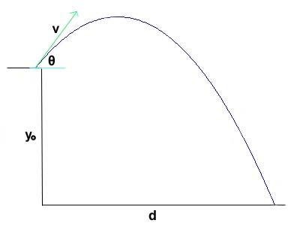
Projectile Height, Range and Angle
Knowing how projectile motion actually occurs is one thing
Knowing how far the projectile will go is another!

Slide 36
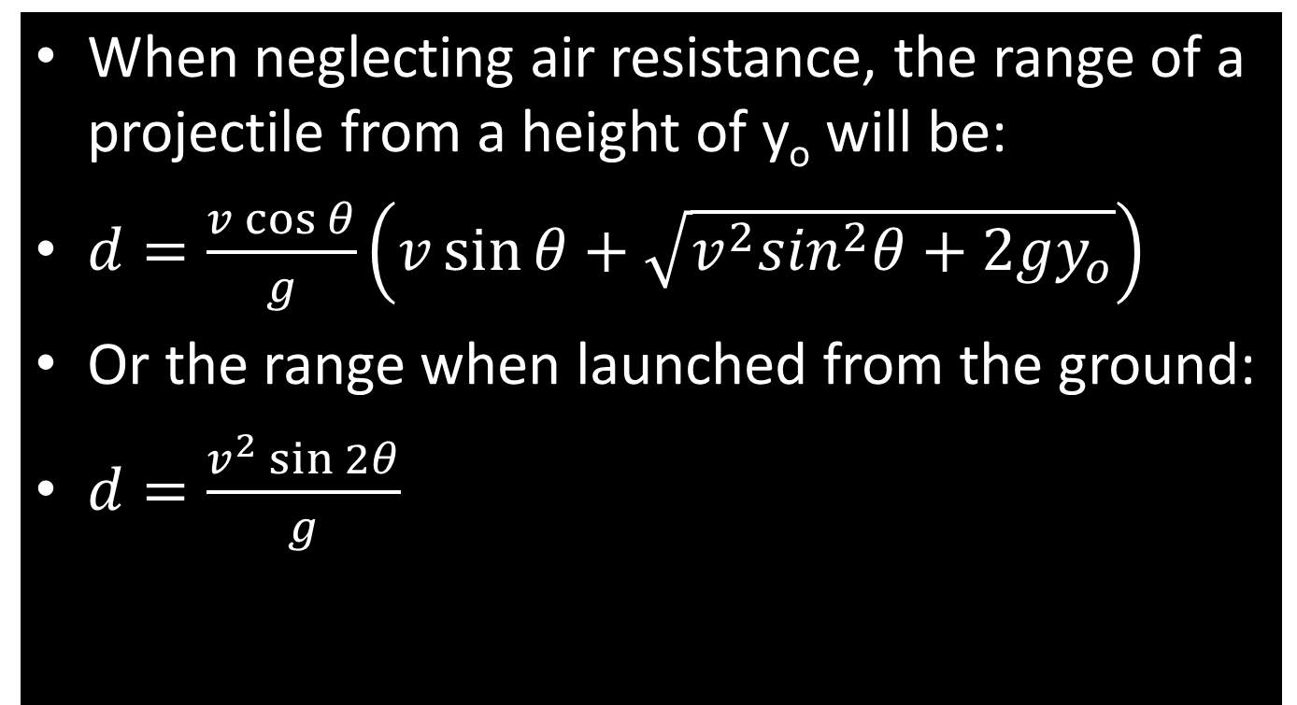
Projectile Height, Range and Angle
When neglecting air resistance, the range of a projectile from a height of y_{o} will be:
$d=\frac{v\cos{θ}}{g}\left(v\sin{θ+\sqrt{v^{2}\sin^{2}θ+2gy_{o}}}\right)$
Or the range when launched from the ground:
$d=\frac{v^{2}\sin{2θ}}{g}$

Slide 37
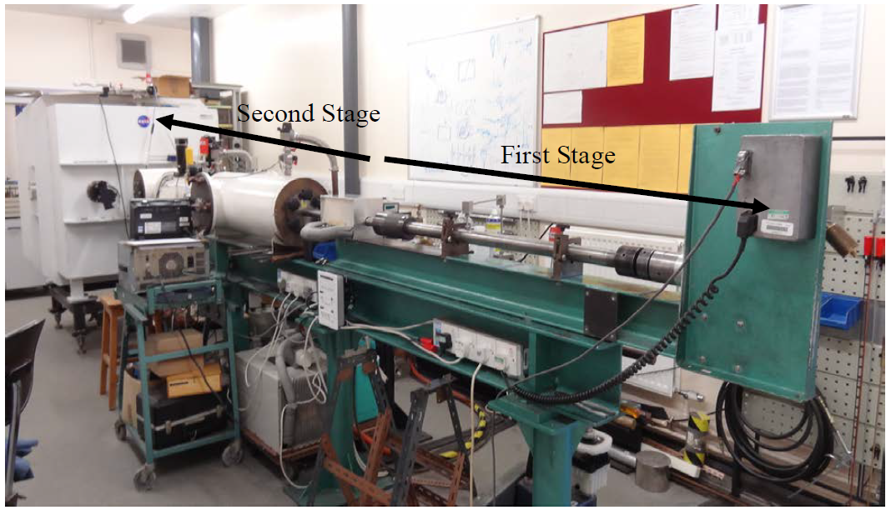
Back of Envelope Calc!

Slide 38
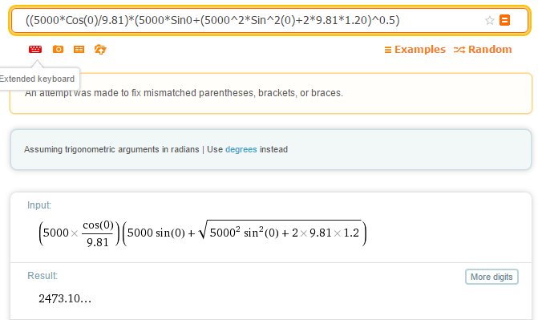
2-Stage Light Gas Gun Projectiles

Slide 39
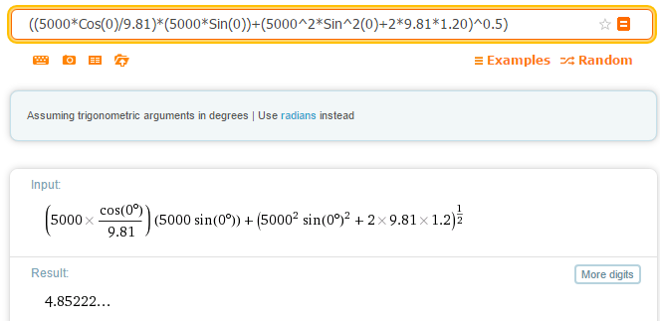
But….

Slide 40
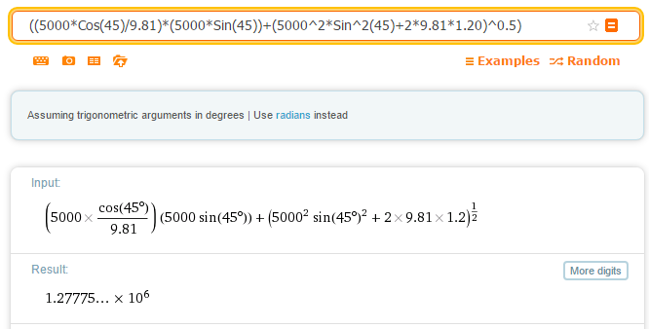
2-Stage Light Gas Gun Projectiles (45º)

Slide 41
Question
Find the optimum launch angle for projectiles fired from the ground at a constant velocity of 300 ms⁻¹
Make a suitable plot of the data you obtain

Slide 42
Answer
Velocity ms⁻¹ | Angle º | Range (m)
300 | 0 | 0
 | 5 | 1593.102547
 | 10 | 3137.79948
 | 15 | 4587.155963
 | 20 | 5897.134034
 | 25 | 7027.930671
 | 30 | 7945.187191
 | 35 | 8621.033218
 | 40 | 9034.933514
 | 45 | 9174.311927
 | 50 | 9034.933514
 | 55 | 8621.033218
 | 60 | 7945.187191
 | 65 | 7027.930671
 | 70 | 5897.134034
 | 75 | 4587.155963
 | 80 | 3137.79948
 | 85 | 1593.102547
 | 90 | 1.12399E-12

Slide 43
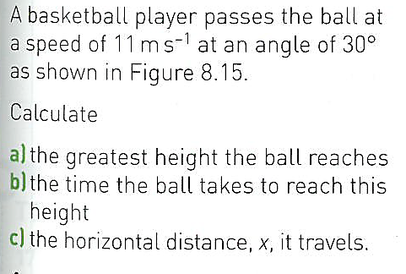
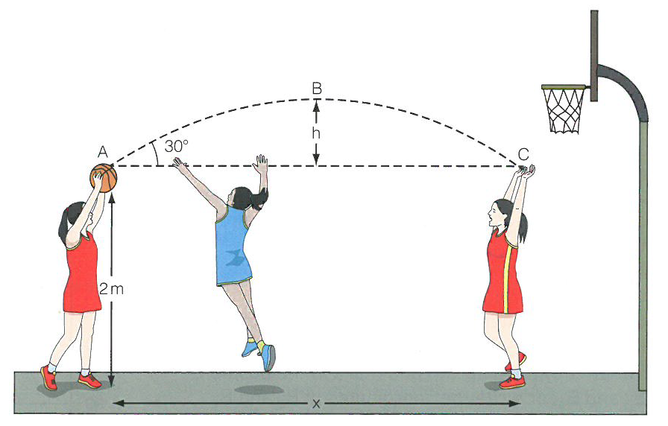
Question

Slide 44
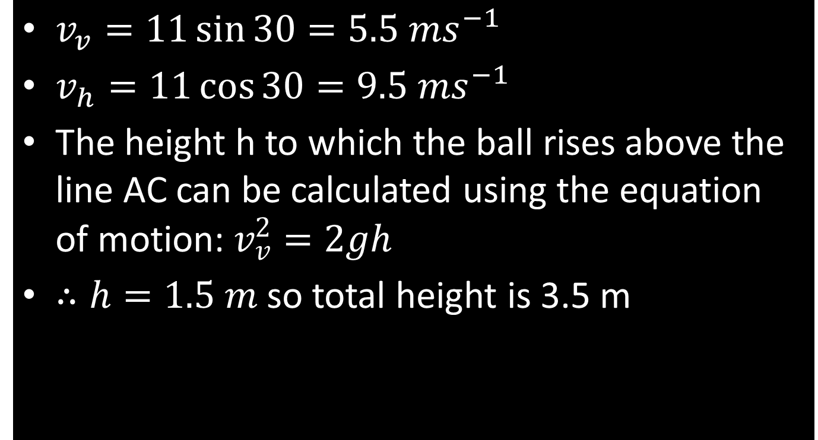
Answer
$v_{v}=11\sin{30}=5.5 {ms}^{−1}$
$v_{h}=11\cos{30}=9.5 {ms}^{−1}$
The height h to which the ball rises above the line AC can be calculated using the equation of motion: $v_{v}^{2}=2gh$
$∴h=1.5 m$ so total height is 3.5 m

Slide 45
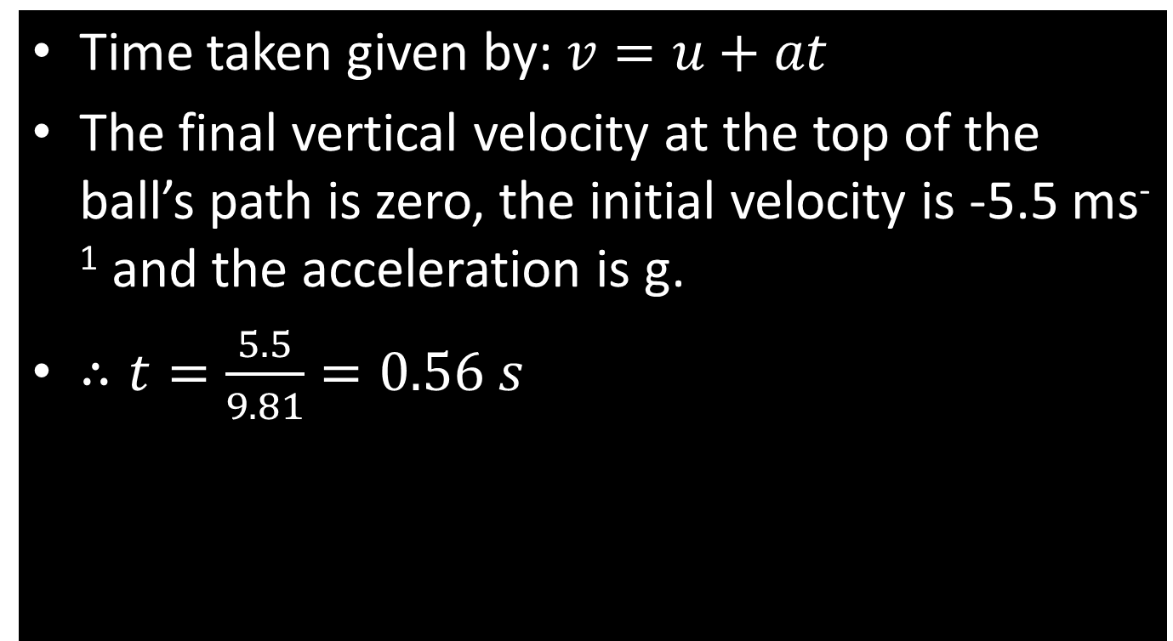
Answer
Time taken given by: $v=u+at$
The final vertical velocity at the top of the ball’s path is zero, the initial velocity is -5.5 ms⁻¹ and the acceleration is g.
$∴t=\frac{5.5}{9.81}=0.56 s$

