Slide 1
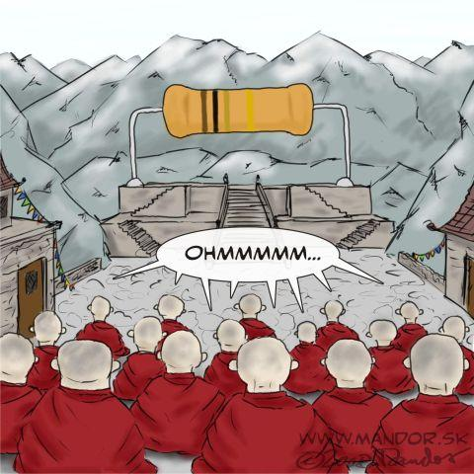
CW | Resistivity | 26/05/2016
What factors effect resistance?
Explain how?
From my learning today I will be able to:
Key: | Describe what factors effect Resistance D/C
Boost: | Explain what Superconductivity is and suggest its applications C/B
Aspire: | Apply understanding to graphically workout resistivity B/A
Objective

Slide 2
Resistivity (ρ)
Experiments show that the resistance of a conductor is:
1. proportional to its length, L
2. inversely proportional to its cross-section area, A
and so: R α L / A

Slide 3
The constant of proportionality is the
resistivity, ρ of the conductor
Therefore: R = ρ L A
Resistivity is measured in ohm-metre, Ωm.
Resistivity equation demo at Phet
KT resistivity simulation

Slide 5
Variation in resistivity
Metals and other good conductors have very low resistivities.
(e.g. copper = 1.7 x 10 ^{– 8} Ωm)
Good insulators have very high resistivities.
(e.g. PVC = 1.0 x 10 ⁺ ¹⁴ Ωm)
Semiconductors have intermediate resistivities.
(e.g. silicon = 2.3 x 10 ⁺ ³ Ωm)
Resistivity table on Wikipedia

Slide 6
Resistivity table on Wikipedia

Slide 7
1. Calculate the resistance of a 0.30m length of copper wire of cross-section area 5 x 10⁻⁶ m² [resistivity of copper = 1.7 x 10⁻⁸ Ωm]
R = ρ L A
= (1.7 x 10⁻⁸ Ωm) x (0.30m) / (5 x 10⁻⁶ m²)
= 0.00102 Ω = 1.02 mΩ
2. Repeat the above question, this time with silicon [resistivity of silicon = 2300 Ωm]
= (2300 Ωm) x (0.30m) / (5 x 10⁻⁶ mm²)
= 1.38 x 10⁸ Ω = 138 MΩ

Slide 8
3. Calculate the resistivity of a metal wire of cross-section diameter 0.4mm if a 25cm length of this wire has a resistance of 6Ω.
A = πd²
4
= π x (4 x 10 ⁻ ⁴ m)² / 4
= π x (1.6 x 10 ⁻ ⁷ m²) / 4
cross-section area = 1.2566 x 10 ⁻ ⁷ m²
ρ = RA
L
= (6 Ω) x (1.2566 x 10 ⁻ ⁷ m² ) / (0.25 m)
resistivity = 3.02 x 10 ⁻ ⁶ Ωm

Slide 10
Measuring resistivity
The Graphical method
Requirements
constantan wire of diameter 0.27 mm or 0.56 mm, power supply, 0–12 V dc, 2 digital multimeters, micrometer screw gauge, 4 mm leads.
y
ρ l
R =
A
x

Slide 11
Superconductivity
Superconductivity is a state where certain materials have zero resistivity.
This occurs at and below a critical temperature (T_{c}) which depends on the material.
T_{c} is usually below – 200ºC.
Applications include:
very strong electromagnets (e.g. in MRI scanners)
power cables to prevent wastage of electrical energy (e.g. to supply the LHC)

Slide 14
Complete the worksheet
Give the equation for resistivity.
What is superconductivity? When does it occur? Give two applications.
Calculate the resistance of a copper wire of diameter 1mm and length 3m.
Compare the resistivities of copper, silicon and PVC.

Slide 15
Homework for Next lesson
Read Required Practical 5 notes and prepare:
Equipment list
Method
Risk assessment
Table of Results
Complete Exam Questions

