Slide 1
CW | Emf and internal resistance | 26/05/2016
From my learning today I will be able to:
Key:
Boost:
Aspire:
Objective

Slide 2
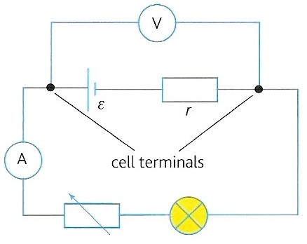
Measurement of internal resistance
Connect up circuit shown opposite.
Measure the terminal pd (V) with the voltmeter
Measure the current drawn (I) with the ammeter
Obtain further sets of readings by adjusting the variable resistor
The bulb, a resistor, limits the maximum current drawn from the cell

Slide 3
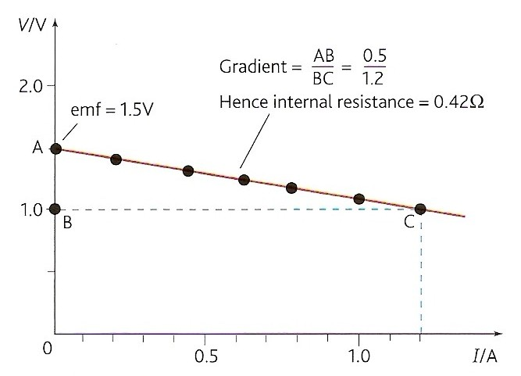
6. Plot a graph of V against I (see opposite)
7. Measure the gradient which equals – r (the negative of the internal resistance)
terminal pd, V = I R
and so: ε = I R + I r
becomes: ε = V + I r
and then V = - r I + ε
this has form y = mx + c,
and so a graph of V against I has:
y-intercept (c) = ε
gradient (m) = - r

Slide 4
Car battery internal resistance
A car battery has an emf of about 12V.
Its prime purpose is to supply a current of about 100A for a few seconds in order to turn the starter motor of a car.
In order for its terminal pd not to fall significantly from 12V it must have a very low internal resistance (e.g. 0.01Ω)
In this case the lost volts would only be 1V and the terminal pd 11V

Slide 5
High voltage power supply safety
A high voltage power supply sometimes has a large protective internal resistance.
This resistance limits the current that can be supplied to be well below the fatal level of about 50 mA.
For example a PSU of 3 kV typically has an internal resistance of 10 MΩ.
The maximum current with a near zero load resistance (a wet person)
= I_{max} = 3 kV / 10 M Ω
= 3 000 / 10 000 000
= 0.000 3 A = 0.3 mA (safe)

Slide 6
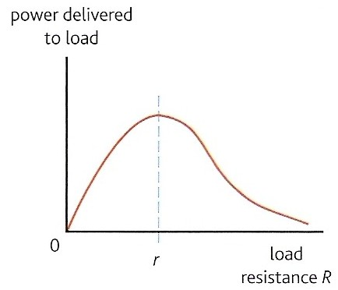
Maximum power transfer
The power delivered to the external load resistance, R varies as shown on the graph opposite.
The maximum power transfer occurs when the load resistance is equal to the internal resistance, r of the power supply.
Therefore for maximum power transfer a device should use a power supply whose internal resistance is as close as possible to the device’s own resistance.
e.g. The loudest sound is produced from a loudspeaker when the speaker’s resistance matches the internal resistance of the amplifier.

