Slide 1
Topic 1: the structure and organisation of the education system

Slide 2
Getting you thinking …..
Consider the following famous people
Match up their Education history
In small groups explain the reasons for your choice.

Slide 3
Richard Branson is one of the wealthiest men in the world with a net worth of over 4.2 Billion. Business tycoon of Virgin group

Slide 4
Lord Sugar is one of the best known Business men in the UK, setting up his own company at the age of 21 Amstrad- which he sold for millions. Now best known as a Business mentor

Slide 5
David Cameron- Former Conservative PM from 2010-2016 Now is still a member of parliament. One of the youngest elected prime ministers

Slide 6
Wayne Rooney is an international footballer who now plays for a team in the US after many successful years at Manchester United. Wayne was chosen to join a professional football academy at the age of 9

Slide 7
Thinking point
There has been extensive research into what makes some people more successful in education than others.
On a separate piece of paper write down all the factors that affect how well you do in education.
Use your own experiences to help

Slide 8
Factors
Influencing educational success

Slide 9
Learning objectives of this booklet
Learning Objectives:
To understand and evaluate key concepts associated with functionalist, New Right and Marxist sociologists’ views of education.
To understand how these approaches explain the function of education and examine the link between education and work wider society.
After studying this Topic, you should:
Have a good knowledge of the history of the British education system since 1945
Know the functions of education that functionalists identify.
Understand the neoliberal and New Right views of the role of the market in education.
Understand the social democratic view of the role of the education system and their criticisms of New Right arguments.
Understand different Marxist views of the role of education, particularly the reproduction and legitimation of class inequality.
Be able to evaluate the functionalist, neoliberal and New Right, and Marxist views of education.

Slide 10
Formal and Informal Education:
Page 2 of booklet
When we think of education we think of sitting in a school or college and being taught by teachers. However this is not the only way of being educated. Sociologists make distinction between;
Formal Education = Delivered by agencies specifically designed for teaching and learning – for instance, schools, colleges, universities – or through virtual institutions
Relies on formal programme, syllabus, curriculum etc.
Informal (hidden) Education = Used to refer to all of the agencies and institutions, which, although not explicitly existing to encourage learning, nevertheless play an important educational role.
Learning may occur ad hoc, i.e, randomly

Slide 11
Activity
Page 2 of booklet
Outline in the box the things you learn directly through the formal curriculum and then the things you learn indirectly through the hidden curriculum (p2).

Slide 12
Topic 1: the structure and organisation of the education system

Slide 13
Quick Recap
What factors effect educational achievement?
What is the formal curriculum?
What is the hidden curriculum?

Slide 14
Meritocracy
Page 3 of booklet
A key argument in the sociology of education is whether the education system in the UK is meritocratic. Find out what this means and write on p.3:
Meritocracy:

Slide 15
Meritocracy
Page 3 of booklet
Meritocracy is the idea of a society governed by people selected according to merit ( Everyone has an equal chance of success as how hard you work will reward you with the success you deserve)
e.g.
"Britain is a meritocracy, and everyone with skill and imagination may aspire to reach the highest level“
What types of society/aspects of society could be seen as not being meritocratic?
On p.3 provide some examples of how our education system is meritocratic and how it is not.

Slide 16
Is the education system meritocratic – feedback pg 3
Yes | No

Slide 17
Is the education system meritocratic – feedback pg 3
Yes | No
Everyone is taught the same national curriculum. Teachers have to pass the same tests to be able to teach well. Schools are assessed to ensure they are enabling students to reach their full potential If students work hard they can achieve despite any barriers they may face. | Some schools have more resources/ provisions/ smaller class sizes Some teachers have to teach subjects that they have not trained in. Not all schools are equally successful – some schools are “ inadequate” Evidence suggests that factors such as gender, class and ethnicity is a factor in educational success.

Slide 18
Key question…….
Is going to school compulsory?

Slide 19
Go to Godalming online and find out!

Slide 20
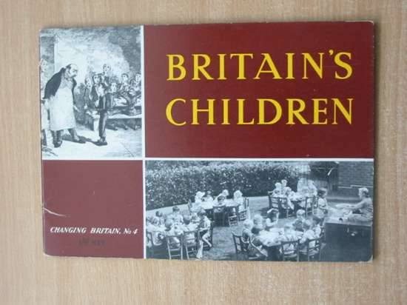
Selection: The Tripartite System 1944
From 1944 education began to be shaped by the idea of meritocracy – individuals should achieve their status through their own efforts rather than through their ascribed status as birth.
The tripartite system selected and allocated students to one of the three different types of schools according to their aptitude and abilities. These were identified by taking the 11+ exam at the age of 11.

Slide 21
Tripartite System
11+ exam
Technical schools: existed in only a few areas. For working class students who displayed only ‘practical’ skills.
Grammar schools:
Offered an academic curriculum and access to non-manual jobs and higher education. For pupils with academic ability who passed the 11+. These pupils were mainly middle class
Secondary modern schools: offered a non-academic, ‘practical’ curriculum and access to manual work for pupils who failed the 11+. These pupils were mainly working class.

Slide 22
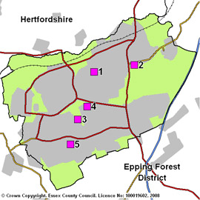
The Comprehensive System from 1965 onwards
The comprehensive system was introduced in many areas from 1965 onwards.
The 11+ was abolished along with grammars and secondary moderns, to be replaced by comprehensive schools that all pupils within the area would attend. This is the current method of school entry for most students today

Slide 23
History of the British Education system- p.4
Intro to education: A History of the British Education System
Educational policy in Britain before 1988 (pages 77-78 Webb).
￼￼￼
1. Briefly describe the main features of the tripartite system.
2. Briefly describe the main features of the comprehensive school system.

Slide 24
Timeline
Using the key dates and issues provided, as a starting point, create a timeline for changes to the British education system since 1945. Bare in mind that a lot of changes occur since 1988, and the exam board expect exam answers to focus on changes from this point.
You could cut and stick the dates/issues onto a timeline, or write the points on the timeline instead.
Aim to include other changes that have occurred.

Slide 25
Educational Timeline
Check your answers!
Colour code your timeline to indicate the political parties responsible for bringing in the education reforms/ policies

Slide 26
Types of schools research
It is important that you are aware of the different types of schools and how these link to the theories, differential educational achievement, meritocracy and social mobility.
Complete the booklet pages 4-6 on types of schools
Use resources on GOL and the internet to complete the table
A brief description of the school
What is its admissions policy? E.g selective?
How is it funded? Privately ( parents) Government funded?
If completed – answer the question on page 7 regarding diversity of education provision

Slide 27
H/W Complete the question on page 7
Complete research
Explain two reasons for the diversity of the British education system pg 7

Slide 28
Topic 1: the structure and organisation of the education system

Slide 29
Match them up! Types of schools
State school |  | School run by a non-state organisation, where families have to pay to attend
Free school |  | A high status and expensive private school in Britain
Faith school |  | A school funded by the government
Public school |  | A secondary state school that does not select students based on ability
Grammar school |  | Students have to pass the 11+ exam to go to this type of school
Private school |  | These are funded by the government but aren’t run by the local council. They have more control over how they do things.
Comprehensive school |  | These have to follow the national curriculum but can choose what they teach in religious studies.

Slide 30
History of Education
Consider the timeline with the major changes in education policy linked with the Governments that were in power at the time.
Can you see any patterns regarding the types of policy and the “ agenda’s” of the political parties?
Keep this in your folder to refer to later.

Slide 31
Example of an “ alternative free school” – this is not like Gove’s free schools!!!
https://www.bing.com/videos/search?q=summerhill+school+you+tuube&qpvt=summerhill+school+you+tuube&view=detail&mid=194B55F8F5ABEE59943B194B55F8F5ABEE59943B&&FORM=VRDGAR
https://www.youtube.com/watch?v=aZsYdesxVCg

Slide 32
Purpose of Education p.8
THE PURPOSE OF EDUCATION
Highlight in one colour the purposes that relate to the individual, and then in another colour highlight those relating to society.

Slide 33
School diversity pg 7
Why is the British Education so diverse?
It reflects the diversity of the UK e.g a range of faith schools for the different religious groups. A range of schools based on “ affordability” e.g private and Public schools for the wealthier groups and states schools for the majority.
Britain is a democratic country – this ensure freedom to vote/ freedom of speech and freedom to choose how you/ your children are Education - if home-schooling is your preferred option, this right is recognised.

Slide 34
Deschooling- a non sociological perspective on education
https://www.ted.com/talks/ken_robinson_says_schools_kill_creativity

Slide 35
Sociological Perspective pg 8
In the Sociology of the Family we studied how different sociological perspectives viewed the family.
We will in this module look at how
Functionalist
https://www.youtube.com/watch?v=2bq90RKDT0w
Marxist
https://www.youtube.com/watch?v=o9xI9DOFZfw
Feminist
Interactionist
sociologists view education.

