Slide 1
How do the key sociological perspectives view education?
Sociology of Education

Slide 2
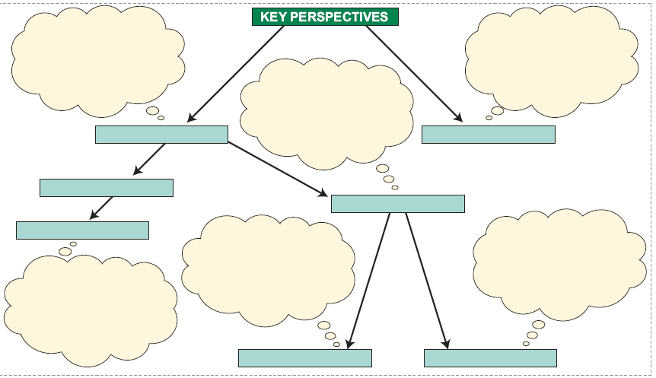

Slide 3
STRUCTURALISM
INTERACTIONISM

Slide 4
Macro Analysis
How does education fit into the wider social structure?
How does education shape the individual and prepare them for their position in society?
Micro Analysis
How is the ‘classroom’ socially constructed out of interactions.
How do these interactions influence success and failure?
STRUCTURALISM
INTERACTIONISM

Slide 5
Macro Analysis
How does education fit into the wider social structure?
How does education shape the individual and prepare them for their position in society?
Micro Analysis
How is the ‘classroom’ socially constructed out of interactions.
How do these interactions influence success and failure?
STRUCTURALISM
INTERACTIONISM
CONSENSUS
CONFLICT

Slide 6
Macro Analysis
How does education fit into the wider social structure?
How does education shape the individual and prepare them for their position in society?
Micro Analysis
How is the ‘classroom’ socially constructed out of interactions.
How do these interactions influence success and failure?
How does education
systematically benefit one group in society at the expense of others.
STRUCTURALISM
INTERACTIONISM
CONSENSUS
CONFLICT

Slide 7
Macro Analysis
How does education fit into the wider social structure?
How does education shape the individual and prepare them for their position in society?
Micro Analysis
How is the ‘classroom’ socially constructed out of interactions.
How do these interactions influence success and failure?
How does education
systematically benefit one group in society at the expense of others.
STRUCTURALISM
INTERACTIONISM
CONSENSUS
CONFLICT
FUNCTIONALISM
MARXISM
FEMINISM

Slide 8
Macro Analysis
How does education fit into the wider social structure?
How does education shape the individual and prepare them for their position in society?
Micro Analysis
How is the ‘classroom’ socially constructed out of interactions.
How do these interactions influence success and failure?
How does education
systematically benefit one group in society at the expense of others.
STRUCTURALISM
INTERACTIONISM
CONSENSUS
CONFLICT
FUNCTIONALISM
How is the education system patriarchal?
What is the experience of males/females in the education system ? How does this shape gender roles?
How does education
benefit the bourgeoisie?
How is education used to control the proletariat and prevent revolution?
What functions does education perform for society?
How does education contribute to the smooth running of society?
MARXISM
FEMINISM

