Slide 1

Functionalism and Education
DAK mod

Slide 2
Objectives
To review the functionalist account of education and its problems
To relate functionalist accounts of education to the wider concerns of functionalist theory
To assess the usefulness of functionalist theory

Slide 3
Functionalism
The functionalist approach highlights a number of core functions of education. These are:
  Teaching the skills needed for economic growth.
  Secondary socialisation.
  Role allocation.

Slide 4
Meritocracy
The functionalist account of education is largely based upon the concept of meritocracy.
Functionalists believe that society is meritocratic and that those who develop their skills and work hard are rewarded regardless of social background.
Using your previous knowledge- in groups discuss- ‘Do you think meritocracy exists?’

Slide 5

Modern Industrial Society
Modern society involves:
Achieved status not ascribed
Industrial production not subsistence agriculture
Impersonal society – the decline or loss of smaller communities
THE MASS EDUCATION SYSTEM MUST ADDRESS THESE ISSUES

Slide 6
Socialisation and Social Integration
Students learn how to behave properly with others outside the family unit
Learn to regard themselves as part of a wider society, not just kin
This integrates society – avoids ANOMIE

Slide 7

Particularistic Vs Universalistic values
Students learn certain values at home (particularistic).
School allows them to learn universalistic values- values and behaviours that apply to all people.
In what ways might the standards of the home be different to school?

Slide 8
Support for Industrial Production
Students learn necessary skills for work
Students learn necessary work disciplines – punctuality, self-discipline, etc
Industry benefits – it becomes more COMPETITIVE

Slide 9

Role Allocation
Students are chosen for roles in later life
Sorting and sifting through rewards and punishments – especially in the examination system
This means that those who are best suited are at the top of society - MERITOCRACY

Slide 10
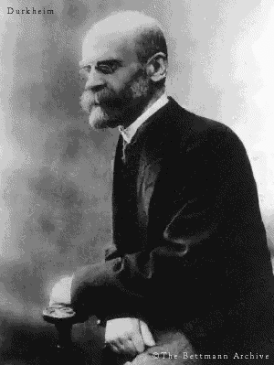
Durkheim
Durkheim was one of the founding fathers of Functionalism and Sociology.
He was a French functionalist sociologist writing at the end of the 19th Century .
He took the conservative view that all institutions within society exist because they have useful functions, contributing to the general good.

Slide 11
Durkheim – Moral Education
According to Durkheim, as everyone has to coexist with other people one of the main functions of education should be to socialise children to the norms and values agreed by society – the value consensus.
“To act morally is to act in terms of the collective interest.”

Slide 12
Durkheim – Moral Education
Durkheim's priority was an orderly and cohesive society.
Durkheim stressed that the chief role of education should be to encourage in children a sense of social solidarity – a feeling of identification with the group and responsibility towards others

Slide 13
Activity p.11
How do schools act as a society in miniature?

Slide 14
According to Durkheim:
Increasing rates of crime were signs of egoism – people pursuing their own goals rather than the good of the community.
Higher levels of suicide were symptomatic of anomie – a lack of shared values and a feeling of moral confusion.
Education had an essential binding role to play in societies where religion had become less influential.
In pairs think of ways in which schools and colleges might foster group solidarity more effectively (page 9)

Slide 15
Applying Durkheim’s views to comprehensive schools
In pairs think of ways to foster group solidarity in schools.- write your ideas on p.11

Slide 16
Other Questions p.11
What is meant by the term VALUE CONSENSUS?
What do functionalist sociologists aim to explain when studying education?

Slide 17
Should we expect schools to integrate people from diverse backgrounds?
Functionalists argue that differences are inevitable between diverse groups to begin with. However, they argue, over time the maintenance of social order and social solidarity mean that minority groups will slowly adapt to the majority culture over time. This process can be referred to as assimilation. The education system is seen as a vital tool to help minority groups into the majority culture.
Is integration possible in the British education system?
And do you agree with the idea of assimilation?

Slide 18
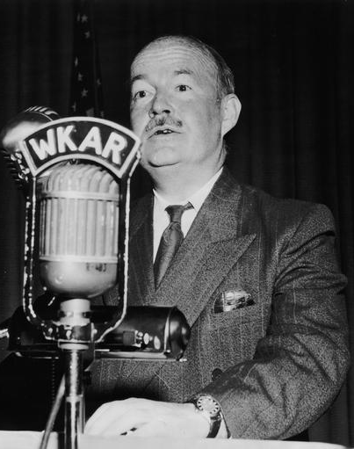
Talcott Parsons
Key figure in the development of functionalist theory in the USA in mid 20th century
Concerned with study of society as a whole
Principal focus on socialisation and role allocation functions

Slide 19
Talcott Parsons: School as a bridge
Education is the main secondary agent of socialisation.
For Parsons, schools operate on meritocratic principles- those who work hardest and have the most ability will do the best.
Parsons believed that schools are a miniature version of wider society.
Young people are required to act in terms of these values in the classroom, preparing children for adult roles. (Role Allocation)

Slide 20
Talcott Parsons: School as a bridge
The school acts as a bridge between the particularistic values of the family to the universalistic values of wider society.
Particularistic values- the status of a child in the family is judged to be individual and special- their status is ascribed as a child, not an adult.
Universalistic values- in wider society the status of individuals is achieved through universalistic rules that apply to everyone. According to Parsons these rules are meritocratic. E.g. a teacher will mark work to a mark scheme (universalistic), not giving different marks because they like a student or not (particularistic).

Slide 21
In pairs think of reasons why the system of role allocation as described by Parsons may not be as fair as it sounds. Write your ideas on p.13 of your workbook

Slide 22
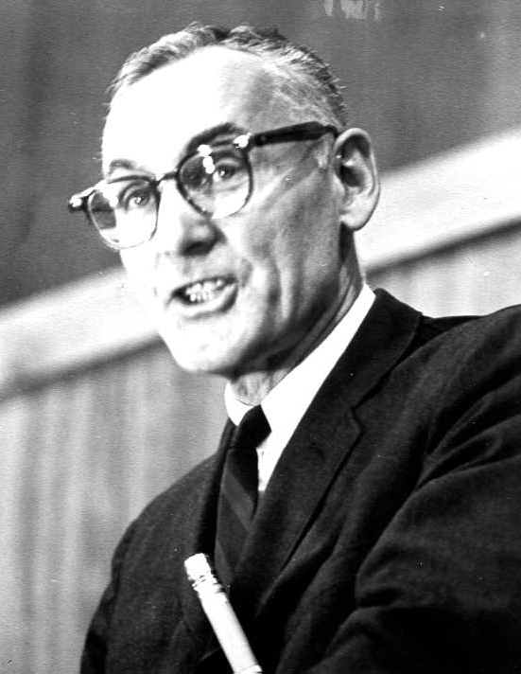
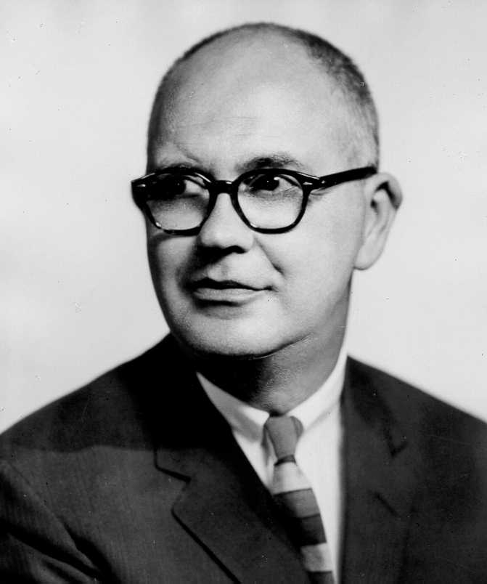
Davis and Moore: Justifying inequality
Davis and Moore developed Parsons idea of 'Role Allocation', and link it to Social Stratification.
Social Stratification is a means of ensuring that the most talented people fill the positions that are most functionally important for society.

Slide 23
Davis and Moore: Justifying inequality
"Proving ground for ability... a selective agency for placing people according to their capacities.”
Education therefore ‘sifts and sorts’ and grades people in terms of ability which is rewarded in exam success, those with the most ability are then rewarded in society in terms of economic rewards to ensure the best people fill the most functionally important roles.

Slide 24
Questions: p.13-14
What is meant by equality of opportunity?
According to Davis and Moore, why is it important for role allocation to be meritocratic?

Slide 25
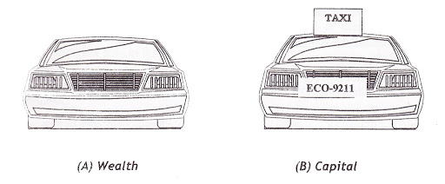
Schultz: Human Capital
Schultz argues high levels of spending on education and training are justified to develop people’s knowledge and skills, and this investment is an important factor in a successful economy.
Functionalists see this development of human capital as necessary to provide a properly trained, qualified and flexible labour force that have high levels of skill and knowledge to undertake a wide range of jobs, which arise in a specialised division of labour.
They argue the people with the best skills who are most qualified end up in the jobs requiring the greatest skills and responsibilities.
What is human capital and why is it essential to the economy? (fill in on page 14)

Slide 26
Evaluation
What problems can we see with the Functionalist view of the education system?
Use Sociology for AQA, Volume 1 (Browne) p.29, and AQA A Level Sociology Book One (Webb) p.68 to help you

Slide 27

Some Problems with Functionalist Theory
Over-optimistic about the nature of social order
Neglects conflict in society
Fails to explain social change effectively
School begins…

Slide 28
Problems for Functionalists and the Education System
Doesn’t address whether the education system helps realise the potential of individuals.
Competition may not always be helpful- people develop at different rates.
Status is not always achieved
Society is not fully open.
Is the education system really fair – a genuine meritocracy?
Elitists only ?

Slide 29

Uses of Functionalism
A standard against which to assess the system
An explanation of the development of mass schooling
An analysis looking at social needs and context

Slide 30

Impact of Functionalism
Seems like “common sense”
Has shaped social and educational policies of government
Particularly influential on New Labour theory
Conservative theory and the New Right also strongly influenced
Has been the most important perspective setting the terms of debate – other perspectives have directly challenged this – Marxism, Feminism, etc

