Slide 1
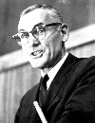
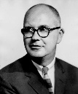
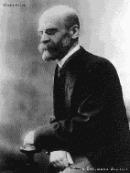
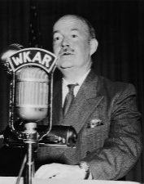
Key concepts:
Meritocracy
Achieved status
Ascribed status
Social integration
Anomie
Particularistic values
Universalistic values
Role allocation
Value consensus
Social solidarity
Human capital (Shultz)
FUNCTIONALIST VIEWS OF EDUCATION
Davis and Moore: view of the role of the education system
Durkheim: view of the role of the education system
Parsons: view of the role of the education system
Evaluation: strengths and weaknesses of the theory. How would other theories view it?

