Slide 1
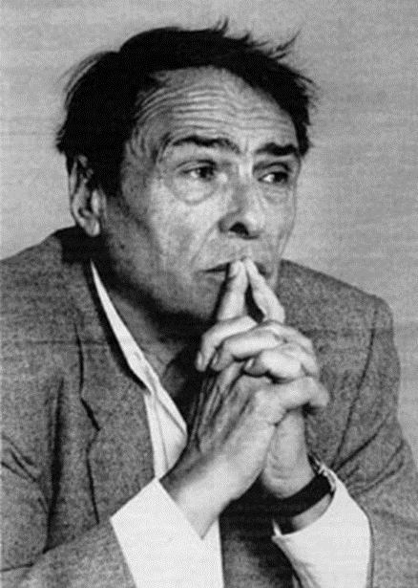
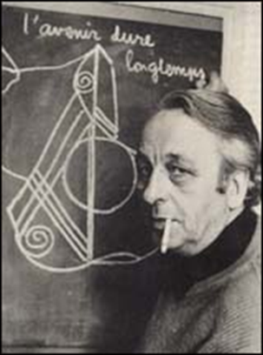
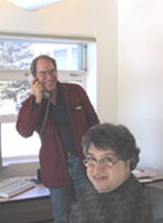
Key concepts:
Informal social control
Formal social control
Ideological state apparatus
Correspondence principle
Myth of meritocracy
Hidden curriculum
Social capital
Economic capital
Cultural capital
MARXIST/NEO VIEWS OF EDUCATION
Bourdieu: forms of capital
Althusser: Ideological state apparatus
Rikowski:
Bowles and Gintis: Correspondence principle
Paul Willis: ‘Learning to Labour’ – how is he different to Bowles and Gintis?
Evaluation: strengths and weaknesses of the theory. How would other theories view it?

