Slide 1
Gender and DEA
2019

Slide 2
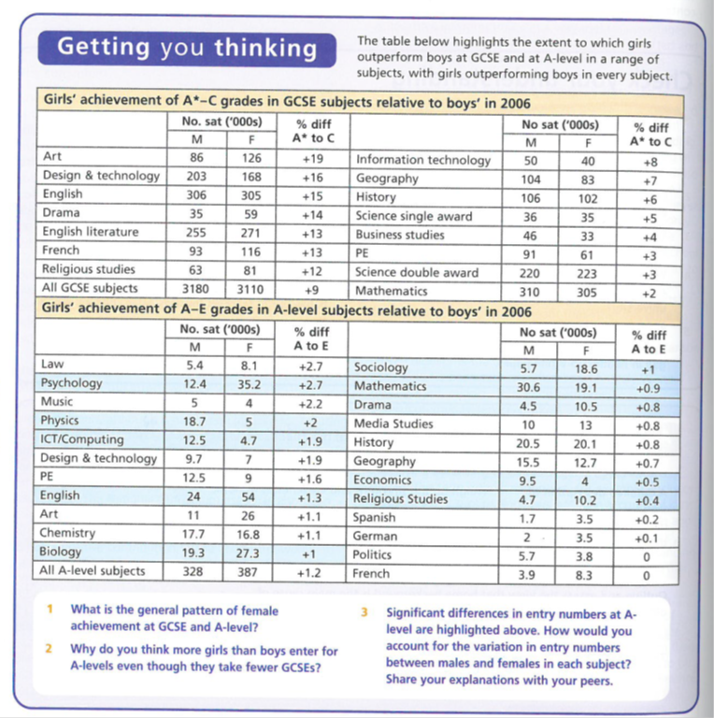
Gender and DEA: Data

Slide 3
Girls and Boys achievement in Education
STUDENT WORK
D1 group
Jan 2018

Slide 4
The impact of the women’s movement | Webb 52 Browne 69
The Family | Webb 52
Changes in women’s employment | Webb 52 Browne 69-70
Girls’ ambition | Webb 52 Browne 70
Maturity | Browne 69 & 70
Globalisation and declining traditional male employment | Webb 57 Browne 71 SIF 184
Male Identity Crisis | SIF 43 & 184
Hegemonic Masculinity | Webb 72 SIF 41
Over estimation of ability | Browne 70 & 71
Labelling and the Self-fulfilling prophecy | Webb 54
Equal Opportunities Policies | Webb 53-54 Browne 69
Positive role models in school | Webb 53 & 54
Challenging gender stereotypes | Webb 55
Marketization | Webb 55
Labelling and the Self-Fulfilling Prophecy | Webb 58 Browne 70
Anti-school subcultures | Webb 58 Browne 71
Feminised curriculum | Webb 57 & 58
Lack of male role models | Webb57-58

Slide 5
EXTERNAL FACTORS: Girls’ relative achievement

Slide 6
The Impact of the women’s movement and Feminism
Feminists have challenged the traditional stereotype of a woman’s role as exclusively that of mother and housewife in a patriarchal nuclear family and inferior to men outside the home, in work, education and the law.
This has raised women’s expectations and esteem – girls’ lives and aspirations reflect this.
Media evidence - Angela McRobbie found that girls’ magazines in the 1970s emphasized the importance of getting married and not being ‘left on the shelf’ whilst nowadays they contain images of assertive, independent women

Slide 7
The Family
There have been major changes in the family since 1970s these include; increases in the divorce rate, increase in cohabitation and a decrease in the number of first marriages, an increase in lone-parent families and smaller families in general.
Family insecurity may make marriage no longer a viable “career” for girls.
The work of Sue Sharpe shows this change in aspiration. Love and marriage no longer “come first”.

Slide 8
Changes in the Position of Women in employment
There are growing employment opportunities for women in the service sector.
As a consequences, girls may have become more ambitious, and less likely to see a home and family as their main aim in life.
Many girls growing up today have mothers in paid employment - provide positive role models. The future involves paid employment, often combined with family responsibilities.
See Sue Sharpe above – plus legislation such as
Equal Pay Act 1970,
Sexual Discrimination Act 1975
Equality act 2010

Slide 9
Girls’ ambition
With role models in the media and in the home and a belief in equality between the sexes, girls’ aspirations had grown to include a career before, during or even instead of marriage.
Sue Sharpe’s interviews with girls in the 1970s and 1990s show a major shift in the way girls see their future.
In 1974, the girls had low aspirations: educational success was unfeminine and appearing to be ambitious was unattractive. Their priorities were ‘love, marriage, husbands, children, jobs, and careers, more or less in that order’. But by the 1990s this had reversed

Slide 10
Maturity?
Girls are thought to mature earlier, physically and emotionally (by the age of 16 girls are estimate to be more mature than boys, by up to 2 years). They work harder and they are better motivated with more peer-group support. Girls are more likely to view exams in a far more responsible way

Slide 11
Insert Student work here

Slide 12
EXTERNAL FACTORS: Boys’ relative underachievement

Slide 13
Globalisation and declining traditional male employment opportunities
Since the 1980s, a significant decline in the primary sector and heavy industries such as iron and steel, shipbuilding, mining, and engineering. Partly the result of the globalisation of the economy, which lead to industry relocating to developing countries. Traditionally these industries were mainly employed by men and associated with masculinity

Slide 14
Male identity crisis
Mac an Ghaill suggests the decline in traditional male working-class jobs is a factor explaining why in particular working-class boys underperform. They lack motivation and ambition because of limited prospects, and qualifications will make no difference.
Boys and men having a lower expectations, a low self-image and a low self-esteem has led to the collapse of the traditional male breadwinner role.

Slide 15
Hegemonic masculinity
A highly stereotypical view of how men should act and present themselves - called hegemonic because it crowds out other masculine styles such as artistic and gay masculine identities.
The traditional view of a man involves lack of housework and childcare. Instead man is a risk taker, independent and self-reliant.
This style of masculinity stresses toughness, competition and aggression.
Young men are put under a lot of pressure to present themselves as hard, strong and independent.
They learn to conceal any ‘girly’ signs of gentleness and kindness.

Slide 16
Hegemonic masculinity
Connell 1995- involves the study of domination over women and the power of some men over other (often minority groups of) men.
Renold 2001- demonstrates the power of hegemonic masculinity in her study of boys in final year of primary school. Some are gentle, academic, artistic and non-sporty and risk being teased and ridiculed for being geeks and nerds rather than ‘real’ boys. Although they continue to study hard, they adopt strategies to avoid being seen as feminine, joining in with the bullying of other studious boys or sometimes behave badly in order to disguise their positive attitude towards study. They also ridicule girls seen as too academic, and boys with poor sporting skills

Slide 17
Over estimation of ability
Boys and girls feel differently about their own ability, with most boys overestimating their ability, and girls underestimating theirs.
Boys feel that they are bright and capable but at the same time they say they don’t like school and they just coast along rather than rise up to the challenge of academic work, and they don’t work enough to get the results of which they think they are capable

Slide 18
Over estimation of ability
Stanworth (1983) and Licht and Dweck (1987) found girls lacked confidence in and underestimating their ability, and felt undervalued in the classroom.
Paradoxically greater anxiety might lead to greater success.
Research by Barber (1996) showed ‘that more boys than girls think that they are able or very able, and fewer boys than girls think they are “below average”’. Yet GCSE results show the opposite.
Francis (1998-9) found boys thought it was easier to coast exams. When boys do fail they blame it on school or not putting in effort rather than their ability.

Slide 19
Insert Student work here

Slide 20
INTERNAL FACTORS: Girls’ relative achievement

Slide 21
Labelling and the self-fulfilling prophecy
The ways in which teachers interact with girls and boys in schools differ
Evidence suggests that staff are more strict with boys as with girls - ore likely to extend deadlines for work, to have lower expectations tolerate more bad behaviour.
These lower expectations may create a self-fulfilling prophecy which contributes to boys lower achievement.
Jane and Peter French found that although boys receive more attention due to being reprimanded, boys feel that they are disciplined more harshly than girls - this causes them to create a self-fulfilling prophecy that they will fail as they are getting told off more severely than girls and so have a negative view towards education

Slide 22
Equal Opportunity Policies
Feminist ideas have had a major impact on the education system. Those who run the system are much more aware of gender issues and teachers are more sensitive to the need to avoid gender stereotype. The belief that boys and girls are equally capable and entitled to the same opportunities is now mainstream thinking in education and influences educational policies
Policies such as GIST and WISE encourage girls to pursue careers in science - a non-traditional areas. Female scientists visit schools as role models, raising girls’ aspirations. Learning materials in science now reflect girls’ interests.
The National Curriculum (1988), removed one source of gender inequality by making girls and boys study the same subjects which was often not the case before.
Joe Boaler 1998 saw the impact of equal opportunities policies as a key reason for the changed in girls achievement. Many of the barriers have been removed and schools have become more meritocratic so that girls who generally work harder than boys achieve more overall.

Slide 23
Positive role models in school
An increase in the amount of female leaders in schools. Women in senior roles act as good role models for female students as it demonstrates that women can achieve as much as or more than men and girls feel empowered in and out of school.
Female teachers would have had to undertake intense and lengthy education and training and this may also encourage girls to work hard in school to achieve what their role models have.

Slide 24
Challenging gender stereotypes
Sociologists argue that by removing gender stereotypes from textbooks, reading schemes and other learning materials we have removed the barrier to girls achievement.
Gaby Weiner (1995) argues that since the 1980’s, teachers have challenged such stereotypes. In general sexist images have been removed from learning materials.
This has helped to raise girls achievement by presenting them with positive images of what girls can do.

Slide 25
Marketization
Marketisation policies have created a more competitive climate in which schools see girls as desirable recruits because they achieve better in exam results.
As a result, boys may be seen as ‘liability students’- obstacles to the school improving its league table scores.
Dave Jackson (1988)- believes that the introduction of exam league tables has improved opportunities for girls: high-achieving girls are attractive to schools, whereas low-achieving boys are not. Creates a self-fulfilling prophecy- girls are more likely to be recruited by good schools, they are more likely to do well.
-Roger lee (1998)- boys are less attractive to schools because they are more likely to suffer from behavioural difficulties and are four times more likely to be excluded

Slide 26
Insert Student work here

Slide 27
INTERNAL FACTORS: Boys’ relative underachievement

Slide 28
Labelling and the self-fulfilling prophecy
The ways in which teachers interact with girls and boys in schools differ
Evidence suggests that staff are more strict with boys as with girls - more likely to extend deadlines for work, to have lower expectations tolerate more bad behaviour.
These lower expectations may create a self-fulfilling prophecy which contributes to boys’ lower achievement.
Jane and Peter French found that although boys receive more attention due to being reprimanded, boys feel that they are disciplined more harshly than girls - this causes them to create a self-fulfilling prophecy that they will fail as they are getting told off more severely than girls and so have a negative view towards education.
Becky Francis (2000) found that mixed gender classrooms tended to be dominated by boys, since they tend to monopolize space in the classroom and playground.

Slide 29
Anti-School Subcultures
Boys may gain peer group status by not working and some develop a laddish, anti-education, anti-learning subculture, where school work is seen as ‘girly’ and ‘unmacho’, and where it is not ‘cool’ to work hard or achieve at school. This may explain why boys are often less conscientious and lack the persistence and application required for exam success
Paul Willis (1977) identified the values of the “lads” as resistance to the school forming an anti-school subculture
Francis’ (2000) research confirmed the view of boys achieving more peer-group macho status by resisting teachers and schools, through laddish behaviour like messing about in class and not getting on with their work, contributing to their underachievement.

Slide 30
Feminisation of the Curriculum
Tony Sewell claims our education system has become ‘feminised’. Schools no longer nurture masculine qualities such as competitiveness and leadership.
They focus on qualities more closely associated with girls instead. (Methodical working, attentiveness in class.
Sewell see coursework as a major cause of gender differences in achievement He argues that some coursework needs to be replaced with final exams and a greater emphasis must be placed on outdoor activity/adventure in the curriculum.
Recent exam reforms have tended to downplay or eliminate coursework.

Slide 31
Lack of male role models
Boys lack male role models at school and at home.
Most boys surveyed are said to behave better and work harder in the presence of a male teacher.
It is believed that the primary school has become feminised and female staff are unable to control boys’ behaviour. This view says that male teachers are more able to impose a strict discipline that boys need in order to concentrate.
Large numbers of boys are being brought up in the 1.5 million female headed lone parent families in the UK.
14% of primary school teachers are male.
According to Yougov, 39% of 8-11 year old boys have no lessons whatsoever with a male teacher

Slide 32
Insert Student work here

Slide 33
CASE STUDY: Archer et al
You will need to review the booklet on page 7 and use the textbook pages 56-57 and article. This follows the main headings only

Slide 34
Archer et al Key headings
Symbolic Capital
Hyperheterosexual feminine identities
Boyfriends
Being "loud"
Working Class Girls' dilemma
'Successful' working class girls

Slide 35
Symbolic Capital
Symbolic Capital = status, recognition, sense of worth from others
This is gained by "performing" working class feminine identities
Contrast to educational capital lost in conflict with schools
strategies to create valued sense of self include:
hyper-hetrosexuallity
having a boyfriend
being "loud"
etc.

Slide 36
Hyperheterosexual feminine identities
Bid for status amongst peers to create a desirable/glamorous identity
Uses branding, etc - identity through consumption
Takes time / effort / money
Leads to conflict with schools
rules on jewellery / makeup / clothing etc
Seen as a distraction from education
THEREFORE school "othered" girls (Symbolic Violence)
Working class girls deemed “unworthy” / “incapable” by school and teachers

Slide 37
Boyfriends
Increased symbolic capital with peers
BUT
obstructs schoolwork
lowered aspirations
“Settling down” becomes the only ambition/aspiration

Slide 38
Being "loud"
Alternative option to be outspoken / assertive
BUT
This leads to conflict with school
Questioning teachers' authority
Behaviour interpreted as aggressive

Slide 39
Working Class Girls' dilemma
EITHER
gain symbolic capital from peers and
maintain hyperheterosexual identity
OR
gain educational capital from school through conformity but
This rejects working class identity
MAYBE ALSO
Try to be "good underneath"
coping mechanism to deal with rejection by school
establish self-worth in face of rejection

Slide 40
“Successful” working class girls remain “home centred”
Even successful girls wish to remain in parental home because
They want to succeed educationally to help their family (Evans)
Its an economic necessity
debt averse and may struggle to meet costs (limited resources)
They positively choose home (Archer)
Habitus – they prefer local to distant
BUT taking the home option limits
Their university choices
The market value of available degrees

Slide 41
So overall…

Slide 42
FEMINIST ANALYSIS blends the structuralist and Interactionist
Concerned with the ways schooling may systematically disadvantage girls and reinforce the nature of patriarchy.
PAST | PRESENT
Concerned with the underperformance of girls in the educational system The ways in which this may have been reinforced by school structures and interaction. | The remaining patriarchal systems that exist in education. Interactions in the classroom and how they create DEA. Some Feminists maybe interested in looking at why boys are now failing. (Liberal feminism)
[What may have influenced this change in focus?]

Slide 43
Recent Trends in Gender from the late 1980s to the present day.
GCSE was introduced in 1988 and from then onwards the female- male gender difference in educational achievement at GCSE level widened
By the late 1980s females were more likely than males to gain two or more A Level passes and during the course of the 1990s they also became more likely to gain 3 or more A level passes.
Females became more likely than males to gain A grades in almost all A Level subjects BUT gender differences in exam performance at A level are smaller than at GCSE.
Females are more likely than males to enrol on Undergraduate and Post Graduate courses.
Males are still marginally more likely than females to gain First Class degrees but females are significantly more likely than males to gain Upper Second degrees.
There are still some significant gender differences in subject choice at Advanced level and Degree level and these differences could potentially restrict women’s future employment prospects.

Slide 44
Problems with this picture
It is important to consider the relative sizes of gender, social class and ethnic differences in educational achievement and the interconnected effects of gender, ethnicity and social class on educational achievement. This is called INTERSECTIONALITY.
Gender differences are far smaller than social class differences in educational achievement. Students of both sexes who are eligible for free school meals are far less likely than students of both sexes ineligible to be successful at all levels of the education system.
Some ethnic differences in educational achievement are also greater than gender differences in educational achievement.
NOTE: All of these are potential evaluation points to include in a relevant essay!

Slide 45
Summary: Explaining the differences
In order to analyse the relative educational improvement from the 1980s onwards we must distinguish between:
factors accelerating the rate of female improvement
factors restricting the rate of male improvement.
and then look at the possible division between schools as a factor in this or wider socio-economic issues
BUT REMEMBER:
Females’ and males’ educational achievements have both improved over time - the rate of female improvement has been faster and this widened the female-male achievement gap
Gender, social class and ethnicity are interconnected. Girls are more successful than boys in all ethnic groups but middle class boys are still more educationally successful than working class girls in all ethnic groups.

Slide 46
CONTINUING PROBLEMS FOR GIRLS? 2 examples
IN EMPLOYMENT
The so-called “glass ceiling” still exists in employment – as women’s careers can stall because of
family pressures / maternity leave
Stereotyping by employers
“Old Boy” Networks
etc
(Post?) feminist approaches – THE “GENDER REGIME”
Valerie Hey/ Martin Mac an Ghaill – Heteronormativity
Heterosexuality is a learned characteristic for most if not all, and hegemonic male sexuality dominates
Other sexualities and genders are relatively stigmatised, marginalised or punished through the hidden curriculum of the school, or the actions of other pupils in reinforcing group norms.
So girls still learn subordination and schools still reinforce patriarchal attitudes

Slide 47
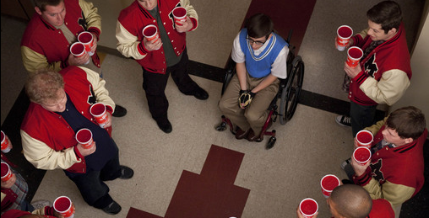
Heteronormativity represented in US TV shows/ Films:
The hierarchy of gender/sexuality
Heterosexual male
Heterosexual female
Homosexual female
Homosexual male
Gender Regime
“Jock Culture”

Slide 48
Planning/Evaluating?
Gender & Education

Slide 49
Q. Why do girls do better than boys in the education system?
INTERNAL
EXTERNAL
Key factors within schools with studies/evidence
Key factors from outside schools with studies/evidence
Identify 3/4 key factors and supporting evidence you would use
Identify 3/4 key factors and supporting evidence you would use
NB
Do these factors effectively explain the change from 1988 onward?
Are these factors measurable/quantifiable?
Do they focus on girls’ relative success or boys’ relative failure?
Can we assume that girls really “do better” in an unqualified way?

