Slide 1
Education Revision

Slide 2
Education Topics
Role & Purpose
Functionalism, New Right, Marxism
Differences in Achievement between social groups
External Factors
Material deprivation, cultural deprivation, cultural capital, gender socialisation
Internal Processes
Teacher labelling & self-fulfilling prophecy, setting/streaming, sub-cultures, pupil identities, curriculum
Educational Policy
Butler Act 1944, Comprehensivisation, New Right & ERA 1988, New Labour 1997-2010, Coalition 2010-2015

Slide 3
Role & Purpose – Functionalist View
Durkheim | Creating Social solidarity Teaching Specialist skills
Parsons | Meritocracy – everyone has an equal chance Bridge between the family and wider society Universalistic standards
Davis & Moore | Role Allocation

Slide 4
Criticisms?

Slide 5
Role & Purpose – New Right View
Similarities with functionalism
Some people are more naturally talented than others
Favour an education system run on the basis of meritocratic principles
Socialise shared values such as competition and national identity
Key Criticism
The current educations system is failing because it is run by the state. Inefficient Not answerable to consumers Low standards = less qualified workforce/less prosperous economy
Solution: Marketisation
Create an ‘Education Market’

Slide 6
Role & Purpose – New Right View
Chubb & Moe – Education Vouchers
Evaluation??

Slide 7
Role & Purpose – Marxist View
Althusser | Education is an ‘Ideological State Apparatus’ Reproduces inequalities by transmitting from generation to generation Legitimates inequalities through ruling class ideology
Bowles & Gintis | Correspondence principle Hidden Curriculum Myth of meritocracy
Paul Willis | Counter school sub-culture
Evaluation?
Don’t forget to use Post-Fordism and postmodernism here

Slide 8
Exam Question: Outline three ways in which school may mirror work in capitalist society.
hierarchical structure (1 mark); in schools head teacher at the top and students low down, in work boss at the top workers low down (+1 mark)
rewards (1 mark); grades in school, pay in work (+1 mark)
fragmentation (1 mark); school divided into unconnected subjects, work divided into unconnected tasks (+1 mark)
degree of autonomy (1 mark); senior pupils/those in higher streams have more autonomy, managers/skilled workers have more autonomy (+1 mark)
monotony (1 mark); having boring lessons, carrying out repetitive tasks at work (+1 mark)
dress code (1 mark); in school you wear uniform to represent the school and in the workplace you wear uniform to represent the company/brand (+1 mark)
legitimation (1 mark); in school pupils are taught that exams are fair and in work promotional opportunities are portrayed as fair (+1 mark)

Slide 9
Exam questions for this topic ☺
Applying material from Item B and your knowledge, evaluate the usefulness of functionalist views of the education system in society today (30)
Short answer questions:
Outline and Explain two ways in which New right views on education are similar to functionalist (4)
Outline three ways in which the education system serves capitalism (6)
Outline two ways in which the schooling system may pass on values and ideas which are in the interests of dominant groups (4)
Outline three ways in which schooling might contribute to social stability (6)

Slide 10
Social Class Differences in Achievement
External Factors
Basil Bernstein ‘Linguistic Deprivation’ | Working class use the restricted code Middle class use elaborated code with wider vocabulary and more complex sentences - gives middle classes advantages at school
Barry Sugarman | Working class sub-culture has 4 features that are a barrier to educational achievement: Fatalism, Collectivism, Immediate gratification, Present-time orientation
Pierre Bourdieu | Middle-class children have ‘cultural capital’ which helps at school. It includes knowledge, attitudes, language and tastes.
Sharon Gewirtz | Cultural and economic capital give middle-class families more choice of schools since marketization started.

Slide 11
Social Class Differences in Achievement
Internal Factors
Ray Rist | Studied American kindergarten. Teacher labelled and grouped children as fast learners called ‘tigers’ who were mainly middle class. She treated them differently from ‘cardinals’ and ‘clowns’ who were mainly working class
Rosenthal & Jacobson | Tested pupils and told teachers they had identified ‘spurters’ (but these were chosen at random). They returned and tested pupils a year later. They found half had spurted. They concluded this was due to labelling and different treatment which led to a self-fulfilling prophecy
Colin Lacey | Found that pupils place in low-streams (mainly working-class) lost self-esteem. Many then formed anti-school subcultures to gain status among peers.
Gilborn and Youdell | A-C economy since marketization has led to ‘Educational triage’. Schools ignore ‘hopeless cases’ often working class and/or black which leads to self-fulfilling prophecy and failure

Slide 12
Pupils’ class identities (new spec)
Louise Archer (2010)
Habitus (linked to Bourdieu’s concept of habitus)
Symbolic capital and symbolic violence
‘Nike’ identities
Nicola Ingram (2009)
Working-class identity and educational success
Sarah Evans (2009)
Class identity and self-exclusion

Slide 13
Differences between social classes cannot be looked at totally separately to gender and ethnicity, you have to understand that these all interact with each other. However differences in educational attainment is more pronounced amongst social class than any other social group and therefore make it clear that social class is the most important difference.

Slide 14
Ethnicity & Educational Achievement
External Factors
Daniel Moynihan | Black lone parent families suffer ‘cultural deprivation’ financially and because of lack of a male role model. This makes them underachieve.
Driver and Ballard | Asian parents have positive attitudes to education and higher aspirations so Asian pupils will do well.
Flaherty | Pakistanis and Bangladeshis’s three times more likely than whites to be in poorest 20% of population and live in overcrowded households

Slide 15
Ethnicity & Educational Achievement
Internal Factors
Gillborn and Youdell | ‘Racialised expectations’ led teachers to label black children and discipline them more than others for the same behaviour.
Mirza | Racist teachers discouraged black pupils form being ambitious
Sewell | Teachers stereotype black boys as rebellious, anti-authority and anti-school and they are therefore more likely to be excluded from school.
Troyna and Williams | ‘Ethnocentric curriculum’ in British schools which prioritises white culture. This is an example of institutional racism

Slide 16
Gender & Educational Achievement
External Factors
Main reasons for girls rapid improvement in results | The impact of feminism, changes in the family, changes in women’s employment, girls changing perceptions and ambitions
Sue Sharpe | Interviewed girls in 1970s and 1990s. Found low aspirations in 1970s and priorities were ‘low, marriage, husbands, jobs’. In 1990s careers to support themselves were a priority.
Hannon | Girls spend leisure time differently to boys
Mac an Ghaill | ‘Crisis of masculinity’ – traditional masculine roles are under threat and w/c boys perception of this may influence their motivation and ambition.
Francis | Boys have unrealistic career ambitions that are less likely to require academic success e.g. professional footballer

Slide 17
Gender & Educational Achievement
Internal Factors
Stephen Gorard | 1988 GCSEs were introduced and coursework. This favoured girls who then did much better than boys.
Debbie Epstein | Laddish subcultures form because working class boys who study are labelled as sissies or ‘gay’ because they associate masculinity with being tough and manual work.
Eileen Byrne | Teachers encourage boys to be tough and girls to be quiet and helpful. This early socialisation shapes boys and girls interests and ‘gender domains’.
Jo Boaler | Equal opportunity policies are key in girls improvements. Policies such as GIST and WISE encourage girls to pursue careers in male dominated areas.
Gaby Weiner | Teachers challenge stereotypes and gender stereotypes have been removed from text books.

Slide 18
Identity, class and girls achievement
Louise Archer (2010)
Symbolic Capital
Hyper-heterosexual feminine identities, boyfriends, being ‘loud’, and working-class girls dilemma
Sarah Evans (2009)
‘Successful working-class girls

Slide 19
Reasons for gender differences in subject choice
Early socialisation
Gendered subject images
Peer pressure
Gendered career opportunities

Slide 20
Pupils’ sexual gender identities
Pupils experiences in schools help to construct and reinforce their gender and sexual identities. These experiences may contribute to reinforcing what Bob Connell (1995) calls ‘hegemonic masculinity’ – the dominance of heterosexual masculine identity and the subordination of female and gay identities:
Double standards
Verbal abuse
The male gaze
Male peer groups
Source: Webb, R et al (2015) Sociology Book One, Napier Press

Slide 21
Applying material from Item B and your knowledge, evaluate the view that gender differences in educational achievement are the result of factors within schools. (30)
Top band marking criteria for AO1, AO2 and AO3
Content to use to answer the question

Slide 22
Educational Policies
You need to know the main phases of educational policy in Britain.
You should be able to apply sociological perspectives to educational policies.
You must be able to evaluate the impact of educational policies on inequality of achievement.

Slide 23
Education (Butler) Act 1944
Tripartite System
11+ exam decided which type of secondary school pupils would go to
Grammar school (20%)
Technical (5%)
Secondary Modern (75%)
GCSE ‘O’ Levels studied at Grammar schools
Later CSE’s were introduce at Secondary Modern schools
Impact
2/3 of grammar school places went to M/C children and 11+ test was biased in favour of M/C children
The mainly W/C children that went to Secondary Moderns were labelled as failures and lacked the means and motivation to succeed
Girls achieved higher so their pass rate was set higher as there were fewer girls grammar schools

Slide 24
Comprehensivisation 1965-1979
Intention
Abolish selection at 11 and educate all children in one type of school regardless of class, gender, ethnicity or ability.
Selection was now based on geography – children would now go to their local school
The Labour government instructed all local authorities to reorganise schools to become comprehensives – not all of them did – some grammar schools remained.
Problems
Catchment areas meant schools had little mixing of social classes and the ‘better’ schools were in the M/C areas attended by mainly M/C children
The tripartite system continued in some local authority areas
Comprehensives organised their classes by ability using setting or streaming, this led to the lower sets or streams being dominated by W/C children and therefore social class inequalities remained.

Slide 25
New Right Policies (1979-1997)
New Vocationalism
The conservatives blamed youth unemployment on the failure of schools to teach work skills. They introduced:
NVQs – job specific qualifications studied p/t at college whilst also working f/t
GNVQs – studied in school as an alternative to academic qualifications
Modern Apprenticeships – combined training at work with college to gain NVQ
Training schemes – The YTS combined work experience with education – employers had to ensure trainees followed a training scheme which led towards a Level 2 NVQ
Criticisms
Real purpose is to create good attitudes and work discipline so young people will come to accept a future of low-paid unskilled work
Perhaps young people don’t lack skills, perhaps there is a shortage of jobs.
Lower ability students put on vocational courses – this is another form of selection with a higher proportion of W/C and ethnic minority students
Training schemes were often gender stereotyped with girls going into hairdressing and beauty and boys construction – this is still the case today.

Slide 26
Education Reform Act 1988
Marketisation of Education included:
Testing - students sat SATS at the ages of 7, 11 and 14, along with new GCSE and A levels.
League Tables – Test and exam results published in league tables and parents use these to make an informed choice of secondary school.
Formula Funding – schools receive an amount of funding per pupil.
National Curriculum – All schools would have to teach a range of subjects
Opting Out – Schools could now opt out of LEA control and decide how to manage their own budgets.

Slide 27
Education Reform Act 1988
Criticisms
Concern over damaging, stressful affects on children on testing children so often. Schools would now only ‘teach to test’.
League tables could lead to low achievers not being entered for exams, or because of competition schools spend large amounts of money on marketing the school rather than educating pupils.
Formula funding would lead to popular schools gaining more funds and so could afford better qualified teachers and better facilities and attract more able/ambitious, generally M/C applicants.
Parentocracy is a myth – M/C parents had more cultural and economic capital – they could make more informed choices OR move into a catchment area of a good performing school.
Therefore reinforced social class differences again!

Slide 28
New Labour 1997-2010
New Right Influenced Policies | Social Democratic Policies
Specialist schools – schools could apply for a specialist status, which could gain extra government funding. Specialist schools can select 10% of students based on aptitude for their specialism. Work-related Learning – Allow schools and colleges more options in providing vocational education – this is facilitated by raising school leaving age to 18, which would also reduce ‘NEETS’ University Fee’s introduced and grants replaced with loans. | Academies – to replace failing schools in poor areas, this led to private businesses becoming involved in state education Education Action Zones – More funding and support for schools in deprived areas Sure Start – wide range of educational and support services in disadvantaged areas EMA – available to 16-19 year old in f/t education from families on low incomes to encourage young people to stay in education

Slide 29
New Labour 1997 - 2010
Criticisms
Contradictions in New Labours policies in tackling inequality and it’s commitment to marketisation.
Perhaps their anti-inequality policies are ‘cosmetic’ and don’t actually reduce inequalities. (EMA contradicted by Uni fees)
Labour are opposed to private schools for the privileged classes, but grammar and private fee-paying schools continue to exist when Labour could have abolished them.
Focus still on exam results and league tables mean M/C have gained most from their policies.
Increase in university entrants under New Labour, but more so for M/C
Overall opportunities have increased for everyone, but class inequalities remain. Does this just reflect society?

Slide 30
Coalition Policies 2010 - 2015
English Baccalaureate (EBacc)
Students to study English, Maths, Science, Humanities & MFL
Pupil Premium
Pupils qualifying as FSM, LAC and from Service families gain extra funding to raise attainment/reduce inequality
Reformed A levels & GCSE’s
Move from modular to liner exams, reduction of course work, new number categories for GCSE
Scrapped EMA and replaced with bursary
Some students from poorest families still receive help, but this is at the discretion of the school and is generally a lower amount and available to fewer students
Rise of University fees to £9000 per year
Reduced university entrants?, more students live at home, poorer students need to work p/t, much larger debts to pay back.

Slide 31
Exam question: Identify three ways in which selection policies may widen social class differences in educational achievement (6)
One way is through the introduction of the 11+ exam. Middle class students are more likely to pass this exam and go to a grammar school where they study an academic curriculum and are more likely to achieve better exam results.
A second way is through streaming. Working class students are more likely to be placed in lower streams meaning they are unlikely to achieve the top grades.
A third way is catchment areas. Successful, over-subscribed schools may only be open to those who can afford to live in the area, which is normally middle class families.
This answer would achieve full marks. Each way is clearly identified. Each way is explained and clearly focused on the question

Slide 33
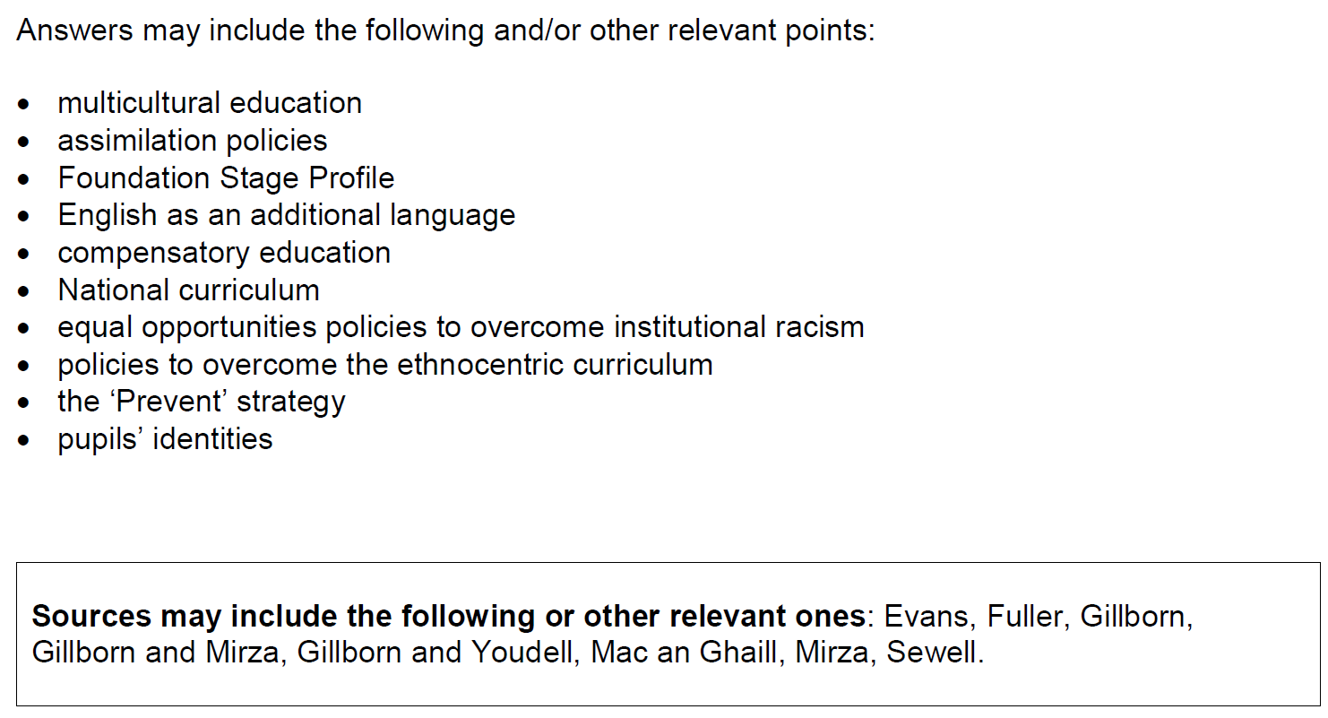
Outline two ways in which educational policies may have affected the experience of minority groups in education (10)*
*This is an AS question, for an A Level paper you would have an item to apply material from

Slide 34
Exam questions to try
Outline two criticisms of the comprehensive school system (4)
Outline three ways in which marketisation is shown in the education system (6)
Outline three reasons why Government education policies aimed at reducing inequality may not always succeed (6)
Analyse two polices creates to improve education for disadvantaged students (10)

Slide 35
Methods in Context
Read back over methods in context sections in text books and your class notes.
Remind yourselves of the studies we’ve looked at and make sure you can evaluate any research methods used to research issues in education.
When answering this question it is not enough just to evaluate a method using PERVRT, you must relate it to the topic being studied within education

Slide 36
Exam Advice
Education Section – (60 minutes)
Q1. Define a key term (2 marks)
Q2. Using an example explain… (2 marks)
Q3. Outline three reasons/criticisms/functions/policies (6 marks)
Q4. Outline and explain two reasons…. Mini essay (10 marks)
Q5. Essay purely on education – remember to use the item (30 marks)
Methods in Context – (30 minutes)
Q6. Essay linking a topic in education to a particular research method.
(20 marks)
E.g. Using Item B and your knowledge of research methods, evaluate the strengths and limitations of using _____________ to investigate___________________

