Slide 1
FUNCTIONALISM AND THE FAMILY

Slide 2

Starter: What type of family do you think is the most dominant in Britain?
Getting you thinking…

Slide 3
The statistics – what do they show us?
In 2017 there were 19.0 million families in the UK, a 15% increase from 16.6 million in 1996.
There were 12.9 million married or civil partner couple families in the UK in 2017. This remains the most common type of family.
The second largest family type was the cohabiting couple family at 3.3 million families, followed by 2.8 million lone parent families.
In the UK there were 27.2 million households in 2017, resulting in an average household size of 2.4.
In 2017, there were 3.9 million people living alone aged 16 to 64 years; a larger proportion were male (58.5%); similarly there were 3.8 million people living alone aged 65 and over but a larger proportion (66.5%) were female.

Slide 4

Couple headed family
How might these families be made up?

Slide 5
Functionalism and the family
INTRO
Functionalism sees the nuclear family as the main family type, either because it is the ‘best’ to socialise children or because it is found everywhere.
It has a key role in society in bringing up a new generation of children
It includes a married couple (husband and wife) and their children.
Already, what issues can we identify with the functionalist argument?

Slide 6
What do these videos tell us about Functionalism?
https://youtu.be/dhhdPgVzkwU
https://youtu.be/L3uZrIYfoL0

Slide 7


Organic analogy
Functionalists regard society as being like a body, with different parts working together for the harmony of the whole.
Functionalists see the family as a vital ‘organ’ in maintaining the ‘body of society.
They are interested to see how the family contributes to the functional prerequisites (or basic needs) of society.
The family is seen by functionalists as being the ‘heart of society’, what do you think they mean by this? [Complete p.8]

Slide 8
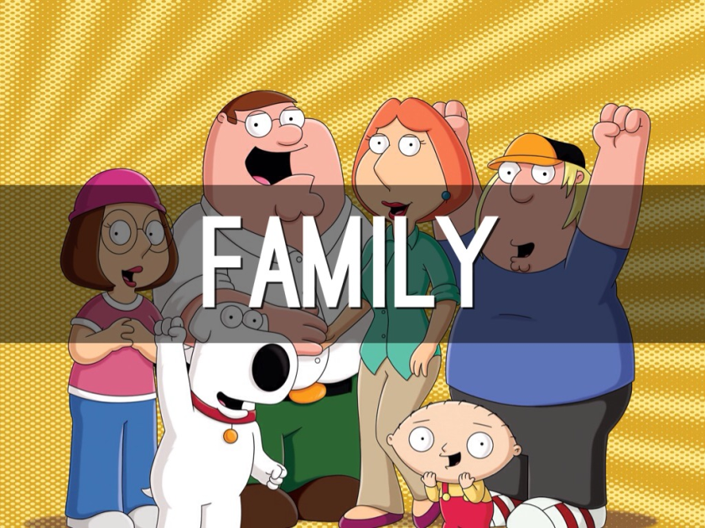
The importance of socialisation p.8
Functionalists stress the importance of primary socialisation as a key function of the family.
Primary socialisation is the way in which our parents and other siblings teach us the norms and values of our culture
Values- general beliefs about what is right or wrong in society and standards we think should be maintained.
Norms- acceptable forms of behaviour linked to those values.
Value consensus- agreement about shared values
Social solidarity- a feeling of belonging based on shared culture
Example
Value- protection of life
Norm- wearing a seatbelt in a car

Slide 9
What does the Family
need to do for society
and the individual?
FUNCTIONS
What type of Family is
best for contemporary society?
STRUCTURE
What do family members need to do to make the family “work”?
ROLES/RELATIONSHIPS

Slide 10
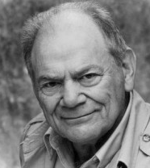
George murdock (1949) p.9
According to Murdock, the nuclear family is universal- it exists as an institution (an organisation founded for social reasons) in all societies cross-culturally or through time either on its own or part of a more complex extended network.
In groups research the other family forms on p.9, using p.268 of the Browne textbook and the internet.
Then answer the question underneath What does the presence of these other types of family indicate about Murdock’s argument?

Slide 11

Murdock’s Definition of the Nuclear Family (p.10)
He identified the following characteristics:
Common residence
Economic co-operation
Reproduction
Adults of both sexes
Socially approved sexual relationship
One or more children
What problems can you identify with Murdock’s 4 ideas about the family and his definition of a nuclear family?- p.10

Slide 12
George murdock (1949)
According to Murdock, the family is universal because only it family can fulfil functional prerequisites (basic needs) that societies need to function (p.10)
These are
  Sexual
  Reproductive
  Socialisation/education
  Economic

Slide 13
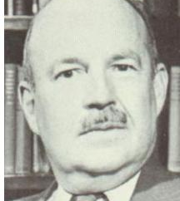
Talcott Parsons (1955)
According to Parsons, the nuclear family as it is now emerged with industrialisation because it is the ‘best fit’. It is not universal as Murdock claims.
He also argues it has lost many functions to other agencies and institutions such as the health and education system:
The nuclear family only has left, what he describes as 2 basic and irreducible Functions:
Primary socialisation- socialising children into their culture and acceptable gender roles
Stabilisation of the adult personality- adults providing support for each other in a society that puts a lot of pressure on people at work. Sexual division of labour helps stabilise adult personalities.
Complete p.11

Slide 14
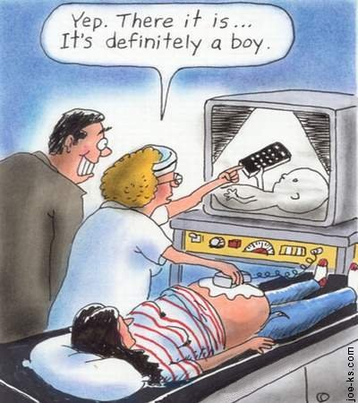
Parsons and the sexual division of labour
Functionalists argue that differing behaviours are natural for men and women. They argue that men and women are socialised into different roles but this is shaping tendencies that are innate (we are born with them)
Basically, biology drives our different roles

Slide 15
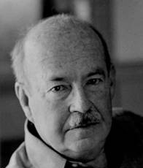
Parsons and the sexual division of labour
Talcott Parsons argues that in industrial society men perform an instrumental role (an economic role) and women perform an expressive role (nurture and emotional support).
This best suits their innate tendencies
This is referred to as the sexual division of labour

Slide 16
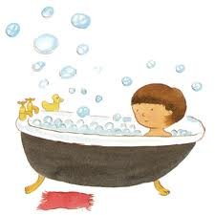
Parsons’ Warm bath theory
As part of the stabilisation of adult personalities, Parsons’ theory is often called a ‘warm bath’ Whereby the woman should act as a metaphorical warm bath, welcoming her husband home after a hard day at work and looking after his needs.
Who might be critical of this idea (complete p.12)

Slide 17
Parsons: the nuclear family is the ‘best fit’ for society
According to Parsons, pre-industrial society was characterised by the extended family, but as a direct result of industrialisation, this was replaced by the isolated nuclear family. (i.e. the nuclear family was caused by industrialisation). The isolated nuclear family is seen as ‘best fitting’ the needs of an industrial economy (i.e. that it is particularly suited to an industrial society). Young and Willmott and Fletcher would also support the view that the classic extended family has largely disappeared and a privatized nuclear family or some form of modified extended family has emerged.

Slide 18
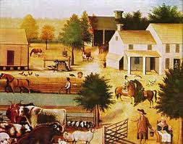
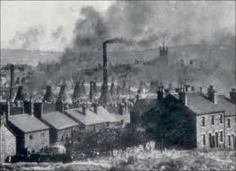
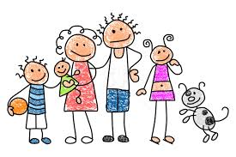
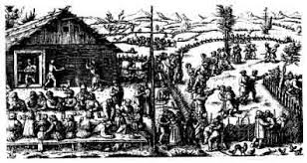
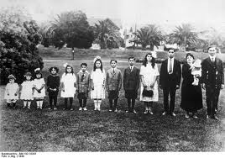
Modernity
Pre-industrialisation
industrialisation
People living in smaller units, seen as isolated. Less connected to wider kin on a regular basis.
Pre 1800s
Agricultural communities whose extended families depended on each other
1750-1850s
Still large families but in smaller housing, becoming more isolated

Slide 19
Family Change – the Parsons Model
Extended, Large Families
Isolated Nuclear Families
Limited Number of Children
Loss of functions – but still always responsible for emotional work, i.e.,
- Primary socialisation
- Stabilisation of adult personalities.
Multifunctional Families:
Welfare, Education &
Training, Religion, Work, Placement, etc.
INDUSTRIALISATION
Source of status (ascribed)
Irrelevant to status (achieved)

Slide 20
The changing functions of the family
Talcott Parsons
Evolutionary view of the family (march of progress)
With industrialisation the family lost many of it functions to other institutions (structural differentiation)
Maintains 2 basic and irreducible functions
Ronald Fletcher
The family continues
to perform a range of important functions
Family operates in partnership with other institutions to perform functions such as education, healthcare etc.

Slide 21
Parsons- reasons for ‘best fit’
Weakened extended family and growth of isolated nuclear family
Strengthened bonds between partners protect family stability
A more meritocratic society- not based on who you know, but what you know
Need to avoid economic and status conflict between kin
Need for small family unit for geographical mobility
High rates of social mobility weaken kin links
Greater affluence and reduced family functions- less need for kin

Slide 22
Parsons- reasons for ‘best fit’
Parsons argues the isolated nuclear family allows for geographic and social mobility. What does he mean by these concepts? Complete p.13
Geographical mobility
The size of the family allows it to be more easily moved around the country for work needs etc.
Social solidarity
Helps to form social bonds based on shared attitudes
Complete the questions about the decline of the extended family on p.14
Complete the fill in the gaps summary on p.15

Slide 23
Problems with functionalism as a theory
1. Down plays the role of conflict in the family. In particular the oppression of women and domestic violence. The family is not always the safe and warm place suggested by Parsons. Feminists and Marxists would support this argument.
2. Out of Date – Women now go out to work and the biological roles as set out by Parsons no longer apply as clearly. Postmodernists would make this argument.
3 Deterministic – Assumes that the members of society automatically take on the norms and values.
4. Ignores family diversity – Assumes that all families are best when nuclear however many family structures are apparent in todays society and still fulfil the same functions. Postmodern argument.

Slide 24
Summary questions
- Make a point and then explain (do this 3 times for 6 mark questions)
Define the term instrumental role [2]
Define the term ‘nuclear family’ [2]
Using one example briefly explain the difference between a family and a household [2]
Outline three functions that functionalists see the family as performing [6]
Outline three problems with the functionalist view of the family [6]
(These are technically AS questions, but are a good way to help summarise a topic).

Slide 25
Exam focus
Outline and explain two functions of the family
Identify Reason One
Provide evidence to support your argument. This should include named sociologists and may also include contemporary evidence, theory, statistics or other relevant points.
Add a tiny bit of evaluation
Explain how evidence relates to question

