Slide 1
MARXISM AND THE FAMILY

Slide 2

Brief introduction to marxism
From this video how does Marx view society?

Slide 3
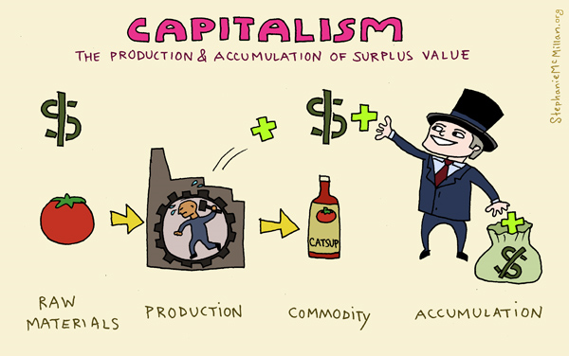
First thing’s first, what is capitalism?
In a basic sense, it’s an economic and political system in which a country's trade and industry are controlled by private owners for profit, rather than by the state
https://www.youtube.com/watch?v=PjctCS1kZp4
Notes:
https://www.youtube.com/watch?v=oFeXZbaKZ7c

Slide 4
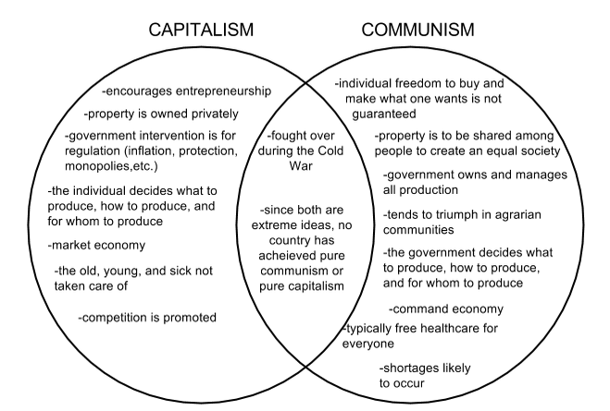
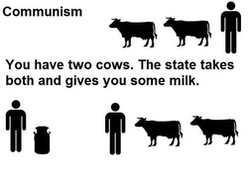
And Communism?
A system in which goods are owned in common and are available to all as needed. A theory supporting the elimination of private property

Slide 5
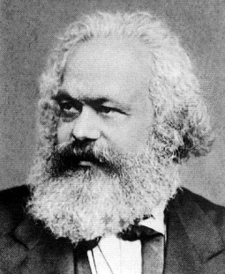
Overview of Marxism
Is a conflict structuralist theory exploring capitalist industrialised societies.
Sees society as ALWAYS based on inequality- where some people with a lot (money) have control over those with little.
This inequality is linked to social class: ruling class (bourgeoisie) and the working class (proletariat).
Takes the side of the working class

Slide 6
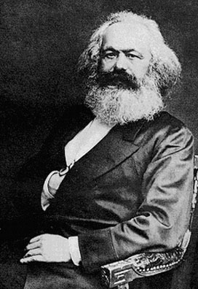
Marxism
Based on analysis of Karl Marx (1818-1883)
Political programme as well as sociological perspective
Nature of society based on economic forces and relationships
Believes that existing society is exploitative and oppressive because of private ownership of wealth
Without the economic system everything else is impossible hence its domination

Slide 7
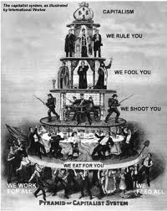
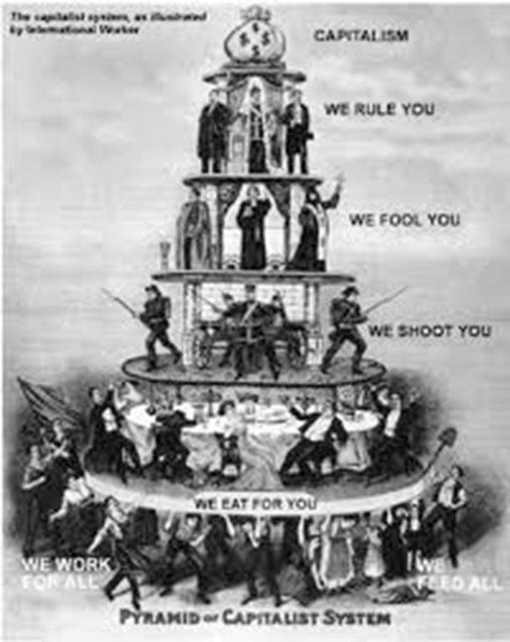
MARXISM: 5 KEY POINTS p.17
Capitalist society is based on conflict.
Conflict is between the ruling class (bourgeoisie) and the working class (proletariat)
The conflict occurs because the ruling class wants to increase profits, this is done by keeping working class wages low. The working class want higher wages, which would lower ruling class profits = CONFLICT!!!

Slide 8
MARXISM: 5 KEY POINTS
4. This creates a situation of exploitation and alienation for the working class.
5. Revolution is prevented along with radical social change by the presence of dominant ideologies which are taught through agents of secondary socialisation, including religion, the media and education.

Slide 9
Marx’s View of History
PRIMITIVE COMMUNISM
COMMUNISM
Ancient Economy
Slavery
Feudalism
Peasants
Capitalism
Wage Slavery
PRIVATE PROPERTY

Slide 10
Draw a representation of the marxist view of society
Using the first few slides and discussion in class, draw a representation of the Marxist view of society and the role of the family on p.18 of your booklet

Slide 11
What problems can you see in viewing society this way
Does this view of society seem relevant to you today?
Put some ideas and examples down on p.18 of your booklet

Slide 12
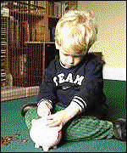
Marxism and the Family- The family’s role p.19
Ideological role: transmits the view that capitalism is acceptable through primary socialisation. Children are taught to accept their position in society.
Economic role: the family buys goods and services that help to maintain capitalism. It is a unit of consumption. Adults within the family also work, which pays for these goods and provides revenue for the government in the form of taxes.
Families could be seen to maintain political elites. Children of the rich and powerful maintain this power.

Slide 13
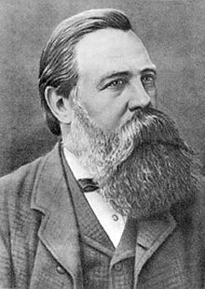



Friedrich Engels (1820-1895)
FUNCTIONS/STRUCTURE
The family is specifically adapted to differing economic conditions, for example:
  Primitive Communism – no property so no need for a family unit
  Ancient and Feudal economies – Agriculturally based production places an emphasis upon extended families. Family is a key source of status
  Modern Capitalism – Need for a flexible and mobile workforce means monogamy and increasingly small family units

Slide 14
Friedrich Engels
FUNCTIONS/STRUCTURE
Patriarchal Control – all forms of family leave a need for male control over women and children this ensures INHERITANCE
Consequently women’s bodies must be controlled by men, and children need to accept paternal authority – in the ages before DNA tests, fatherhood was difficult to establish – and still is
Engels describes marriage as legitimised prostitution – the exchange of the body in return for financial and other forms of security

Slide 15
What problems can you see with engels theory of the family?
On p.20 summarise Engel’s theory in bullet points and evaluate his ideas.

Slide 16
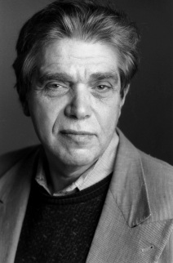
Eli zaretsky (1976)
WHAT’S THE FAMILY FOR?
The family props up capitalism – tries to keep it going in spite of its self-destructive qualities
The family is one place where male workers can feel they have power and control. This helps them accept their oppression in wider society.
(nb – based on traditional sexual division of labour …)

Slide 17

Eli zaretsky
WHAT’S WRONG WITH FUNCTIONALISM?
A “haven in a heartless world”? – the family in functionalism is seen as a safe place to be – it cannot be
The family is vulnerable to the demands of Capitalism – changes in the economy leave the family exposed – it cannot be immune to changes in employment, technology, welfare, etc

Slide 18

Eli zaretsky
THE CHANGING FAMILY
The family formerly a “unit of production”– in the pre-capitalist era, the family was the principal economic unit. It was only with the separation of home and work in INDUSTRIALISATION that this role has declined
The family is now – as a “unit of consumption” - central to a market economy– the family is left as both a refuge from the harsh world of work and a consumer unit toward which capitalist production is geared
THIS IS VERY CLOSE TO THE FUNCTIONALIST VIEW BUT IS CRTICAL OF THE ROLE THE FAMILY HAS

Slide 19
What problems can you see with zaretsky’s theory of the family?
P.22

Slide 20
Althusser (1971)
The family as an Ideological State Apparatus
The family works as an ideological state apparatus, alongside other institutions such as education and media, by passing on the ideology (ideas and beliefs) of the ruling class.
Through socialisation the family transmits these ideas to maintain a ‘false class consciousness’ (a failure of members of classes to recognise the inequality that is occurring)

Slide 21
Summary of marxism and the family
The family is “bad” because it helps to maintain this inequality and capitalism by
  Maintaining traditional gender roles:
    Exploiting women’s domestic labour
    Controlling women’s bodies – ensuring patrilineal inheritance
  Ideological control, including:
    Socialising children to accept their place
    “Pretending” but failing to support its members in the face of exploitation

Slide 22

MARXISM
PROBLEMS
Do Marxists really offer anything new?
  Traditional Marxist theory seems to simply be a kind of “inverted functionalism” – the family performs the same functions but in the context of an exploitative rather than a beneficial society.
What alternatives does Marxism offer?
  The family may be harmful in particular ways, but what else is there?
  Engels seems to want an end to monogamy and private property, but how is this to be achieved?
  And Zaretsky seems to want a strengthened modern family rather than an end to it.
Analysis of relationships within the family?
  Like functionalism, Marxism seems to offer a series of stereotypical assumptions about the family.
  How are the family relationships described really changing?

Slide 23
Marxism: SOME EVALUATIVE POINTS
Most people would not regard themselves as being controlled by capitalism in their family
Difficult to see alternatives to the current form of the family or of capitalism
Useful balance to uncritical views of family (Functionalism)
Criticisms
Too focused on the role of the economy
Contributed to understanding the family as an ideology
Strengths
Ignores diversity of family forms in capitalist society e.g. single parents, ethnic diversity
Functionalists would argue the family has a more positive role both for society and for its members
Accounts for some of the darker elements of family life e.g. domestic abuse
Acknowledges family as part of state apparatus

Slide 24
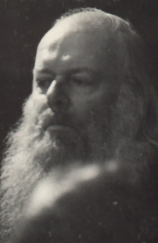

David cooper & anti-psychiatry
USING MARXISM?
David Cooper and RD Laing in the 1960s felt that capitalism, through the family, led to toxic family relationships and consequent mental illness
In his book, The Death of the Family, Cooper attacked the family as the basis of mental illness
In this he echoed the work of Edmund Leach (a functionalist anthropologist) who described the family as “the source of all our discontents”
HOWEVER, Cooper’s work remains controversial (for reasons other than his “Marxism”) and seems to use rather than develop Marxist ideas.

Slide 25

FEMINISM
MOVING ON FROM MARXISM
Feminist ideas owe a lot to the work of Engels and his theories especially about the patriarchal nature of the family
BUT feminists will differ considerably as to what is the ultimate cause of male rule
Michele Barrett talked about a “strange marriage” between Marxism and feminism

Slide 26
Summary questions
Make a point and back it up
Define the term ‘bourgeoisie’ [2]
Define the term ‘ideology’ [2]
Using one example, explain how the nuclear family acts a ‘unit of consumption’ [2]
Using one example, explain how the nuclear family ‘props up’ capitalism [2]
Outline three reasons why Marxists believe that the nuclear family functions to benefit capitalism [6]
Outline three problems with the Marxist view of the family [6]
N.B. – these are also examples of AS questions

