Slide 1
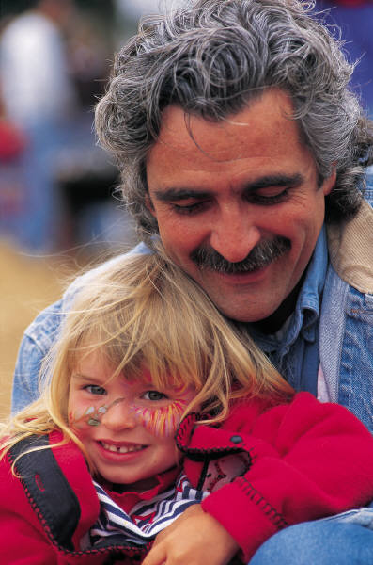
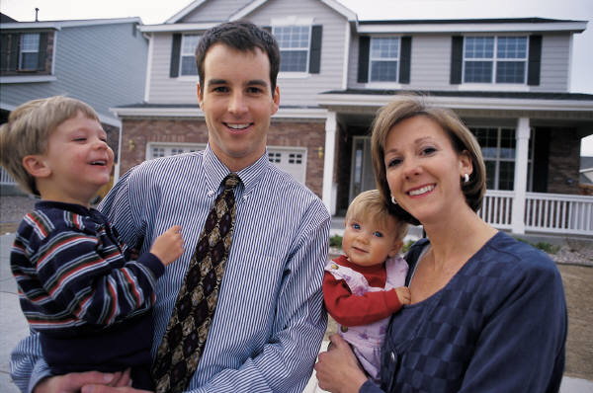
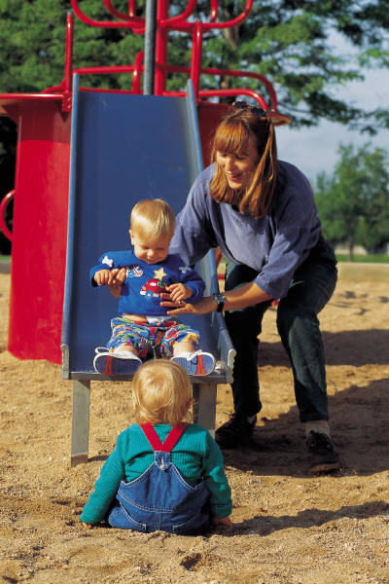
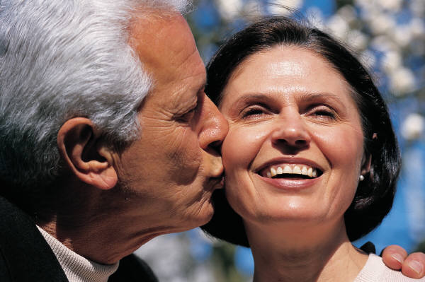
Family Diversity

Slide 2
What do we mean by the term diversity? p.3
DIVERSITY

Slide 3
Activity p.4
Draw a picture of the dominant stereotypical family in the UK.
What problems can you see with this stereotypical image of the family?
Who would agree with this image?
Who would be opposed to or challenge this image?

Slide 4
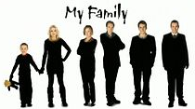
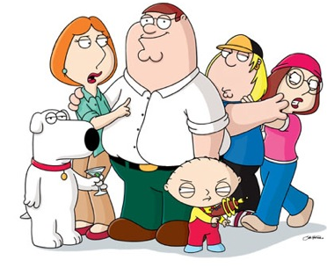
Key Question: Is the nuclear family still dominant?
This is the key issue when discussing diversity.
Is the nuclear family dominant or are British families a bit more complicated than this?

Slide 5

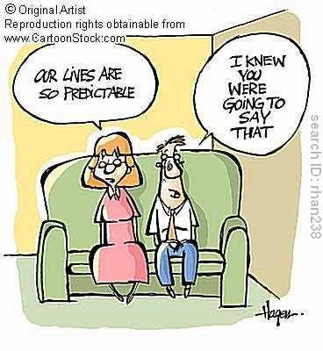
Functionalism and Family Diversity
Modernist perspective Modern society is fixed and predictable. One type of family is the best.
Parsons the functional fit is the nuclear family as provides 2 main functions
Primary socialisation
Adult stabilisation

Slide 6
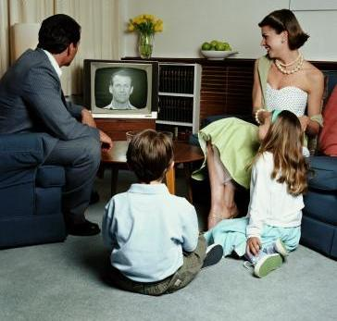
Functionalism
Parsons believes we can generalise about the family type we will find in society – Nuclear with a clear division of labour.
Other types could be seen as deviant or unproductive as they are less able to perform the functions required of the family.

Slide 7
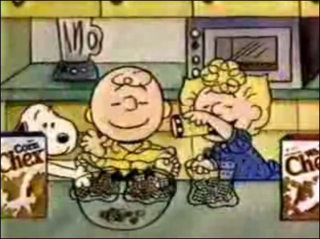
Traditional ideas of the nuclear family
The nuclear family is presented as ‘normal’- Edmund Leach regarded the nuclear family as the ‘cereal packet’ image of an ideal family in the 1960s of a heterosexual couple and two children who were close in age.
Leach regarded the modern nuclear family as broadly dysfunctional when compared to more extended family networks – as an emotional hothouse it becomes “the source of all our discontents”
Like other functionalists though, he assumes this family structure is dominant in our society

Slide 8
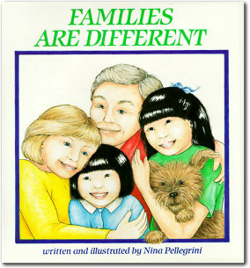
The Neo-conventional Family
Chester (1985) accepts recent diversity, but does not see this as significant or negative.
1 important change is move from:
Traditional Neo-conventional
Nuclear family Family

Slide 9
Chester: The Neo-conventional Family
Dual earner family (symmetrical family)
Nuclear family remains an ideal.
Most people will be part of a nuclear family at some point.
Most people still:
marry
have children
stay together till death
jointly register births
live in a household with a married couple.
The New Right Exagerrate

Slide 10
The Life cycle of the family
What do you imagine the life course/cycle of a typical individual in the contemporary UK? Draw a picture of this on page 6.
Postmodernists, Alan and Crow would argue that families do not pass through ‘typical’ life cycles any more. Why do you think they believe this?
Counter point: Oakley is critical of the sexual division of labour of men and women in the home because of the burden it places on women. So why do you think she still thinks the nuclear family is conventional?

Slide 11

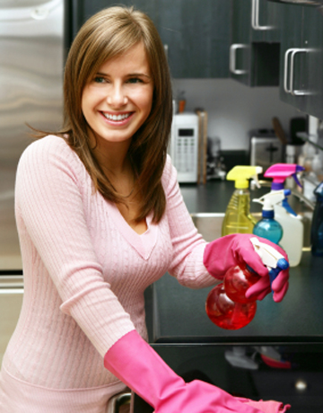
The New Right
Conservative and anti-feminist approach. Firmly opposed to family diversity.
Only one correct family type.
The nuclear family is ‘natural’ and based on fundamental biological differences between men and women.
Decline in nuclear family is the cause of many social problems.
Bensons’ (2006) study shows that cohabitating couples (20%) are more likely to separate after having a child than married couples (6%).
Amato (2006) children in nuclear family are less likely to experience poverty, education failure crime and health problems.
Do you think the decline in the nuclear family is to blame for many social problems in society? Page

Slide 12
Key Study: Rapoport and Rapoport
Robert and Rhona Rapoport are postmodernists- offering contemporary reasons for social phenomena.
Argue that although families might look like nuclear families from the outside they may be very differently set up on the inside. They also argue there are many other types of family, which traditional theorists tend to ignore.

Slide 13
Rapoport and Rapoport (1984) identified five elements of family diversity:
Organisational: different structures and how roles are divided in the household.
Cultural: the nature of the family and relationships can vary considerably between different ethnic and cultural groups
Class/Economic: differences may be based on class, such as sharing of domestic roles and decisions, employing a nanny. Differences in socializing children.

Slide 14
Life Course: The nature of the family can change over the life-course of an individual. For example, living in a nuclear family is more likely for those in their thirties than those in their sixties
Cohort: individuals born at the same time may have similar experiences because of wider social and historical events, such as economic depression, war, expansion of education

Slide 15
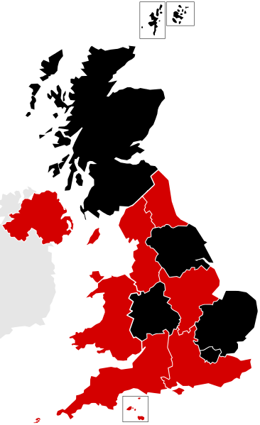
Eversley and Bonnerjea (1982) – Diversity and Location
David Eversley and Lucy Bonnerjea add in the additional factor of regional diversity
They suggest that local influences produce different life experiences, and so, diversity.
They identify FIVE areas of Britain which offer different types of family organization- affluent, rural, geriatric, inner cities, old industrial

Slide 16
Eversley and Bonnerjea (1982) – Diversity and Location
Many coastal regions attract elderly couples ‘geriatric wards’, e.g.Brighton
Inner city areas have greater concentrations of lone parents and ethnic minority families in the poorer areas, e.g., inner city Manchester
Traditional rural areas have more reliance on extended family, e.g. Devon
Affluent Suburbs tend to attract young families ‘family builders’, e.g. Godalming!
Old industrial areas may have the kind of extended family networks identified by Young and Willmott in their original study, e.g Yorkshire

Slide 17
Extended families
There is also the idea that although families may look nuclear they may in fact be part of a more complex extended structure.
Unlike Parsons, other functionalist sociologists such as Sussman (1965), have argued that the thesis of family units being isolated must be rejected. In particular, he showed that aid and assistance, particularly financial, still flows from parents to children and argued that extended family networks occur widely in industrial societies.
The findings of Willmott and Young, etc support this

Slide 18
Peter Willmott (1988)
Conducted a study of families in a North London suburb and identified FOUR main types of extended families:
Extended family of residence – where members of the family live in the same household
Local extended family – where 2 or 3 nuclear families live separately, but in close proximity and see each other often
Dispersed extended family: nuclear families who see each other reasonably frequently but live further apart and do not see each other as regularly
Attenuated extended family: similar to the dispersed extended family but the contact is even less frequent

Slide 19
Cultural diversity
Culture refers to the way of life of different groups of people. It can vary in terms of language, dress, religion, nationality, traditions etc. It crosses over with ethnicity, in terms of the differences between people.
How might the differences between cultural groups impact the nature of families in the UK?
Make notes using pages 311 of Browne pages 9 in booklets

Slide 20
Postmodern views of diversity
From your research on p.10 of the booklet, what do the postmodern arguments indicate about the nature of family diversity today?
How do they challenge functionalist ideas and views of people like Robert Chester.

Slide 21
Conclusion
Diversity is not just about the structure- the extent to which the family looks like the nuclear family- it is also about how similar families are on the inside- at the interpersonal level. For example
  differences in male/female roles
  ideas about socialising children
  the role of religious ideas
  etc.
  What matters in interpreting this is the emphasis placed on different features.

