Slide 1



Family Trends and Demographics
Notes:
Plan to cover:
p.3-4 – use PPT to flip/ or go through in class
p.5 class discussion
p.5-6 – use PPT to flip/or go through in class
p.7-8 research (hwk?)
If the bulk of this was flipped it would take an hour to go through and then groups could research for p.9-10 – more indepth discussion in class
p.9-10 – research in groups and feedback – add to.
p.11-16 flip – resource is at the end of the booklet
p.17-18 – group work if you wish
p.19-20 – could be set up as a bit of a competition

Slide 2
Topic overview
WHAT YOU NEED TO KNOW
Outline, explain, analyse and evaluate sociological explanations for:
- Changes in patterns in marriage
- Changes in patterns in cohabitation
- Changing patterns of separation and divorce
- Changing patterns of childbearing
N.B. you’ll be able to use a lot of content from the first four booklets for this topic

Slide 3
A way to remember reasons for changes to the family:
LIST
Legal (changes in law and government policy)
Ideological (changes in ideas about what is right or desirable)
Social (includes sociological theory, demographics and studies)
Technological

Slide 4
LEGAL: Changes in the law and government policy

Slide 5
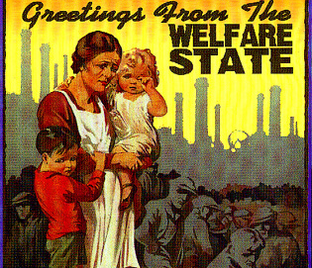
Legal Factors – Expansion of the Welfare State System
Since the 2nd world war there has been a rapid expansion of the welfare state system – this has included improved healthcare and the development of the ‘safety net’of the benefits system including housing child and income support benefits.
What impact do you think this has had on families?

Slide 6

Legal Factors – Divorce Reform Act (1969/71)
Before this act there needed to be proof that one partner was the ‘guilty party’ and had committed one of 3 ‘matrimonial offences’:
  Cruelty
  Adultery
  Desertion
The act removed the need to prove a guilty party and made ‘irretrievable breakdown’ the grounds for divorce by proving unreasonable behaviour, adultery, desertion or separation (with or without consent)

Slide 7

Legal Factors – The Matrimonial Family Proceedings Act (1984)
This act reduced the length of time that a couple needed to be married before filing for divorce down from 3 years to 1 year

Slide 8
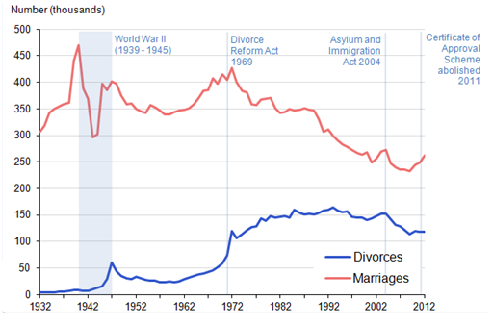
What does this diagram show us about divorce and marriage rates in the UK?

Slide 9

Legal Factors – Equality Act 2010
This Act brought together key anti-discrimination policy to protect people against discrimination in the workplace based on grounds of gender, religion, sexual orientation and age.
It Includes the:
The Sex Discrimination Act 1975 and Equal Pay Act 1970
Impact on the family?

Slide 10
Children Act 1984/2004
The Act aims to make living in the UK, as a child, as safe as possible by protecting their welfare and rights.
The act allows the state to intervene in a family should the welfare of a child be called into question.

Slide 11
Child Maintenance Service (2012)
Requires absent parents to pay maintenance for children they do not live with.
This service is used when parents cannot agree on a ‘family-based arrangement’
This maintenance is calculated using a set formula.
Impact on the family?

Slide 12
Civil Partnership Act (2004)
Gave legal recognition to the relationships of same-sex couples who enter a civil partnership, involving similar arrangements to a legal marriage.
Allows same-sex couples to marry on the same basis as opposite- sex couples.
Marriage (Same Sex Couples) Act 2013

Slide 13
Abortion Act 1967
The law in England, Wales and Scotland allows abortion up until 24 weeks gestation. Abortion was decriminalised in Northern Ireland in October 2019
Two doctors must agree there is medical need, such as if continuing the pregnancy is a greater risk to the mother's physical or mental health, or that of her other children, than having a termination.
Initially the law allowed terminations up to 28 weeks.
In 1990 the law was updated so that it was illegal to abort a foetus after 24 weeks except in certain circumstances - for instance if it is to save the mother's life or there is evidence of extreme foetal abnormality.

Slide 14
NHS Policy – Contraceptive Pill
1961 – the contraceptive pill is made widely available
The launch of the contraceptive pill, which suppresses fertility with either progestogen or oestrogen or, more commonly, a combination of both, plays a major role in women's liberation and contributes to the sexual freedom of the so-called "Swinging Sixties". Initially, it is only available to married women, but the law is relaxed in 1967.
Between 1962 and 1969, the number of women taking the pill rises dramatically, from approximately 50,000 to 1 million.
Notes:
https://www.radiotimes.com/news/2017-03-12/call-the-midwife-the-real-history-of-the-contraceptive-pill/

Slide 15
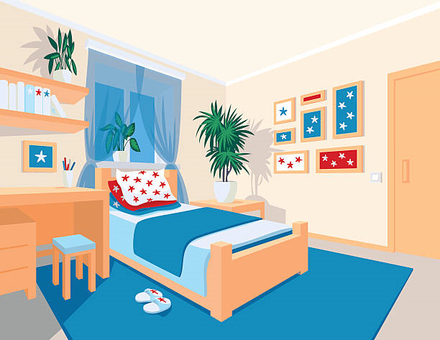
Bedroom Tax (2012)
The under-occupancy penalty results from a reform contained in the British Welfare Reform Act 2012 whereby tenants living in public housing (also called council or social housing) with rooms deemed "spare" face a reduction in Housing Benefit, resulting in them being obliged to fund this reduction from their incomes or to face rent arrears and potential eviction by their landlord (be that the local authority or a housing association).

Slide 16
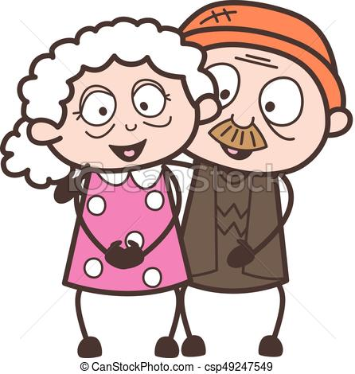
Retirement age
In 2011, compulsory retirement was outlawed.
The employment rate of over 65’s has increased from 5% in 2001 to nearly 10% in 2013.
Impact on the family?

Slide 17
IDEOLOGICAL: changes in ideas of what is right or acceptable in society

Slide 18
Page 5
Changes in values towards family and marriage… how have social attitudes changed?

Slide 19

Ideological Factors – Materialism / Individualism
Many social commentators point to the following changes in values:
Increased individualism and an emphasis on personal fulfilment (Beck and Beck - Postmodernists)
Increased materialism and a pursuit of wealth
A greater emphasis on careerism
Impact on the family?

Slide 20

Ideological Factors – Cohabitation as the Norm
The idea of living together without being married is no longer widely regarded as ‘living in sin’ but as the norm
In the 1950’s only 2% of marriage partners had cohabited prior to marriage.
Nearly half of babies are born to people who are not married (in the United Kingdom 47.3% in 2011
Some people use it as a stepping stone to marriage, others see it as an alternative to marriage
Couples that have lived together before marriage are more likely to divorce than those who have not. Why do you think this is?
Notes:
https://www.thespruce.com/cohabitation-facts-and-statistics-2302236

Slide 21
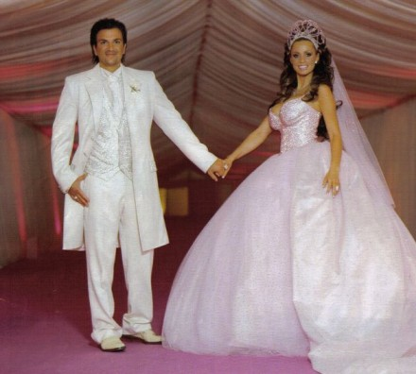
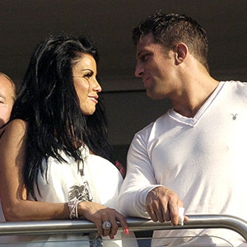

Ideological Factors – Changing Norms of Love, Marriage and Divorce
The primary reason given for modern marriage is ‘love’. Giddens argues people seek confluent love (fulfilment).
The idea of ‘permanence’ is not regarded as a central idea
There is less social stigma attached to divorce
This has led to the creation of many more reconstituted/ step families
Some Functionalists such as Talcott Parsons have argued that the increase in the divorce rate is due to the increased importance placed upon marriage.

Slide 22
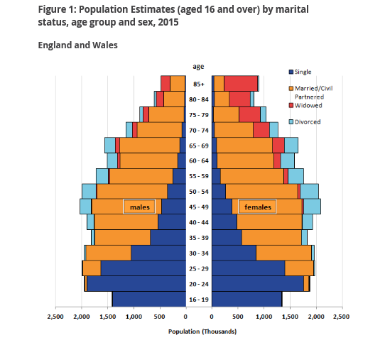
What does this diagram indicate?
Notes:
https://www.ons.gov.uk/peoplepopulationandcommunity/populationandmigration/populationestimates/bulletins/populationestimatesbymaritalstatusandlivingarrangements/2002to2015

Slide 23
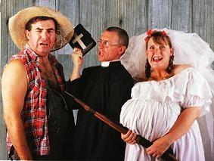
Changing attitudes towards single parent/lone parent families
There is less social stigma toward lone parenthood.
Historically women who were unmarried that became pregnant would be socially shunned and depending on their age may have had to give the baby up for adoption.
Becoming pregnant without being married often led to many ‘shot gun’ weddings to avoid the social stigma. This did not always mean the couple were happy together.

Slide 24
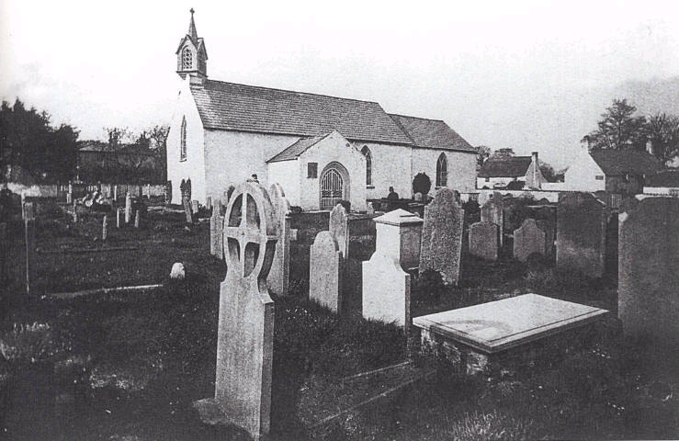
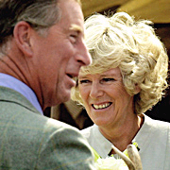
Ideological Factors - Secularisation
The decline in religious values, has led to:
The influence of religious ideas about ‘til death us do part’ weakened.
Fewer weddings in churches
Living together and not being married no longer viewed as ‘living in sin’
More people remarrying following divorce

Slide 25

Ideological Factors – The influence of the Feminist Movement
The feminist movement has done much to empower women to be able to assertively make their own life choices.
Second wave feminism of the 1970s has had an important impact on many legal changes.
Impact on the family?

Slide 26

Changing aspirations of women
Sue Sharpe demonstrated women’s aspirations have changed between the 1970s and 1990s, with more focus on careers rather than marriage. Her study “ Just like a girl” found a major change in attitudes towards the importance of careers over marriage from the 1970- 1990

Slide 27
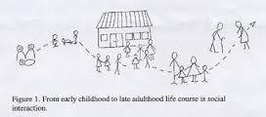
Changing life course of the family
A wide range of choices and options means there is far more uncertainty when it comes to making decisions about an individual’s life course.
Alan and Crow argue our lives are now characterised by choice, which makes families far more diverse.
The life course no longer occurs in one set pattern, but can vary massively between people.

Slide 28

Childfree couples
Carol Smart’s Personal life perspective (covered in the first booklet) explored how many families are now chosen, with elements like fictive kin and pets.
In addition to this are a growing number of childless couples who are choosing not to have children
Or who are forming relationships later in life and therefore are unable to conceive.

Slide 29
SOCIAL: wider changes in society

Slide 30
Financial
Identify at least four examples of financial issues that could effect the family ….

Slide 31
Social factors- Finance
Economic issues- costs of weddings (av £20,000), problems with getting mortgages.
Cost of childcare- A survey in 2004 by the Daycare Trust found that childcare costs were nearly a quarter of an average household income.
Bills going up due to cost of living rising.
Extended responsibility for “ adult” children e.g Uni fees, children living at home for longer

Slide 32
TECHNOLOGICAL

Slide 33
How have changes in technology impacted upon the family?
INFLUENCE OF TECHNOLOGY

Slide 34
Technological changes
How has the development of contraception influenced the family?
Family Size
Control over how many children
More child centred families
More disposable income
How has the technological development of IVF changed the family?
Couple who wouldn’t be able to conceive naturally now can
More Gay couples with children
More Multiply births ( twins and triplets)
How has the technological development of Abortion changed the family?
Smaller family sizes
Women have more choice about when/ if they start a family

Slide 35
Summary
What is the impact of the LIST factors on the patterns/changes in the family on p.9-10. You may need to do some more research using p.211-223, p.199-201 of Webb

Slide 36
Demographic change

Slide 37
Demographics
Demographics are the statistical data about a population e.g. age, life expectancy, income, level of education, number of families etc.
Some examples of demographics linked to the family- there has been a decline in the size of the average family from 3.1 people in 1961 to 2.4 in 2006.

Slide 38
What you need to know
Outline and explain the following concepts:
- Net migration
- Infant mortality rate
- Fertility rate
- Birth rate
- Death rate (mortality rate)
Use the notes at the end of your booklet to complete p.11 (definitions) and p.12 (statistics)
Then explain what the reasons are for these trends (use the LIST factors) and offer an explanation of the impact this has had on the British family p.13 of your booklet.

Slide 39
The ageing population
The average age of the population is getting higher, with a greater proportion of the population over retirement age and a smaller proportion of young people e.g. it is projected by 2041 there will be as many 78 year olds as five year olds.
The dependency ratio will increase with the rise in the number of retired people and decrease of younger people. In 2015 there were 3.2 people for every pensioner; by 2033 this is expected to have fallen to 2.3. This is not to say all older people will be dependent, but are much more likely to require care and financial assistance (including pensions paid by current working people’s taxes) than working age people.
What impact will a growing dependency ratio have on our society?
Other impacts have been the creation of a Sandwich Generation. Grundy and Henretta argued that middle aged women now face the pressures of looking after elderly parents and their teenage children or grandchildren.

Slide 40
The ageing population
Positive impact | Negative impact

Slide 41

Migration
Migration refers to movement of people from place to place. This could be within a society or internationally.
Emigration is when someone moves to another country and this new country becomes their destination of usual residence.
Immigration is where someone enters another country and this new country becomes their destination of usual residence.
Migration can occur because of push and pull factors.
Pull factors include:
Push factors include:

Slide 42

Other trends
There are a few other trends we need to consider, such as Living Apart Together, beanpole families, more people living on their own and more young people living with their parents.
On p.17-18 find some reasons/impacts of these other family trends
Living Apart Together, use p.218 Webb
People living on their own, use p.217 Webb
Young people living with their parents
Beanpole families p.222 Webb

Slide 43
Cross over of topics p.19-20
Cross over of topics: AQA exam questions typically put together two separate parts of the course and ask you to bring material together from both
Using all of your knowledge of the sociology of the family. How might particular changes in the family affect others i.e. how does the changing nature of women’s roles impact the experience of childhood?
Split into groups and see how many you can get – which group can get the most?

Slide 44
Theories – how would they view family trends?
Functionalism | Marxism | Feminism | Postmodernism
Would be concerned about the impact on the nuclear family, which they regard is the best family type to socialise children | May be concerned with the negative impact that some changes have had on the economic position of some individuals e.g. lone parents | Liberal feminists would regard many of the changes as a ‘march of progress. Whereas radical feminists would be wary of the impact some changes have had on women i.e. triple shift | Would argue we now live in a society that is based more on choice and individualism. Changes in the family reflect this.

Slide 45
Test your knowledge
Complete the following 10 mark questions:
Outline and explain two reasons for the changes in the size of families and households in the last 50 years. (10)
Outline and explain two ways in which changes in the law have affected women's family roles in the past 60 years. (10)
30 minutes to complete

Slide 46
Family trends assessment – 20 mark essay
Item: There has been a significant increase in the number of divorces since 1970. One important factor behind the increase has been the changes in the law relating to divorce. However, legal changes alone may not be enough to explain the trend and sociologists have suggested a number of possible causes of a higher divorce rate. One of these is a decline in the influence of traditional norms and values about marriage that used to stigmatise divorce.
Evaluate the view that legal changes are the main reason for the increase in divorce over the past 40 years in the contemporary UK (20 marks)
Complete the essay plan – consider the theory you need to include- look at your theory booklets and handouts

