Slide 1
Research methods
Research methods is an important part of paper 1 and 3. In paper 1 you will be asked to evaluate the effectiveness of using a particular method for studying an issue in education. In paper 3 you will need to evaluate methods and methodological issues

Slide 2
When you have worked through this unit you will be able to:
Define key terms and concepts related to sociological research including primary and secondary data, triangulation, representativeness, reliability, generalisability, validity, quantitative and qualitative data, Interpretivism, Positivism and Realism
Understand the problems in selecting appropriate research methods and topics of research.
Begin to think about ways to evaluate research, including issues with ethics.

Slide 3
Types of data
To stop Sociology being ‘Common Sense’ it has to collect evidence to support its claims (e.g. as done by the sociologists we have seen in the gender booklet). This evidence is known as DATA.
ACTIVITY
On p.5 of your booklets use p.120-121 of ‘Sociology in Focus’ 2nded, or p.135-137 of the Browne textbook to complete the different types of data.
Once you have completed this, apply your knowledge to p.6

Slide 4
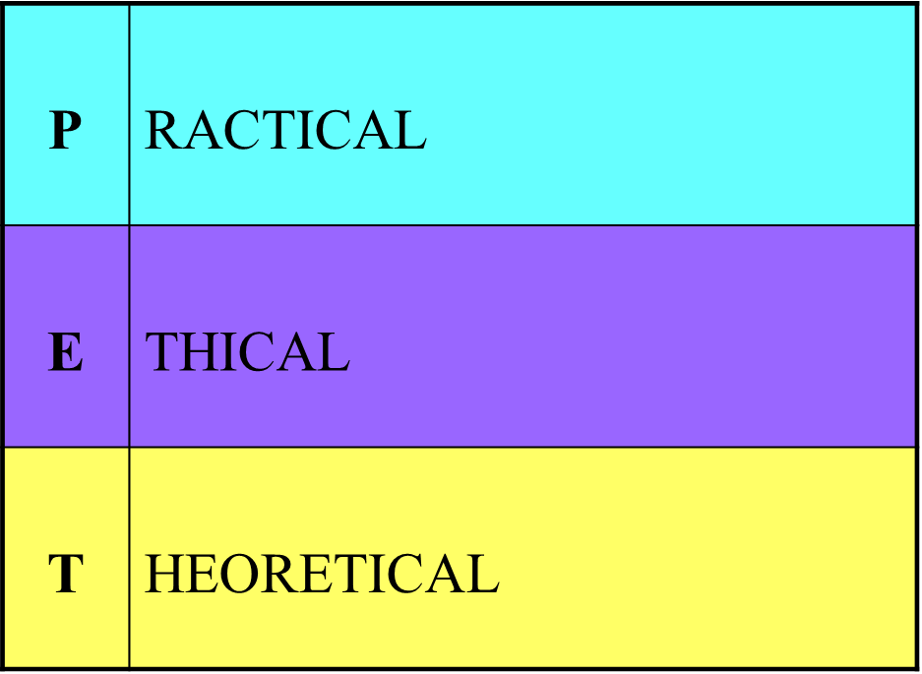
Factors influencing the choice of method: P.E.T

Slide 5
Practical Issues
Access to those being studied- can you reach the people or information you need to e.g. children are hard to access because you may need a DBS.
Time and Money – time & money can restrict the choice of methods, e.g. semi-structured interviews are relatively time-consuming. Funding Bodies – may require the results to be in a particular form, e.g. a government department may prefer the data to be in numerical form gained through questionnaires or structured interviews.
Availability of the data- is there information on the topic available e.g. historical events may lack specific information.
Values and beliefs of the researcher- will influence the choice of topic and could bias how the data is collected and how results are presented.
Pressure to publish – will you run out of time to do the research because of demands from employers/funders to release the info?
Values of society- will society accept your findings? Could they be controversial?
Personal Skills/Characteristics of Researcher – certain methods (e.g. participant observation) require the researcher to possess skills/characteristics that allow him or her to establish rapport.

Slide 6
ethics
What do we mean by the term ethics or ‘being ethical’?

Slide 7
Ethical Issues
Informed Consent – participants should be informed about the research and be given the right to refuse to be involved.
Confidentiality and Privacy – identity of participants should not be revealed and privacy respected.
Deception and covert research- not making people aware they are being studied (covert) may lead to research being invalid because it has not gained consent.
Safety of the Participants – researchers need to be aware of the possible effects of their work on those they study (e.g. psychological damage).
Findings reported accurately and honestly- there is an ethical obligation to be fair and honest.
Vulnerable Groups – special care should be taken when dealing with vulnerable groups (e.g. children).

Slide 8
Theoretical Issues (p.9)
Validity – a valid method produces a ‘mirror image’ of reality and allows the researcher to get to the ‘truth’ of what he or she is studying.
Reliability – a reliable method is one which, when repeated by another researcher, gives the same results.
Representativeness – refers to whether or not the people we are studying (sample) have the same characteristics as the group we are interested in (target population)
Generalizability – relates to representativeness and suggests that if the sample is large enough (i.e. representative), we can apply the data to the target population.
Methodological Perspective (Positivism, Interpretivism, Realism)

Slide 9
Research methods video
As we have seen when studying the education system Sociologists take different standpoints on the same thing. This is the same with how Sociologists approach studying the social world.
Some Sociologists think society should be studied scientifically, by looking a big social issues and observing ‘facts’ about the world, they are known as Positivists.
Other Sociologists think we should study individuals and their own experiences, rather than trying to make grand theories or ‘facts’, they are known as Interpretivists.
Others combine these two approaches, and are known as Realists.
The video notes on p.11 give more details of these approaches

Slide 10
There are two research traditions for methodological approaches
interpretivism
Positivism
Approach to the social world:
The individual is the product of the social influences around them.
Science alone can provide true knowledge about the world.
Scientific knowledge is based on direct observation which can be counted e.g. exam results.
Aim of science is to generalise observations in order to construct social facts which describe the causes and consequences of phenomena (‘Social phenomena’)
Approach to the social world:
The sociologist is concerned with exploring small scale interactions. Society is created by individuals who negotiate the meanings of social life between themselves.
Sociologists should not only consider the behaviour itself but also the motives and meanings behind it e.g. what went on in someone’s life to influence their exam results.
You can’t understand people using scientific methods. You have to get inside people’s heads.

Slide 11
Preferred data
POSITIVISTS
QUANTITATIVE
Statistical data allows us to draw generalisations and be systematic.
INTERPRETIVISTS
QUALITATIVE
Allows us to explore meanings. Generalisations are less important than looking a reality in depth.

Slide 12
Preferred methods
POSITIVISTS
Social Surveys/Questionnaires
Structured interviews.
Non Participant Observation
Social experiments
Official/non official statistics
INTERPRETIVISTS
Participant Observation
Unstructured/ semi interviews
Life documents e.g. diaries, letters

Slide 13
They want:
POSITIVISTS
Reliable data. They want hard facts and so their research needs to be repeatable.
Representative data- the sample represents the characteristics of the target population.
Generalisable data- the data can be applied to the nature of the whole group.
INTERPRETIVISTS
Valid data. The data should allow us to uncover hidden meaning and see a ‘mirror image of reality’

Slide 14
Realists
There is also another theoretical approach to research methods: Realism.
These researchers choose to take a multi-method approach where they combine both Positivist and Interpretivist methods.
The aim for these researchers is to gain valid and reliable data, usually through triangulation (the use of multi-methods to check validity and reliability) or methodological pluralism (the use of multi-methods to build a fuller picture of the issue).

Slide 15
Fitness for purpose
The method is:
Suitable to study the sample (group) being researched e.g. if researching small children a self completion questionnaire is not suitable.
Viable given practical constraints such as time and cost e.g. if there is a limited deadline you would not have time to complete unstructured interviews, self completion questionnaires may be more suitable.
The safety constraints are too significant e.g. studying gun crime using participant observation may not be suitable.

Slide 16
Fitness for purpose
The method:
Must adhere to British Sociological Association Guidelines e.g. covert observation may be rejected even before planning stage is reached.
Should fit in with the theoretical position of the researcher e.g. questionnaires would not be suitable for Intepretivist and Feminist methodologies.
Suits the needs of the topic being researched e.g. you could study male/female roles in the family using diaries, but not participant observation.

