Slide 1
Applying for Sociology related degrees

Slide 2
Routes
Sociology
Criminology
Anthropology
Combine with sociology, languages
Combine with sociology/law
Combined honours with
English, criminology, education, social work, languages
Law, languages, psychology
Biology, forensics

Slide 3
Studying Sociology at University
Degrees in Sociology can vary a lot in their content and focus. It’s important to do your research for topics you are interested in
IT'S THE STUDY OF THE STRUCTURES AND NATURE OF HUMAN SOCIEITIES.
A Sociology degree can help lead you into all sorts of job areas. Have a look here
Topics these courses can cover: Theory, Methods, Gender, Education, Crime, Race + Ethnicity, Culture, Politics, Identity, Media, Social Policy…

Slide 4
Studying Criminology at University
Criminology degrees can vary quite a lot between universities. All will have Sociological content, as theory makes up the basis of Criminology. Other subjects that could be combined within the degree are Psychology, Media, Forensics (which may include Biology and Anthropology) and Law. Types of topics will include punishment, justice, global crime, explanations of crime, terrorism etc.
A 10 min clip of a student explaining why she chose criminology

Slide 5
Studying Anthropology at University
Anthropology is the study of human cultures. Anthropologists immerse themselves in the lives of the people they are studying to understand the culture in terms of the interpersonal relationships, decision making, economics and history.
What is Anthropology?

Slide 6
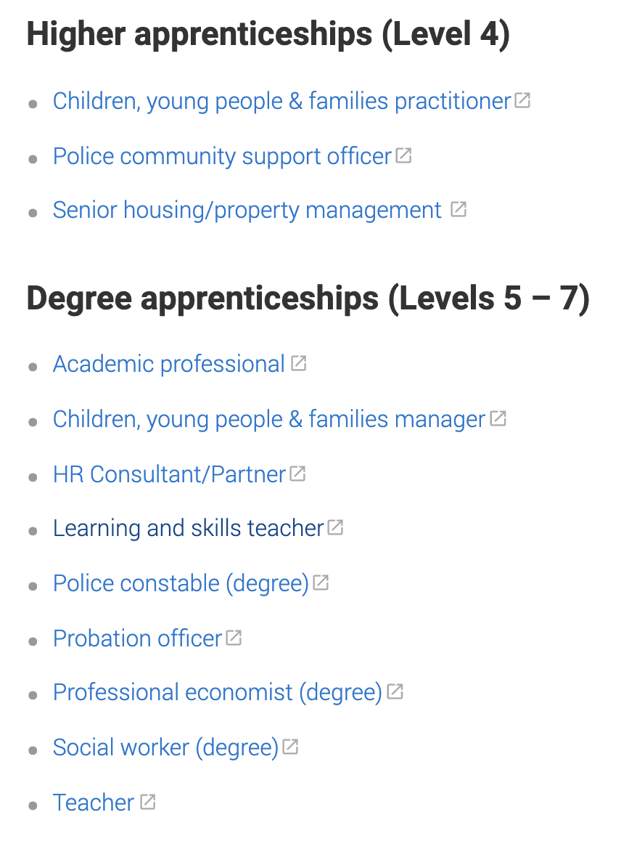
Non university options
Find the links to these apprenticeships here
https://www.ucas.com/explore/subjects/social-studies
SOCIOLOGY (NURTURE)
PSYCHOLOGY
(NATURE)

Slide 7
Personal statement
How to write a personal statement
https://www.ucas.com/undergraduate/applying-university/how-write-ucas-undergraduate-personal-statement
Personal statement
Competition for places can be high so personal statements form an essential part of the selection process. Admissions tutors want to see you have aptitude, interest, and motivation in you chosen subject. In general, this means they are looking for:
an explanation of what drives your interest in your chosen field
evidence that you have a real enthusiasm for the subject, which could be demonstrated by:
relevant work experience/shadowing or voluntary work
additional reading and research
membership of related societies/clubs
a range of interests outside of academic study – e.g. sport, music
a well written statement that shows you are a motivated individual who has something to contribute to the university
ability to work individually and in teams

Slide 8
Questions?
Q+A

