Slide 1

Kinetics
2008 SPECIFICATIONS
KNOCKHARDY PUBLISHING

Slide 2
COLLISION THEORY
Before you start WATCH https://www.youtube.com/watch?v=7qOFtL3VEBc
Watch https://www.youtube.com/watch?v=OttRV5ykP7A
Page 3
Collision theory states that...
particles must COLLIDE before a reaction can take place
not all collisions lead to a reaction
reactants must possess at least a minimum amount of energy - ACTIVATION ENERGY
plus
particles must approach each other in a certain relative way - the STERIC EFFECT

Slide 3
INCREASING THE RATE
Page 3
The following methods may be used to increase the rate of a chemical reaction
INCREASE THE SURFACE AREA OF SOLIDS
INCREASE TEMPERATURE
SHINE LIGHT
ADD A CATALYST
INCREASE THE PRESSURE OF ANY GASES
INCREASE THE CONCENTRATION OF REACTANTS

Slide 4
Page 4
COLLISION THEORY
Watch https://www.youtube.com/watch?v=wbGgIfHsx-I
Collision theory states that...
particles must COLLIDE before a reaction can take place
not all collisions lead to a reaction
reactants must possess at least a minimum amount of energy - ACTIVATION ENERGY
plus
particles must approach each other in a certain relative way - the STERIC EFFECT
ACTIVATION ENERGY is the minimum energy required for a reaction to occur.
According to collision theory, to increase the rate of reaction you therefore need...
more frequent collisions increase particle speed or
have more particles present
more successful collisions give particles more energy or
lower the activation energy

Slide 5
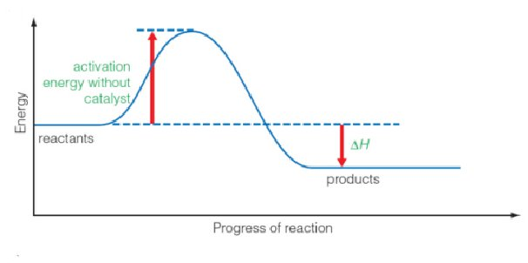
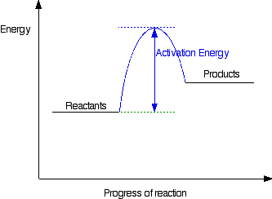
Energy profiles and activation energy
Page 5
Note that this is an exothermic reaction as the products end up at a lower energy level than the reactants
This is an endothermic reaction as the products end up at a higher energy level than the reactants

Slide 6
Page 6 -7
Ref Edexcel A-level Chemistry Book 1 page 265-268
Watch https://www.youtube.com/watch?v=JpoOfrPKgmM
Draw particle diagrams to illustrate how the collision theory explains a change in rate for concentration, surface area, temperature and pressure.

Slide 7
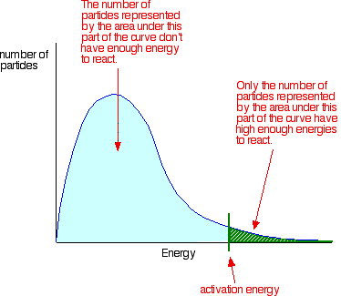
The Maxwell-Boltzmann distribution The y-axis of the Maxwell-Boltzmann graph can be thought of as giving the number of molecules with kinetic energy E. So, if the graph is higher in a given region, it means that there are more gas molecules with that energy. The x axis is the kinetic energy E
Page 8

Slide 8
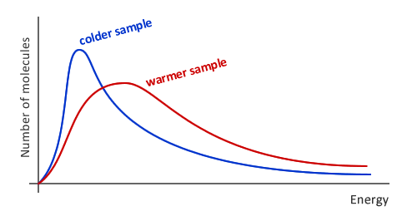
Page 9
As the temperature increases, the average energy of the particles increases. Note that the peak of the graph moves to the right. The energy spread of the molecules also increases so there are more molecules with an energy greater than or equal to the activation energy Ea shown by the increased shaded area under the curve to the right of the EA value
Remember that the total number of molecules remains the same so the area under each curve must remain the same.

Slide 9
Relative Reaction Rates
Ref Edexcel A-level Chemistry Book 1 page 262-264
Consider the reaction between calcium carbonate and hydrochloric acid
Page 10-11
Draw and label the apparatus you would use to measure this rate of reaction.
Collection of gas method
https://www.youtube.com/watch?v=P-jE7KXYfPw
Loss of mass method
https://www.youtube.com/watch?v=0RUYNpdnALg

Slide 10
MEASURING THE RATE
Pages 12-13
Experimental Investigation
the variation in concentration of a reactant or product is followed with time
the method depends on the reaction type and the properties of reactants/products
In your pack write notes on the following techniques, you might want to use Edexcel A-level Chemistry Book 2 page 148-150 and include the advantages and disadvantages of each method and a small diagram.
Titration
Colorimetry
Mass change
Volume of gas evolved
Other suitable techniques (e.g. Conductivity, IR )
Core practical 13a 13b Titrimetric method (basically a titration) and Harcourt-Esson (iodine clock reaction (details in this afternoon session)
Two colourless solutions are mixed and at first there is no visible reaction. After a short time delay, the liquid suddenly turns to a shade of dark blue

Slide 11
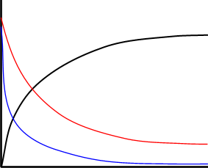
RATE CHANGE DURING A REACTION
Reactions are fastest at the start they
get slower as the reactants concentration drops.
Page 14
Reactants (A and B)
Concentration decreases with time
Product (C)
Concentration increases with time
the steeper the curve the faster the
rate of the reaction
reactions start off quickly because of
the greater likelihood of collisions
reactions slow down with time as
there are fewer reactants to collide
C
CONCENTRATION
B
A
TIME

Slide 12
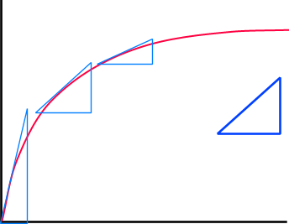
MEASURING THE RATE
RATE How much concentration changes with time. It is the equivalent of velocity.
THE SLOPE OF THE GRADIENT OF THE
CURVE GETS LESS AS THE
REACTION SLOWS DOWN
WITH TIME
Page 15-16
CONCENTRATION
y
x
gradient = y
x
TIME
the rate of change of concentration is found from the slope (gradient) of the curve
the slope at the start of the reaction will give the INITIAL RATE. This is the point at which we know the concentration to the highest degree of accuracy
the gradient gets less, showing the rate is slowing down, as the reaction proceeds

Slide 13
https://www.youtube.com/watch?v=RN_f1qp83bM
Page 17
First order
This is a first order reaction, the concentration is directly proportional to the concentration
Rate
Concentration
This is a second order reaction the concentration is proportional to the square of the concentration.
Second order
Rate
Concentration

Slide 14
Page 18
Zero order
This is a zero order reaction the concentration has no effect on the rate
Rate
Concentration
We can combine the information from each individual reactant into the rate equation which shows how each chemical impacts on the overall rate.

Slide 15
THE RATE EQUATION
Page 19
Format links the rate of reaction to the concentration of reactants
it can only be found by doing actual experiments
it cannot be found by just looking at the equation
the equation... A + B ——> C + D
might have a rate equation like this r = k [A] [B]²
r rate of reaction units of conc. / time usually mol dm⁻³ s⁻¹
k rate constant units depend on the rate equation
[ ] concentration units of mol dm⁻³
Interpretation
The above rate equation tells you that the rate of reaction is...
proportional to the concentration of reactant A doubling [A] doubles rate
proportional to the square of the concentration of B doubling [B] quadruples (2²) rate

Slide 16
ORDER OF REACTION pages 19-20
Order tells you how much the concentration of a reactant affects the rate
Individual order The power to which a concentration is raised in the rate equation
Overall order The sum of all the individual orders in the rate equation.

Slide 17
ORDER OF REACTION pages 19-20
Order tells you how much the concentration of a reactant affects the rate
Individual order The power to which a concentration is raised in the rate equation
Overall order The sum of all the individual orders in the rate equation.
e.g. in the rate equation r = k [A] [B]²
the order with respect to A is 1 1st Order
the order with respect to B is 2 2nd Order
and the overall order is 3 3rd Order
Value(s) need not be whole numbers
can be zero if the rate is unaffected by how much of a substance is present

Slide 18
ORDER OF REACTION pages 19-20
Order tells you how much the concentration of a reactant affects the rate
Individual order The power to which a concentration is raised in the rate equation
Overall order The sum of all the individual orders in the rate equation.
e.g. in the rate equation r = k [A] [B]²
the order with respect to A is 1 1st Order
the order with respect to B is 2 2nd Order
and the overall order is 3 3rd Order
Value(s) need not be whole numbers
can be zero if the rate is unaffected by how much of a substance is present
NOTES
The rate equation is derived from experimental evidence not by looking at an equation.
Species appearing in the stoichiometric equation sometimes aren’t in the rate equation.
Substances not in the stoichiometric equation can appear in the rate equation - CATALYSTS

Slide 19
THE RATE EQUATION
Experimental determination of order
Method 1
Plot a concentration / time graph and calculate the rate (gradient) at points on the curve
Plot another graph of the rate (y axis) versus the concentration at that point (x axis)
If it gives a straight line, the rate is directly proportional to concentration - 1st ORDER.
If the plot is a curve then it must have another order. Try plotting rate v. (conc.)².
A straight line would mean 2nd ORDER. This method is based on trial and error.

Slide 20
THE RATE EQUATION
Experimental determination of order
Method 1
Plot a concentration / time graph and calculate the rate (gradient) at points on the curve
Plot another graph of the rate (y axis) versus the concentration at that point (x axis)
If it gives a straight line, the rate is directly proportional to concentration - 1st ORDER.
If the plot is a curve then it must have another order. Try plotting rate v. (conc.)².
A straight line would mean 2nd ORDER. This method is based on trial and error.
Method 2 - The initial rates method.
Do a series of experiments (at the same temperature) at different concentrations of a reactant but keeping all others constant. Plot a series of concentration / time graphs and calculate the initial rate (slope of curve at start) for each reaction. From the results calculate the relationship between concentration and rate and hence deduce the rate equation. To find order directly, logarithmic plots are required.

Slide 21
THE RATE CONSTANT (k)
Units The units of k depend on the overall order of reaction.
e.g. if the rate equation is... rate = k [A]² the units of k will be dm³ mol⁻¹ sec⁻¹
Divide the rate by as many concentrations as appear in the rate equation.
Overall Order 0 1 2 3
units of k mol dm⁻³ sec⁻¹ sec⁻¹ dm³ mol⁻¹ sec⁻¹ dm⁶ mol⁻² sec⁻¹
example in the rate equation r = k [A] k will have units of sec⁻¹
in the rate equation r = k [A] [B]² k will have units of dm⁶ mol⁻² sec⁻¹

Slide 22
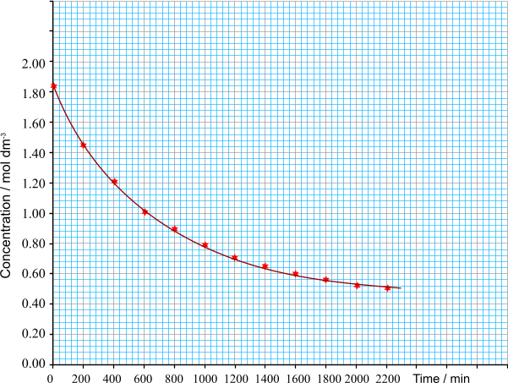
GRAPHICAL DETERMINATION OF RATE
The variation in rate can be investigated by measuring the change in concentration of one of the reactants or products, plotting a graph and then finding the gradients of the curve at different concentrations.
In the reaction…
A(aq) + B(aq) ——> C(aq) + D(aq)
the concentration of B was measured every 200 minutes. The reaction is obviously very slow!
RATE CALCULATION
The rate of reaction at any moment can be found from the gradient of the tangent at that point. The steeper the gradient, the faster the rate of reaction
Place a rule on the outside of the curve and draw a line as shown on the graph.
y
x
gradient = y / x

Slide 23
GRAPHICAL DETERMINATION OF RATE
The variation in rate can be investigated by measuring the change in concentration of one reactants or product, plotting a graph and then finding the gradients of tangents to the curve at different concentrations.
concentration = 1.20 mol dm⁻³
gradient = - 1.60 mol dm⁻³
1520 min
rate = - 1.05 x 10⁻³ mol dm⁻³
The rate is negative because
the reaction is slowing down
RATE CALCULATION
The rate of reaction at any moment can be found from the gradient of the tangent at that point. The steeper the gradient, the faster the rate of reaction
Place a rule on the outside of the curve and draw a line as shown on the graph.
y
x
gradient = y / x

Slide 24
GRAPHICAL DETERMINATION OF RATE
The variation in rate can be investigated by measuring the change in concentration of one of the reactants or products, plotting a graph and then finding the gradients of the curve at different concentrations.
The gradients of tangents at several other concentrations are calculated.
Notice how the gradient gets less as the reaction proceeds, showing that the reaction is slowing down.
The tangent at the start of the reaction is used to calculate the initial rate of the reaction.
RATE CALCULATION
The rate of reaction at any moment can be found from the gradient of the tangent at that point. The steeper the gradient, the faster the rate of reaction
Place a rule on the outside of the curve and draw a line as shown on the graph.
y
x
gradient = y / x

Slide 25
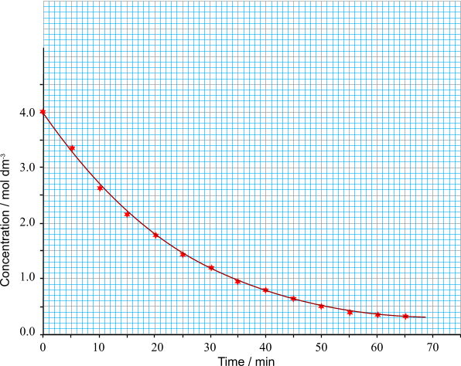
FIRST ORDER REACTIONS AND HALF LIFE
Page 21
One characteristic of a FIRST ORDER REACTION is that it is similar to radioactive decay. It has a half-life that is independent of the concentration.
It should take the same time to drop to one half of the original concentration as it does to drop from one half to one quarter of the original.
The concentration of a reactant falls as the reaction proceeds

Slide 26
FIRST ORDER REACTIONS AND HALF LIFE
The concentration of reactant A falls as the reaction proceeds
The concentration drops from
4 to 2 in 17 minutes

Slide 27
FIRST ORDER REACTIONS AND HALF LIFE
The concentration of reactant A falls as the reaction proceeds
The concentration drops from
4 to 2 in 17 minutes
2 to 1 in a further 17 minutes

Slide 28
FIRST ORDER REACTIONS AND HALF LIFE
The concentration of reactant A falls as the reaction proceeds
The concentration drops from
4 to 2 in 17 minutes
2 to 1 in a further 17 minutes
1 to 0.5 in a further 17 minutes

Slide 29
FIRST ORDER REACTIONS AND HALF LIFE
The concentration of reactant A falls as the reaction proceeds
The concentration drops from
4 to 2 in 17 minutes
2 to 1 in a further 17 minutes
1 to 0.5 in a further 17 minutes

Slide 30
ORDER OF REACTION – GRAPHICAL DETERMINATION
The order of reaction can be found by measuring the rate at different times during the reaction and plotting the rate against either concentration or time. The shape of the curve provides an indication of the order.

Slide 31
ORDER OF REACTION – GRAPHICAL DETERMINATION
The order of reaction can be found by measuring the rate at different times during the reaction and plotting the rate against either concentration or time. The shape of the curve provides an indication of the order.
PLOTTING RATE AGAINST CONCENTRATION
RATE OF REACTION / mol dm⁻³ s⁻¹
CONCENTRATION / mol dm⁻³

Slide 32
ORDER OF REACTION – GRAPHICAL DETERMINATION
The order of reaction can be found by measuring the rate at different times during the reaction and plotting the rate against either concentration or time. The shape of the curve provides an indication of the order.
PLOTTING RATE AGAINST CONCENTRATION
ZERO ORDER – the rate does not depend on the concentration. The line is parallel to the x axis.
RATE OF REACTION / mol dm⁻³ s⁻¹
CONCENTRATION / mol dm⁻³

Slide 33
ORDER OF REACTION – GRAPHICAL DETERMINATION
The order of reaction can be found by measuring the rate at different times during the reaction and plotting the rate against either concentration or time. The shape of the curve provides an indication of the order.
PLOTTING RATE AGAINST CONCENTRATION
ZERO ORDER – the rate does not depend on the concentration. The line is parallel to the x axis.
RATE OF REACTION / mol dm⁻³ s⁻¹
FIRST ORDER – the rate is proportional to the concentration so you get a straight line of fixed gradient. The gradient of the line equals the rate constant for the reaction.
CONCENTRATION / mol dm⁻³

Slide 34
ORDER OF REACTION – GRAPHICAL DETERMINATION
The order of reaction can be found by measuring the rate at different times during the reaction and plotting the rate against either concentration or time. The shape of the curve provides an indication of the order.
PLOTTING RATE AGAINST CONCENTRATION
SECOND ORDER – the rate is proportional to the square of the concentration. You get an upwardly sloping curve.
ZERO ORDER – the rate does not depend on the concentration. The line is parallel to the x axis.
RATE OF REACTION / mol dm⁻³ s⁻¹
FIRST ORDER – the rate is proportional to the concentration so you get a straight line of fixed gradient. The gradient of the line equals the rate constant for the reaction.
CONCENTRATION / mol dm⁻³

Slide 35
ORDER OF REACTION – GRAPHICAL DETERMINATION
The order of reaction can be found by measuring the rate at different times during the reaction and plotting the rate against concentration. The shape of the curve provides an indication of the order.
PLOTTING RATE AGAINST CONCENTRATION
SECOND ORDER – the rate is proportional to the square of the concentration. You get an upwardly sloping curve.
ZERO ORDER – the rate does not depend on the concentration. The line is parallel to the x axis.
RATE OF REACTION / mol dm⁻³ s⁻¹
FIRST ORDER – the rate is proportional to the concentration so you get a straight line of fixed gradient. The gradient of the line equals the rate constant for the reaction.
CONCENTRATION / mol dm⁻³

Slide 36
ORDER OF REACTION – GRAPHICAL DETERMINATION
The order of reaction can be found by measuring the concentration at different times during the reaction and plotting the concentration against time. The shape of the curve provides an indication of the order.
PLOTTING CONCENTRATION AGAINST TIME
ZERO ORDER
A straight line showing a constant decline in concentration.
FIRST ORDER
A slightly sloping curve which drops with a constant half-life.
Concentration / mol dm⁻³
SECOND ORDER
The curve declines steeply at first then levels out.
TIME / s

Slide 37
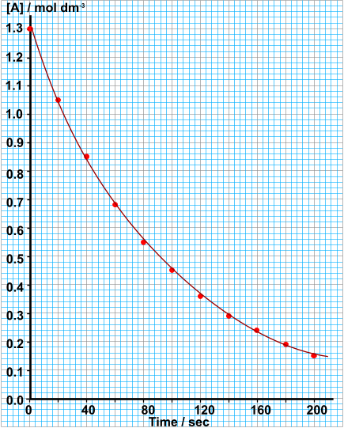
ORDER OF REACTION
GRAPHICAL DETERMINATION
Calculate the rate of reaction at
1.0, 0.75, 0.5 and 0.25 mol dm⁻³
Plot a graph of rate v [A]
Calculate the time it takes
for [A] to go from...
1.00 to 0.50 mol dm⁻³
0.50 to 0.25 mol dm⁻³
Deduce from the graph
that the order wrt A is 1
Calculate the value and
units of the rate constant, k

Slide 38
Page 22
Fill out the definitions/equations for the words listed

Slide 39
P23 onwards
There are 3 experiments to do

