Slide 2
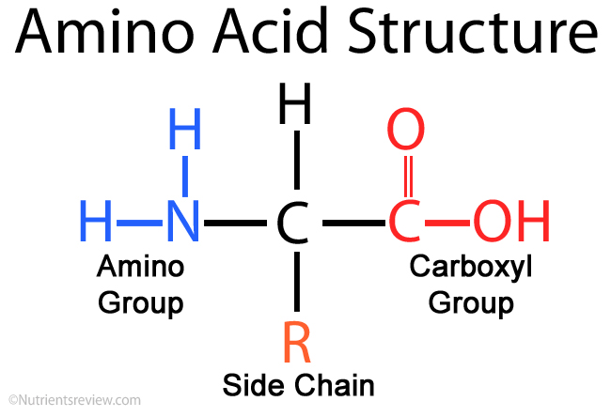
Amino acids

Slide 3
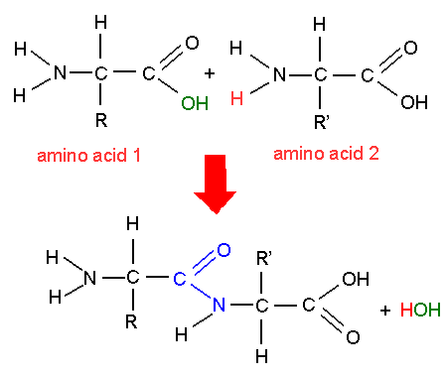
Condensation reaction
Two amino acids join together to make a dipeptide

Slide 4
Protein structure

Slide 5
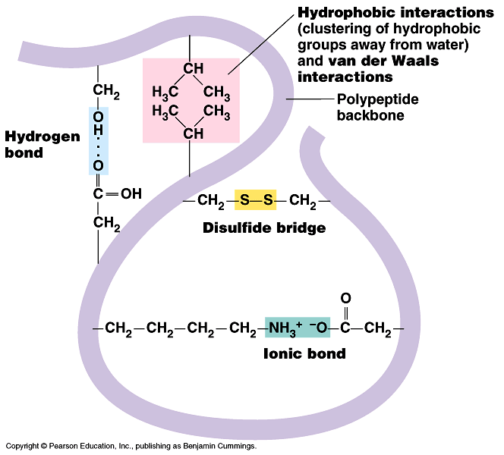
Tertiary structure

Slide 6
Enzymes
An enzyme is a particular type of protein
It speeds up reactions in your body eg
Respiration
digestion

Slide 7
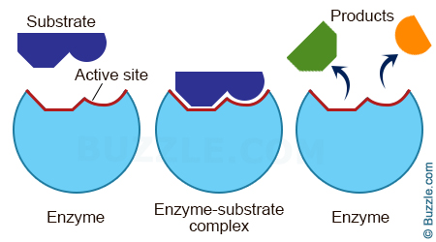
An enzyme’s active site

Slide 8
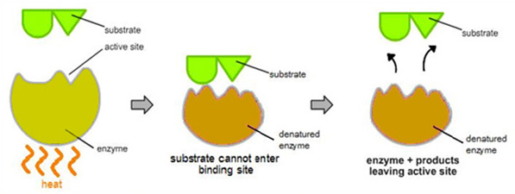
Denatured enzymes

Slide 9
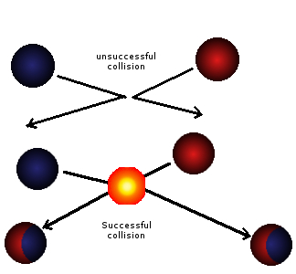
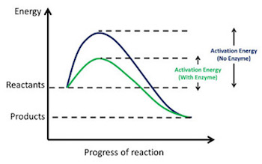
Collision theory
Correct orientation
Have enough energy to react (activation energy)

Slide 10
How to speed up a reaction
Increase concentration of reactants
Increase surface area if a solid is reacting
Increase temperature
Adding a catalyst

Slide 11
Factors which affect enzyme activity
Substrate concentration
Enzyme concentration
Temperature
pH

Slide 12
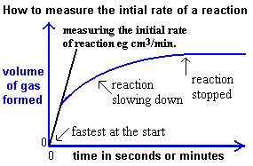
Initial rate
The most accurate rate to measure as you know the concentration of the substrate

Slide 13
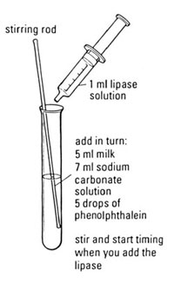
Effect of temperature on lipase
Independent variable
What you are going to change
Dependant variable
The variable which (may) change as a result of changing the independent variable. It is the variable you will measure
Control variables
Variables you will need to keep constant

Slide 14
Effect of temperature on lipase
Independent variable
Temperature
Dependant variable
Time taken for acid to form (and the solution goes colourless)
Control variables
Volume of milk, volume and conc of sodium carbonate and lipase, rate of stirring.

Slide 15
Get 3 test tubes
Put your initials on them
Put in:
5ml milk
7ml sodium carbonate
4 drops phenolphthalein
Put them into 3 different temperatures of water baths and leave

Slide 16
Yeast, sugar and limewater
https://www.youtube.com/watch?v=yQOxoy_NlDE
Devise the experiment to see how temp affects the experiment
Hypothesis (1)
Variables (4)
Method and equipment (6)
Results table (2)
How would you extend it? (1)

Slide 17
Higher temp would result in quicker reaction, until a point when the yeast denatures
Dependant – time
Independent – temp
Control – amount of yeast, water, sugar, limewater
Method – different water baths at x y z temps. Put in x ml of water – leave to get to temperature, once at temp put in 1g yeast then put on bung and delivery tube into limewater. Time how long it takes so you can’t see the ‘dot’. Repeat 3 times and do at different temps.
Results table – temp (/C) and time (s), trials and averages
Extend it – different amounts of yeast, different pHs, more sugar?

Slide 18
Revision page
What is an enzyme made of?
How does an enzyme work?
What affects how it works?
What is collision theory?
What is initial rate all about?
What must you include in an experiment?
How do you make experiments fair?

