Slide 1
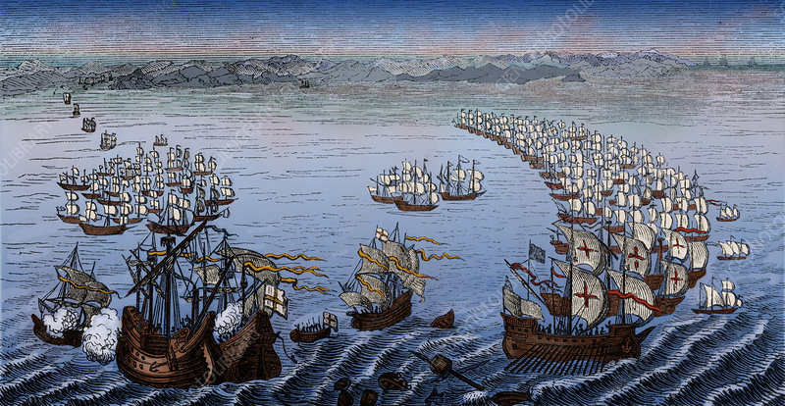
The Armada, England’s 16th century battle to save Britain
What was the reason that England was able to defeat the super power Spain?

Slide 2
The reasons that England was able to defeat the Spanish super power in 1588
Overly controlling tactics by Philip II of Spain. The Spanish planning.
Luck and the weather
English ability and tactics – the privateers and the small manourvrable ships
The Spanish navy and weapons

Slide 3
Question -Assess the significance of failures in Spanish planning as a reason for the English defeat of the Armada in 1588.

Slide 4
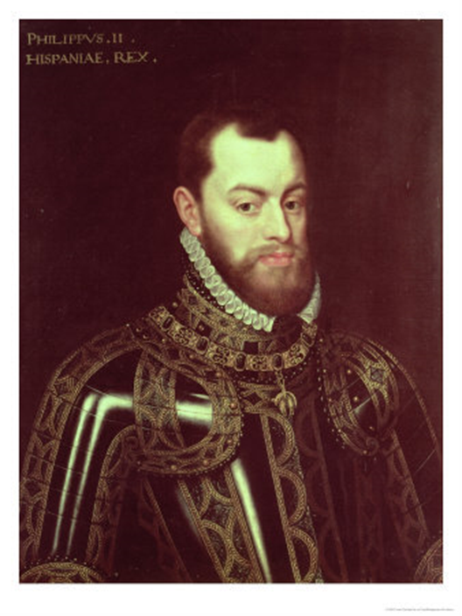
Context - Spain
In 1492 Spain had discovered South America. In the next few years their conquistadors took Peru and Mexico.
South American silver poured into the Spanish treasury.
But the enormous empire over which the Hapsburgs ruled also provided them with almost constant wars.
He would have preferred not to fight England also.

Slide 5
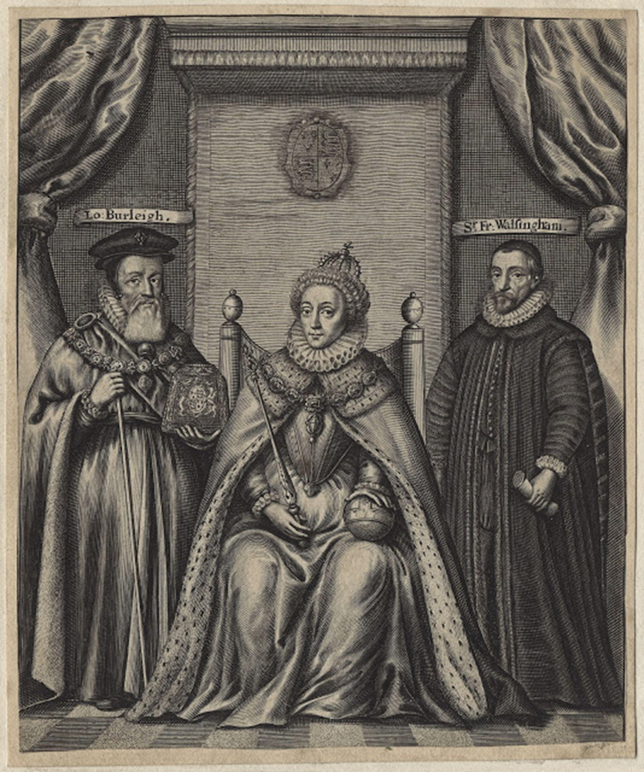
Context - England
England felt threatened by Catholics – particularly after Mary Queen of Scots arrived in 1568 and plots to replace Elizabeth with her Catholic cousin were discovered.
Catholics were increasingly persecuted.
English privateers had been trying to muscle in on South American treasure.
The Netherlands were trying to throw off Spanish rule and Elizabeth was persuaded to help them.

Slide 6
Which qualities did Philip have that made winning a challenging naval invasion difficult? P. 34
Philip was keen to keep a tight on control on this expensive campaign. He is known as a micro-manager.
He trusted that in a war against a heretic God was bound to help.
He assumed it would be relatively easy for the Duke of Parma with his soldiers in Belgium to meet up with his navy in the English Channel.
His strategy was to collect the renowned Spanish army from the Netherlands rather than to have them come back to Spain and travel up in the ships.

Slide 7
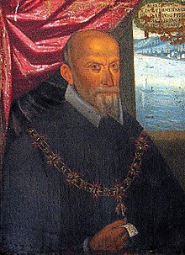
– Why did Philip appoint the Duke of Medina Sidonia as his admiral? – Task 7 p. 35
Medina Sidonia had experience of a naval operation and had been putting together the defensive squadrons for the Indies.
He was a very high aristocrat which in Philip’s view made him an ideal commander as his status and his capacity to enforce obedience would be second to none.
He was regarded as a great administrator who would obey his instructions to the letter.

Slide 8
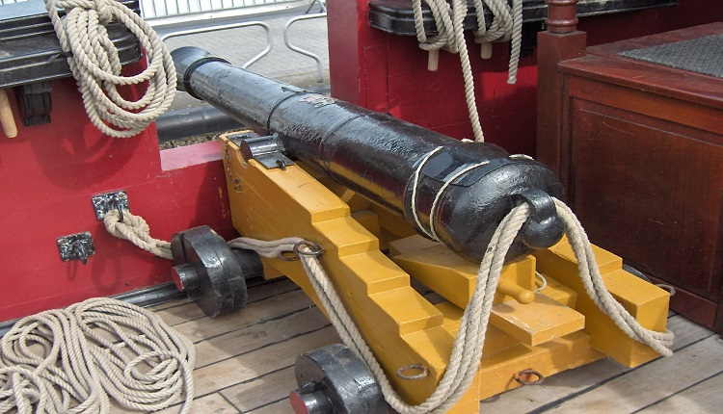
What advantages did the English have?
1. The Guns (task 8 page 36)
Spanish cannon were, as we know from Medina Sidonia's instructions to the fleet, and from actual examples of Armada artillery recovered from the wrecks, always kept loaded; so that when battle was joined one salvo was available for immediate use.
They expected to fire just before ramming the enemy. They expected there would be neither opportunity nor need for a second round, and so no procedure existed for reloading as a battle-drill.
The inefficient design of Spanish gun carriages made it very hard to reload safely while the ships were engaged in battle.

Slide 9
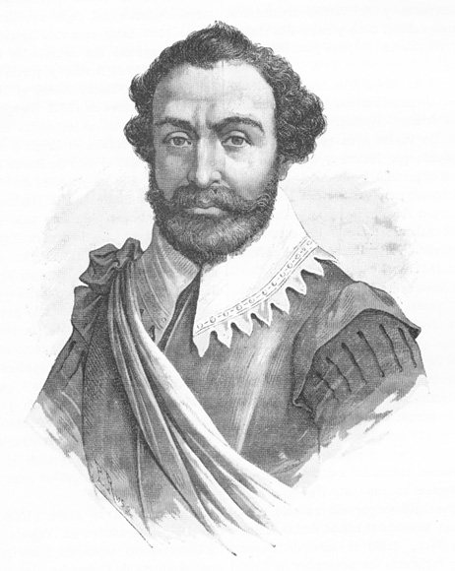
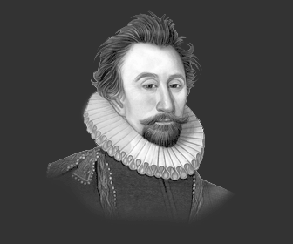
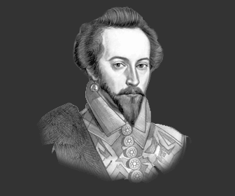
Elizabeth’s famous privateers
In 1572 Drake’s expedition to Panama netted £40,000 worth of Spanish silver.
In 1577 financed by a powerful court syndicate Drake set sail again and returned with an estimated £400,000 worth of Spanish treasure.
They were experienced at fighting the Spanish and Drake had already postponed the Armada by a year by sailing in to Cadiz an d destroying much of the fleet.
Task 9 page 37
Sir Francis Drake
Sir John Hawkins
Sir Martin Frobisher

Slide 10
Spanish planning – page 37
1. Philip had to get his troops from mainland Europe and get them across to England.
2. Would they be able to surprise the English?
3. How should they fight the small English ships?
4. What provisions would they need?
5. Who would have ultimate control?
6. They also assumed God would help them against the heretic Elizabeth.

Slide 11
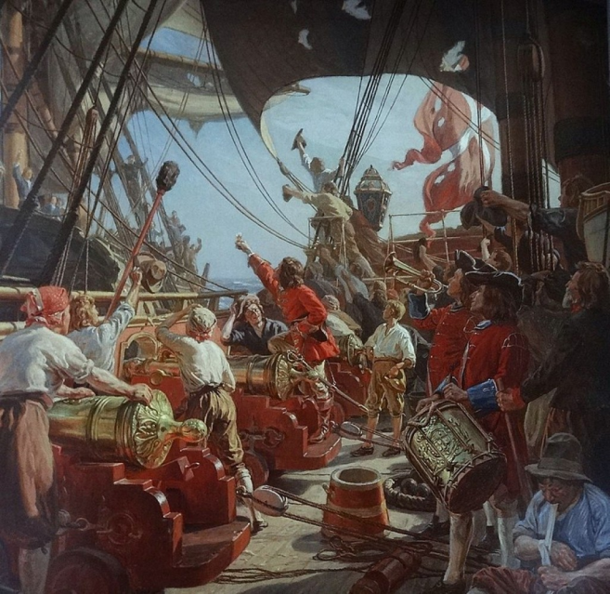
Conclusion – so there were many reasons that the Armada failed. Weigh their significance.
Watch the documentary “Battlefield Britain: Armada” on E stream and complete the questions on pages 38- 40
https://estream.godalming.ac.uk:444/View.aspx?id=1095~4p~QbzuuvJt
Put in 1095 and it should
come up

