Slide 1
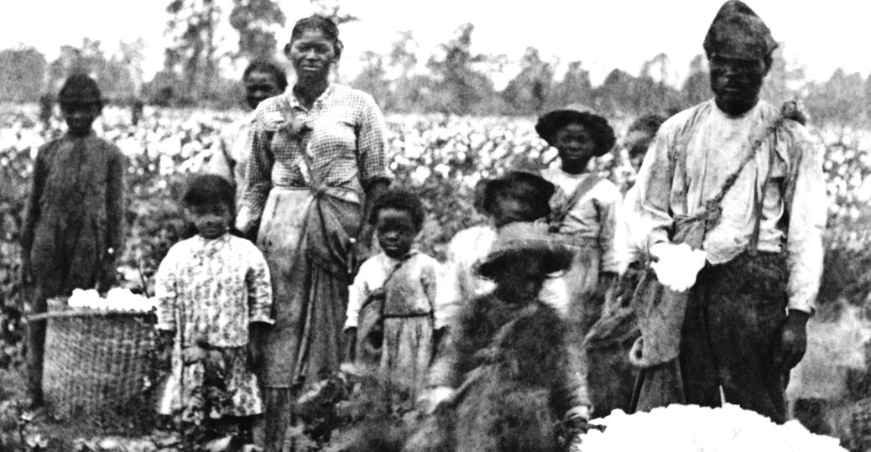
Historical background to slavery in America
Why did slavery develop in America?
Why did slavery survive the birth of the USA?
How did slavery contribute to the outbreak of the American Civil War?

Slide 2
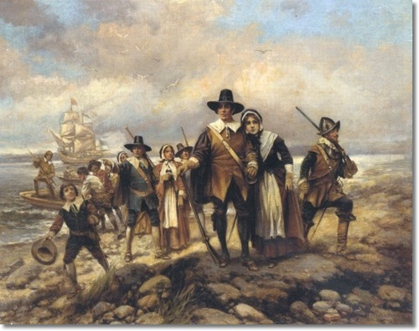
The arrival of European Settlers to America
This began from the fifteenth century onwards as European explorers ‘discovered’ the New World. By the sixteenth century Spain, France and England had all extended their influence and control over the Continent.
Soon the economic potential of the American continent became clear as highly profitable produce such as tobacco, cotton and sugar could be grown in the southern regions
KEY QUESTION: Why might the farming of produce such as tobacco, cotton and sugar contribute to the growth of slavery in America?

Slide 3
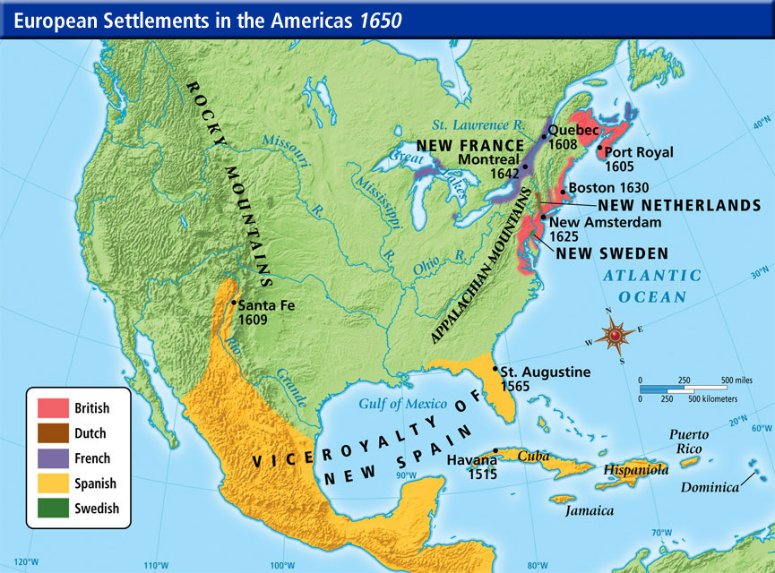
The arrival of European Settlers to America

Slide 4
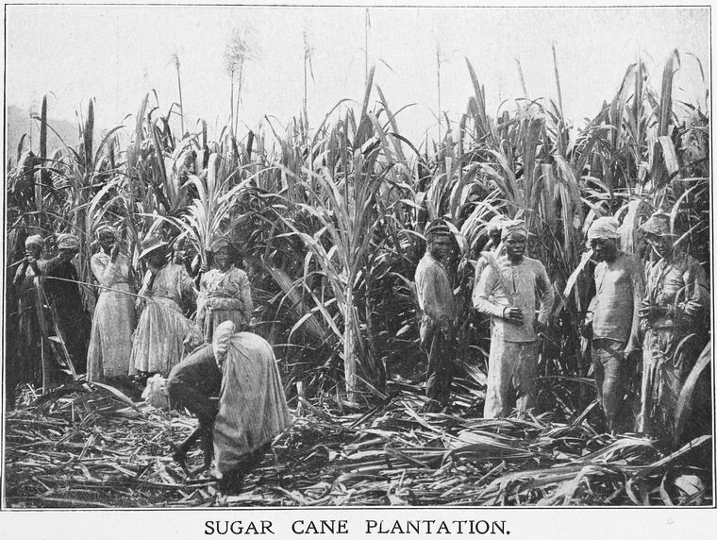
The introduction of slavery
European colonies in America (particularly the British) began to farm these crops in what were known as plantations – large tracks of land where only one type of crop was grown. However tobacco, cotton and sugar were labour intensive to grow and there were relatively few European settlers.
It was out of this economic need that slaves from Africa began to be brought to America
Slave traders would kidnap Africans from the West Coast of Africa and transport them to America, where they would be sold to plantation owners in an auction.
Soon a complex and highly profitable slave trade would develop, known as the ‘triangular trade’

Slide 5
The introduction of slavery The Trans-Atlantic Slave Trade
https://www.youtube.com/watch?v=3NXC4Q_4JVg

Slide 6
The introduction of slavery
By 1660 slavery was both common and legal. The English considered it as acceptable to use Africans as slaves because Africans had a different, non- Christian culture and were perceived as uncivilised heathens. Moreover the huge profits to be made from plantation crops overrode all other considerations.
By 1776 British North America contained 2,500 000 people 1/5 of whom were black slaves.
What was the experience of black slaves?
Study the sources on p.8 of your lesson materials and answer the questions

Slide 7
The arrival of European Settlers to America

Slide 8
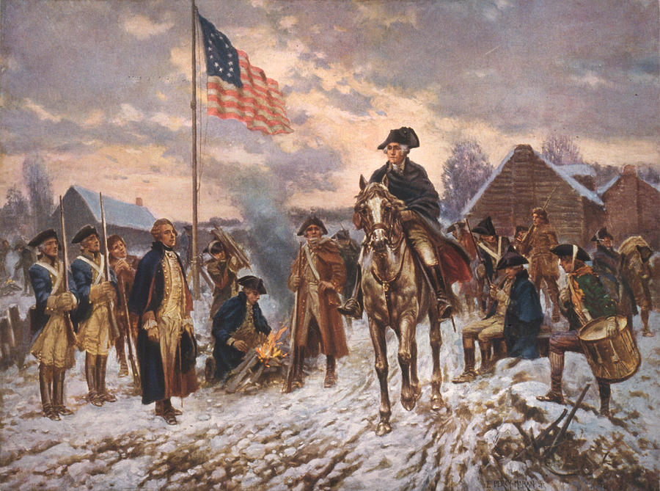
The Development of Slavery in the USA Revolution
In 1776 American colonists demanded freedom from British rule and declared their independence
In the eyes of American rebels, the revolution was fought against a tyrannical king and in the name of freedom and equality
These ideas had obvious consequences for black slaves if applied to all those living in the British colonies

Slide 9
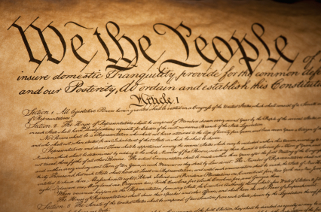
The Development of Slavery in the USA
Constitution
In 1783 the British government recognised American independence. The United States of America was formed from 13 ex-colonies now called states. Delegates from these states (the Founding Fathers) were responsible for drawing up a list of rules defining the new system of government of the USA called the Constitution.
The constitution was based on the principle of ‘unalienable rights’ i.e. natural rights that every man had from birth and which could not be taken away. The idea of extending these rights to black slaves, however was never seriously contemplated. The focus instead was on how or if slaves should be counted for purposes of representation and taxation.

Slide 10
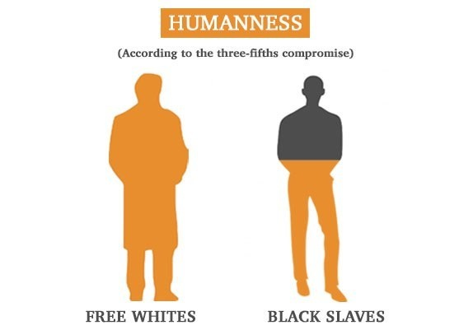
The Development of Slavery in the USA
Constitution
The debate about how to count slaves in the new United States was between those states that had large numbers of black slaves (in the south) and those that had few (in the north)
The southern slave states wanted slaves to be counted if it gave them more representatives in the new Congress, but did not want them to be counted if it meant that the state would have to pay more in taxation
The result (agreed in 1787) became known as the ‘Three-Fifths Clause’ stated that a black slave represented three-fifths of a white person
KEY Question: Why was the Three-Fifths Clause so significant in the long-term treatment of African Americans?

