Slide 1
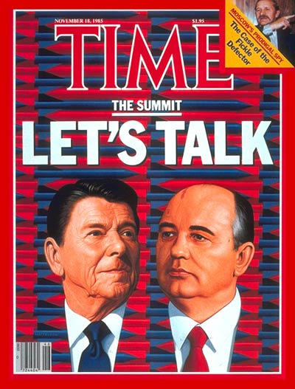
Q8: The end of the cold war
Key Questions:
What was the state of the Cold War in the 1980s?
How did Reagan (USA) and Gorbachev (USSR) change their nation’s cold war policies?
Why did the Cold War end in 1989?

Slide 2
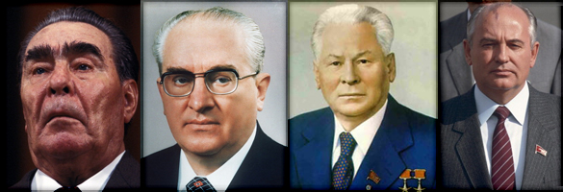
What was the state of the Cold War in the 1980s?
The 1980s is sometimes referred to as the ‘Second Cold War’ as tensions between the superpowers reignited following a period of ‘détente’ in the 1970s
One reason for this was the change in leadership in the superpowers. The USSR experienced a quick succession of leaders (Brezhnev, Andropov and Chernenko) between 1982 and 1985 all of whom were old and ill. The USA meanwhile elected Ronald Reagan as President in 1980. When he took office the following year, he talked openly about confronting communism and spending more on the military.
One of the best examples of the heightened state of tension between the superpowers in the 1980s is the 1983 ‘war scare’.
Watch the extract from 1983: Brink of Apocalypse and answer the questions on page 60 .

Slide 3
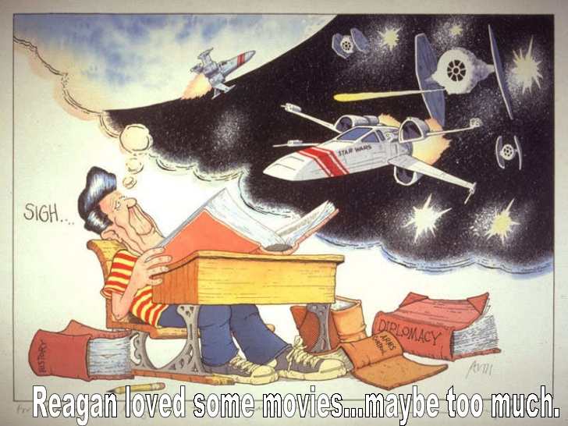
Reagan and US Militarism in the 1980s
Taking office in 1981, Reagan was determined to revive American power and be more proactive in trying to ‘win’ the cold war
He declared the Soviet Union to be an ‘Evil Empire’ that he wanted to leave on ‘the ash heap of history’
Reagan increased US defence spending from $325.1 billion in 1980 to $456.5 billion in 1987
The show piece of this was an estimated $26billion spent on the Strategic Defence Initiative (SDI) also known as ‘Star Wars’
One argument as to why the Cold War ended in 1989 is the US crippled the Soviet economy by reigniting the arms race

Slide 4
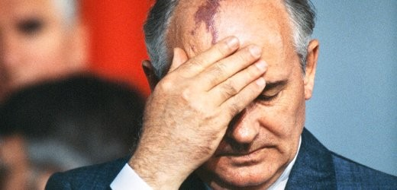
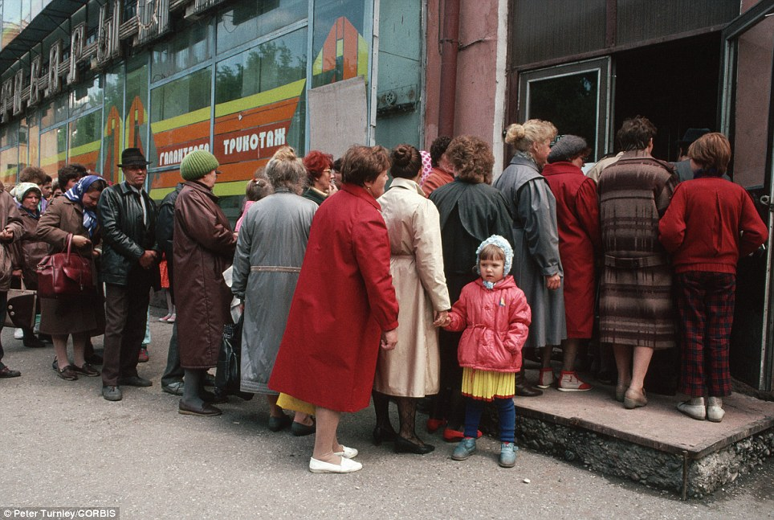
The Decline of the soviet union
During the 1980s Soviet economic and political power began to decline rapidly. This contributed to the increase in tension in the 1980s and to the eventual end of the cold war
Long-term economic problems:
A command economy
Inefficient and corrupt
Lack of technology
Domestic social problems:
Low standard of living
High levels of alcoholism
Growing discontent with communism
Stagnant leadership:
Quick turn-over of old and ill leaders
Unwillingness to reform or ability to see reforms through
Eastern Europe:
Huge cost of maintaining a sphere of influence
Growth in opposition movements e.g. Solidarity in Poland
The Arms Race:
Huge cost of maintaining a vast nuclear arsenal
Pressure to compete with the USA e.g. ‘Star Wars’
War in Afghanistan:
Started in 1979
Additional drain on the Soviet economy

Slide 5
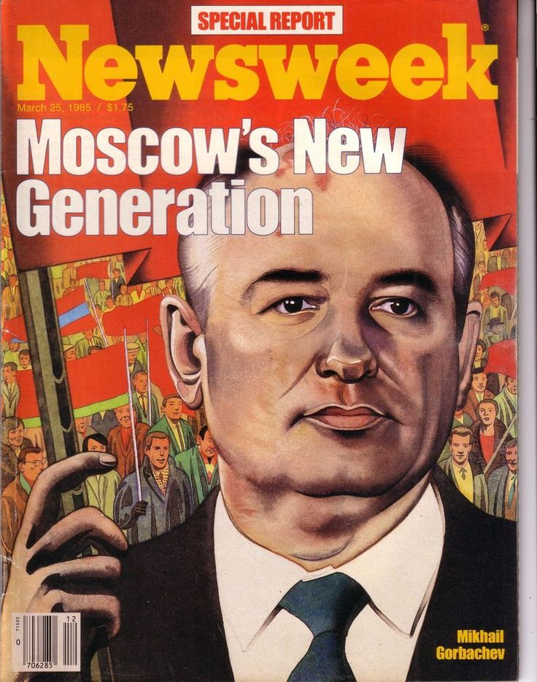
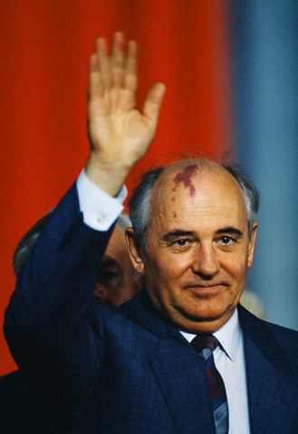
Mikhail Gorbachev
In 1985 the youthful (54) Mikhail Gorbachev became General Secretary (leader) of the Soviet Union. Gorbachev was viewed as a reformer and a breath of fresh air for the USSR
Margaret Thatcher declared after meeting him for the first time that he was a man with whom the west could ‘do business’.
Gorbachev was determined to reform and modernise the USSR through his policies of perestroika (restructuring) and glasnost (openness)
This created a new period of Soviet foreign policy referred to as Gorbachev’s ‘new thinking’. Some have argued that this led to a reduction in Cold War tension and was the primary cause of the Cold War’s end in 1989

Slide 6
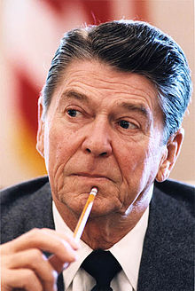
TASK
Read the notes on p.59 of your Cold War booklet to gain a more detailed understanding of why the Cold War came to an end.
Use this (and powerpoint slides) to complete the ‘pie chart’ on p.61 by giving each factor a portion of the chart depending on how important it was. Once you have done this, explain your answer.
If you want to add more detail to this, read the extension article: The Cold War Endgame by Andrew Mitchell (on Godalming Online) before dividing up your pie chart

