Slide 1
Narrative
Definitions
Theories
Applications

Slide 2
Narrative definitions
The 'story' that is told by the media text
All media texts, not just fictional texts, have a narrative. For example, magazines have a clear beginning, middle, and end.
We use narrative to analyse media texts
By applying narrative theories we can understand a media text in more detail

Slide 3
theorists
Need to learn two theorists for the first year…
Theorist | Prompts
Claude Levi-Strauss | Binary Opposition
Roland Barthes | The 5 Codes (SEARS)

Slide 4
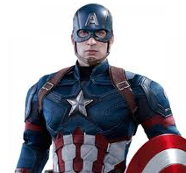
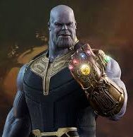
Levi Strauss: Binary opposition
‘Binary oppositions’ are concepts that appear opposite but actually need each other to define their meaning.
Binary oppositions are often used in media to achieve a narrative tension.
HERO
GOOD
VILLAIN
EVIL
What other binary oppositions can you think of that appear in TV/films ?

Slide 5
Roland Barthes: Codes
Roland Barthes was a French philosopher who suggested that a media text can be:
'Open' - when lots of, or all, the narrative codes are used making the story complex. For example the film 'Inception' is an open media text, as it has embedded complex storylines.
'Closed' - is when a single narrative code is used, therefore the story is simple. For example fairy tales are often a closed texts as the stories they tell are simple.

Slide 6
Roland Barthes Codes: SEARS
Roland Barthes’ five codes that can explain the way a story is told:
Code (SEARS)
Semantic Code
Enigma Code
Action Code
Referential Code
Symbolic Code

Slide 7
Roland Barthes Codes: SEARS
Code (SEARS) | Description
Semantic Code | Refers to the connotations found within the text that gives additional meaning over the basic denotative meaning. These additional meanings are usually dependent on how the audience read the image. Semantic codes can be tightly connected to genre and the audience’s association with generic signifiers.
Enigma Code | Refers to the mystery within a text, where clues are dropped but there are no clear answers given to the audience. Enigmas within the narrative make the audiences want to know more, but unanswered enigmas tend to frustrate audiences as most audiences prefer closed endings
Action Code | Contains sequential elements of action in the text to add suspense and tension. The enigma and action codes work as a pair to develop the story's tensions and keep the reader interested.
Referential Code | Refers to anything in the text which may refer to an external body of knowledge such as scientific, historical, cultural knowledge. The referential code makes the audience understand or expect stories from what we already know…because we are smart, informed spectators!
Symbolic Code | Refers to symbolism within the text which emphasises opposites to show contrast and create greater meaning creating tension, drama and character development. So it could be the symbolism of two opposing character types.

Slide 8
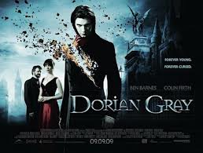
Semantic Code
The semantic code refers to the connotations found within the text that gives additional meaning over the basic denotative meaning.
These additional meanings are usually dependent on how the audience read the image.

Slide 9
Enigma Code (Hermeneutic)
Anything that sets up questions in the narrative, or delays the provision of an answer
Structures the plot by setting a series of major and minor questions
Keeps the viewer’s interest
Governs a sense of mystery and suspense
False leads and delays to answering major questions
Ending usually provides closure and answers at least some of the questions
Enigmas can also be used in written texts

Slide 10
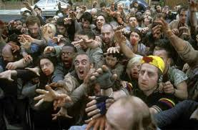
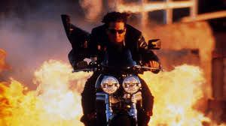
ACTION CODE (Proairetic)
Contains sequential elements of action in the text to add suspense and tension.
The enigma and action codes work as a pair to develop the story's tensions and keep the audience engaged.

Slide 11
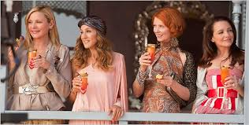
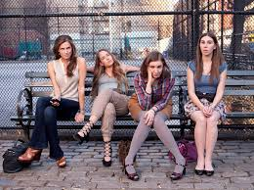
Referential Code
References to knowledge of the time and period
E.g. science, medicine, history, literature, art, mass media, architecture, geography, events, to other texts/intertextuality.
Codes that are defined by the world outside the narrative, which are understood through our interaction with the world.

Slide 12
Symbolic Code
This provides the major structuring themes in the text and can often be described in binary oppositions
E.g. in the Western – desert v garden, savagery v civilisation, domestic v independent.
Oppositions can be expressed across actions, characters, settings style etc.

Slide 13
Summary
The 'story' that is told by the media text
We use narrative theories to analyse and understand media texts
Theorist | Prompts | Theory
Roland Barthes | The 5 Codes (SEARS) | The idea that texts communicate their meanings through a process of signification The idea that signs can function at the level of denotation, which involves the ‘literal’ or common-sense meaning of the sign, and at the level of connotation Semantic –denotation, connotation Enigma – refers to a mystery within the text, audience not aware. Action – action to add suspense and develop story. Referential – refers to an external body of knowledge. Symbolic –shows contrast to create tension
Levi Strauss | Binary Oppositions | The idea that texts can best be understood through an examination of their underlying structure The idea that meaning is dependent upon (and produced through) pairs of oppositions The idea that the way in which these binary oppositions are resolved can have particular ideological significance.
Theory Videos: Mrs Fisher

