Slide 1
Mediation

Slide 2
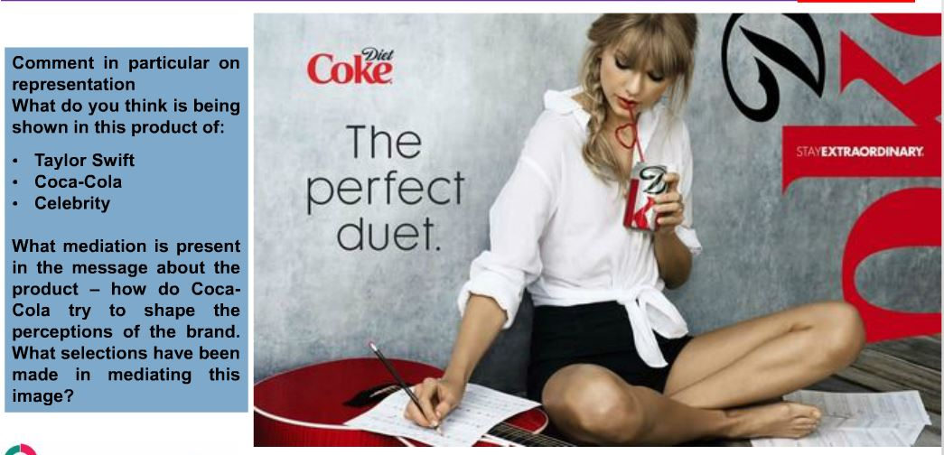
5 mins – bullet point analyse this media product

Slide 3
Lesson Objectives:
1. Knowledge: to develop ideas about how media representations are constructed
2. Learning: to build ideas of effect of media representations in media products
3. Application: to link this prior knowledge by analysis of media products

Slide 4
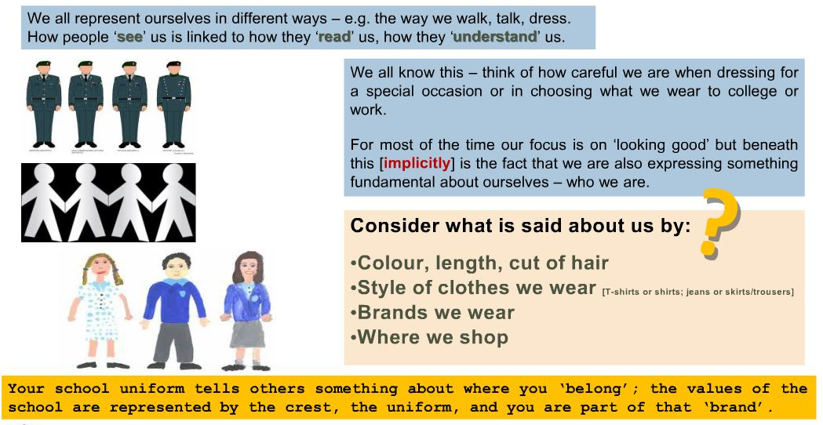

Slide 5
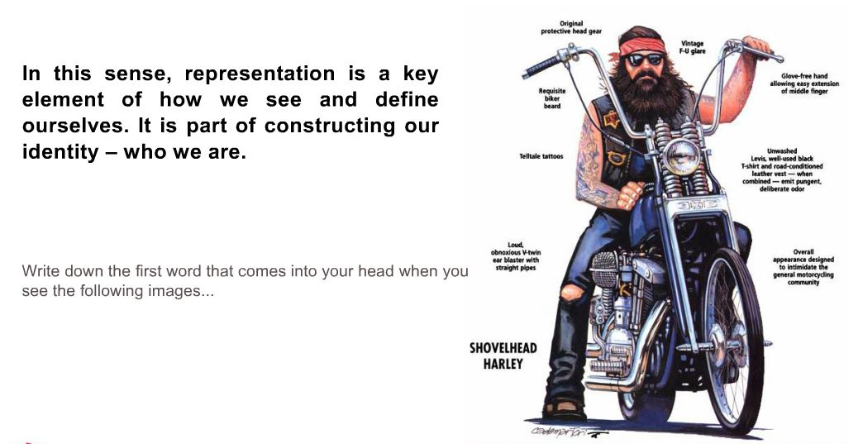

Slide 6
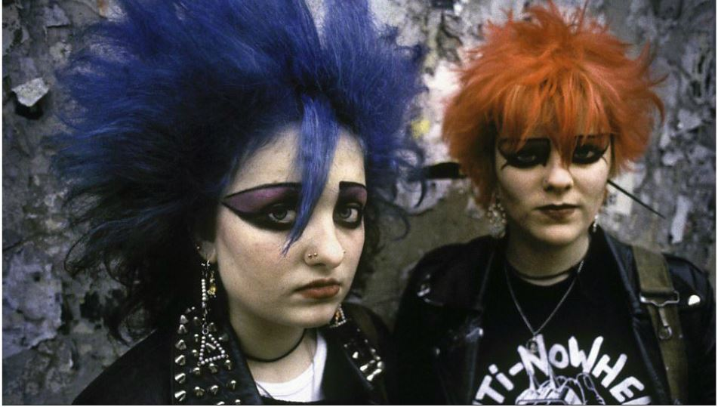

Slide 7


Slide 8
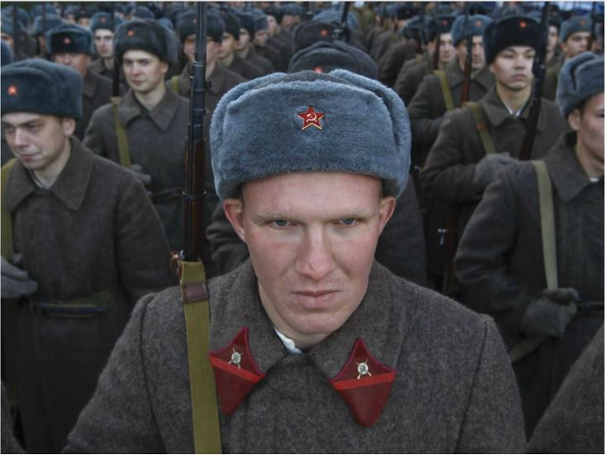

Slide 9
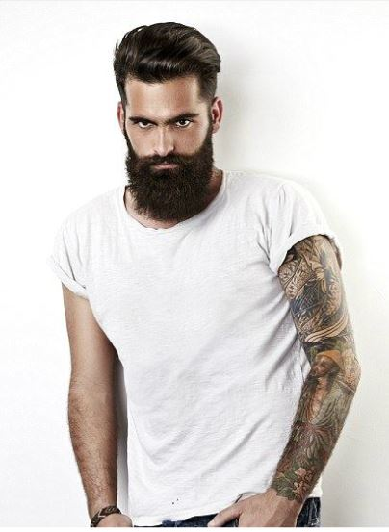

Slide 10
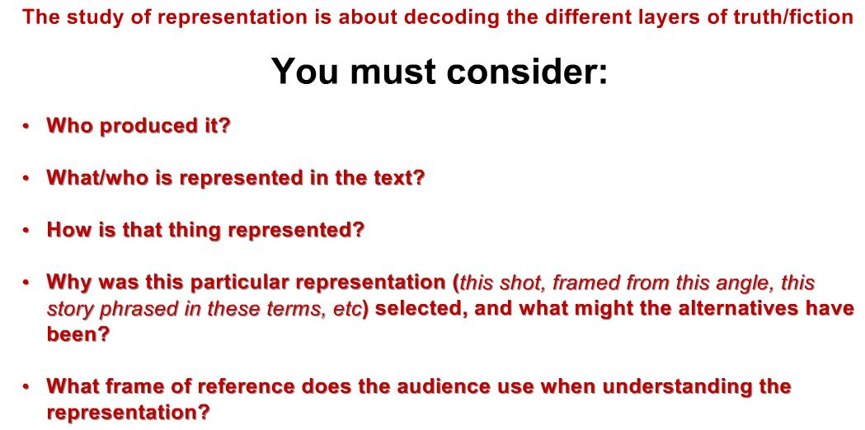

Slide 11
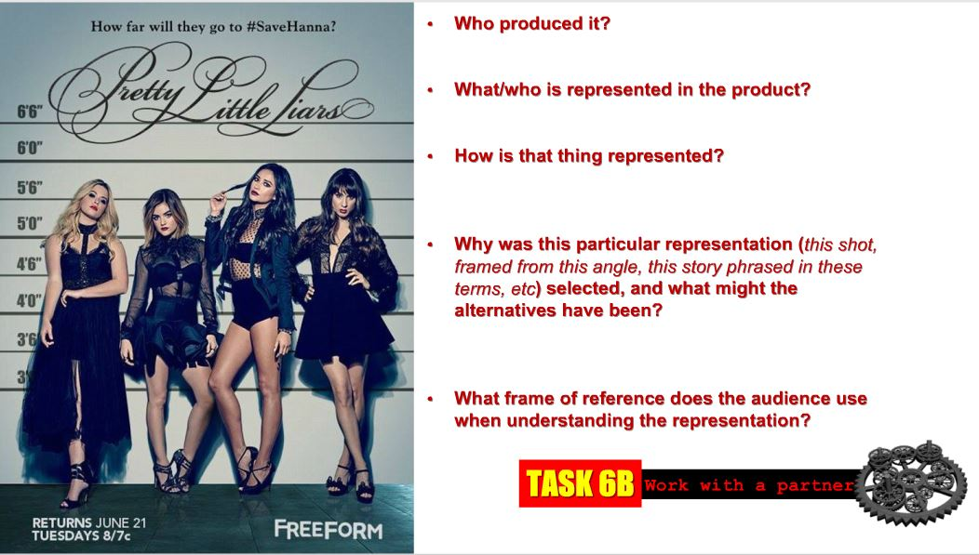

Slide 12
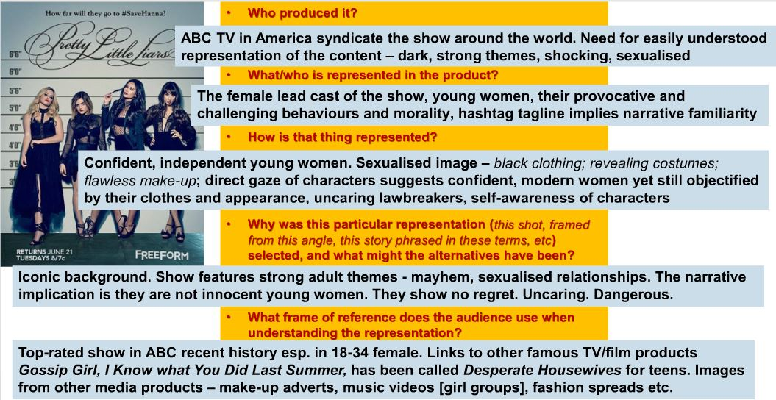

Slide 13
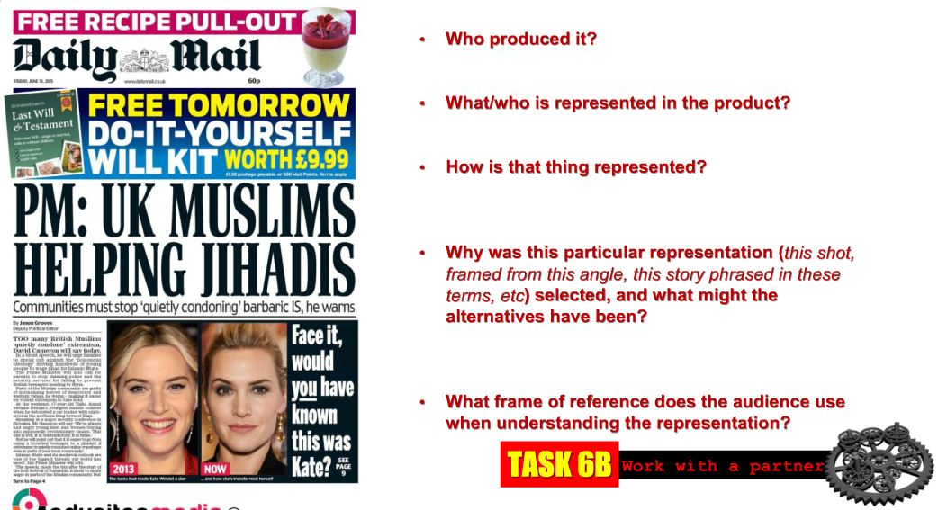

Slide 14
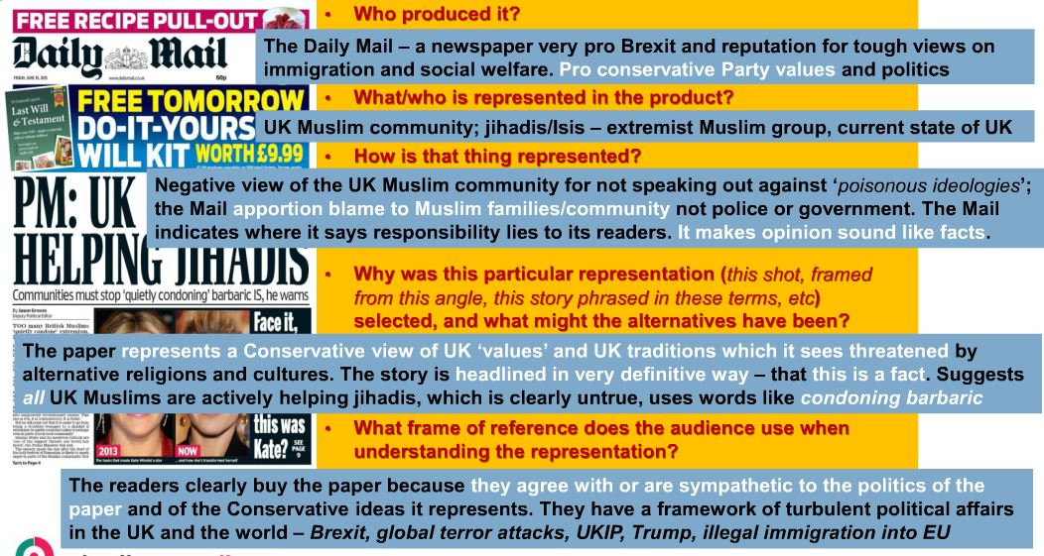

Slide 15
Task:
Choose any front cover newspaper and ANALYSE it using the KEY REPRESENTATION questions:
Who Produced it?
What/Who is represented in the text?
How is that thing represented?
Why was this particular representation selected, and what might the alternatives be?
What frame of reference does the audience use when understanding the representation?

