Slide 1
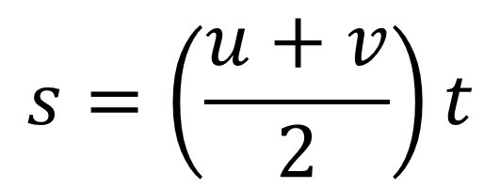
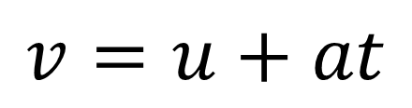
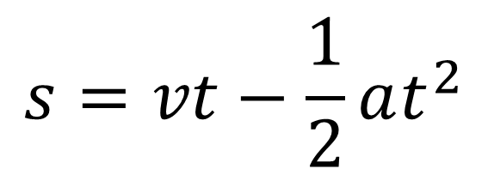
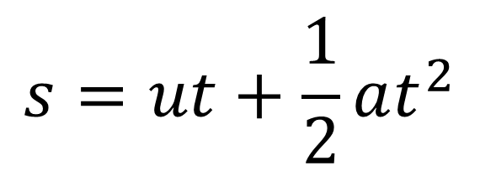
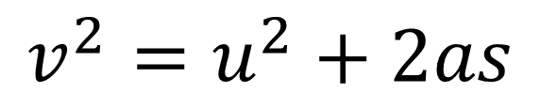
SUVAT The Equations
$$v=u+at$$
$$v^{2}=u^{2}+2as$$
$$s=vt−\frac{1}{2}at^{2}$$
$$s=\left(\frac{u+v}{2}\right)t$$
$$s=ut+\frac{1}{2}at^{2}$$

Slide 2





Example 1
A cyclist is travelling along a straight road. She accelerates at a constant rate from a speed of 4ms⁻¹ to a speed of 7.5ms⁻¹ in 40 seconds. Find:
The distance travelled over this 40 seconds
The acceleration over the 40 seconds
$$v=u+at$$
$$v^{2}=u^{2}+2as$$
$$s=vt−\frac{1}{2}at^{2}$$
$$s=\left(\frac{u+v}{2}\right)t$$
$$s=ut+\frac{1}{2}at^{2}$$

Slide 3





Example 2
A particle moves in a straight line from a point A to B with constant deceleration of 1.5ms⁻². The speed of the particle at A is 8ms⁻¹ and the speed of the particle at B is 2ms⁻¹. Find:
The time taken for the particle to get from A to B
The distance from A to B
$$v=u+at$$
$$v^{2}=u^{2}+2as$$
$$s=vt−\frac{1}{2}at^{2}$$
$$s=\left(\frac{u+v}{2}\right)t$$
$$s=ut+\frac{1}{2}at^{2}$$

Slide 4





Example 2 (continued)
After reaching B the particle continues to move along the straight line with the same deceleration. The particle is at point C, 6 seconds after passing through A. Find:
c) The velocity of the particle at C
d) The distance from A to C
$$v=u+at$$
$$v^{2}=u^{2}+2as$$
$$s=vt−\frac{1}{2}at^{2}$$
$$s=\left(\frac{u+v}{2}\right)t$$
$$s=ut+\frac{1}{2}at^{2}$$

Slide 5





Example 3
A car moves from traffic lights along a straight road with constant acceleration. The car starts from rest at the traffic lights and 30 seconds later passes a speed trap where it is travelling at 45 kmh⁻¹. Find:
The acceleration of the car
The distance between the traffic lights and the speed-trap.
$$v=u+at$$
$$v^{2}=u^{2}+2as$$
$$s=vt−\frac{1}{2}at^{2}$$
$$s=\left(\frac{u+v}{2}\right)t$$
$$s=ut+\frac{1}{2}at^{2}$$

Slide 6





A particle is moving in a straight line from A to B with constant acceleration 5ms⁻². The velocity of the particle at A is 3ms⁻¹ in the direction AB. The velocity at B is 18ms⁻¹ in the same direction. Find the distance from A to B.
$$v=u+at$$
$$v^{2}=u^{2}+2as$$
$$s=vt−\frac{1}{2}at^{2}$$
$$s=\left(\frac{u+v}{2}\right)t$$
$$s=ut+\frac{1}{2}at^{2}$$

Slide 7





Example 6
A particle is moving in a straight horizontal line with constant deceleration 4ms⁻². At time t = 0 the particle passes through a point O with speed 13ms⁻¹, travelling to a point A where OA = 20m. Find:
The times when the particle passes through A
The time taken for the particle to return to O
$$v=u+at$$
$$v^{2}=u^{2}+2as$$
$$s=vt−\frac{1}{2}at^{2}$$
$$s=\left(\frac{u+v}{2}\right)t$$
$$s=ut+\frac{1}{2}at^{2}$$

Slide 8





Example 7
A particle is travelling along the x-axis with constant deceleration 2.5ms⁻². At time t = O, the particle passes through the origin, moving in the positive direction with speed 15ms⁻¹. Calculate the distance travelled by the particle by the time it returns to the origin.
$$v=u+at$$
$$v^{2}=u^{2}+2as$$
$$s=vt−\frac{1}{2}at^{2}$$
$$s=\left(\frac{u+v}{2}\right)t$$
$$s=ut+\frac{1}{2}at^{2}$$

