Slide 1

P1 Chapter 10 :: Trigonometric Identities & Equations
jfrost@tiffin.kingston.sch.uk
www.drfrostmaths.com
@DrFrostMaths
Last modified: 21st September 2018

Slide 2
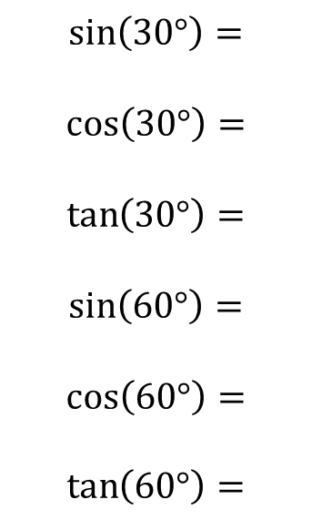
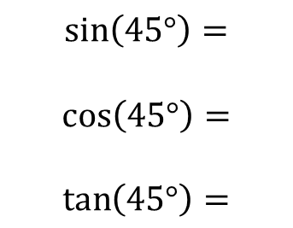
sin/cos/tan of $30°, 45°, 60°$
You will frequently encounter angles of $30°, 60°, 45°$ in geometric problems. Why?
We see these angles in equilateral triangles and half squares.
Although you will always have a calculator, you need to know how to derive these.
All you need to remember:
! Draw half a unit square and half an equilateral triangle of side 2.
$$\sin\left(30°\right)=$$
$$\cos\left(30°\right)=$$
$$\tan\left(30°\right)=$$
$$\sin\left(60°\right)=$$
$$\cos\left(60°\right)=$$
$$\tan\left(60°\right)=$$
$$\sin\left(45°\right)=$$
$$\cos\left(45°\right)=$$
$$\tan\left(45°\right)=$$
?
$$1$$
$$2$$
$$45°$$
$$1$$
?
$$60°$$

Slide 3
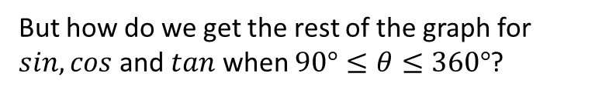


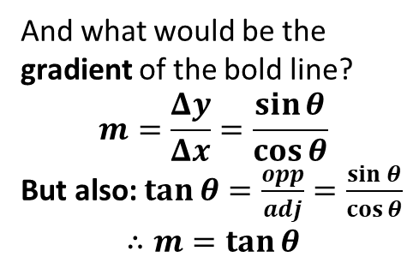

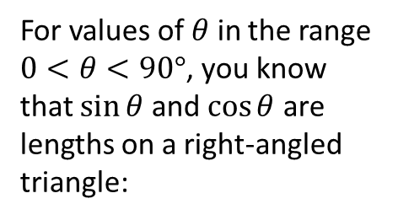




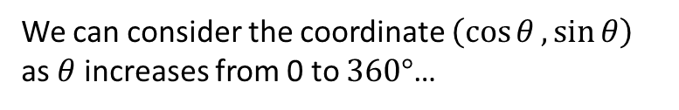


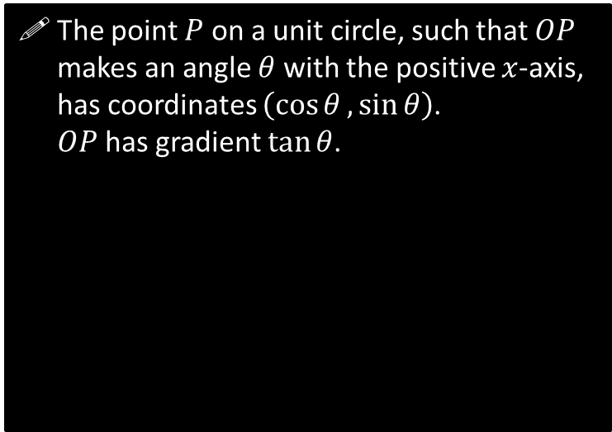

The Unit Circle and Trigonometry
For values of $θ$ in the range $0<θ<90°$, you know that $\sin{θ}$ and $\cos{θ}$ are lengths on a right-angled triangle:
But how do we get the rest of the graph for $sin, cos$ and $tan$ when $90°≤θ≤360°$?
The point $P$ on a unit circle, such that $OP$ makes an angle $θ$ with the positive $x$-axis, has coordinates $\left(\cos{θ},\sin{θ}\right)$.
$OP$has gradient $\tan{θ}$.
$$1$$
$$y$$
$$\sin{θ}$$
$$P\left(\cos{θ},\sin{θ}\right)$$
$$θ$$
$$1$$
$$\cos{θ}$$
$$θ$$
$$x$$
$$O$$
And what would be the gradient of the bold line?
$$m=\frac{Δy}{Δx}=\frac{\sin{θ}}{\cos{θ}}$$
But also: $\tan{θ}=\frac{opp}{adj}=\frac{\sin{θ}}{\cos{θ}}$
$$∴m=\tan{θ}$$
Angles are always measured anticlockwise.
(Further Mathematicians will encounter the same when they get to Complex Numbers)
We can consider the coordinate $\left(\cos{θ},\sin{θ}\right)$ as $θ$ increases from 0 to $360°$…

Slide 4
































Mini-Exercise
Use the unit circle to determine each value in the table, using either “0”, “+ve”, “-ve”, “1”, “-1” or “undefined”. Recall that the point on the unit circle has coordinate $(\cos{θ},\sin{θ})$ and $OP$ has gradient $\tan{θ}$.
$x$-value
$y$-value
Gradient of $OP$.
$$\cos{θ}$$
$$\sin{θ}$$
$$\tan{θ}$$
$$\cos{θ}$$
$$\sin{θ}$$
$$\tan{θ}$$
$$θ=0$$
$$θ=180°$$
$$y$$
1
0
0
$$y$$
$$P$$
$$x$$
$$P$$
$$θ$$
$$x$$
$$0<θ<90°$$
$$180°<θ<270°$$
$$y$$
$$y$$
$$1$$
$$P$$
$$θ$$
$$θ$$
$$x$$
$$x$$
$$P$$
$$θ=90°$$
$$θ=270°$$
$$y$$
$$y$$
$$P$$
$$θ$$
$$θ$$
$$x$$
$$x$$
$$P$$
$$90°<θ<180°$$
$$270°<θ<360°$$
$$y$$
$$y$$
$$P$$
$$θ$$
$$P$$
$$x$$
$$θ$$
$$x$$

Slide 5



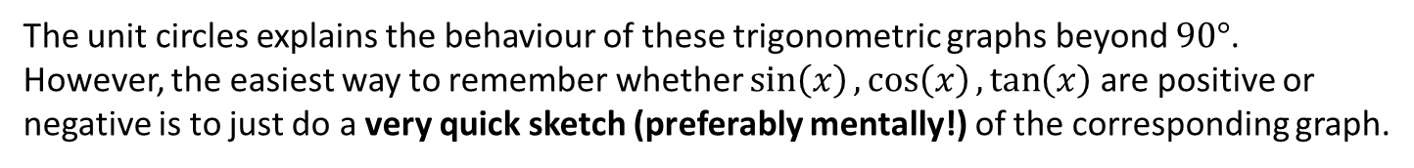



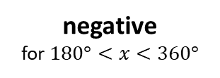

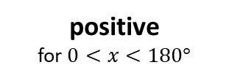
The Unit Circle and Trigonometry
The unit circles explains the behaviour of these trigonometric graphs beyond $90°$.
However, the easiest way to remember whether $\sin\left(x\right),\cos\left(x\right),\tan\left(x\right)$ are positive or negative is to just do a very quick sketch (preferably mentally!) of the corresponding graph.
$$y$$
positive
for $0<x<180°$
$$y=sin\left(x\right)$$
$$x$$
$$90$$
$$180$$
$$270$$
$$360$$
Note: The textbook uses something called ‘CAST diagrams’. I will not be using them in these slides, but you may wish to look at these technique as an alternative approach to various problems in the chapter.
negative
for $180°<x<360°$

Slide 6

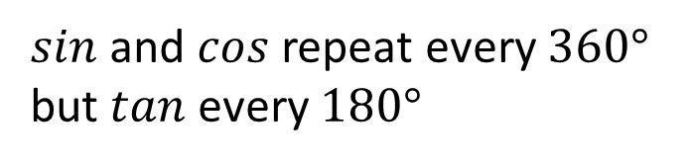


















A Few Trigonometric Angle Laws
The following are all easily derivable using a quick sketch of a trigonometric graph, and are merely a convenience so you don’t always have to draw out a graph every time.
You are highly encouraged to memorise these so that you can do exam questions faster.
$$y=\sin\left(x\right)$$
1
$$\sin\left(x\right)=\sin\left(180°−x\right)$$
We saw this in the previous chapter when covering the ‘ambiguous case’ when using the sine rule.
e.g. $\sin\left(150°\right)=\sin\left(30°\right)$
$$30$$
$$150$$
$$180$$
$$y=\cos\left(x\right)$$
2
$$\cos\left(x\right)=\cos\left(360°−x\right)$$
$$30$$
$$330$$
$$360$$
e.g. $\cos\left(330°\right)=\cos\left(30°\right)$
$sin$ and $cos$ repeat every $360°$
but $tan$ every $180°$
$$y=\sin\left(x\right)$$
3
$$30$$
$$360$$
$$390$$
$$720$$
e.g. $\sin\left(390°\right)=\sin\left(30°\right)$
$\sin\left(x\right)=\cos\left(90°−x\right)$
Remember from the previous chapter that “cosine” by definition is the sine of the “complementary” angle.
This was/is never covered in the textbook but caught everyone by surprise when it came up in a C3 exam.
4
e.g. $\sin\left(50°\right)=\cos\left(40°\right)$

Slide 7
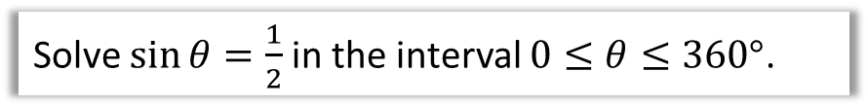
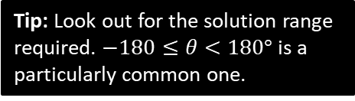
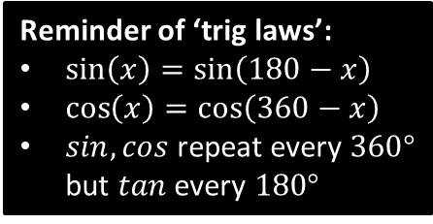
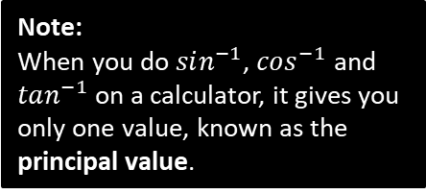
Solving Trigonometric Equations
Remember those trigonometric angle laws (on the right) earlier this chapter? They’re about to become super useful!
Reminder of ‘trig laws’:
$\sin\left(x\right)=\sin\left(180−x\right)$
$\cos\left(x\right)=\cos\left(360−x\right)$
$sin,cos$ repeat every $360°$ but $tan$ every $180°$
Solve $\sin{θ}=\frac{1}{2}$ in the interval $0≤θ≤360°$.
Note:
When you do $sin^{−1}$, $cos^{−1}$ and $tan^{−1}$ on a calculator, it gives you only one value, known as the principal value.
Solve $5\tan{θ}=10$ in the interval $−180°≤θ<180°$
Tip: Look out for the solution range required. $−180≤θ<180°$ is a particularly common one.

Slide 8
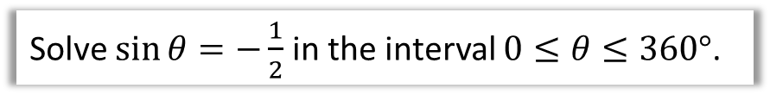
Slightly Harder One…
Solve $\sin{θ}=−\frac{1}{2}$ in the interval $0≤θ≤360°$.

Slide 9

Test Your Understanding
Solve $2\cos{θ}=\sqrt{3}$ in the interval $0≤θ≤360°$.

Slide 10




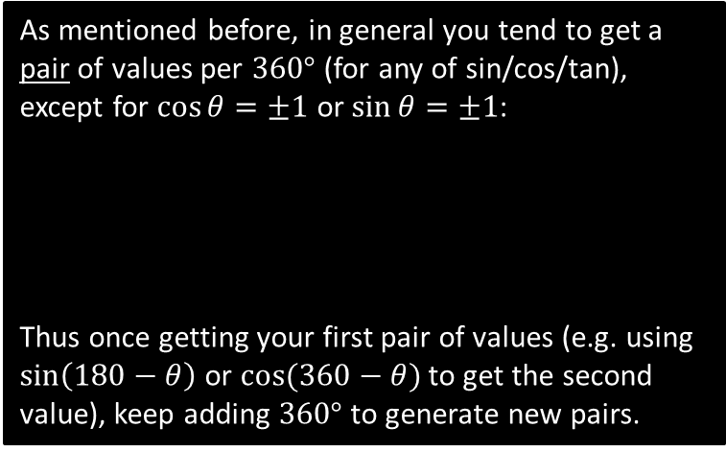

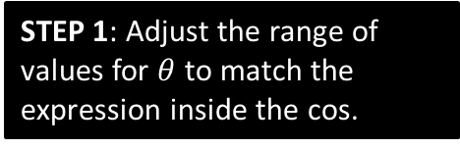


Harder Equations
Harder questions replace the angle $θ$ with a linear expression.
Solve $\cos{3x=−\frac{1}{2}}$ in the interval $0≤x≤360°$.
STEP 1: Adjust the range of values for $θ$ to match the expression inside the cos.
STEP 2: Immediately after applying an inverse trig function (and BEFORE dividing by 3!), find all solutions up to the end of the interval.
As mentioned before, in general you tend to get a pair of values per $360°$ (for any of sin/cos/tan), except for $\cos{θ=±1}$ or $\sin{θ}=±1$:
Thus once getting your first pair of values (e.g. using $\sin\left(180−θ\right)$ or $cos⁡(360−θ)$ to get the second value), keep adding $360°$ to generate new pairs.
$$y$$
STEP 3: Then do final manipulation to each value.
$$y=\cos\left(x\right)$$
$$90$$
$$180$$
$$270$$
$$360$$
$$x$$

Slide 11
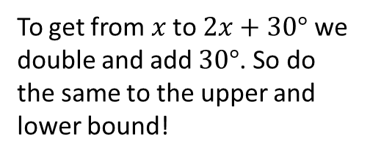
Further Example
Solve $\sin{(2x+30°)=\frac{1}{\sqrt{2}}}$ in the interval $0≤x≤360°$.
To get from $x$ to $2x+30°$ we double and add $30°$. So do the same to the upper and lower bound!

Slide 12
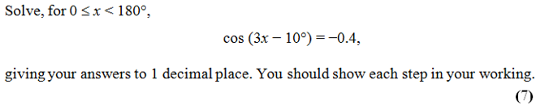
Test Your Understanding
Edexcel C2 Jan 2013 Q4

Slide 13
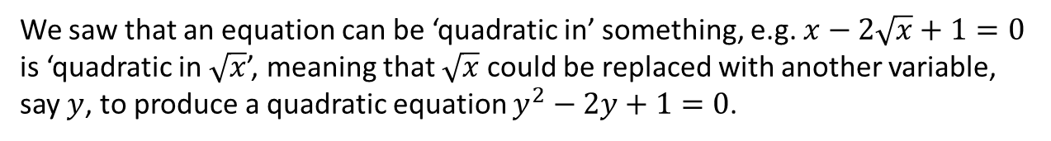
Quadratics in sin/cos/tan
We saw that an equation can be ‘quadratic in’ something, e.g. $x−2\sqrt{x}+1=0$ is ‘quadratic in $\sqrt{x}$’, meaning that $\sqrt{x}$ could be replaced with another variable, say $y$, to produce a quadratic equation $y^{2}−2y+1=0$.
Solve $5\sin^{2}{x}+3\sin{x}−2=0$ in the interval $0≤x≤360°$.

Slide 14







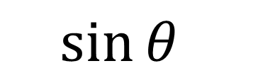
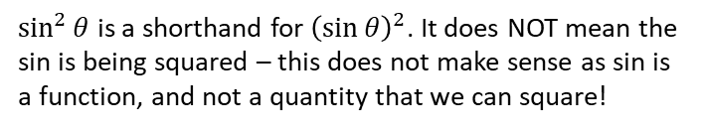
Trigonometric Identities
$$P$$
Let’s say we have a right angled triangle with hypotenuse of 1
$$1$$
$$\sin{θ}$$
$$θ$$
$$O$$
$$cos θ$$
1
Then $tan θ=\frac{sin θ}{cos θ}$
Pythagoras gives you...
$$sin^{2}θ+cos^{2}θ=1$$
2
$\sin^{2}{θ}$ is a shorthand for ${\left(\sin{θ}\right)}^{2}$. It does NOT mean the sin is being squared – this does not make sense as sin is a function, and not a quantity that we can square!

Slide 15
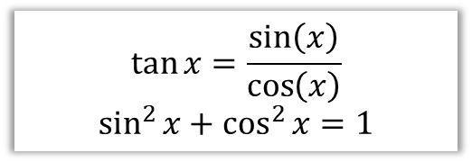
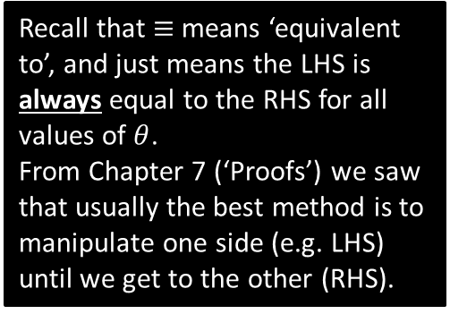
Application of identities #1: Proofs
Prove that $1−\tan{θ}\sin{θ}\cos{θ}≡\cos^{2}{θ}$
$$\tan{x}=\frac{\sin\left(x\right)}{\cos\left(x\right)}$$
$$\sin^{2}{x}+\cos^{2}{x}=1$$
Recall that $≡$ means ‘equivalent to’, and just means the LHS is always equal to the RHS for all values of $θ$.
From Chapter 7 (‘Proofs’) we saw that usually the best method is to manipulate one side (e.g. LHS) until we get to the other (RHS).

Slide 16
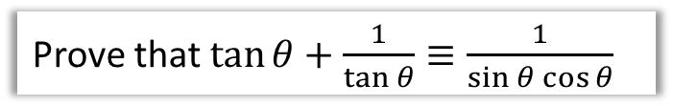
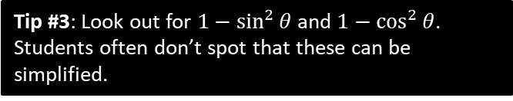

More Examples
Edexcel C2 June 2012 Paper 1 Q16
Prove that $\tan{θ}+\frac{1}{\tan{θ}}≡\frac{1}{\sin{θ}\cos{θ}}$
Simplify $5−5\sin^{2}{θ}$
Tip #3: Look out for $1−\sin^{2}{θ}$ and $1−\cos^{2}{θ}$.
Students often don’t spot that these can be simplified.
Tip #2: In any addition/subtraction involving at least one fraction (with trig functions), always combine algebraically into one.

Slide 17
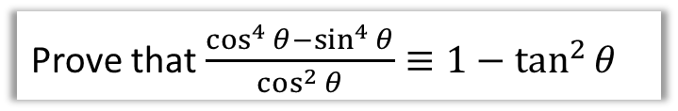
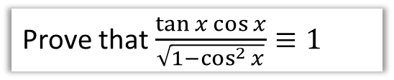
Test Your Understanding
Prove that $\frac{\tan{x}\cos{x}}{\sqrt{1−\cos^{2}{x}}}≡1$
Prove that $\frac{\cos^{4}{θ}−\sin^{4}{θ}}{\cos^{2}{θ}}≡1−\tan^{2}{θ}$
AQA IGCSE Further Maths Worksheet
Prove that $\tan^{2}{θ}≡\frac{1}{\cos^{2}{θ}}−1$

Slide 18
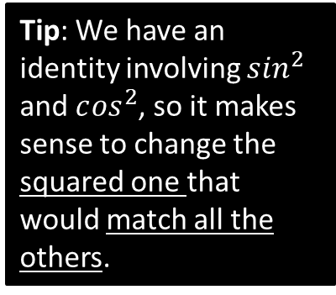
More Examples of Quadratics
Solve $\tan^{2}{θ}=4$ in the interval $0≤x≤360°$.
Solve $2\cos^{2}{x}+9\sin{x}=3\sin^{2}{x}$ in the interval $−180°≤x≤180°$.
Tip: We have an identity involving $s{in}^{2}$ and $c{os}^{2}$, so it makes sense to change the squared one that would match all the others.

Slide 19
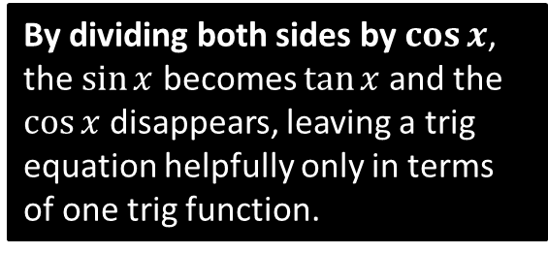
Further Example
Solve $\sin{x}=2\cos{x}$ in the interval $0≤x<300°$
By dividing both sides by $\cos{x}$, the $\sin{x}$ becomes $\tan{x}$ and the $\cos{x}$ disappears, leaving a trig equation helpfully only in terms of one trig function.

Slide 20
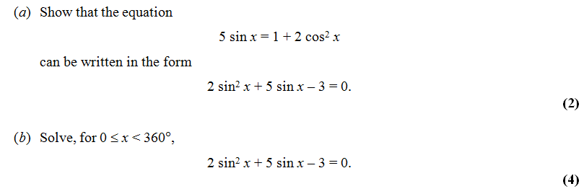
Test Your Understanding
Edexcel C2 Jan 2010 Q2

