Slide 1
P1 Chapter 13 :: Integration

Slide 2
Integrating $x^{n}$ terms
Integration is the opposite of differentiation.
(For this reason it is also called ‘antidifferentiation’)
Gradient Function
Function
multiply by power
reduce power by 1
$$15x^{2}$$
$$5x^{3}$$
divide by new power
increase power by 1
However, there’s one added complication…
Find $y$ when $\frac{dy}{dx}=3x^{2}$
Adding 1 to the power and dividing by this power give us:
$$y=x^{3}$$
However, other functions would also have differentiated to $3x^{2}$:
$$y=x^{3}+1, y=x^{3}−4, …$$
Clearly we could have had any constant, as it disappears upon differentiation.
$$∴y=x^{3}+c$$
$c$ is known as a constant of integration

Slide 3
Examples
Find $y$ when:
$$\frac{dy}{dx}=4x^{3} y=x^{4}+c$$
$$\frac{dy}{dx}=x^{5} y=\frac{1}{6}x^{6}+c$$
$$\frac{dy}{dx}=3x^{\frac{1}{2}} y=3\left(\frac{2}{3}\right)x^{\frac{3}{2}}+c=2x^{\frac{3}{2}}+c$$

Slide 4
More Fractional Examples
Find $y$ when:
$$\frac{dy}{dx}=\frac{4}{\sqrt{x}}=4x^{−\frac{1}{2}} y=8x^{\frac{1}{2}}+c$$
$$\frac{dy}{dx}=5x^{−2} y=−5x^{−1}+c$$
$$\frac{dy}{dx}=4x^{\frac{2}{3}} y=4\left(\frac{3}{5}\right)x^{\frac{5}{3}}+c=\frac{12}{5}x^{\frac{5}{3}}+c$$
$$\frac{dy}{dx}=10x^{−\frac{2}{7}} y=10\left(\frac{7}{5}\right)x^{\frac{5}{7}}+c=14x^{\frac{5}{7}}+c$$

Slide 5
Test Your Understanding
Find $f(x)$ when:
$$f^{′}\left(x\right)=2x+7 f\left(x\right)=x^{2}+7x+c$$
$$f^{′}\left(x\right)=x^{2}−1 f\left(x\right)=\frac{1}{3}x^{3}−x+c$$
$$f^{′}\left(x\right)=\frac{2}{x^{7}}=2x^{−7} f\left(x\right)=−\frac{1}{3}x^{−6}+c$$
$$f^{′}\left(x\right)=\sqrt[3]{x}=x^{\frac{1}{3}} f\left(x\right)=\frac{3}{4}x^{\frac{4}{3}}+c$$
$$f^{′}\left(x\right)=33x^{\frac{5}{6}} f\left(x\right)=18x^{\frac{11}{6}}+c$$
Note: In case you’re wondering what happens if $\frac{dy}{dx}=\frac{1}{x}=x^{−1}$ , the problem is that after adding 1 to the power, we’d be dividing by 0. You will learn how to integrate $\frac{1}{x}$ in Year 2.

Slide 6
Integration notation
The following notation could be used to differentiate an expression:
$$\frac{d}{dx}\left(5x^{2}\right)=10x$$
There is similarly notation for integrating an expression:
$$∫10x dx=5x^{2}+c$$
The $dx$ here means differentiating “with respect to $x$”.
“Integrate…”
“…with respect to $x$”
(the $dx$ is needed just as it was needed in the differentiation notation at the top of this slide)
“…this expression”
This is known as indefinite integration, in contrast to definite integration, which we’ll see later in the chapter.
It is called ‘indefinite’ because the exact expression is unknown (due to the $+c$).
Advanced Note: For the moment you should think of the $dx$ just as part of the $\int{\left(…\right) dx}$ notation, informing us what variable we’re integrating with respect to. But strictly the $dx$ actually beh

Slide 7
Examples
Find $\int{(x^{−\frac{3}{2}}+2) dx}$
$$=−2x^{−\frac{1}{2}}+2x+c$$
Find $\int{(6t^{2}−1) dt}$
$$=2t^{3}−t+c$$
Find $\int{(px^{3}+q) dx}$ where $p$ and $q$ are constants.
$$=\frac{1}{4}px^{4}+qx+c$$

Slide 8
Test Your Understanding
Edexcel C1 May 2014(R) Q4b
?
$$y=2x^{5}+6x^{−\frac{1}{2}} \\ \int{y dx}=\frac{1}{3}x^{6}+12x^{\frac{1}{2}}+c$$

Slide 9
Finding constant of integration
Recall that when we integrate, we get a constant of integration, which could be any real value. This means we don’t know what the exact original function was.
$$y$$
$$y$$
$$f\left(x\right)=x^{3}+c$$
$$f^{′}\left(x\right)=3x^{2}$$
$$∫$$
$$\left(1,3\right)$$
$$f\left(x\right)=x^{3}$$
$$f\left(x\right)=x^{3}−1$$
?
$$x$$
$$x$$
But if we know one point on the curve, it leaves only one possibility.
The curve with equation $y=f(x)$ passes through $\left(1,3\right)$. Given that $f^{′}\left(x\right)=3x^{2}$, find the equation of the curve.
$$f^{′}\left(x\right)=3x^{2} \\ ∴f\left(x\right)=x^{3}+c$$
Using the point $(1,3)$: $3=1^{3}+c ∴c=2$
$$f\left(x\right)=x^{3}+2$$

Slide 10
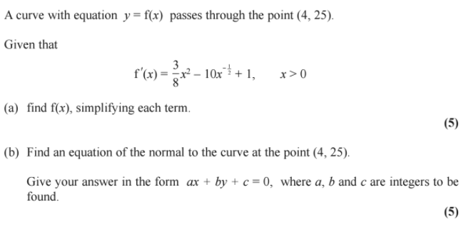
Test Your Understanding
Edexcel C1 May 2014 Q10

Slide 11
Lesson 2: Definite Integration
So far we’ve seen integration as ‘the opposite of differentiation’, allowing us to find $y=f\left(x\right)$ when we know the gradient function $y=f^{′}\left(x\right)$.
In practical settings however the most useful use of integration is that it finds the area under a graph. Remember at GCSE for example when you estimated the area under a speed-time graph, using trapeziums, to get the distance?
If you knew the equation of the curve, you could get the exact area!
Before we do this, we need to understand how to find a definite integral:
speed
$$Area=distance$$
time
These are known as limits, which give the values of $x$ we’re finding the area between.
We integrate as normal, but put expression in square brackets, meaning we still need to evaluate the integrated expression using the limits.
$$y$$
$$y=4x^{3}$$
$$\int_{1}^{5}{4x^{3} dx}=$$
$${\left[x^{4}\right]}_{1}^{5}$$
$$=\left(5^{4}\right)−\left(1^{4}\right) \\ =624$$
$$?$$
$$Area=distance$$
$$x$$
$$1$$
$$5$$
Write $\left(…\right)−(…)$ and evaluate the expression for each of the limits, top one first.

Slide 12
Another Example
$$\int_{−3}^{3}{x^{2}+1 dx}={\left[\frac{1}{3}x^{3}+x\right]}_{−3}^{3} \\ =\left(\frac{1}{3}{\left(3\right)}^{3}+3\right)−\left(\frac{1}{3}{\left(−3\right)}^{3}−3\right) \\ =12−−12 \\ =24$$
We DON’T have a constant of integration when doing definite integration. I’ll explain why later.
Write out you working EXACTLY as seen here. The $\left(…\right)−(…)$ brackets are particularly crucial as you’ll otherwise likely make a sign error.
“Use of Technology”:
You can use the $⟦\int_{b}^{a}{□}⟧$ button on your calculator to evaluate definite integrals.
But only use it to check your answer.

Slide 13
Areas under curves
$$y$$
$$y=f(x)$$
Earlier we saw that the definite integral $\int_{a}^{b}{f(x)} dx$ gives the area between a positive curve $y=f(x)$, the $x$-axis, and the lines $x=a$ and $x=b$.
$$Area$$
$$Area=distance$$
$$x$$
$$a$$
$$b$$
Find the area of the finite region between the curve with equation $y=20−x−x^{2}$ and the $x$-axis.
Factorise in order to find roots:
$$20−x−x^{2}=0 \\ x^{2}+x−20=0 \\ \left(x+5\right)\left(x−4\right)=0 \\ x=−5 or x=4$$
Therefore area between curve and $x$-axis is:
$$\int_{5}^{4}{20−x−x^{2} dx}={\left[20x−\frac{1}{2}x^{2}−\frac{1}{3}x^{3}\right]}_{−5}^{4} \\ =\left(80−8−\frac{64}{3}\right)−\left(−100−\frac{25}{2}+\frac{125}{3}\right) \\ =\frac{243}{2}$$
$$y$$
$$x$$
$$−5$$
$$4$$

Slide 14
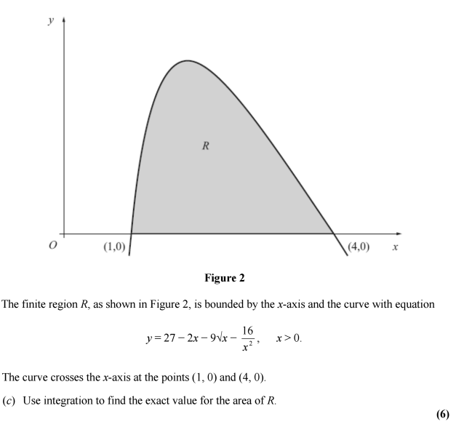
Test Your Understanding
Edexcel C2 Jan 2013 Q9c
?
Solution: -12

Slide 15
‘Negative Areas’
Sketch the curve $y=x(x−1)(x−2)$ (which expands to give $y=x^{3}−3x^{2}+2x$).
Now calculate $\int_{0}^{2}{x\left(x−1\right)\left(x−2\right)} dx$. Why is this result surprising?

Slide 16
Example
Find the total area bound between the curve $y=x(x−1)(x−2)$ and the $x$-axis.
$$y$$
Strategy:
Separately find the area between $x=0$ and 1, and between 1 and 2. Treat any negative areas as positive.
?
$$x$$
$$1$$
$$2$$
$$x\left(x−1\right)\left(x−2\right)=x^{3}−3x^{2}+2x$$
$$\int_{0}^{1}{x^{3}−3x^{2}+2x} dx={\left[\frac{1}{4}x^{4}−x^{3}+x^{2}\right]}_{0}^{1}=\frac{1}{4} \\ \int_{1}^{2}{x^{3}−3x^{2}+2x} dx={\left[\frac{1}{4}x^{4}−x^{3}+x^{2}\right]}_{0}^{2}=−\frac{1}{4}$$
Treating both as positive:
$$Area=\frac{1}{4}+\frac{1}{4}=\frac{1}{2}$$
? Solution

Slide 17
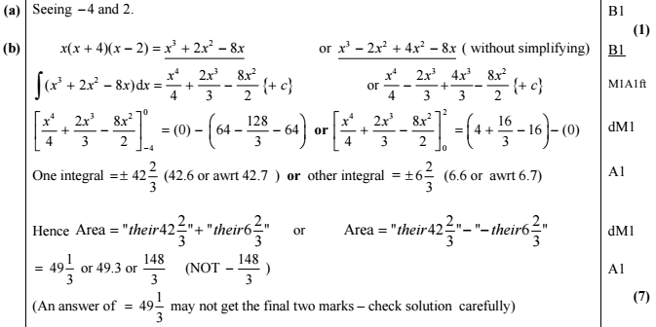
Test Your Understanding
Edexcel C2 May 2013 Q6
?
?

Slide 18
Lesson 3: Areas between curves and lines
$$y$$
$$y=x$$
How could we find the area between the line and the curve?
$$?$$
?
Start with the area under $y=x\left(4−x\right)$ up to the point of intersection, then subtract the area of the triangle to ‘cut it out’.
$$y=x\left(4−x\right)$$
Click for
Fro-animation >
Determine the area between the lines with equations $y=x\left(4−x\right)$ and $y=x$
?
Find point of intersection:
$$x\left(4−x\right)=x \\ ∴x=0 or x=3$$
Area under curve:
$$\int_{0}^{3}{x\left(4−x\right) dx}={\left[2x^{2}−\frac{1}{3}x^{3}\right]}_{0}^{3}=9$$
Area of triangle $=\frac{1}{2}×3×3=\frac{9}{2}$
$∴$ Shaded area $=9−\frac{9}{2}=\frac{9}{2}$

Slide 19
A Harder One
[Textbook] The diagram shows a sketch of the curve with equation $y=x\left(x−3\right)$ and the line with equation $y=2x$.
Find the area of the shaded region $OAC$.
$$y=x(x−3)$$
$$C$$
$$y=2x$$
What areas should we subtract this time?
Start with triangle $OBC$ and subtract the area under the curve $AC$.
$$O$$
$$A$$
$$B$$
?
First find points of intersection:
$$x\left(x−3\right)=2x → x=0 or x=5$$
When $x=5, y=10 → C\left(5,10\right)$
Also need to find the point $A$:
$$x\left(x−3\right)=0 → A(3,0)$$
$∴$ Area of triangle $OBC=\frac{1}{2}×5×10=25$
Area under $AC$: $\int_{3}^{5}{x\left(x−3\right)dx}= …=\frac{26}{3}$
$∴$ Shaded area $=25−\frac{26}{3}=\frac{49}{3}$
?

Slide 20
Test Your Understanding
Edexcel C2 May 2012 Q5

