Slide 1
P1 Chapter 9 :: Trigonometric Ratios
Pupil Notes
Last modified: 11th March 2020

Slide 2
Lesson 1: Proof of Cosine Rule
We want to use Pythagoras, so split $c$ into two so that we get two right-angled triangles.
$$b$$
$$a$$
$$h$$
$$A$$
$$c−x$$
$$x$$

Slide 3
Proof of Sine Rule
$$C$$
The idea is that we can use the common length of $ΔACX$ and $∠XBC$, i.e. $h$, to connect the two triangles, and therefore connect their angles/length.
$$b$$
$$a$$
$$h$$
$$A$$
$$B$$
$$X$$
$$c$$

Slide 4
Cosine Rule
We use the cosine rule whenever we have three sides (and an angle) involved.
Proof at end of PowerPoint.
Cosine Rule:
$$a^{2}=b^{2}+c^{2}−2bc\cos{A}$$
$$15$$
$$115°$$
$$x$$
$$12$$

Slide 5
Dealing with Missing Angles
You have | You want | Use
All three sides | An angle | Cosine rule
$$a^{2}=b^{2}+c^{2}−2bc\cos{A}$$
$$7$$
$$α$$
$$4$$
$$9$$

Slide 6
Harder Ones
Determine the value of $x$.
$$x$$
$$2x−1$$
$$60°$$
$$x+8$$
[From textbook] Coastguard station $B$ is 8 km, on a bearing of $060°$, from coastguard station $A$. A ship $C$ is 4.8 km on a bearing of $018°$, away from $A$. Calculate how far $C$ is from $B$.

Slide 7
Examples
8
Q2
Q1
8
50°
85°
100°
45°
30°

Slide 8
Examples
When you have a missing angle, it’s better to reciprocate to get:
$$\frac{\sin{A}}{a}=\frac{\sin{B}}{b}$$
i.e. in general put the missing value in the numerator.
5
Q3
Q4
8
85°
40.33°
6
10

Slide 9
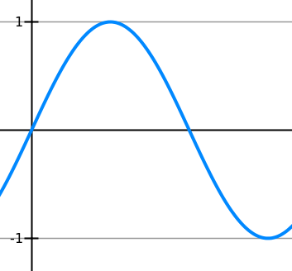
The ‘Ambiguous Case’
$$A$$
Suppose you are told that $AB=4$, $AC=3$ and $∠ABC=44°$. What are the possible values of $∠ACB$?
$C$ is somewhere on the horizontal line. There’s two ways in which the length could be 3. Using the sine rule:
$$4$$
$$3$$
$$3$$
$$44°$$
$$B$$
$$C_{1}$$
$$C_{2}$$
0.9262
! The sine rule produces two possible solutions for a missing angle:
$$\sin{θ}=sin⁡(180°−θ)$$
Whether we use the acute or obtuse angle depends on context.
$$67.9°$$
$$112.1°$$
$$180°$$

Slide 10
Test Your Understanding
Given that the angle $θ$ is obtuse, determine $θ$ and hence determine the length of $x$.
10
$$θ$$
5
$$20°$$
$$x$$

Slide 11
Test Your Understanding
The area of this triangle is 10.
Determine $x$.
$$x$$
$$30°$$
$$x+3$$
$$5$$
The area of this triangle is also 10.
If $θ$ is obtuse, determine $θ$.
$$6$$
$$θ$$

Slide 12
Problem Solving With Sine/Cosine Rule
[From Textbook] The diagram shows the locations of four mobile phone masts in a field, $BC=75 m$.
$CD=80m$, angle $BCD=55°$ and angle $ADC=140°$.
In order that the masts do not interfere with each other, they must be at least 70m apart.
Given that $A$ is the minimum distance from $D$, find:
The distance $A$ is from $B$
The angle $BAD$
The area enclosed by the four masts.
Using triangle $BCD$: $BD^{2}={75}^{2}+{80}^{2}−2×75×80×\cos{55°}$ $$BD=71.708…$$ Then use sine rule to find $∠BDC$: $\frac{\sin\left(∠BDC\right)}{75}=\frac{\sin\left(55\right)}{71.708} → ∠BDC=58.954$
$$∴∠BDA=81.045…$$
We can then use cosine rule on $ΔABD$:
$$AB^{2}={70}^{2}+{71.708}^{2}−2×70×71.708×cos\left(81.045\right)$$
$$AB=92.1 m \left(3sf\right)$$
Using sine rule on $ΔABD, ∠BAD=50.3° (3sf)$
By adding areas of $ΔABD$ and $ΔBDC$:
$$Area ABCD=4940 m^{2} (3sf)$$
$$B$$
a
?
$$75 m$$
$$55°$$
$$A$$
$$C$$
$$70 m$$
$$140°$$
$$80 m$$
$$D$$
b
?
c
?

Slide 13
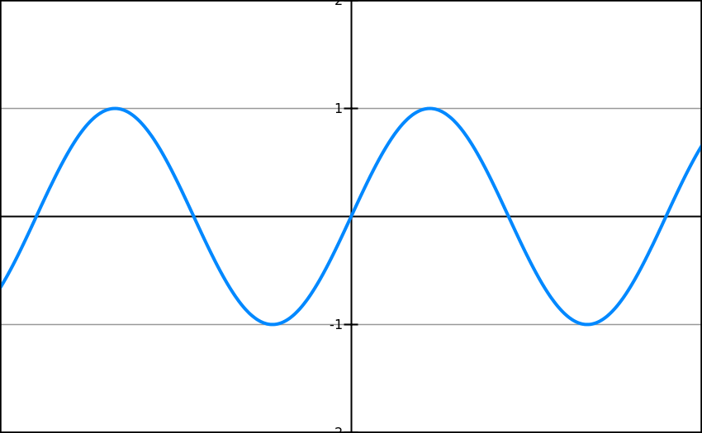
Lesson 2: Sine Graph
What does it look like?
Key Features:
Repeats every $360°$.
Range: $−1<\sin\left(x\right)<1$
-360
-270
-180
-90
90
180
270
360

Slide 14
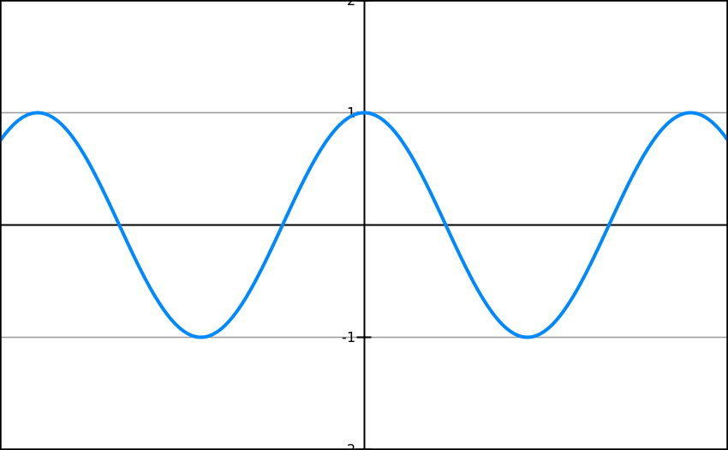
Cos Graph
What do the following graphs look like?
Key Features:
Repeats every $360°$.
Range: $−1<\sin\left(x\right)<1$
-360
-270
-180
-90
90
180
270
360

Slide 15
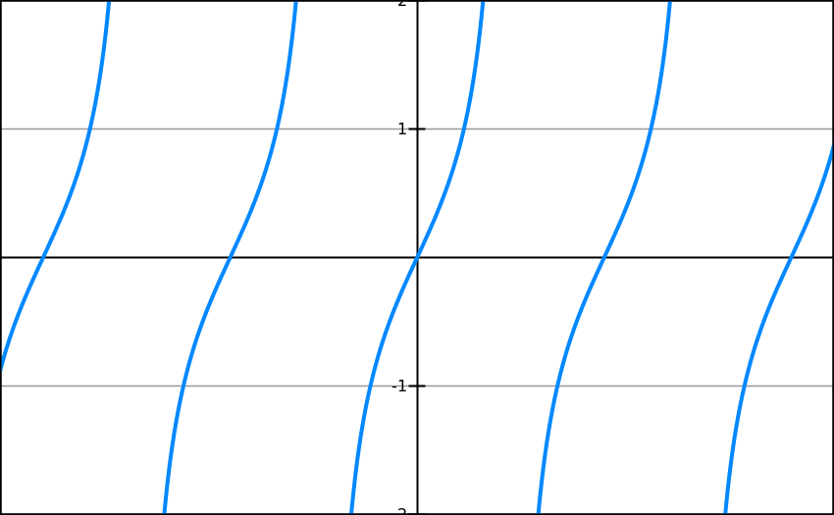
Tan Graph
What does it look like?
-360
-270
-180
-90
90
180
270
360
Key Features:
Repeats every $180°$.
Roots: $0,180°,−180°, …$
Range: $\tan\left(x\right)∈ℝ$ (i.e. no min/max value!)
Asymptotes: $x=±90°, ±270°,…$

Slide 16
Transforming Trigonometric Graphs
There is no new theory here: just use your knowledge of transforming graphs, i.e. whether the transformation occurs ‘inside’ the function (i.e. input modified) or ‘outside’ the function (i.e. output modified).
Sketch $y=4\sin{x}$, $0≤x≤360°$
Sketch $y=\cos\left(x+45°\right)$, $0≤x≤360°$

Slide 17
Transforming Trigonometric Graphs
Sketch $y=−\tan{x}$, $0≤x≤360°$
Sketch $y=\sin\left(\frac{x}{2}\right)$, $0≤x≤360°$

