Slide 1
Research Techniques – Task 2 c
Unit 26 Industry related project – P2/M1 continued.

Slide 2
Context
Research forms a major part of your Unit 26 project.
Compiling your project will be done individually and you will formulate/plan/carry out your own research methods, as well as use existing sources of information to help put together your project (and meet your objectives).

Slide 3
Context
(P1) Task 1 – 3 options (choose 1)
(P2/M1) Task 2 – Planning your Project
a) Project Outline
b) Task 1/2 Objectives
b) Task 3 Skills Analysis
c) Market Research Plan
d) Market Research Methods Preparation.
e) Designing/Identifying Specific Resources you will use for your research.
f) Project Action Plan.
(P3/M2) Task 3 – Carrying out your project (writing up the results of your research).
(P4/D1) Task 4 – Project Evaluation.

Slide 4
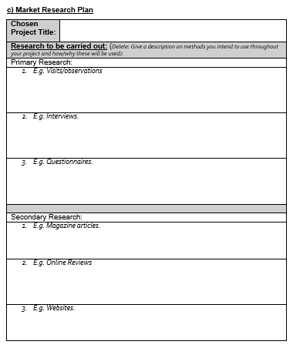
For section 2c) you are giving an outline of the research that you will be undertaking during the completion of the project.
You must plan a MINIMUM of 3 primary AND 3 secondary methods.
These should be chosen so that they enable you to generate the information that will help you meet your objectives e.g. discover strengths/weaknesses of an aspect business, then develop recommendations.
Once you have identified/described your methods, your must EXPLAIN HOW/WHY YOU WILL USE THESE.

Slide 5
Types of Research
Primary Research
Original research gathered by the researcher; this can include results of
interviews, questionnaires, focus groups etc. OR textual analysis of a media
product.
Secondary Research
Using research already carried out by other people; this can include academic research, critical reviews and opinions etc. OR statistics, results of somebody else's focus group etc.
REMEMBER, YOU MUST CHOOSE AT LEAST 3 PRIMARY AND 3 SECONDARY METHODS – YOU CAN USE MORE IF YOU NEED TO.
These two types of research can also be divided into;
Quantitative Research
Research based on numbers, statistic or tables, producing “hard” data. Usually involves working with large groups of people.
Qualitative Research
More detailed, in-depth research which may involve discussion or analysis of peoples attitudes and behaviour. Usually involves working with smaller groups of people. i.e. seeking QUALITY information.

Slide 6
Each method you use needs to be:
Outlined (in task 2c – market research plan)…using the Task 2c table.
Researched (in task 2d – preparation)…to be discussed in next week’s lesson.
Identified/Designed/planned/justified in-depth (in task 2e – resources section)…to be discussed in next week’s lesson.

Slide 7
Methods of PRIMARY Research (at least 3) you may wish to use…
Questionnaires – a list of written questions requiring written answers (mixture of quantitative/qualitative results data). Staff? Customers?
Surveys – Gathering information from/about people (usually short/closed/quantitative data). Staff? Customers? (face to face or online).
Observations – Researcher observes consumers/staff to draw conclusions on behaviour/reactions/standards of service etc.) At the business(es) you are researching, but could also be carried out at competitors to get ideas for improvements?
Structured interviews – Basically a spoken questionnaire, where the interviewer writes down the responses of the interviewee. Staff? Managers? Industry experts? (Can be done face to face or by phone).
Unstructured interviews – Much less formal interviews where the interviewer is able to change the order of questions, re-phrase them or just provide a general guide for discussion. During observations – informal chats with staff/customers?
Focus groups – Interviews carried out with groups of people rather than individuals. Staff/customers – prompted discussion.

Slide 8
PRIMARY RESEARCH: What you will be doing with this information (in task P3/M2 project)
Using the resources you have designed, carry out the primary research.
Show the results.
Analyse the results.
Make conclusions (strengths/areas for improvement, common opinions etc…).

Slide 9
Methods of SECONDARY Research
At least ONE of your methods secondary methods should be used to research how your project topic relates to/or is viewed by “the hospitality industry” (e.g. industry reports, text book theory etc.).
The Research Investigation requires you to have research from a "...wide variety of sources...“. These can include;
Books – Use theories, ideas and arguments. Remember to use the library – the librarians will help you find relevant material but you can also use the HERITAGE database on Godalming Online to find specific titles, subject searches etc.
Websites –
On-line articles /news stories etc. Be thorough when looking through sites - don't always search for the most obvious things and make sure you read rather than just surf from one place to the next!
Review sites (Trip Advisor etc.)
Social Media sites.
Organisation’s websites
Industry bodies e.g. www.bha.org.uk (British Hospitality Association)
Leisure, Travel and Tourism sites.
News Sites.

Slide 10
Methods of SECONDARY Research
The Research Investigation requires you to have research from a "...wide variety of sources...“. These can include;
PDF documents – academic articles, reports etc. from previous studies/research.
TV programmes/YouTube – Documentries, News reports
Magazines / newspapers / journal – use the college library / collect articles / collect quotes (Daily National Newspapers, local newspapers, Hospitality journals such as Caterer and Hotelkeeper, Hospitality Today).
Marketing Materials
Training Materials – presentations, hand books, posters etc.

Slide 11
SECONDARY RESEARCH: What you will need to do (in task 3 project)
Find academic texts, articles, relevant video clips, magazine and books.
Read the chapters, articles, journals etc.
Highlight/Annotate/Make notes, make conclusions.
Remember to make note of quotations you have found with page numbers and explanations as to why you think the quote might be useful.
Keep ALL details for your bibliography

