Slide 1
Ethnicity and Crime

Slide 2
What do we mean by the following terms?
Race
Racism
Ethnicity

Slide 3
Defining the terms: Race & Ethnicity
“Race” relates to supposed biological differences such as differences in skin colour, hair texture or shape of eyes between different social groups .
However, this term does not take into account significant cultural differences that may exist between people who would be categorised in the same “race”. E.g. people from the Indian subcontinent may all be categorised as belonging to the Asian race, but there are hundreds of different languages spoken and religions practiced by these people.
For this reason most sociologists do not consider “race” to be a meaningful concept, and some see it as a dangerous concept which can lead to the persecution of one “race” by another.
The term ethnicity relates to cultural differences which may exist between different social groups and sociologists see this term as more useful than “race” for the analysis of different social groups

Slide 4
Ethnic Minority population
What percentage of the British population do you estimate to be:
Asian
Black
White

Slide 5
Ethnic Minority Population – Data from 2011 Census
England and Wales has become more ethnically diverse with rising numbers of people identifying with minority ethnic groups in 2011.
White was the majority ethnic group at 48.2 million in 2011 (86.0 per cent) a decrease from 91.3 per cent in 2001 and 94.1 per cent in 1991.
Across the English regions and Wales, London was the most ethnically diverse area, and Wales the least.

Slide 6
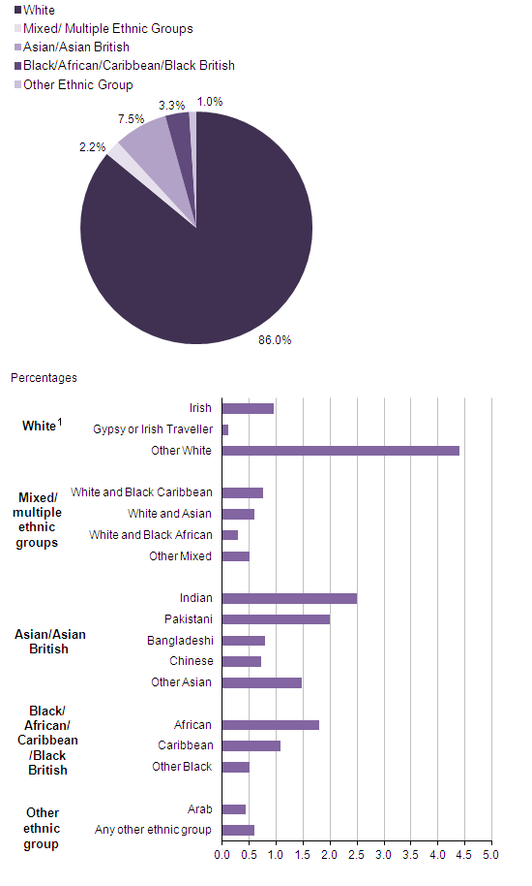

Slide 7
Ethnic Minority population
Compare your estimates to the data on the previous slide.
If your estimates are higher than the real data, what does this tell us about our attitudes in relation to the issue of ethnicity?
Where do these attitudes come from?

Slide 8
Patterns and Trends with offending/victimisation of ethnic minority groups

Slide 9
The issue:
Coretta Philips and Ben Bowling (2002) argue that the issue of ‘race’ and crime returned to public attention in the 1970s because of the consistent pattern of Afro-Caribbean people being over-represented in the prison population in the UK. This is a pattern that has be maintained ever since.

Slide 10
Questions to ask:
How do we explain these ethnic differences in criminalisation?
Is it because some ethnic groups are more likely to offend in the first place- and if so, how do we explain such differences? How do we avoid sounding racist when trying to form such explanations?
Or is it because the criminal justice system is racist or discriminates against ethnic minorities?

Slide 11
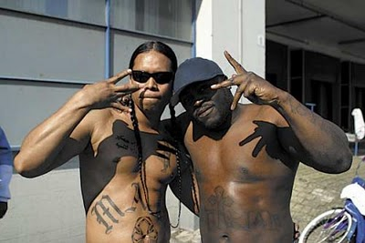
Ethnicity & Crime
BAME groups are significantly over-represented in the prison system, with approximately 25 per cent of the overall prison population from a BAME community.
In 2014, black or Black British people made up 10 per cent of the total prison population, whilst making up just 3 per cent of the UK’s total population.
Asian or Asian British people made up 6 per cent of the prison population.
White British people made up approximately 75 per cent of the prison population, whilst making up over 85 per cent of the UK’s total population.
This does not apply to all ethnic minorities - South Asians not disproportionately represented and Chinese conviction rates relatively low

Slide 12
The Ministry of Justice in 2013, reported that compared to white people, black people were:
Over twice as likely to be cautioned by the police.
Around three times more likely to be arrested.
If arrested, more likely to be charged, remanded in custody and face court proceedings than to receive a caution.
More likely, if found guilty, to receive a custodial (prison) sentence and for a longer term.
Five times more likely to be in prison (which has increased from 4 times as likely in 2011).
On page 15 complete the 10 mark question on official statistics

Slide 13
Victims of Crime
Ethnic minorities are also more likely to be victims of crime disproportionately to their numbers, and this is particularly s for ethnic minority women.
Why do you think this is
the case?

Slide 14
Hate crime
Hate crime is defined as ‘any criminal offence which is perceived by the victim or any person, to be motivated by a hostility or prejudice towards someone based on a personal characteristic’ (College of Policing, 2014).
There are five centrally monitored strands of hate crime:
Race or ethnicity
Religion or beliefs
Sexual orientation
Disability, and
Transgender identity

Slide 15
Police recorded Hate Crime (Home Office, 2018)
In 2017/18, there were 94,098 hate crime offences recorded by the police in England and Wales.
71,251 (76%) race hate crimes
11,638 (12%) sexual orientation hate crimes
8,336 (9%) religious hate crimes (52% against Muslims, 12% Jewish)
7,226 (8%) disability hate crimes
1,651 (2%) transgender hate crimes

Slide 16
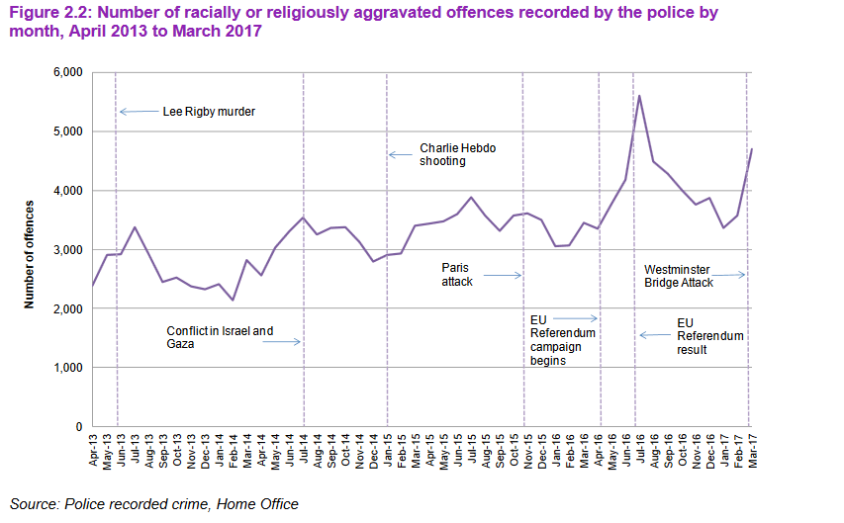

Slide 17
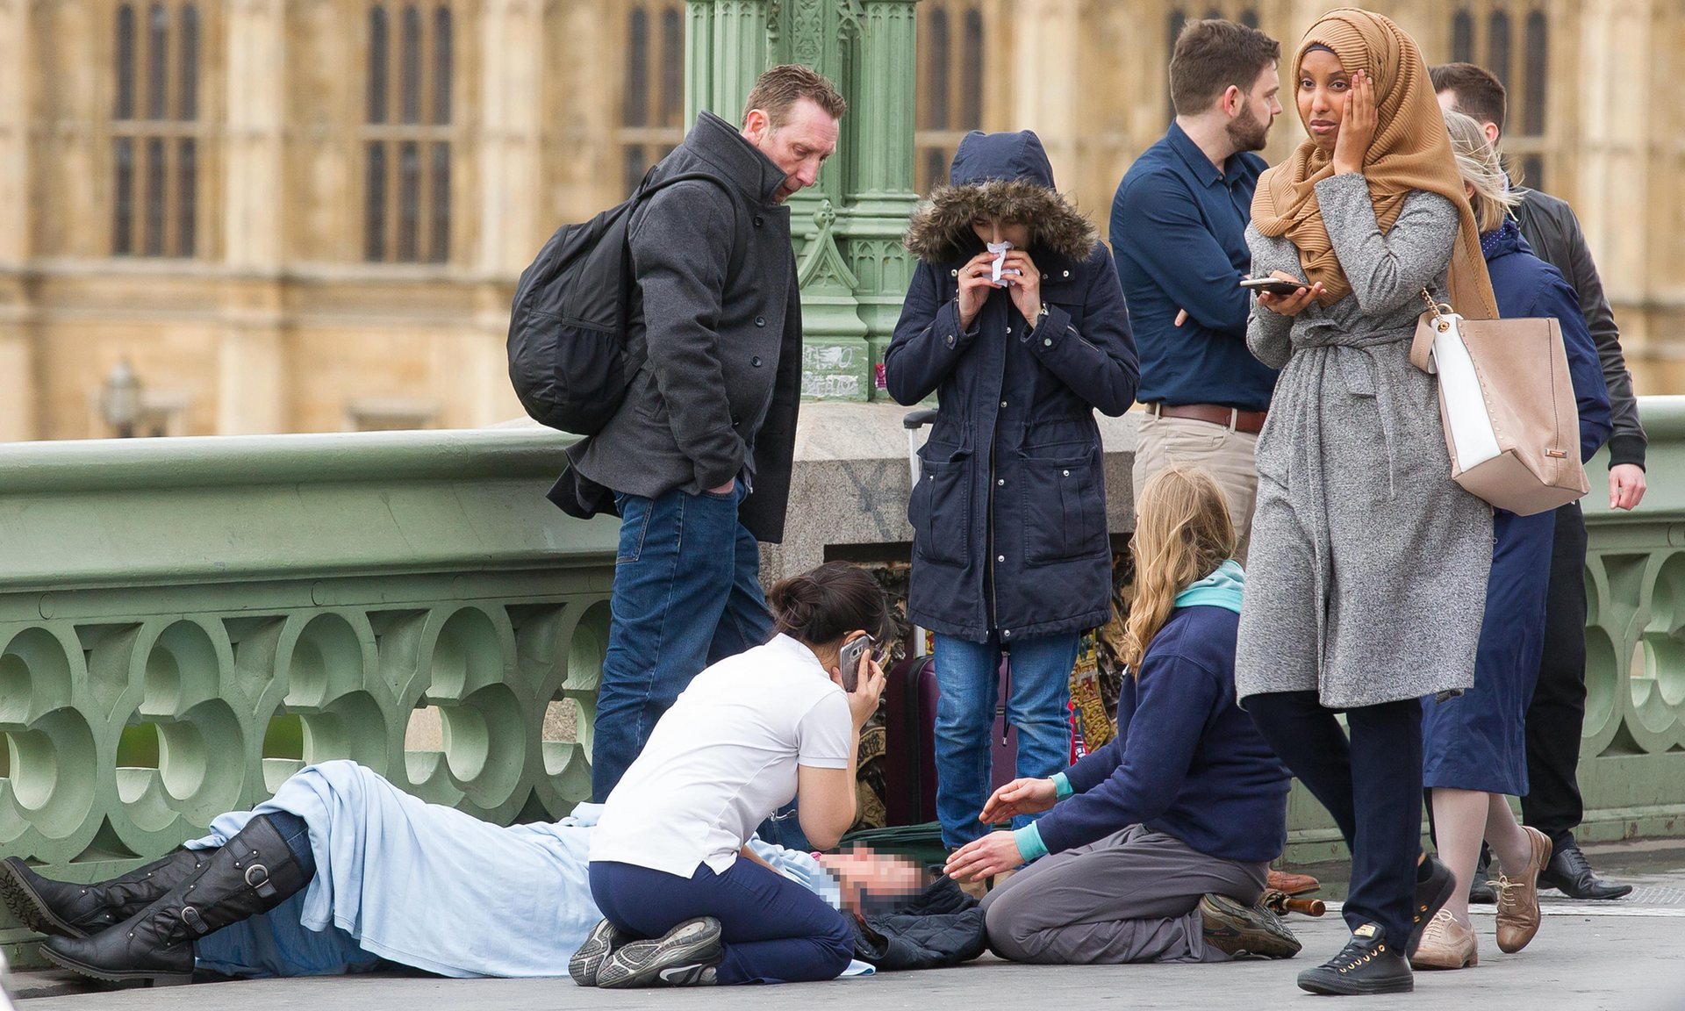

Slide 18
Ethnicity And Victimisation
The BCS (British Crime Survey) and victim surveys are the main providers of information about the type and incidence of racially motivated crimes.
Most recorded racist incidents are crimes against property and verbal harassment
Most incidents are unreported
On page 15 complete the 10 mark question on victim surveys

Slide 19
Self-report studies
Ask people about their own dishonest and violent behaviour.
The last major self-reported study of ethnicity and offending in Britain was carried out in 2005 and had a sample of more than 10,000 respondents.
> The highest rate of offending where found among ‘whites’, with 42% admitting an offence during their lifetime.
> Compared to 39% of ‘Mixed’ ethnicity.
> 28% ‘Black’
> 21% ‘Asian’
The data therefore suggests some bias in the criminal justice system because whites appear more likely to offend than blacks.
Page 16- What problems might there be with using self-report studies?

Slide 20
Explanations for the trends

Slide 21
Key question
Are the higher rates of crime recorded for ethnic minorities:
A- A true representation of reality- ethnic minorities commit more crime?
B-The statistics are a social construct and therefore biased?
C- A result of racist police practises and CJS?
D- A combination of all of the above?

Slide 22
Ethnicity & Crime
The links between ethnicity and crime are complex, as it is quite difficult to discover whether differences between ethnic groups are a result of their ethnic identity, or because of differences in age, social class and the areas in which they live.
For example; compared to White people, minority ethnic groups tend to have higher proportions of young people, those suffering social deprivation and those living in deprived urban communities.
Higher crime rates may therefore reflect these factors rather than greater criminality arising from ethnicity itself.

Slide 23
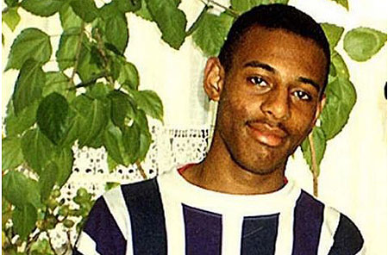
Stephen Lawrence
Notes:
Stephen Lawrence, a black British teenager (born 13 September 1974) from Eltham, southeast London, was stabbed to death while waiting for a bus on the evening of 22 April 1993.[1]
After the initial investigation, five suspects were arrested but never convicted.[2] It was suggested during the course of investigation that the murder had a racist motive and that Lawrence was killed because he was black, and that the handling of the case by the police and Crown Prosecution Service was affected by issues of race leading to an inquiry.[3]
In 1999, an inquiry headed by Sir William Macpherson examined the original Metropolitan police investigation and concluded that the force was "institutionally racist" and has been called 'one of the most important moments in the modern history of criminal justice in Britain'.[4]
The case is important in British legal history as it heavily contributed to the creation and passing of the Criminal Justice Act 2003 that altered the centuries-old principle of double jeopardy—which stipulated that a person could not be tried twice for the same offence.

Slide 24
Using the textbook, research the following issues/studies to be aware of when researching this topic (p.17-19 of booklet):
Paul Gilroy ‘Myth of Black Criminality’
Policing
Stuart Hall ‘Policing the Crisis’
Stephen Lawrence case and Macpherson Report
Stop and search
Arrests, cautions, prosecution and trial
Convictions and sentencing.

Slide 25
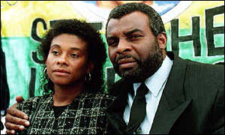
BBC Report on Stephen Lawrence
http://news.bbc.co.uk/1/hi/uk/285553.stm

Slide 26
Theoretical approaches

Slide 27
Reasons for Criminality
There are two main strands of thought as to why ethnic minorities are more likely to be seen as criminals and be victims of crime.
They are:
Structuralist views: They are more criminal
Social Constructionist views: The justice system is unfair

Slide 28
Using the content from p.21-22 (further evidence in next slides)
EM do commit more crime – Left realists | Racist police practise and social construction of statistic – Neo Marxists and labelling | Alternative view
Lea and Young | Gilroy (neo-marxist) Hall et al (neo-marxist) Reiner (labelling) Philips and Bowling (labelling) | FitzGerald- Neighbourhood Sharp and Budd- Getting caught Waddington

Slide 29
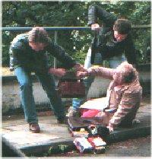
Reasons for High criminality of Afro-Caribbean (Structural)
Lea & Young (left realists) – first criminologists to acknowledge that black people were not simply victims of a racist police force and criminal justice system but are actually more likely to be involved with street crime than whites.
Reasons
Marginalisation
Relative Deprivation
Sub cultural response
Notes:
Their explanation of crime is based on the concepts of relative deprivation, marginalisation and subculture. Minorities suffer relative deprivation not only in areas shared with sections of the white working class (high unemployment and poor environment), but also racial discrimination and racially motivated attacks. Young unemployed blacks are marginalised in that they are unorganised and have few pressure groups to lobby on their behalf, so their frustrations are more likely to be expressed in illegal activity.
Subcultural responses include the hustling subculture described by Pryce in his ethnographic study of St Paul’s in Bristol, with young blacks involved in petty street crime, drug dealing and prostitution, getting by from day to day.

Slide 30
Left Realism
Lea and Young (1993) argue that ethnic differences in the statistics reflect real differences in the levels of offending by different ethnic groups.
Racism has led to the marginalisation and economic exclusion of ethnic minorities, who face higher levels of unemployment, poverty and poor housing.
A response to this is delinquent subcultures e.g. gangs.
However, they do acknowledge the police often act in racist ways.
But they don’t think discriminatory policing explains the whole picture e.g. 90% of crimes are reported to the police not found by them.
Evaluation: outdated, research came out before the Macpherson Report.
Stereotypes are still important- Asian groups are more likely to be criminalised today post 9/11.

Slide 31
Other reasons for higher rates of street crime amongst blacks
Educational success
2006 – only 23% of Afro-Caribbean boys achieved 5 GSCE’s
Affects self-confidence, employability (think Merton and sub cultural theorists)
Family Structure
60% of young black males live with just one parent (normally the mother)
Mass Media
Influence of black ‘Rap Artists’
According to some New Right and conservative thinkers ‘Rap music’ encourages ‘BLING, VIOLENCE AND CRIMINALITY’
Single parent families also tend to be poorer than nuclear families so the link could be related to poverty as well
This view has been challenged because it is questionable to simply blame one form of entertainment

Slide 32
Neo Marxism
Left realists see the differences in official statistics between ethic groups as being due to differences in offending. Neo-Marxists argue the statistics don’t reflect reality.
The statistics are social constructions that reflect a process of stereotyping by the police and criminal justice system e.g. Gilroy- black criminality is a myth, Hall et al- there has been a moral panic over black crime that does not reflect the reality of this crime.
Evaluation: Gilroy’s argument doesn’t address that most crime committed by ethnic groups is against people of the same ethnicity (Lea and Young).
Hall- left realists argue people’s fear about mugging were not panicky, but realistic.

Slide 33
Evaluation
It has often been claimed that black crime is no higher than crime by the majority, that the official statistics reflect discriminatory practices by the police and courts. Sometimes questioning this claim can be presented as racist.
On the other hand, however, and sometimes in the same accounts, it is claimed that high rates of some crimes, especially street crimes, are to be expected, part of the survival strategy of a reserve army of labour which finds itself unwanted, an understandable response to disadvantage and discrimination.
Like other Marxists studying crime, Gilroy can be seen as reading meanings which may not be there into the behaviour of young blacks; they are unlikely to agree with his explanation of their behaviour.

Slide 34
Labelling theories
Crime statistics are socially constructed.
They argue statistics that show black and Asian people are more likely to commit crime are misleading and only reflect selective law enforcement rather than higher rates of criminality.
Reiner (2000) points to a racist ‘canteen culture’ in the police, which includes suspicion, macho values and racism and this encourages racist stereotypes.
Bowling and Phillips (2002): Higher levels of robbery among black people could be the product of labelling that arises from the use of regular stop and search procedures, which in turn leads to the self fulfilling prophecy.
Evaluation: does not take account of changes to the police such as the inclusion of black police associations and training for officers.

Slide 35
More recent approaches
NEIGHBOURHOOD: FitzGerald et al (2003) found the higher involvement of young, black men in street robbery was due to the higher likelihood of them living in poorer neighbourhoods. Whites that lived in these areas were also more likely to commit such crimes. Ethnicity was not the key cause, the area was.
GETTING CAUGHT: Sharp and Budd (2005) found that black offenders were more likely than white offenders to have been arrested. This was because they were more likely to commit visible crimes where they could be identified by victims. And they were more likely to be excluded from school or to associate with known criminals- factors that raised their visibility.

Slide 36
Waddington (2004)
Published in the British Journal of Criminology argues that the police do stop a proportionately higher number of blacks compared to whites.
However, he argues that there are more ethnic minority youths out at night in inner cities and that the police simply target those in high risk areas. If the areas is disproportionately represented by young black males they are more likely to be stopped and searched – because of where they are rather than their ethnicity

Slide 37
What would other theories say?
FUNCTIONALISM?
NEW RIGHT?

Slide 38
Check your understanding
Gilroy (1982) argues that crime by black people, particularly in the 1970’s, was a form of what?
What are the three main elements that Lea and Young suggest we must consider in order to understand crime in relation to ethnic minorities?
How does Hall explain how the governments crisis of hegemony led to the creation of the ‘black mugger’?
Sociological explanations of
black criminality
What does Reiner (2000) mean when he talks about a police ‘canteen culture’.
How do Bowling and Philips explain the lower crime rate among Asian groups?
How do regular stop-and-search procedures by the police link to the concept of the self-fulfilling prophecy?

Slide 39
Key facts
Official statistics say black people are:
7 times more likely to be stopped and searched.
3 ½ times more likely to be arrested.
5 times more likely to be in prison than their white counterparts.
Victim studies say black people are more likely to be identified as offenders & most crime is intra –ethnic meaning it takes place among rather than between ethnic groups.
Self-report studies conclude that black people have similar rates of offending to whites if not lower.
Ethnicity and the criminal justice system
1. Policing
Many allegations of oppressive policing from minority ethnic communities are made.
Stop and search
Lots of stop an search is perhaps due to racism and the targeting of ethnic minorities.
3. Arrests and cautions
More likely to be arrested and cautioned perhaps due to a mistrust of police and not admitting to the offence.
Ethnicity and crime
4. Prosecution & conviction
Crown prosecution Service more likely to drop cases against ethnic minorities. Black and Asian defendants are less likely to be found guilty.
5. Sentencing and Prison
Custodial sentences more likely to be given to black offenders. Blacks and Asians over-represented in prisons and more likely to be given longer sentences.

Slide 40
Explaining differences in offending
Neo-Marxist - Paul Gilroy
Black people commit more crime because they resent the cultural experience of colonialism i.e. being taken over and having black slaves sent to Britain to work. This experience causes resentment in young black males which makes them commit crime.
Neo-Marxist - Stuart Hall et al (Policing the crisis)
Combines Marxism and Labelling theory.
Economic conditions in the 1990’s were bad, government look for a scapegoat.
Young black muggers are labelled and a moral panic is created about their behaviour in the media.
Young black males commit no more crime than any other group but labelling and the economy makes it seem like they do.
Left realism
Ethnic minorities commit more crime because racism in wider has caused them to be marginalised, coupled with economic exclusion such as high unemployment and poor housing. Left realists don’t believe that racism in the police can account for higher crime because black people have a higher offending rate than Asians.
Ethnicity and crime
Stephen Lawrence
The death of Stephen Lawrence in 1993 by a white gang caused outcry as police botched the investigation. The inquiry called the Macpherson report declared institutional racism in the police.
Victimisation
Police recorded 61,000 racists incidents while the BCS reports 184,000 many go unreported. People from mixed ethnic backgrounds were more likely to be victims of crimes.

Slide 41
Plan the following example questions
Group 1
Evaluate the suggestion that high rates of crime by ethnic minorities could be explained by Racist Police Practises (30)
Group 2
Evaluate the suggestion that high rates of crime committed by Ethnic minorities indicated in official statistics is a true reflection of society (30)
Group 3
Evaluate sociological explanations of the relationship between ethnicity and crime (30)

