Slide 1
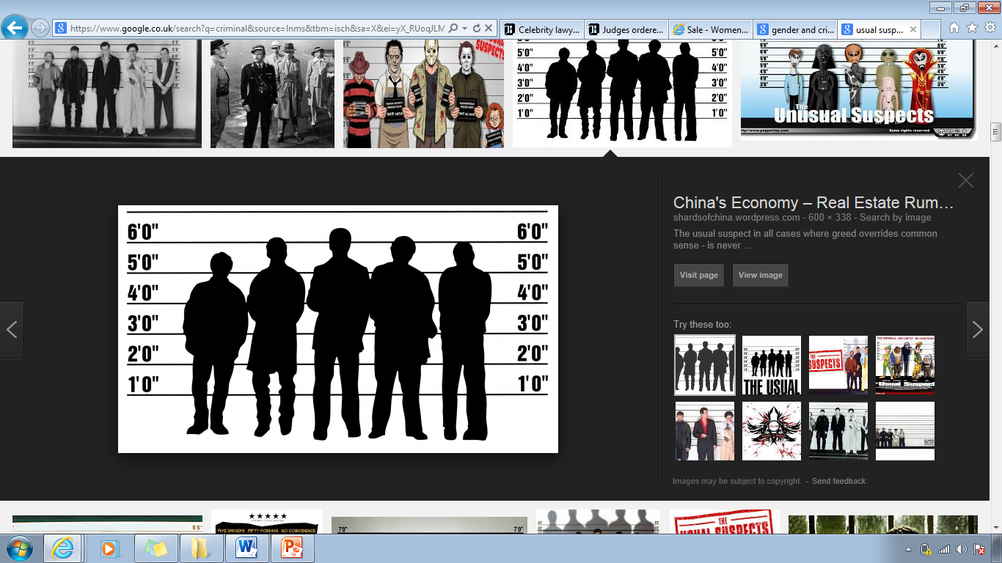
Social patterns of crime
Gender and crime

Slide 2
Areas to cover
1. What are the statistics concerning gender and crime
2. Is women's involvement in crime underrepresented by statistics?
3. Theories explaining gender patterns of crime
4. Why do men commit more crime?

Slide 3
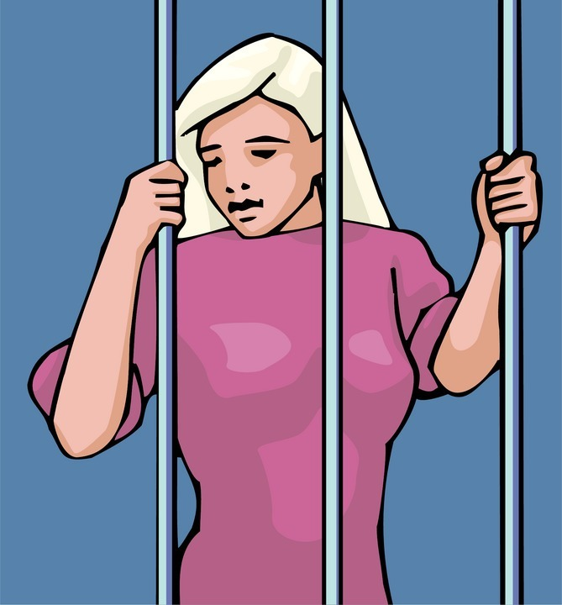
Neglect of women in criminology
In 1977 Carol Smart put forward the following Reasons to explain the neglect of women in criminology:
Women tend to commit fewer crimes than men.
Most crimes committed by women appear to be of a comparatively trivial nature - shoplifting and sexual offences.
Sociology and criminology tend to be dominated by men.
Traditional criminology is motivated by a desire to control problem behaviour. As women's behaviour is less of a problem than men's it has received less attention.

Slide 4
Evidence p.24
What are the patterns in the crime statistics in terns of men and women as offenders and as victims?

Slide 5

Gender & Crime- the Statistics (page 24)
Official statistics show;
That males in most countries commit far more crime than females.
4/5 Crimes in England are committed by males
They are more likely to be repeat offenders
In general they commit more serious offences
Men are a number of times more likely to be found guilty or cautioned for offending than women;
About 50 times more likely for sex offences
About 14 times more likely for burglaries
About 18 times more likely for robbery and drug offences
About 7 times more likely for criminal damage
About 5 times more likely for violence against the person, though this is much greater for violence which results in serious injury

Slide 6
Are the official statistics misleading?
Official statistics indicate that women in all age groups appear to commit far less crime than men. This pattern has raised three main questions:
1 Do women really commit fewer crimes than men, or are the figures misleading?
2 Is the proportion of crimes committed by women increasing, and is this linked to 'women's liberation'?
3 Why do some women break the law?

Slide 7
Is women's involvement in crime underrepresented by statistics?
Some sociologists and criminologists argue that female offending is underestimated. For 2 reasons:
Typically female crimes such as shoplifting are less likely to be reported. It will go un-noticed compared to sexual or violent crime.
Women are more likely to get let off lightly.
How far do you agree? Can you think of any real life examples of this?

Slide 8
The Chivalry Thesis
p.24 and 25 of the booklet
What do we mean by the concept ‘chivalry thesis’?
What evidence is there for and against this?
How does Patriarchy also explain a bias against women?

Slide 9

However…
Even if the Criminal Justice System is lenient on females…
How can we explain the behaviour of those women who do commit crime?

Slide 10
The chivalry thesis
Leniency towards female offenders: the 'chivalry’ thesis (p.24 booklet)
Campbell (1981) conducted a self‑report study and found that:
1 Female suspects were more likely than male suspects to be cautioned rather than prosecuted.
2 The rate of male: female juvenile offending was 1.33: 1.0 rather than the official figure of 8.95: 1.0.
Hood (1989) compared the sentencing of men and women and found that men were more likely to be given custodial sentences than women.

Slide 11
The case against the chivalry thesis
Evidence against the 'chivalry' thesis
Hales (2009) found in self reported studies men actually committed more crime than is recorded in official statistics. And that the gender gap becomes bigger as crimes become more serious.
Farrington and Morris (1983) conducted a study of sentencing in magistrates' courts. Although men received more severe sentences than women, the differences disappeared when the severity of offences was taken into account.
Lenience might just be because female offences are less serious.

Slide 12
Women Penalised
Walklate (1995) believes that it is the female victim rather than the male suspect who ends up on trial in rape cases. Women have to establish their respectability if their evidence is to be believed.
In a study of domestic violence Dobash and Dobash (1979) found that police officers were very unlikely to make an arrest in cases of domestic violence.
In 2012, only 8% of females who had been victims of serious sexual assault reported to the police.

Slide 13

Dual standards
Double standards in criminal justice
Heidensohn (1985) argues that the justice system is influenced by attitudes to gender in society as a whole. Women are treated more harshly when they deviate from norms of female sexuality. Sexually promiscuous girls are more likely to be taken into care than similar boys. On the other hand, courts may be reluctant to imprison mothers with young children.
Carlen (1997) argues that women are more likely to be sentenced according to the court's assessment of them as wives, mothers and daughters rather than the seriousness of their crimes.

Slide 14
Explaining female crime (or lack of)
Research activity.
Using textbooks make notes on the following, including evaluation:
Biological/psychological explanations p.107 Webb, p.401 Haralambos (8.ed).
Functionalist sex role theory, p.107 Webb.
Feminist approach: patriarchal control theory, p.107-108 Webb.

Slide 15
Explaining gender and crime: women
Functionalism: Sex role theory and gender socialisation
Traditional “ male and “ female” roles mean men are more likely to have the opportunity and lifestyle to commit crime. Primary socialisation teaches girls certain types of behaviour which do not lead to criminal acts.

Slide 16
Explaining gender and crime: women
Feminist – Heidensohn/ Dobash and Dobash
Control theory and rational choice. Women are controlled by their fathers and partners so have less opportunity to commit crime .Women are naturally more caring and think rationally about the effect crime will have on their victims

Slide 17
Explaining gender and crime: women
Feminist- Carlen
The gender and class deal. Refers to the rewards that women feel from fulfilling their roles at home with the family and gaining emotional and financial support from the male breadwinner women choose to make money through correct means such as employment rather than turning to crime to make money.

Slide 18
Practice Exam Question
Identify and explain three reasons why women are under represented in crime statistics (6)

Slide 19
Male offending

Slide 20
Why do men commit more crime?
Sex-role theory and gender socialisation
Traditional role;
Family provider/ breadwinner
The adoption of the independent, tough, competitive, aggressive, dominant and risk taking behaviour associated with their image in the world
Male peer groups – reinforce these tendencies
Men’s traditional roles in employment, their lack of responsibility for housework and childcare, and the lack of the various constraints encouraging women’s conformity, all give men more independence and more opportunities to commit crime than women

Slide 21
The assertion of masculinity
Messerschmidt (1993)
Men sometimes turn to crime and violence as a means of asserting their masculinity when legitimate and traditional means of demonstrating masculinity and being a ‘real man’ are blocked i.e. success at school, having a steady, reliable, well-paid job, a stable family life etc.
Those lacking legitimate masculine-validating resources are most likely to be those from more deprived backgrounds (the most common criminals).

Slide 22
Problems of the masculinity thesis
Develop some criticisms of this thesis – how do you think it can be criticised.
Try to think about what it ‘does’ explain and then what is ‘doesn’t’
Criticisms : Messerschmidt’s analysis –
While it provides a plausible explanation for why men might commit more crime than women, it doesn’t have explanations for why all men who don’t have access to legitimate means of asserting masculinity don’t turn to crime – and most don’t – or for the different types of crime that are committed.
Not all male crime can be interpreted as an expression of masculinity

Slide 23
The assertion of masculinity
Connell (1987, 1995) – ‘Hegemonic masculinity’
A male gender identity that defines what it means to be a ‘real man’; men who don’t want to be regarded as ‘wimps’, abnormal or odd are meant to accomplish this masculinity
It features such things as toughness, aggression, competitiveness, control, success and power over – and subordination of – women.

Slide 24
Lyng - ‘edgework’
Edgework or risk taking may be a motivating factor among some men to get involved in crime as a means of expressing their masculinity
The nature of hegemonic masculinity may also explain why middle class men try to assert masculinity through ruthlessness, ambition and thrill-seeking in business, leading to white collar crime and corporate crimes such as computer hacking, fraud, illegal stock market or money market trading.
The nature of hegemonic masculinity may also explain why men from all social classes commit domestic violence and rape

Slide 25
Winlow: Postmodernity, Masculine & Crime
Globalisation has led to a shift from a modern industrial society to a postmodern de-industrialised society. Men have lost opportunities to express their masculinity through traditional manual jobs and therefore provide for their families. The expansion of the night time sector has provided working class men with legal employment, opportunities for crime and a channel through which to express their masculinity.

Slide 26
To do
Item A: Most criminals are men. The most consistent finding of research into crime in different societies and over many decades is that there is a clear link between crime and masculinity. However, the kind of crimes committed varies between different groups of men. So too does what counts as being a ‘real-man’ and the resources to achieve it. Changes over time in the economy and the employment structure – such as de-industrialisation, for example – may also affect men opportunities to express their masculinity.
1. Applying material from Item A, analyse two reasons why men commit crime [10 marks]

Slide 27
To do/Homework – for next Wednesday. No lesson on Tuesday due to inset
Make sure your booklet is complete and that you have planned an ethnicity essay
10 mark question on p.27
Make revision summaries for ethnicity and gender.
Each should be at least two sides of A4 or a side of A3 each.
They should cover the main theoretical views and debates. Ensure key concepts are defined.
Evaluate the views with general arguments and those from other theoretical views.
You could use revision books from the library to help you

