Slide 1
CRIME STATISTICS

Slide 2
Objectives
Following this slide show you should be aware:
That crime statistics are a social construction.
That the official crime rate rose steadily for the past 100 years and peaked in mid-1990s.
That the official rate significantly underestimates the real rate of crime.
That victim and self-report studies show that there is significant under-reporting and under-recording of crime.

Slide 3
Types of crime statistics
Police recorded statistics – records kept by the police and other official agencies. Have been recorded since 1857
Victim studies – are based on surveys asking people if they have been a victim of crime. Good to look at unrecorded crime.
Self- report studies – ask people if they have committed crimes

Slide 4
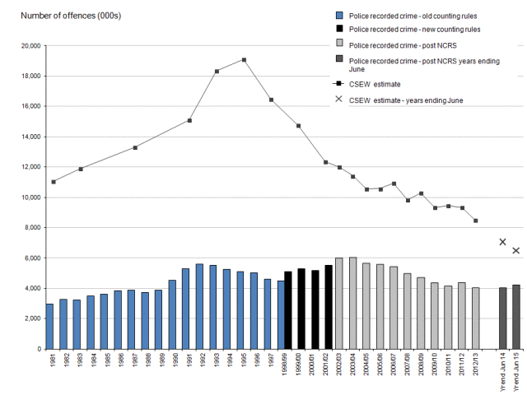
Trends of Recorded Crime and the Crime Survey of England and Wales

Slide 5
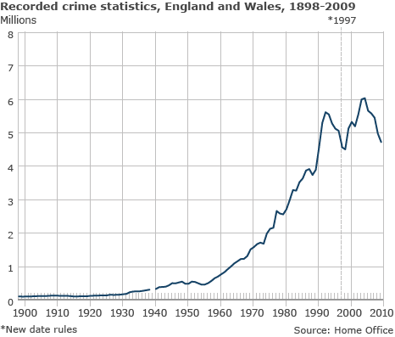
Reasons For The Rise in Crime
More state action: as policing gets better more crimes are detected.
More laws: Because of more legislation on the statute book, there are more possible crimes (traffic offences, financial fraud, computer related crimes, etc.)
More victims: Because of increased affluence there are more things to steal. As opportunities have risen, so have crimes.
More sensitivity: People are more sensitive to reporting crimes physical and sexual violence to the police.

Slide 6
Police-recorded statistics as social constructions
Police-recorded statistics are based on info the criminal justice agencies collect.
But crimes cannot be recorded by them unless they are reported in the first place.
A lot crimes are not reported. Why is this?

Slide 7
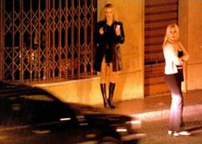
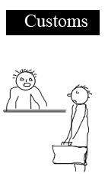
Underreporting
Some crimes are not reported because they are victimless, e.g. drug-taking, smuggling, prostitution, etc.
Some crimes are not reported because of the humiliation felt by the victim such as rape, domestic violence, etc.
Corporate and white-collar crime is extremely difficult to detect and thus report.

Slide 8
Recording crime
Most reported crimes do not go on to be recorded crimes. HMIC in 2014 found 1/5 crimes are not included in the statistics for recorded crime.
This may be because there was not enough evidence to pursue a case or the victim withdrew their claim.

Slide 9
Under-recording: Police as ‘Filters’
Moore, Aiken and Chapman (2000) see the police as filters, only recording some of crimes reported to them.
Seriousness: the offence may be regarded as too trivial.
‘Social status’ of the victim: important people tend to get a more favoured response than the poor, down and outs and homeless.
Classifying the crime: (minor ‘assaults’ may not be investigated but ‘aggravated assaults’ usually are).

Slide 10
Police as Filters (continued)
Discretion: each police officer has the discretion to press charges or let the individual off – even if they are known to be ‘guilty’.
(Those whose demeanour is deferential, co-operative and polite are more likely to be let off for minor offences. Consider here Aaron Ciçourel’s ‘negotiation’, Howard Becker’s labelling theory and Reiner’s ‘canteen culture’).
Promotion and relations at work: Police officers have to tread a tightrope between trying to impress senior officers and not appearing too keen (as this makes more work for their colleagues).

Slide 11
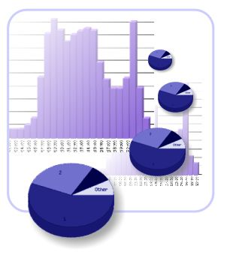
Dark Figure of Crime Statistics
Sociologists argue that the Official Crime Rate (recorded level) of crime seriously underestimates the real or true rate of crime.
The Crime Survey suggests that the true level of crime is at least twice the Official Crime Rate.
The difference between the official crime rate and the real crime rate is referred to as the ‘dark-figure’ of crime statistics

Slide 12
Crime Survey of England and Wales
Previously known as the British Crime Survey. The CS measures the amount of crime in England and Wales by asking people about crimes they have experienced in the last year.
The CS includes crimes which are not reported to the police, so it is an important alternative to the Official Crime Rate.
Victims do not report crime for various reasons. Without the CS the government would have no information on these unreported crimes.

Slide 13
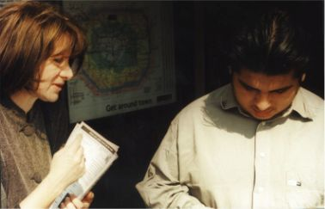
Victim Studies
These are surveys of people who are asked to report all cases where they have been a victim of crime recently.
Examples can be local like the Islington Crime Survey (1986 and 1995) or national like the Crime Survey (annually).
Victim surveys give a clearer idea of the extent of crime, who is likely to be a victim and people’s fears about crime.
They also highlight the risk of repeat victimisation of victims.

Slide 14
Crime Survey
An annual survey conducted by the Home Office of 40,000 households with data fed into laptops.
Now includes a section on domestic violence, but interviews are usually with male head of household.
Does not include corporate or workplace crime, victimless crime or crimes against people under age of 16.
So it still underestimates the real rate of crime.

Slide 15
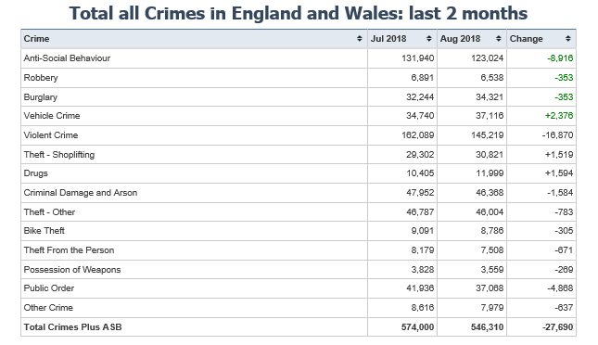
Recent Crime Rates

Slide 16
Crime Survey
Answer the questions on p.7 of the booklet about the Crime Survey. Use a separate piece of paper.

Slide 17
Victim Surveys
Strengths | Weaknesses

Slide 18
Self-Report Studies
These ask people to honestly confess to crimes they have committed over a period of time.
They can be an important way of getting a better picture of some crimes like drug-use.
Anne Campbell gave a self-report study to young females and found they had almost as high a crime rate as young males.
However, Steven Box argued that if petty crime was removed then the male-female ratio was closer to the official one: 5:1.

Slide 19
Self-Report Surveys
Strengths | Weaknesses

Slide 20
Criminal Characteristics
The Official Crime Rate (OCR) is compiled annually by the police for the Home Office.
They show criminals are typically:
Male;
Working-class;
Youthful;
Disproportionately black.
In addition they are likely to have a poor educational record, and come from a broken home.

Slide 21
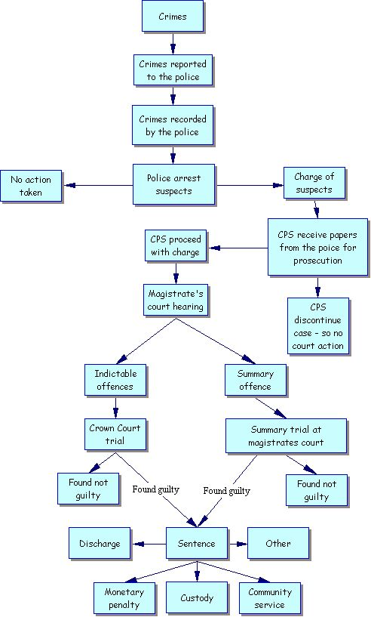
Social Construction of Official Crime Statistics
Criminal statistics are a social construction because they are the product of social processes.
They involve not only offenders but reporting and the behaviour of the police.
It is estimated by the CS that only 31% of crimes are reported and recorded.

Slide 22
Functionalist View on Statistics
Functionalists share the view of positivists and tend to accept crime statistics uncritically.
The functionalist-inspired subcultural theory for example started with the view that crime is a young, working-class, male phenomenon.

Slide 23
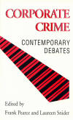
Marxist View on Statistics
Marxists recognise the systematic bias in favour of the powerful in the application of the law.
As a general rule, the higher people are in the social system the less likely they are to be arrested, charged, prosecuted and found guilty.
Marxists stress the significant ‘dark-side’ of white-collar and corporate crime that is largely invisible and absent from crime statistics.

Slide 24
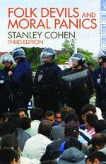
Interactionist/Labelling Theory View of Statistics
This interpretivist approach sees crime statistics as largely useless and a distortion of reality.
They argue statistics are a social construction and tell us nothing about the real level of crime, only who compiled them and how.
Labelling theory is more interested in questions such as why some acts are viewed as more deviant than others and why some groups become labelled as deviant.

Slide 25
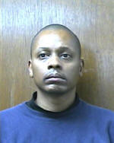
Left Realist View on Statistics
Left Realists are almost unique (apart from Functionalists) in accepting that official statistics have some value and should not be rejected out of hand.
They accept the statistical view that typical offenders are young, male, working-class and disproportionately black.
Using victim studies, they highlight how people (especially the poor and vulnerable) have real fears of crime.

Slide 26
Feminist View on Statistics
Feminists argue that crime statistic underplay the extent of females as victims: personal attack; domestic violence, etc.
Until recently the police viewed attacks in the home as “domestics” and were reluctant to get involved.
Many female victims of physical and sexual attack are reluctant to report offences.

Slide 27
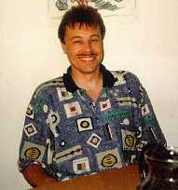
Statistical Explosion in a Risk Society
Ulrich Beck (1995, pictured left) coined the term ‘risk society’ to refer to the shared knowledge of contemporary risks, including rising crime.
Mike Maguire (2002) notes how we are bombarded with data not just from the Home Office but researchers, agencies and even victims. This adds to our knowledge and fear of crime.
Garland (2001) argues in late modernity we have lost confidence in governments. This explains why when officially the crime rate is falling, many people believe it is still rising.

Slide 28
Weaknesses of Victim Studies
Relying on people's memory is a problem as recollections may be incorrect or biased.
Sometimes people put crimes into the wrong categories.
Surveys exclude white-collar crimes such as fraud and corporate crime: these become effectively 'invisible crimes'.
People will not report 'victimless crimes' such as drug taking, or prostitution.
There is an under-reporting of personal attack, domestic violence and sexual crimes, despite anonymity. (Note: the media sensitising issues can encourage people to report).

Slide 29
Weaknesses of Self-Report Studies
Steven Box (1971) argues self-report studies suffer from issues of validity, representativeness and relevance:
‘Validity’: are they true to life? Respondents can forget, play-down or exaggerate the extent of criminal activity they have been involved in.
‘Representativeness’. Since most self-report studies are on young people, they rarely include professional or managerial adults.
‘Relevance': the majority of crimes reported are trivial.

Slide 30
To do: > Complete p.14-16 of the trends booklet. Pick one of the 10 mark questions on p.15 and p.16 and complete it. Then Complete p.17-20

Slide 31
To do: > Complete p.14-16 of the trends booklet. Pick one of the 10 mark questions on p.15 and p.16 and complete it. Then Complete p.17-20 p.21-25 (we need this for the second week after Christmas hols) Homework: Revise for mocks

