Slide 1
WELCOME BACK TO SOCIOLOGY

Slide 2
Health and safety in the classroom
•Please sanitise your hands as you enter the room, then take a wipe and wipe your desk down. The wipe should be put in the bin when you exit the room.
•Maintain social distance as you enter the room and take your desk. Your desk will be yours for the next 4 weeks at least.
•Do not move the furniture – especially the chairs
•Maintain social distancing in class
•Bring in some form of technology to use in lessons to write and submit work to be marked – make sure your tech has a good battery or that you bring a power pack (don’t bring leads).
•Windows will be open – if you are a person who gets cold please wear layers
•If you are asked to use a computer please wipe down before and after use.
•No food or drink in the classroom (other than a bottle of water)

Slide 3
Lessons at home
•Join the lesson on time via Teams
•Have you mic muted as you join the lesson
•Have your video on with an appropriate background
•Make sure you are wearing appropriate clothing
•So that you can join in on the chat, try to have a phone (having joined teams) on alongside your laptop/tablet so that you can see this
•There will be targeted questions, tasks to complete and your work will be checked at the end of the lesson.

Slide 4
expectations
•Please bring the relevant booklet and equipment to all lessons (we will not be lending pens or paper)
•Ensure prep work is either brought to lesson (if we’ve asked you to do in your booklet) or uploaded to the assignment area on Teams before the lesson.
•Arrive promptly to the lesson having been to the toilet beforehand
Every bit of work you do this year counts – think about what happened this year – as we don't know what will happen to exams

Slide 5
CONTENT OF COURSE THIS YEAR
Groups: E, G (2.25 split) | Group B (2.25 split) | Group C, D (1.5/3 split) | Group A
Sarah for Stratification + Theory and Methods. Strat Mock: After Feb half term Theory and methods mock: Just before Easter | Amy for Stratification + Theory and Methods. Strat Mock: After Feb half term Theory and methods mock: Just before Easter | C: Hannah for strat D: Sarah for strat Strat mock: Easter | Hannah's sole group Autumn term: Crime Mock in January (+ Education mock)
Hannah for Crime Mock: Easter | Hannah for Crime Mock: Easter | C: Sarah for crime and theory (3) D: Hannah for crime and theory (3) Mock: Feb half term | Spring term: Stratification Mock at Easter
You will also have mocks for Education and Family in January | You will also have mocks for Education and Family in January | You will also have mocks for Education and Family in January | Education mock in January, Family mock in February

Slide 6
The sociology of the coronavirus

Slide 7
Starter - Norms and values
What new ‘norms’ were introduced during the Corona Virus?
How did values change?
Why did these change?

Slide 8
Learning objectives
To apply Coronavirus to sociology.
To see the impact the virus had on society.
Review the sociological perspectives in relation to the Coronavirus.

Slide 9
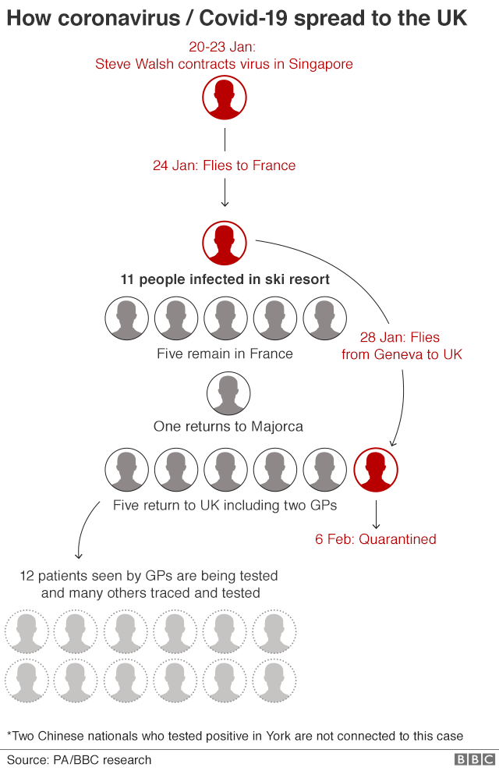
How did it spread?
Think - share –
how did the virus spread so quickly?
Where did it start?
Where did it impact the most?
Globalisation is often understood as the process through which products, people, ideas, culture, and capital, are transferred around the world creating a system of global integration.

Slide 10
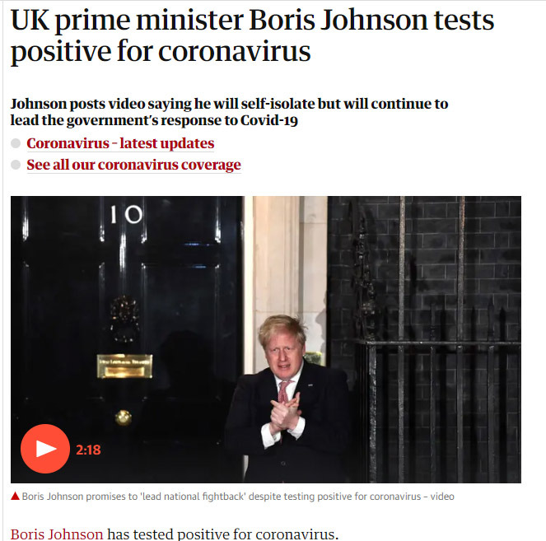
Functionalist view of coronavirus
Parsons (1951)- argued that being sick means that the sufferer enters a role of “sanctioned deviance”. This is because, from a functionalist perspective, a sick individual is not a productive member of society.
The sick person’s rights are twofold: the first one is being exempt from normal social roles e.g. going to work, caring for the family; the second one is not being responsible for their condition.
The role of a sick person is to get better.
With most people told to socially isolate, who were the productive members of society?
Furloughed members of society – how were they viewed?
Do you agree that the main role sick people had with coronavirus is to get better?

Slide 11
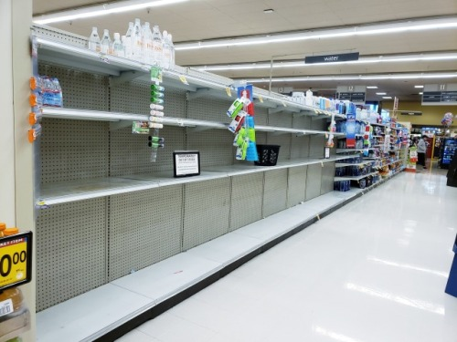
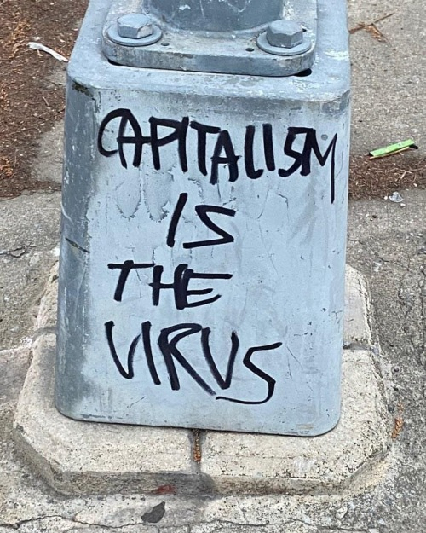
Poverty and inequality – how might Marxists view this?

Slide 12
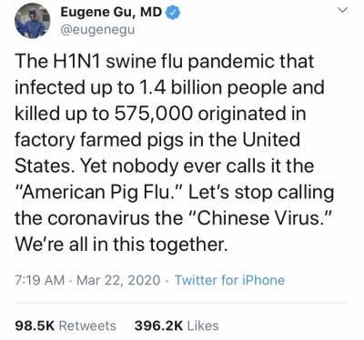
Inequality and racism
How did Covid-19 become linked to racism?
Is calling coronavirus the ‘Chinese virus’ racist?
https://www.youtube.com/watch?v=5q-lq8DewIE

Slide 13
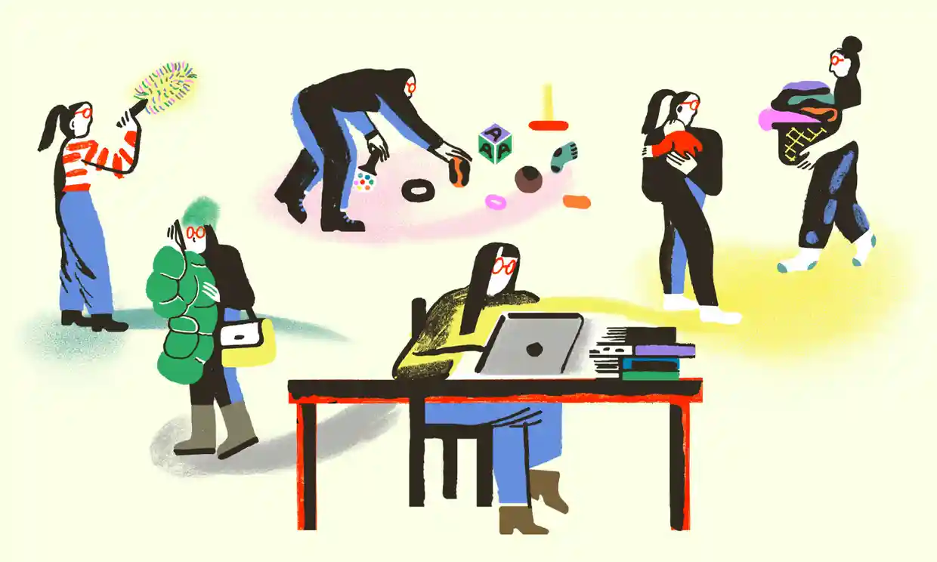
Feminist view of corona virus – how did the impact impact women and men?
1. More caregiving and housework - The mass shutdown of childcare centres and schools has left many working parents with no choice but to take time off, or to try to work from home while caring for their children.
As The New York Times reports, the closing of schools hits women particularly hard because much of the responsibility for childcare still falls on them.
2. More economic stress – loss of jobs and reduced pay means both men and women are less able to support their families.
3. More gender based violence -In China there was a threefold increase in cases reports of male on female domestic abuse to police stations in February compared with the previous year.
A study of some 44,600 people with COVID-19 from the Chinese Center for Disease Control showed the death rate among men was 2.8%, compared with 1.7% for women.

Slide 14
Interactionist perspective
Interactionists argue that health and illness are socially constructed.
In essence, interactionists focus on the specific meanings and symbols in people or objects and what causes people attribute to illness.
You are only ‘sick’ if society labels you as so.
For example, staying home and not going out for weeks on end might be seen as a sign of depression – however in the coronavirus pandemic this is seen as responsible and not sick.

Slide 15
How did the meaning of a medical mask shift during the pandemic? What meaning was attached to this?

Slide 16
How else might the coronavirus be linked to sociology?
Education – lack of interaction in school.
The digital divide – if people do not have access to internet they are severely disadvantaged.
Family relationships.
Demography – increase birth/death rate?
Social distancing – how did this impact relationships?
This just goes to show that Sociology can be found everywhere in life – you just need to know where to look!

Slide 17
homework
Go to Sociology Year 2 on GOL
Click on Stratification and then on ‘Theories of Stratification’
Read the pdf ‘Chapman textbook’
And then complete the Word document below ‘Theoretical views of stratification’
Upload this to the assignment area of your class’s Teams, by….

