Slide 1
Macroeconomics Year 1
Page 1
1. ECONOMIC TOOLKIT
The Economic Problem
Opportunity Cost
PPFs
Specialisation
2. MACRO OBJECTIVES
High Economic Growth
Low Unemployment
Low and Stable Inflation
Balanced Balance of Payments
3. MACRO POLICIES
Monetary Policy
Fiscal Policy
Supply-Side Policies

Slide 2
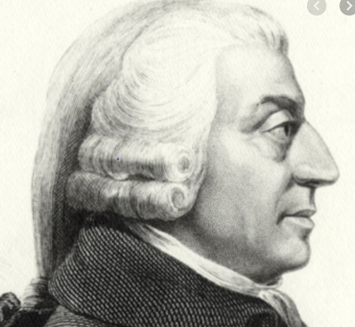
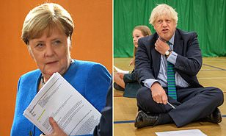
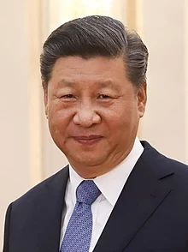
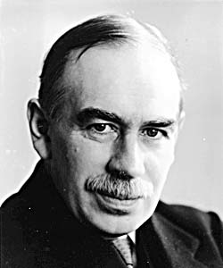
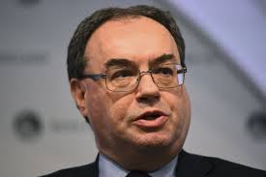
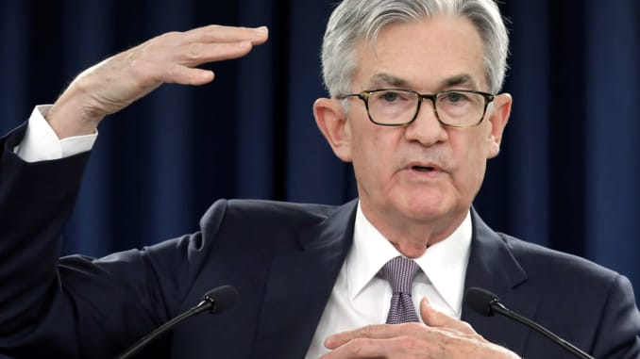
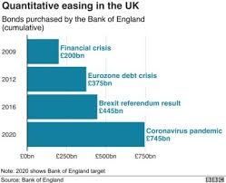

Slide 3
Names Roles
Rishi Sunak
Boris Johnson
Jerome Powell
Christine Lagarde
Milton Friedman
John Maynard Keynes
Don Trump
Angela Merkel
Xi Jinping
Adam Smith
Macron
Jeff Bezos
Elon Musk
Andrew Bailey
Governor of Bank of England
Chairman of Federal Reserve
President
Prime Minister
Economist
Entrepreneurs
Governor of European Central Bank
Chancellor of the Exchequer

Slide 5
What is Economics?
Page 2
Micro is the study of individual markets e.g. housing market
Macro is the study of the whole economy e.g. UK unemployment
Activity: Decide whether the events relate to MICRO or MACRO (5 mins)
Extension: Add 2 events of your own to each column
Top Tip: Work together with your learning partner!

Slide 6
Positive or Normative?
Pages 3-4
Economics is the best subject in the world
Economics graduates have the highest average salaries upon leaving university
GBBO is overrated
GBBO is the most watched TV show on the BBC this year
Activity 1: Write one positive statement and one normative statement – test your partner! (5 mins)
Activity 2: Coke v Pepsi. Which is better? Justify your choice (5 mins)
Extension: Evaluate your argument (give balance)
Discussion! Economists are interested by these sorts of things ☺ (5-10 mins)

Slide 7
Economics as a Social Science
Page 6
Scenario A (5 mins)
The basic assumption that parents would want to avoid the fee proved to be flawed!
Most parents interpreted the late arrival fine as a fee. They were happy to pay for additional childcare and more turned up late as compared to before.
(True story)
Scenario B (5 mins)
Whilst some part-time workers see a lower wages as less incentive to work, it is likely that a larger proportion of part-time workers will want to work more hours
E.g. to support their family and maintain their standard of living
(Remains to be seen)

Slide 8
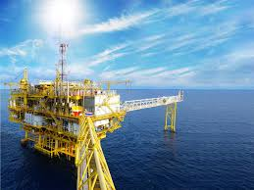
Factors of Production (a.k.a. Resources)
Page 7
Activity 1 (5 mins)
Task (3 mins)
Activity 2 (3 mins)
Notes:
Land:
Land includes all natural physical resources – e.g. fertile farm land, the benefits from a temperate climate or the harnessing of wind power and solar power and other forms of renewable energy.
Labour:
Labour is the human input into production e.g. the supply of workers available and their productivity
Capital:
C
Entrepreneurship:
A specialised form of labour input
An entrepreneur is an individual who takes on risk to supply products to a market to make a profit.

Slide 9
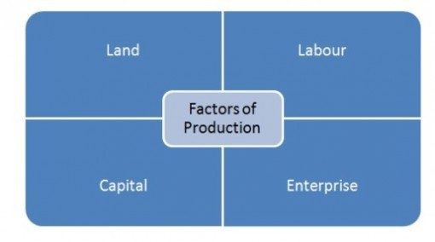
Which Factor of Production (FoP)?
Page 8
1. For each of the words below, write which FoP it would be classed as!
Fish in the sea
Tractor
Farmer
Mark Zuckerberg
Teacher
Doctor
Sewing machine
Coco Chanel
Oil field
2. List all of the resources that went in to making the pair of shoes that you have on!
Hint: draw the diagram below and list the resources on there!
(7 mins!)
My Shoes

Slide 10
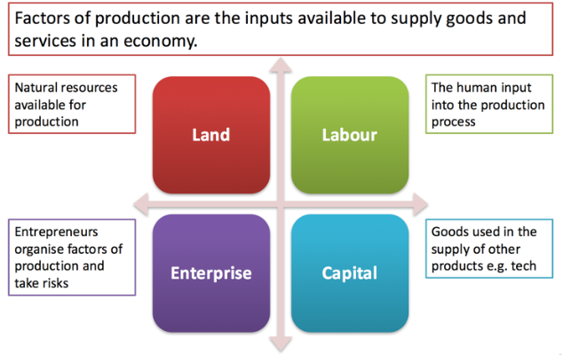
Factors of Production (Factor Inputs)

Slide 11
Factors of Production (Factor Inputs)
Land -
Includes all natural physical resources e.g fertile land, fish etc
Labour -
The human input into production e.g the supply of workers
available and their productivity.
An increase in the size and quality of the labour force is vital
if a country wants economic growth.
Capital -
Used to produce other consumer goods and services in the future.
Machinery, equipment, new technology, factories and other buildings.
Working capital is stock
Enterprise -
Supplies product to market to make a profit. They invest their
own financial capital in the business and take on risk.

Slide 12
Opportunity Cost
Pages 9-11
Make a Choice (2 mins)
Free goods vs Economic goods (2 mins)
Opportunity Cost Examples – show workings and answers on page 11 (15 mins)
“The value of the next best alternative forgone when a choice is made”

Slide 13
Opportunity Cost Examples
Pages 10-11
1. Train = 350
Car = 275
OC = £75 per month worse off (but can work on train, less stress etc.)
2. 85 x 2 = 170
Ticket = 55
OC = £225 worse off (but a good day out)
3. Profit = (30,000 - 25,000) = 5,000
Future value = 32,000
OC = £7,000 loss of profit
(Acccept £2,000 loss of profit)
4. Loss of earnings = 200 x 12 = 2,400
Minus cost of cleaning pool – 500
OC = £1,900 worse off
5. Savings = 15,000 x 1.05 = 15,750
Advocaat = £15,300
OC = £450 worse off
6. 500 x 78 = 39,000
520 x 76 = 39,520
OC = £520 worse off
Mark __ / 6

Slide 14
PPFs
Page 12
“A PPF shows the maximum possible output combinations of two goods or services that an economy can achieve when all resources are fully and efficiently employed”
PPF
Activity 1 (5 mins)

Slide 15
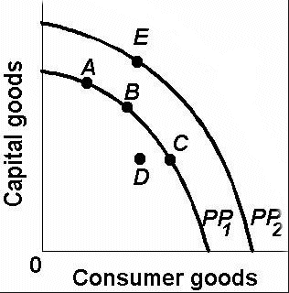

Slide 16
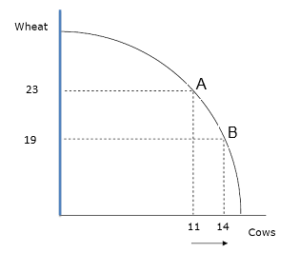
PPFs and Opportunity Cost
Page 13
Challenge! Why is the PPF curved (concave) and not straight? (5 mins)
The law of diminishing returns states that if we add more units of a variable factor to fixed amounts of another factor, the change in total output will at first rise and then fall.
E.g. as you keep increasing the number of chefs (labour) in a kitchen (capital), they will eventually end up getting in each others way!
Therefore, opportunity cost is not constant!
What is the opportunity cost of producing 3 more cows? (A to B)
PPF
PPFs and Opportunity Cost: https://www.youtube.com/watch?v=-XK9KW9dYwU

Slide 17
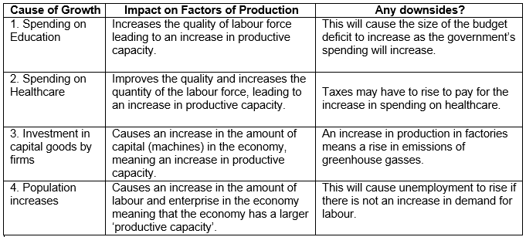
PPF and Economic Growth (long run)
Pages 14 - 15
Growth ant PPFs: https://www.youtube.com/watch?v=GoLYDe3xPP0

Slide 18
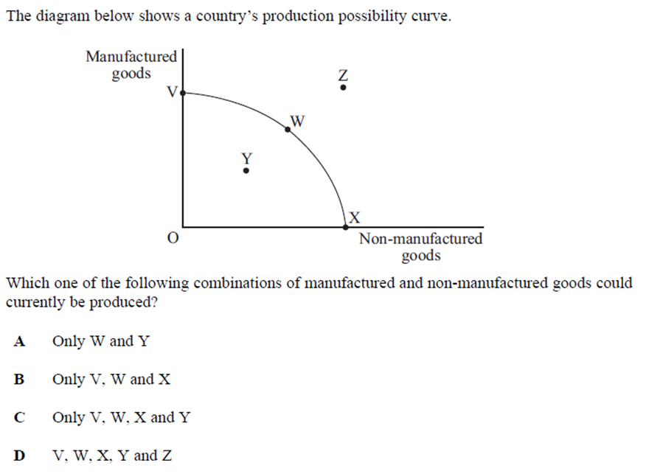

Slide 19
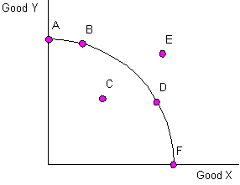
Economic Efficiencies
Page 15
Productive efficiency means an economy is operating at its full potential (on the PPF).
Pareto efficiency is a situation where you cannot make more of one good, without producing less of another.
Allocative efficiency occurs when there is an optimal distribution of goods and services, taking into account consumer’s preferences.

Slide 20
Worksheets on PPFs (20 mins)
Complete worksheet 1 (p16)
Complete worksheet 3 (p17)

Slide 21
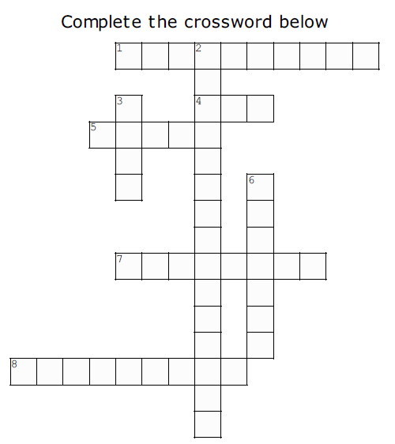
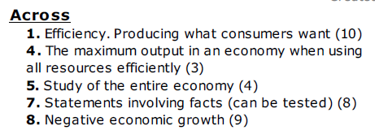
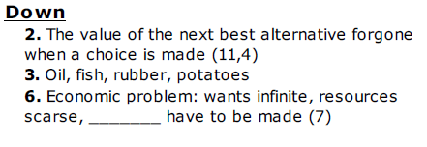
scarce
Get your PPF Multiple choice test out!

Slide 22
HW: Mid-Topic Test (12 mins + ET)
ANSWERS
C
D
A
C
N/A
N/A
D
A
C
N/A
B
B
A (accept E)
C
A or C
Mark /12

Slide 23
WWW: EBI:
1. My own reflections
What did you do well? E.g. knowledge of key terms, eliminating incorrect answers
How can you improve? E.g. read over notes, interpreting questions, revise key terms etc.
%
A*/A/B/C
Working at
Target
2. My learning partner says…
a) Your strengths are (WWW):
b) But it would be even better if (EBI):
What did your learning partner do well?
What could your learning partner improve?
3. Action Plan:
To make progress and improve my work I will:
1.
2.
Write down at least 1 thing that you will take away from this assessment and work on! E.g. I will read over my notes after every lesson and produce revision cards containing key terms.

Slide 24
Home Work; Due in your last lesson next week
RWS#1 MACRO: Economics Toolkit
RWS#1 MICRO: Supply and Demand
Revision Work Sheet (RWS) Key Points:
Computerised
1 sheet of A4 (double-sided)
Use all COMPULSARY RESOURCES
Set margins to narrow (on MS Word)
Include all I’ve asked for on SPECIFIC INSTRUCTIONS
Assessment
1 = Outstanding
2 = Good
3 = Requires improvement
4 = Do it again

Slide 25
Specialisation and Division of Labour
Page 16
Points to Ponder
“Specialisation occurs when we concentrate on a particular task”
It happens at many levels: within families, businesses and countries
“Division of labour (DoL) occurs where production is broken down into many separate tasks”
DoL is specialisation within a business
https://www.youtube.com/watch?v=ATPxQih6Uag
“Production is the process of turning inputs into outputs”
…Whereas productivity is the efficiency of production”
Labour productivity =
total output
units of labour
i.e. the efficiency of labour at turning inputs into outputs

Slide 26
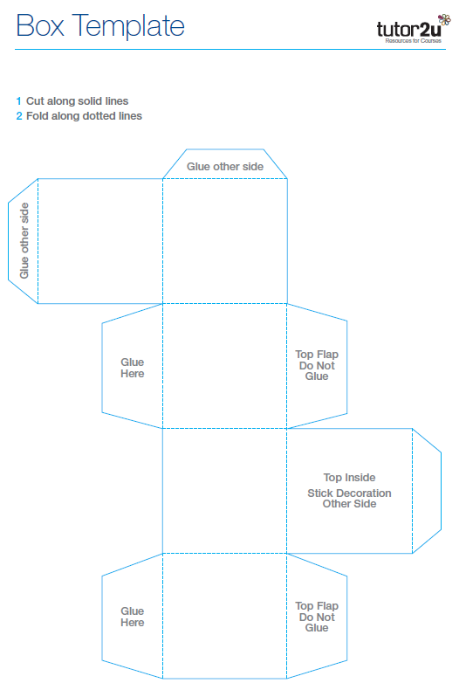
Division of Labour: Box Making Activity!
Pages 17-18
Round 1: No groups can specialise except Team A (7 mins)
Complete a) and b) (10 mins)
Round 2: All groups can specialise! (7 mins)
Complete c) (5 mins)
Page 18 – make notes on the benefits and drawbacks of the division of labour (5 mins)

Slide 27
DoL: Benefits and Drawbacks: Explain each one on your mind-map
Page 19
Benefits
Higher output due to higher labour productivity
Labour becomes more skilled in specialised task – quality improves
Economies of Scale (higher output = lower average cost due to bulk buying)
Potentially a lower cost for consumers (due to EoS and increased supply)
Drawbacks
Repetitive work leads boredom and lower productivity
Workers demotivated by task – quality suffers
High worker turnover (expensive for a business)
Can lead to structural unemployment (when there is no longer demand for the type of work)

Slide 28
Extension
Pages 20-21
a) Ford Production Line
https://www.youtube.com/watch?v=cTZ3rJHHSik
b) Adam Smith
https://www.youtube.com/watch?v=Mq6VF7TSpk4

Slide 29
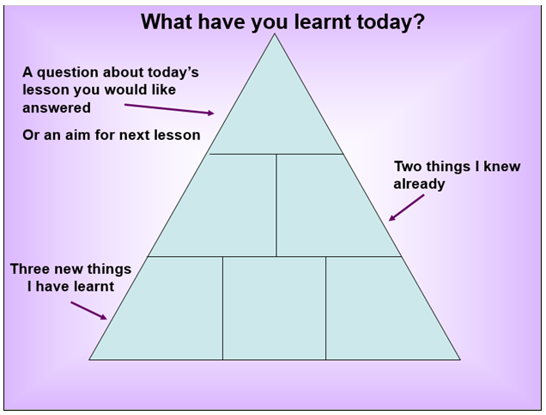
Page 22

