Slide 1
WELCOME BACK TO SOCIOLOGY

Slide 2
Health and safety in the classroom
•Please sanitise your hands as you enter the room, then take a wipe and wipe your desk down. The wipe should be put in the bin when you exit the room.
•Maintain social distance as you enter the room and take your desk. Your desk will be yours for the next 4 weeks at least.
•Do not move the furniture – especially the chairs
•Maintain social distancing in class
•Bring in some form of technology to use in lessons to write and submit work to be marked – make sure your tech has a good battery or that you bring a power pack (don’t bring leads).
•Windows will be open – if you are a person who gets cold please wear layers
•If you are asked to use a computer please wipe down before and after use.
•No food or drink in the classroom (other than a bottle of water)

Slide 3
Lessons at home
•Join the lesson on time via Teams
•Have you mic muted as you join the lesson
•Have your video on with an appropriate background
•Make sure you are wearing appropriate clothing
•So that you can join in on the chat, try to have a phone (having joined teams) on alongside your laptop/tablet so that you can see this
•There will be targeted questions, tasks to complete and your work will be checked at the end of the lesson.

Slide 4
expectations
•Please bring the relevant booklet and equipment to all lessons (we will not be lending pens or paper)
•Ensure prep work is either brought to lesson (if we’ve asked you to do in your booklet) or uploaded to the assignment area on Teams before the lesson.
•Arrive promptly to the lesson having been to the toilet beforehand
Every bit of work you do this year counts – think about what happened this year – as we don't know what will happen to exams

Slide 5
CONTENT OF COURSE THIS YEAR
Groups: E, G (2.25 split) | Group B (2.25 split) | Group C, D (1.5/3 split) | Group A
Sarah for Stratification + Theory and Methods. Strat Mock: After Feb half term Theory and methods mock: Just before Easter | Amy for Stratification + Theory and Methods. Strat Mock: After Feb half term Theory and methods mock: Just before Easter | C: Hannah for strat D: Sarah for strat Strat mock: Easter | Hannah's sole group Autumn term: Crime Mock in January (+ Education mock)
Hannah for Crime Mock: Easter | Hannah for Crime Mock: Easter | C: Sarah for crime and theory (3) D: Hannah for crime and theory (3) Mock: Feb half term | Spring term: Stratification Mock at Easter
You will also have mocks for Education and Family in January | You will also have mocks for Education and Family in January | You will also have mocks for Education and Family in January | Education mock in January, Family mock in February

Slide 6
The sociology of racial inequality & Crime
Exploring issues of race & ethnicity in policing, offending and sociological explanations

Slide 7
Starter – ethnicity & Race
What do we mean by the concept race?
How is it different to the concept ethnicity?
Why is race such a contested concept?
What about bame?

Slide 8
Learning objectives
To explore the response to the death of George Floyd sociologically.
To see the impact the event had on US and British society and the diffferent resoponses.
Review the sociological perspectives in relation to ethnic inequality.

Slide 9
SUMMER OF UNREST, WHAT SPARKED IT?
George Floyd's death has sparked protests across the US, with demonstrators desperately calling for an end to police violence.
Mr Floyd was an unarmed black man who died after a Minneapolis police officer kneeled on his neck for more than eight minutes as he told them "I can't breathe".
He moved to Minneapolis after being released from prison and was known as a "gentle giant" who was trying to turn his life around.
He was pinned to the ground by police officer Derek Chauvin while being arrested for allegedly using a fake $20 note in a shop.
In footage of the arrest (1 June 2020), Mr Floyd can be heard saying he could not breathe, before he is seen being lifted on to a stretcher and into an ambulance.
He died in hospital.
Chauvin has been charged with third-degree murder and manslaughter, while three other officers involved in the incident were sacked.
Notes:
https://news.sky.com/story/who-was-george-floyd-the-gentle-giant-who-loved-his-hugs-11997206

Slide 10
The stats for police related fatalities

Slide 11
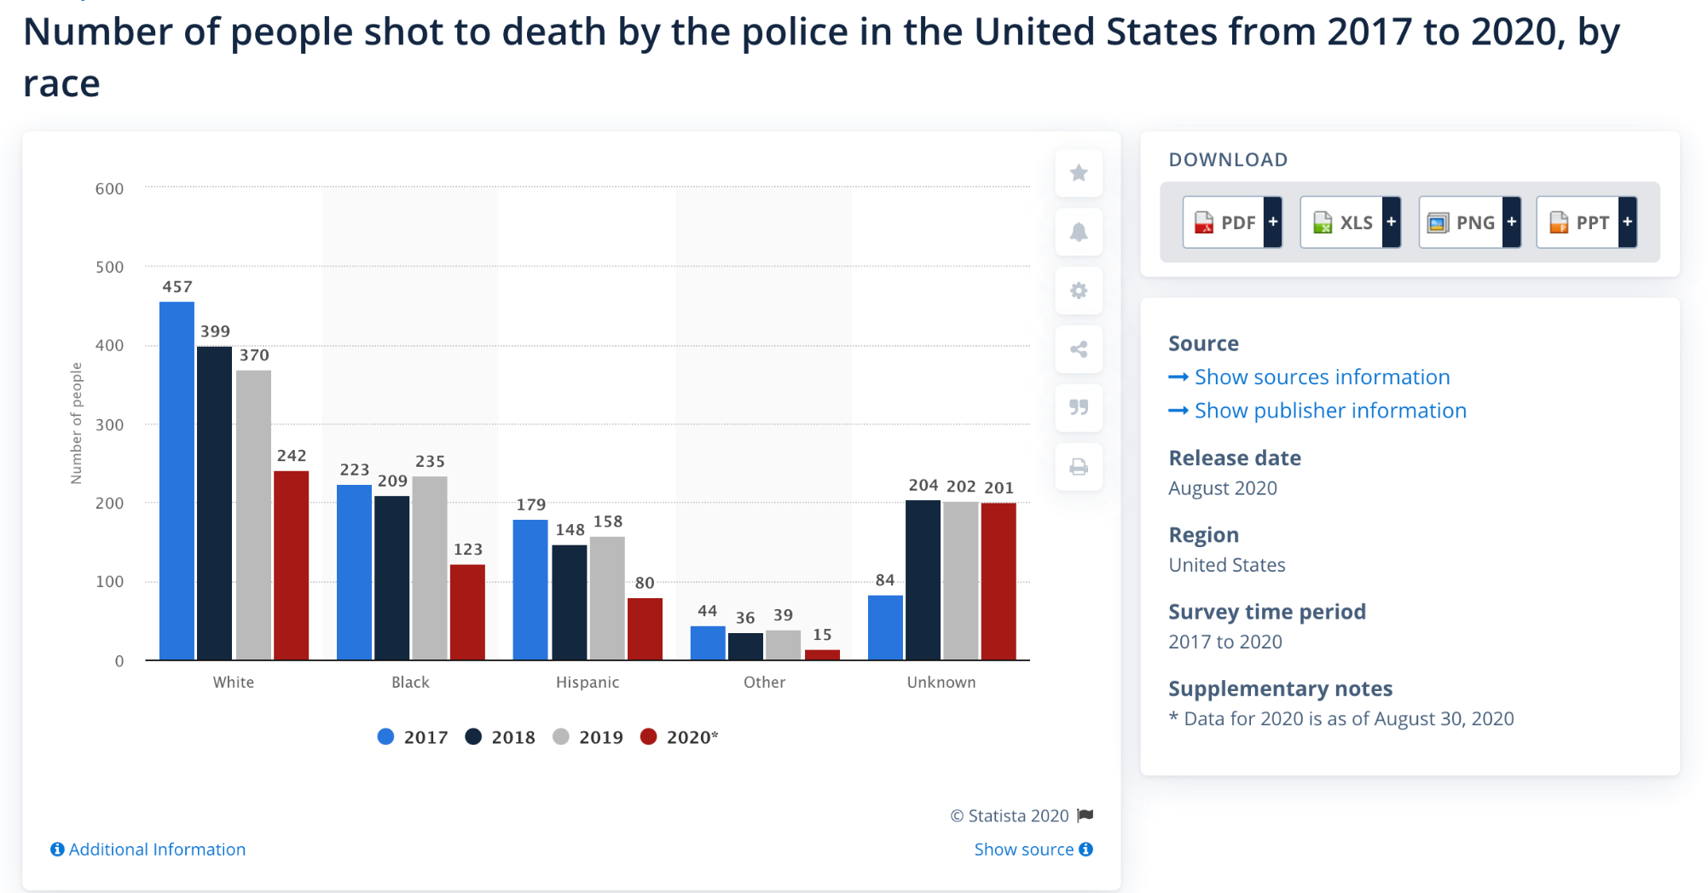
Sadly, the trend of fatal police shootings in the United States seems to only be increasing, with a total 661 civilians having been shot, 123 of whom were Black, as of August 30, 2020. In 2018, there were 996 fatal police shootings, and in 2019 this figure increased to 1,004. Additionally, the rate of fatal police shootings among Black Americans was much higher than that for any other ethnicity, standing at 31 fatal shootings per million of the population as of August 2020.
https://www.statista.com/statistics/585152/people-shot-to-death-by-us-police-by-race/

Slide 12
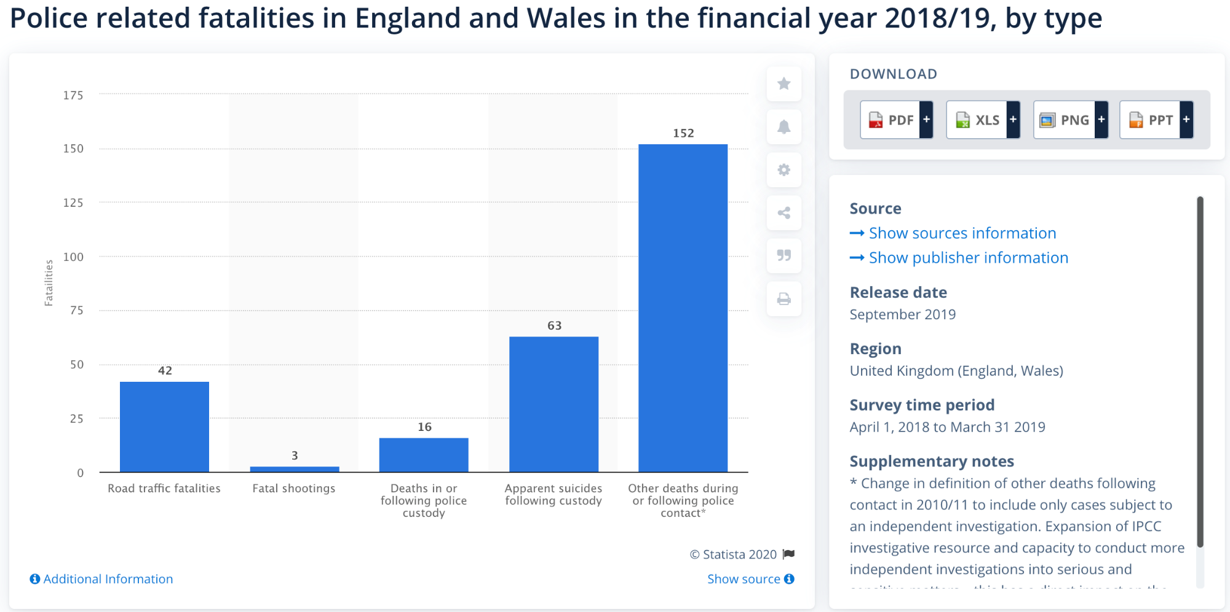
This statistic shows the number of police related fatalities in England and Wales in the financial year 2018/19, by type. The most common cause of police related fatalities in England and Wales in this period were other deaths following police contact, at 152 incidents. In this period, there were three fatal shootings in total.
https://www.statista.com/statistics/319287/deaths-during-or-following-police-contact-causes-england-and-wales/

Slide 13
Impact of floyd’s death (UK)
The death of a black man in police custody in Minneapolis has led to a wave of protests in the United States and beyond.
In the UK, thousands marched in London, Cardiff and Manchester following the killing of George Floyd, chanting "black lives matter".
Some have raised the issue of policing and race here, saying that black people are disproportionately likely to die in police custody.
What do the figures show?
Over the past 10 years, 164 people have died in or following police custody in England and Wales, according to the Independent Office for Police Conduct (IOPC) - the body responsible for police complaints.
Death in custody is the term for anybody who dies while in the custody of the state - this could include while being detained by a police officer or while being held as a prisoner in a police station.
Of the deaths in the last 10 years:
141 were white
13 were black
10 were from other minority ethnic groups.
When you compare these figures to how much of the population these groups make up (as measured by the 2011 census), black people are more than twice as likely to die in police custody.
The 2011 census - the most accurate source - showed that 3% of the English population were black (though this proportion may have grown since then). Black people accounted for 8% of deaths in custody.

Slide 14
Differences in policing
Usa
uk
Militarised techniques e.g. use of rubber bullets to deter rioters
Firearms issued to all officers with variable levels of training across different states.
Policing is federalised e.g. each state will take a slightly different approach and there is no one organisation that investigates the actions of officers.
Have not gone through a review of policing practice.
There have been a number of recent deaths caused by police that have received a lot of high profile attention, lead to protests and riots.
Focus on descalation e.g. protests given a ‘light touch’
Specialised officers - Territorial Support Group (TSG) – trained in public order policing. Each police force has a specialised firearms unit. These officers are trained to a very high standard (often alongside elite military teams).
Policing is split into ‘forces’ who all train their officers in the same way. Serious concerns about an officer or case are investigated by the Independent Police Complaints Commision.
Met Police were investigated via the Macpherson Report in 1999, branded them institutionally racist.

Slide 15
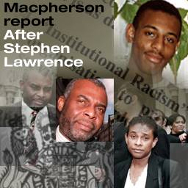
The macpherson report 1999 (UK)
The inquiry into the failure of the original police investigation to find and convict Stephen's killers, headed by Sir William MacPherson and which reported in 1998, became one of the most important moments in the modern history of criminal justice in Britain.
It concluded the Metropolitan Police were "institutionally racist", it made 70 recommendations and had an enormous impact on the race relations debate - from criminal justice through to all public authorities.
22 April 1993 - Stephen Lawrence murdered
The 18-year-old was stabbed to death in an unprovoked attack by a gang of white youths as he waits at a bus stop in Eltham, south-east London, with his friend Duwayne Brooks.

Slide 16
Ethnicty and offending stats
BAME groups are significantly over-represented in the prison system, with approximately 25 per cent of the overall prison population from a BAME community.
In 2014, black or Black British people made up 10 per cent of the total prison population, whilst making up just 3 per cent of the UK’s total population.
Asian or Asian British people made up 6 per cent of the prison population.
White British people made up approximately 75 per cent of the prison population, whilst making up over 85 per cent of the UK’s total population.
This does not apply to all ethnic minorities - South Asians not disproportionately represented and Chinese conviction rates relatively low

Slide 17
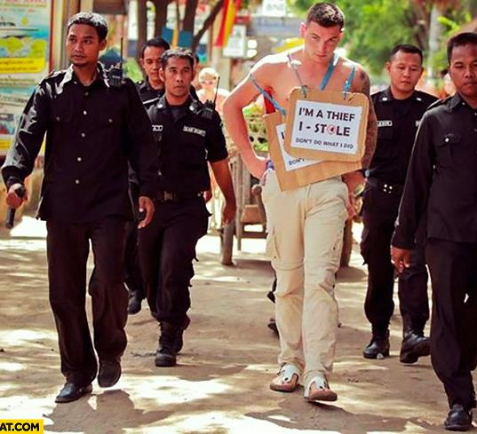
Interactionist perspective of differences in offending rates / police approaches
Interactionists argue that deviance and crime are socially constructed.
Deviance is in the eye of the beholder. They would argue that certain groups are more likely to be ‘typified’ (typed/labelled) as offenders (Arron Cicourel)
Who is more likely to be typified in our society?

Slide 18
Labelling in practice today?
The Angiolini Review
In 2017, the Angiolini review of deaths in police custody concluded that improvements were needed for investigations into deaths as well as greater care for vulnerable individuals across all ethnic groups.
However, this was particularly true in relation to race and mental health issues.
"The stereotyping of young black men as 'dangerous, violent and volatile' is a longstanding trope that is ingrained in the mind of many in our society. People with mental health needs also face the stereotype of the mentally ill as 'mad, bad and dangerous'," says the review.
Inquest, a charity which focuses on police and prison deaths, said that because of this black people with mental health problems faced "double discrimination" by the police.
It also suggested that investigations needed to explore whether discrimination played a factor in the deaths of black and minority ethnic (BAME) individuals more often.
The Lammy Review
In 2017, the Lammy Review, conducted by Labour MP David Lammy, of the treatment of minority groups in the criminal justice system said many in those communities found the system was "stacked against them".
He found didn’t find evidence for institutional racism in the Criminal justice system today but argued there is still unconcious bias
What links does this have to what you have already studied?
Notes:
https://www.bbc.co.uk/news/52890363

Slide 19
Symbols of shared views
What do these symbols/slogans signify?
What issues are held with each of them?
Notes:
https://blacklivesmatter.com/ - running for 6 years. Started in the US. In July 2013, the movement began with the use of the hashtag #BlackLivesMatter on social media after the acquittal of George Zimmerman in the shooting death of African-American teen Trayvon Martin 17 months earlier, in February 2012.
Amazon accused of selling ‘Blue lives murder’ tshirts. Black History Afrocentric Company made them

Slide 20
A contemporay view
https://www.youtube.com/watch?v=fVEhBekLm9I
Akala on Police and Protests
Notes:
Watch to about 10mins in

Slide 21
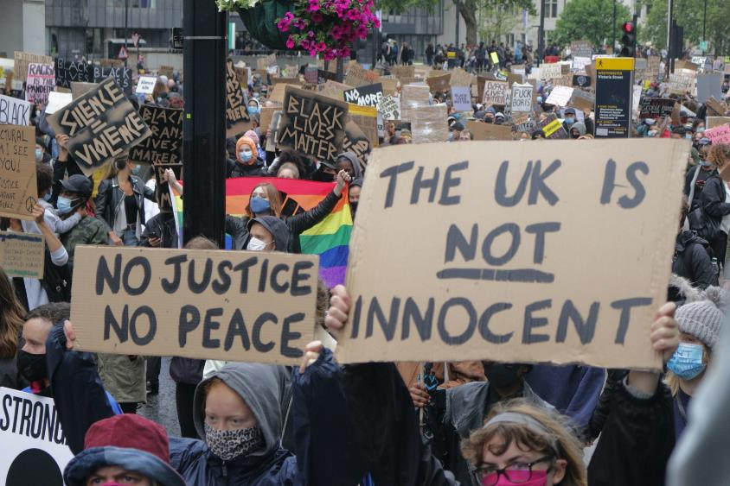
Poverty, inequality & Race – how might Marxists view this?
Neo-Marxists recognised that working-class criminals made an active choice to break the law.
However, they argued that sometimes this was a positive political act against the bourgeoisie: e.g. the Black Panthers – a radical black rights group in the US in the 1960s and 1970s who did engage in criminal activity in the course of their political activism. This neo-Marxist approach to crime and deviance became known as critical criminology or, sometimes, radical criminology.
Neo-Marxists such as Stuart Hall and Paul Gilroy have made a number of key arguments about this since the 1970s
What perceptions are there of protests?
Do you think that protests help to improve scenarios?
Notes:
Issues of copycat behaviour?

Slide 22
Left realist explanations
Lea and Young (1993) argue that ethnic differences in the statistics reflect real differences in the levels of offending by different ethnic groups.
Racism has led to the marginalisation and economic exclusion of ethnic minorities, who face higher levels of unemployment, poverty and poor housing.
A response to this is delinquent subcultures e.g. gangs.
They don’t think discriminatory policing explains the whole picture e.g. 90% of crimes are reported to the police not found by them.

Slide 23
How else might the ethnic differences in offending, arrest and prosecution sociology?
Education – underachievement of certain groups
Cultural memory – should statues of people linked to slavery be taken down?
Family – New Right views of rates of single parenthood
Poverty – racism in wider society leading to BAME groups ending up in low paid roles.
This just goes to show that Sociology can be found everywhere in life – you just need to know where to look!

