Slide 1
Welcome
Gill Thompson’s first year English Literature Class (B block)

Slide 2
The Course
Tricia: Frankenstein/ Never Let Me Go. Half of modern poetry
Gill: Modern Poetry, A Streetcar Named Desire, Othello.

Slide 3
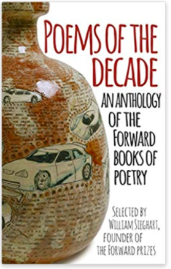
Poetry: Poems of the Decade
A few available from English department (hurry) or order from bookshop/online: ISBN 978-0-571-32540-5

Slide 4
But first, your own anthology
Over the first term you are going to collect six poems, which may include one song lyric. I will give you more details on this on Monday, but for the time being I would like you to browse online for poems which appeal to you. Please don’t just choose those you studied for GCSE but search for new ones too. Start thinking about why you like them. I don’t just want a dry analysis of the poem, I want an explanation of why you chose it and why it is special to you.
This is your task for the lesson.

Slide 5
My example
Robert Frost: The Road Not Taken
Two roads diverged in a yellow wood,
And sorry I could not travel both
And be one traveler, long I stood
And looked down one as far as I could
To where it bent in the undergrowth;

Slide 6
Then took the other, as just as fair,
And having perhaps the better claim,
Because it was grassy and wanted wear;
Though as for that the passing there
Had worn them really about the same,

Slide 7
And both that morning equally lay
In leaves no step had trodden black.
Oh, I kept the first for another day!
Yet knowing how way leads on to way,
I doubted if I should ever come back.

Slide 8
I shall be telling this with a sigh
Somewhere ages and ages hence:
Two roads diverged in a wood, and I—
I took the one less traveled by,
And that has made all the difference.

Slide 9
So, To Summarise
Spend the rest of the lesson browsing the internet for six poems that you would like to include in your anthology. Think about your motivation for choosing each poem, in preparation for your analysis of it later.
Hope to see you on Monday!

Slide 10

Hope to see you on Monday
This Photo by Unknon Author is licensed under CC BY-SA
This Photo by Unknown Author is licens under CC BY-S

