Slide 1
Welcome to a2 English Literature

Slide 2
Poetry paper 3 (approx. 30% of A Level Marks).
Section A: compare one poem from Forward Collection with one unseen poem. (poems printed on exam booklet)
Section B: An essay question on a pre 1900 poet. Open book

Slide 3
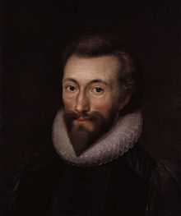
So, what will this year look like?
Second year poet:
John Donne
This Photo by Unknown Author is licensed undr C

Slide 4
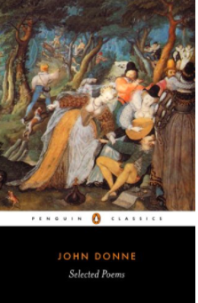
Poetry
Pre 1900 poet.
Please buy immediately:
Penguin Classics: John Donne, Selected Poems, ISBN
9780140424409
You’ll be doing research for this first week, but I expect
you to have this by next week’s lessons.

Slide 5
Revision
Gill – revisit Othello, this time with critics
Revisit A Streetcar Named Desire
Jennie – revisit prose and poetry.

Slide 6
So, Who is John Donne?
Please watch documentary on estream: https://estream.godalming.ac.uk:444/View.aspx?id=15879~5r~Lx8cwqg5bO (or just type ‘John Donne’ into the estream search engine.
As you watch the film, please answer the questions on the sheet (Simon Schama documentary) that I have uploaded onto your area of GOL (English Literature Gill Thompson’s lessons). It’s also on the John Donne section of English Literature on GOL.
We will go over the questions next lesson so please have your answers ready.

Slide 7
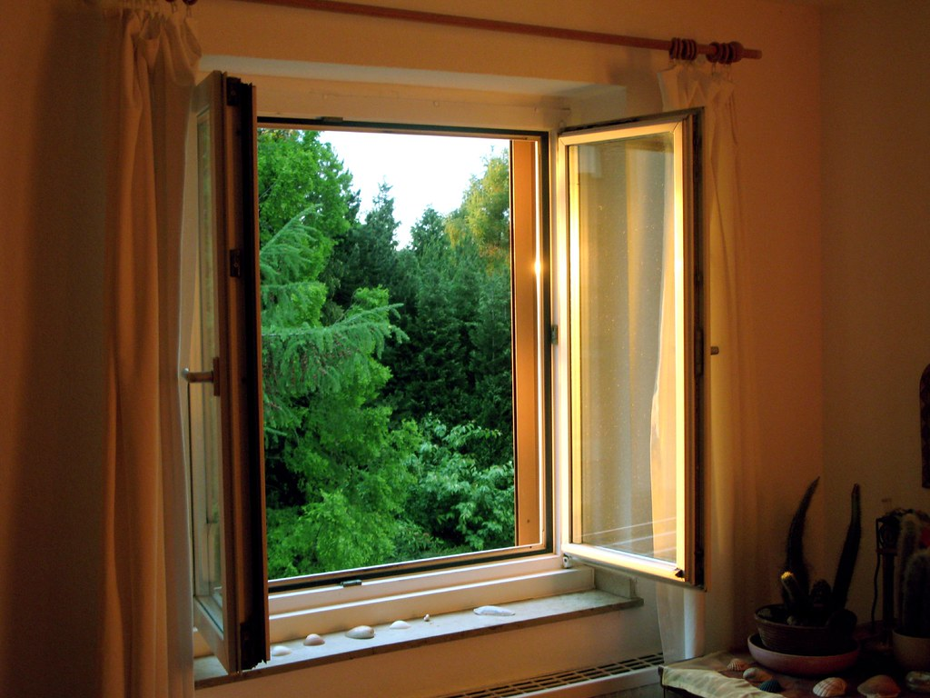
Just a few things…
This Photo by Unknown Author is licensed under CC BY-SA

