Slide 1
Unit 2 Marketing
BTEC National and Extended Certificate

Slide 2
What will take place in the exam room
You will be seated at a computer and there will be a number of procedures to follow BEFORE the exam can begin.
These instructions must be followed to the letter, in silence, so that you are correctly logged on to your exam script
This will NOT be part of your time allowance

Slide 3
What you need for this exam
Up to six sides of A4 typed research notes
A pen/biro to sign you printed sheets at the end
This can be data, facts, statistics (your research on the topic)
You can also make notes for points that you wish to include (eg to remind you about the structure, points for PEST and SWOT etc)
You should not write paragraphs of analysis or evaluation

Slide 4
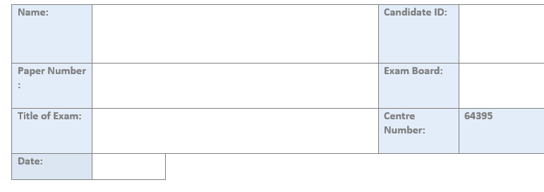
To get started
The first instruction will be to edit the Header.
Listen carefully to the instructions on how to do this.
You will edit and close the header and then click SAVE
You will now be ready to start

Slide 5
Writing the assessment ..
You will now be issued with the exam paper and can begin to write your answers.
You must keep track of time throughout, be mindful of the marks scheme so that you do not run out of time or spend too long on a low mark question
You will be given 1.5 hours for Activity A and 1.5 hours for Activity B with a short break in-between.

Slide 6
The most important point..
The template is set to 12 point font with double spacing
Do not alter this
You will need to keep saving the work. You will be prompted to save every 10 mins. The work will not auto save. Get used to using the save icon every paragraph.
NEVER CLOSE THE DOCUMENT

Slide 7
At the end..
SAVE again. DO NOT CLOSE THE DOCUMENT AT ANY TIME.
Select the correct printer (you will be told which one on the day)
You will be called to print your document (in small groups) and you will need to sign the cover sheets, initial each page and treasury tag your work ready to submit to the exam board.
NEVER CLOSE THE DOCUMENT

Slide 8
At the end..
When your work is printed off and tagged you will be allowed to leave.
This will take place in small groups of students (row by row) and must take place in silence until everyone has left.
Do not log off or close your document at any time.

