Slide 1
BTEC NATIONAL IN BUSINESS Unit 2 Marketing The Role of Marketing (A1)
Lesson 1

Slide 2
Marketing is a FUNCTION of Business
Production
Human Resources
Training and Development
Finance
Record keeping
Marketing
Product
Price
Place
Promotion
Recruitment
Workforce Planning
New product development
Production techniques
Quality
Financial Accounts
Budgeting
Notes:
Brief info slide to explain that marketing is a key functional area but no need to dwell on the other functions

Slide 3
What does marketing involve?
Identifying needs (market research)
Brand development
Promoting products
Pricing strategies
Place and Distribution
Notes:
TEXTBOOK P61-69
Brief overview of MR and the Marketing Mix
Market research gathering and analysing information of consumers, the marketplace and competition
Market analysis examining market conditions to identify new opportunities
Marketing objectives setting of marketing goals to support the company objectives
Marketing strategy a plan detailing how the marketing objectives can be achieved
The marketing mix the 4Ps of marketing, getting the price, place, product and promotion right

Slide 4
Key roles of marketing
Anticipating demand (eg seasonal demand, new product launch, blockbuster film etc)
Recognising demand (monitoring sales and competitors
Stimulating demand (advertising and promotion, special offers)
Satisfying demand (ensuring correct price, product and stock availability)
Notes:
TEXTBOOK P61-62

Slide 5
Marketing aims and objectives
Understanding customer needs and wants
Developing new products
Improving profitability
Increasing market share
Diversification
Increased brand awareness and loyalty
Notes:
NEEDS AND WANTS – ignore textbook on this one
Needs are things that we consider to be essential – food and shelter, hot running water
Wants might be a new phone, a bigger house, a better car etc
The trick of marketing is to turn a want into a perceived need – a must-have essential
Developing new products refer back to Dyson, Apple etc, previous work on innovation
Improving profitability – by reducing costs, improving efficiency or increasing no of sales or selling price. Again be wary of the textbook on this one.
MARKET SHARE (value or volume) see slides 10 & 11
The percentage of an industry or market's total sales that is earned by a particular company over a specified time period.
Market share is calculated by taking the company's sales over the period and dividing it by the total sales of the industry over the same period. Gives a general idea of the size of a company in relation to its market and its competitors
Increasing market share helps with market control
DIVERSIFICATION
Corporate strategy: When a firm enters an industry or market different from its core business.
Reasons for diversification include
(1) reducing risk of relying on only one or few income sources,
(2) avoiding cyclical or seasonal fluctuations by producing goods or services with different demand cycles
(3) achieving a higher growth rate and
(4) countering a competitor by invading the competitor's core industry or market.
Increased brand awareness and loyalty
Consider food brands, technology brands, retail outlets etc that students recognise and rate. Good for diversification eg Sainsbury’s and Sainsbury's Bank etc (strategy also used by Tesco, John Lewis, M&S)
Marketing objectives of FOUR organisations: profit business, a social enterprise, a charity and a public sector organisation

Slide 6
What might typical marketing objectives be in these four different organisations?
Activity
a profit making business eg Nandos
a social enterprise eg Jamie Oliver’s Fifteen restaurant
charity eg Mane Chance Horse Sanctuary
public sector eg Royal Surrey County Hospital
In pairs/groups – discuss and write down your answers for the four categories above.
Some objectives will be true for every category, some will be particular to that type of organisation. Highlight the ones that are the same.

Slide 7
Answers for discussion – some typical marketing objectives in different types of organisations
Profit making business increase sales, market share, brand awareness, beat the competition
social enterprise, sales, awareness and as above but the main objective is social rather than profit making
charity – revenue generation, public awareness and support, publicity of the work carried out
public sector organisation – all about explaining how well the organisation spends the budget, not profit making
Notes:
What these organisations have in common (ie critical marketing objectives)
Sales/revenue generation are basically the same
Awareness, reputation and public opinion matter to all organisations

Slide 8
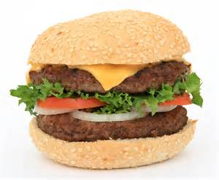
Setting up Brett’s Burgers
Activity
Brett and his partner are setting up a small independent Burger shop in Guildford. As part of their Business Plan he needs to create a Marketing Plan
What are his Marketing Objectives?
How could he achieve them?
Who are his competitors?
In pairs/groups – discuss and write down your answers

Slide 9
Setting up Brett’s Burgers
Discussion
What are his Marketing Objectives?
It’s a profit making business so…
Understanding customer needs and wants
Developing new products and selling them
Improving profitability and increasing sales
Increasing market share (beating the competition)
Creating brand awareness and loyalty
How could he achieve them? (see slide 4)
Who are his competitors?
SPIDERGRAM – discuss and write down more detailed answers to the above.

Slide 10
What is a market? A market is a place where goods are bought and sold in exchange for money
Lesson 2

Slide 11
What is a market?
Markets can be defined by type eg
The supermarket market
The confectionary market
The mobile phone market

Slide 12
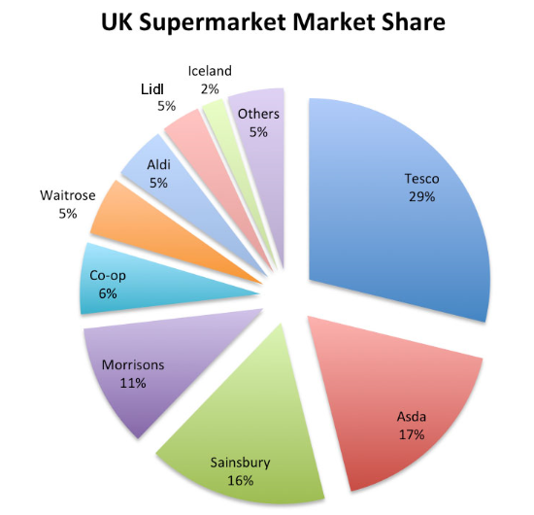
Notes:
Typical marketing aim – increase market share

Slide 13
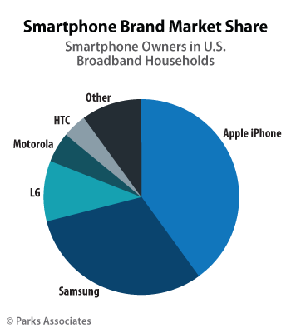
Notes:
Typical marketing aim – increase market share

Slide 14
What does the Burger market look like in the UK?
Activity
Quick research task
How many burger chains operate in the UK?
How many small burger outlets are there?
What advantages might there be in being a small outlet?
What disadvantages would there be?
In pairs/groups – discuss and write down your answers

Slide 15
Types of market local/global mass/niche trade/consumer product/service seasonal
Lesson 2

Slide 16
Local & Global markets
LOCAL
Where a business targets local customers
eg Godalming Taxi rank, Daisies sandwich shop
GLOBAL
Where a business sells across the world
eg MacDonald's, Vodafone, Kellogg's, BP, Coca Cola

Slide 17
Product & Service markets
Products are tangible
Clothing
Computers
Cars
Houses
Services are intangible
Hairdressing
Holidays
Accountancy
Law
Dentistry

Slide 18
Seasonal markets - dependent on time of year
Christmas items
Summer fashion/winter fashion
Easter eggs
Ski holidays

Slide 19
Trade & Consumer markets
B2B
Business sells to other businesses
Corn, wheat etc
Petrol/fuel
Metals for engineering
Coca Cola, L'Oréal etc (goods are sold to the supermarket)
B2C
Business sells to consumers
Sainsbury's
Boots
Amazon
Topshop
MacDonald's
Both
Some businesses sells to both the trade and consumers
Stationers
Utilities (water, electricity etc)
Milk

Slide 20
Niche & Mass markets
Where a business targets smaller segment of a larger market, where customers have specific needs and wants
Organic chocolate
Farmers market produce
Where a business sells into the largest part of the market, where there are many similar products on offer
Car Market
Confectionary
Phone
Food
Notes:
Niche and Mass market (ppt)
Identification of some niche markets and the attractiveness and drawbacks of them. Do the same for some mass markets.
http://www.tutor2u.net/blog/index.php/business-studies/comments/a-niche-market-in-which-the-market-leader-is-well-protected
Reasons such as: identifying requirements of different groups more precisely, meeting the needs of target groups more precisely than the competition, avoiding wasteful marketing that is not targeted and marketing a wider range of differentiated products
Market segment online task (see GOL)
Look at segmentation by social class (HJR page 157)
Also BTEC book page 64 segmentation of a product

Slide 21
What sort of market is the Brett’s Burgers in?
Activity
Quick task for discussion feedback
local/global?
mass/niche?
trade/consumer?
product/service?
Seasonal?
What are the advantages/disadvantages of each of the above? Be ready to EXPLAIN & JUSTIFY your answers

Slide 22
Niche Market
ADVANTAGES
Less competition
Clear focus
Builds up specialist skills
Can charge higher prices
Higher profit margins
Customer loyalty
DISADVANTAGES
Lack of economies of scale
Risk of over dependence on a single product
Attract competition if successful
Vulnerable to market changes
Notes:
Niche and Mass market (ppt)
Identification of some niche markets and the attractiveness and drawbacks of them. Do the same for some mass markets.
Reasons such as: identifying requirements of different groups more precisely, meeting the needs of target groups more precisely than the competition, avoiding wasteful marketing that is not targeted and marketing a wider range of differentiated products
Market segment online task (see GOL)
Look at segmentation by social class (HJR page 157)
Also BTEC book page 64 segmentation of a product
Mass Advantages & Disadvantages
Customer needs and wants are general
High production output and capacity (EOS)
Success associated with low-cost production
Large distribution channels
Market leading brands
Higher barriers to entry
Competition
Changes in demand
Adding value
Generic products

Slide 23
Market Segmentation age, socio-economic, gender, location, religion, ethnicity
Lesson 3

Slide 24
What is it?
A way of breaking down the market into segments (sub-groups)
These groups have common features or individuals who make purchasing decisions on common factors

Slide 25
What makes targeting a segment worthwhile?
A segment must be recognisable
Must have critical mass (be big enough to be worthwhile)
Targetable – have their own identity that can be promoted to

Slide 26
Typical forms of segmentation
Geographic segmentation – where do customers live, where do they buy?
Demographic segmentation – groups based on age, sex, ethnic background, occupation and income
Behavioural segmentation – looking at usage patterns, levels of brand loyalty, elasticity of demand
Psychographic segmentation – lifestyle groups, personal values and attitudes

Slide 27
Demographic segmentation
age
gender
cultural/ethnic/religious background
socio-economic group
occupation and income
geographical location
Notes:
Reasons such as: identifying requirements of different groups more precisely, meeting the needs of target groups more precisely than the competition, avoiding wasteful marketing that is not targeted and marketing a wider range of differentiated products
Market segment online task (see GOL)
Look at segmentation by social class (HJR page 157)
Also BTEC book page 64 segmentation of a product

Slide 28
Reasons for segmentation
Targeted marketing
Better serving of customers needs and wants
Higher profits
Opportunities for growth
Sustainable customer relations
Stimulating innovation
Higher market share

Slide 29
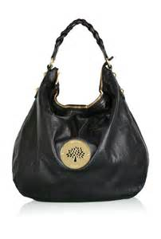
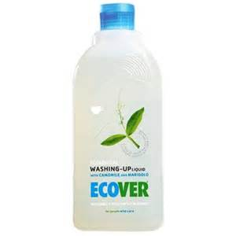
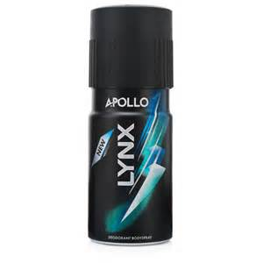
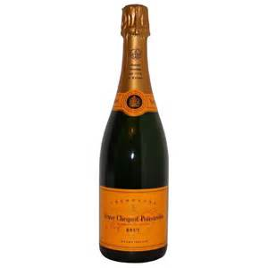
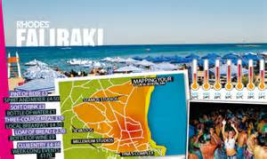
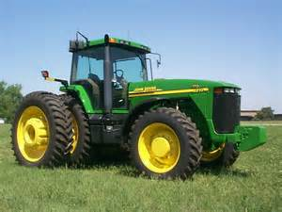
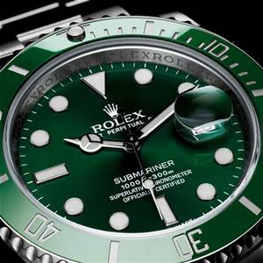
Can you segment these products?
Activity

Slide 30
Conclusion - why segment a market?
To identify the requirements of your customers more precisely
To meet the needs of your customers more effectively than the competition
To avoid wasteful marketing that is not targeted
To avoid having to sell a wide range of differentiated products
Notes:
Choose a product in a Supermarket (e.g. shampoo) and see how it is segmented. Compare with the Car market to see how and why the markets are segmented.
Market segmentation for the 21st century (on GOL)

Slide 31
Market Segmentation
Activity
Choose a product in a Supermarket (e.g. shampoo) and see how it is segmented.
Compare with the Car market to see how and why the markets are segmented.
What are the advantages/disadvantages of each of the above? Be ready to EXPLAIN & JUSTIFY your answers

Slide 32
Branding A name, term, sign, symbol, design or any other feature that allows consumers to identify the goods and services of a business and to differentiate them from those of competitors. McDonald’s ‘golden arches’, Nike ‘swoosh’, Adidas three stripes, Coke bottle, Virgin font/colour
Lesson 4
Notes:
Brands have value and are shown on a firms balance sheet

Slide 33
What is a brand?
A brand is a name given to a product to differentiate it from similar products
A brand is a product consumer’s rely upon for quality, value and service
A brand involves a distinctive identity for a product which users can identify
Notes:
Brands have value and are shown on a firms balance sheet
Branding, brand personality, brand image, USP

Slide 34
Why use branding?
To create customer loyalty
To increase price inelasticity of demand
To increase the value of the firm
To ease customer choice
Notes:
Disadvantages of branding
High cost of advertising
Loss of value of one product can affect a whole range of similarly branded products
Branding invites competition
High cost of R & D
Advantages
Brands offer long-term profitability to firms, giving some predictability on sales and revenue.
In order to maintain the brand a firm must:
Be sure of brand identity
Offer value to customers
Advertise and promote
Carry out market research
Continually develop the brand
Remember what made the brand successful
Protect the brand from competition

Slide 35
What do we mean by…
Brand personality?
Brand image?
USP (Unique Selling Point)?
What are the financial implications for the marketing activity for a business?
Discuss this in pairs ready to answer in 5 minutes
Notes:
Brands have value and are shown on a firms balance sheet
Marketing may be able to benefit from economies of scale as the brand is promoted which covers all the individual products
Products may be more marketable if the brand is desirable

Slide 36
Working in pairs/small groups
Activity
Can you see any brands in the room?
Write down 5 favourite or well known brands
Pick one and explain what the brand message is
Why is the practice of ‘branding’ so useful to business?

Slide 37
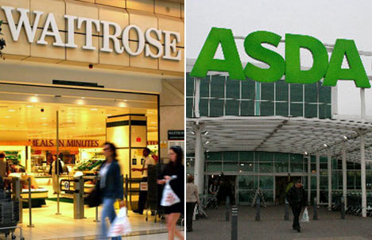
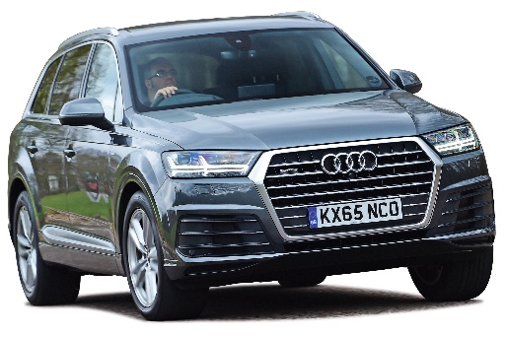
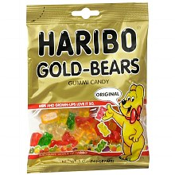
What is brand image and how is it established?
Activity
Research a range of recognised brands from different markets, for each brand identify
the brand image
the targeted customer segment and
the needs and wants of the customer that is satisfied by the brand.
Discuss this in pairs ready to answer in 5 minutes
Notes:
Brands have value and are shown on a firms balance sheet
Marketing may be able to benefit from economies of scale as the brand is promoted which covers all the individual products
Products may be more marketable if the brand is desirable

Slide 38
Extension/HW
Read Chapter 28 Effective Marketing (AQA AS Business Studies Wolinski & Coates) also on GOL
Answer the Practice Questions (briefly)
Lush Cosmetics Case Study – answer questions 1-7

